Slide 1
When Violence Affects Your Tenancy
October 2017
Notes:
Title Page

Slide 2
RTA & QCAT
RESIDENTIAL TENANCIES AUTHORITY | QUEENSLAND CIVIL & ADMINISTRATIVE TRIBUNAL
The Queensland Government statutory authority that administers the Residential Tenancies and Rooming Accommodation Act 2008 and manages rental bonds | Hears and makes binding decisions about residential tenancy disputes covered by the Residential Tenancies and Rooming Accommodation Act 2008
Provides forms, information and services to lessors, agents, providers, tenants and residents | Aims to resolve tenancy disputes in a way that is fair, just, accessible, quick and inexpensive
Conducts dispute resolution and investigates complaints of unlawful conduct under tenancy laws | It is a Tribunal, not a court. Parties must represent themselves and present their own case.
www.rta.qld.gov.au
www.qcat.qld.gov.au
Notes:
The RTA is the statutory authority that administers the Residential Tenancies and Rooming Accommodation Act 2008 and manages rental bonds. As you can see from the table, the RTA provides forms, information and services to lessors, agents, providers, tenants and residents. They also conduct dispute resolution and investigate complaints of unlawful conduct under tenancy laws.
QCAT is the Queensland Civil and Administrative Tribunal is a tribunal and not a court. This means that parties must represent themselves and present their own case. The Tribunal aims to resolve tenancy disputes in a way that is fair, just, accessible, quick and inexpensive and makes binding decisions about tenancy disputes that are covered by the Residential Tenancies and Rooming Accommodation Act 2008. Tenants need to be prepared when attending tribunal hearings – always good to connect with TQ QSTARS advice workers regarding this!

Slide 3
Domestic violence Ending or changing tenancy agreements Debt disputes Tenancy databases
Residential Tenancies and Rooming Accommodation Act 2008 (RTRAA)

Slide 4
Domestic Violence

Slide 5
What is domestic violence?
Domestic violence is defined in s 8(1) Domestic and Family Violence Protection Act 2012 (Qld) to include behaviour by the first person towards the second person with whom the first person is in a relevant relationship that is –
Physically or sexually abusive; or
Emotionally or psychologically abusive (as defined in s 11); or
Economically abusive (as defined in s 12) ; or
Threatening; or
Coercive (see s 8(5) for meaning of coerce); or
In any other way controls or dominates the second person and causes the second person to fear for his/her safety of wellbeing or for that of someone else.

Slide 6
Domestic associate
Definition in the Domestic and Family Violence Protection Act 2012 (Qld)
Spousal relationship
An intimate personal relationship
A family relationship
An informal care relationship
(See also RTRAA s245 (9) and s321(2)&(3))
Notes:
USE PAGE ONE OF THE DV FLOW CHART
Spousal relationship – includes a spouse, a former spouse and a parent or former parent of a child of the person – does not include foster carer or kinship carer
Intimate personal relationship – includes a spousal relationship or an engagement relationship or a couple relationship;
Informal care relationship - such a carer but not an informal parent child care relationship

Slide 7
Key Questions
What is the relationship between your client and the perpetrator – domestic associate or not?
Does your client want to stay at the property or leave?
What is the status of your client in regard to the tenancy agreement – occupant, tenant, co-tenant?

Slide 8
What QCAT must consider before deciding an application
In deciding an application, QCAT must consider (s245(4)):
Whether the applicant has applied for a Domestic Violence Protection Order (DVPO) against the offending tenant (domestic associate), and its conditions.
If the applicant is not a tenant, whether the applicant is a domestic associate of the violent tenant, or an occupant (i.e. whether the applicant lives at the premises.)
In an application to add a person’s name as tenant, whether the property owner agrees to add that person.
Whether the evidence proves the applicant has suffered or is likely to suffer domestic violence.
QCAT does not always have to consider the circumstances of the property owner when hearing an application, although it may call for them to be involved in the proceeding.

Slide 9
Evidence to support an application
The applicant must provide evidence to substantiate the application. An application is more likely to be granted if QCAT receives relevant evidence, such as:
Copies of any DVPO’s in place
Photos of injury or damage
Proof of occupancy
Witness statement
Bank statements showing financial hardship
When making an application to QCAT, applicants must ensure they name all parties on the lease. The offending tenant should be named as respondent. The property owner or property manager should also be named as respondent.

Slide 10
Ending or changing tenancy agreements

Slide 11
Domestic Associate wants to stay
If you are the domestic or occupant, and you occupy the premises with the tenant, and the tenant causes serious damage to the premises, or commits an act of domestic violence, you can apply to QCAT for an urgent hearing.
s245 – if you are a domestic associate of a tenant or co-tenant, you may apply to the tribunal for an order recognising you as a tenant or co-tenant instead of your domestic associate.
Notes:
QCAT form 2, filing fee $25.45 or waiver of fee due to financial hardship form 49

Slide 12
Occupant wants to stay
s246 if you are an occupant (but not a tenant /sub-tenant) you may apply to be recognised as the tenant or a co-tenant instead of the perpetrator.
If you are already a co-tenant or a sub-tenant you are legally allowed to stay at the property however there is no application you can make to have the perpetrator’s name removed as the tenant

Slide 13
Domestic Associate wants to terminate
If you are the domestic associate:
Section 321 Application by the tenant’s domestic associate for termination for damage or injury, because the tenant has intentionally or recklessly or is likely to intentionally or recklessly cause:
- serious damage to the premises; or
- has committed domestic violence against the domestic associate.

Slide 14
Occupant wants to terminate
If you are the occupant:
Section 322 Application by occupant for termination for damage or injury. An occupant of the premises, not the tenant (includes a domestic associate) may apply to a tribunal for a termination order because the tenant has intentionally or recklessly causes, or is likely to intentionally or recklessly cause:
-serious damage to the premises or
-injury to the applicant or someone else…
Note an occupant is not named on the lease as a tenant , they are not legally liable for the tenancy. An occupant can leave anytime and is not liable for damage to the premises caused by the tenant.

Slide 15
Tenant/Co-Tenant wants to terminate
Tenants can apply to QCAT for an urgent tenancy hearing to terminate their tenancy under the following sections:
s310 Excessive hardship
s312 Damage or injury by a co-tenant
If other tenants/co-tenants are listed on the tenancy agreement list them as respondents along with the lessor or agent.
If security is a concern QCAT has security officers, or applicants can apply to QCAT to attend the hearing by phone.

Slide 16
Restraining orders
S323(2) RTRAA – A domestic associate or occupant may apply to a tribunal for an order to restrain the tenant from causing the further damage or injury, if they believe on reasonable grounds that the tenant is likely to engage in the above behaviours.

Slide 17
How to apply
Apply using QCAT form 2 Application for Minor Civil Dispute, 3 or 4 copies, service by QCAT.
Urgent hearing – listing times vary however expect 2-3 weeks.
If financial hardship, apply for a fee waiver (Form 49)
If other tenants/co-tenants are listed on the tenancy agreement list them as respondents along with the lessor or agent.
If DV is the reason for ending the tenancy early it is good to attach evidence such as a DVO, a DVO application, police report or affidavit from a health provider or support service, photographs.
Tenants Queensland – QCAT DVD on our website

Slide 18
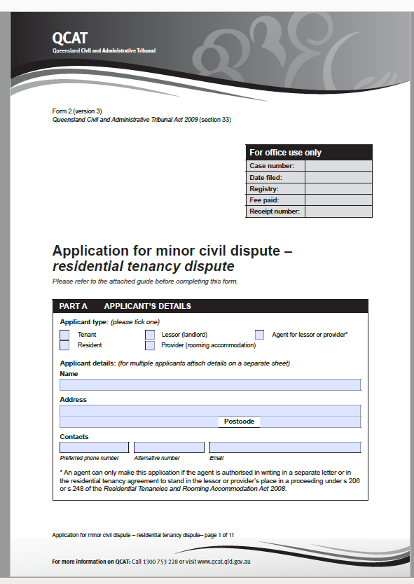

Slide 19
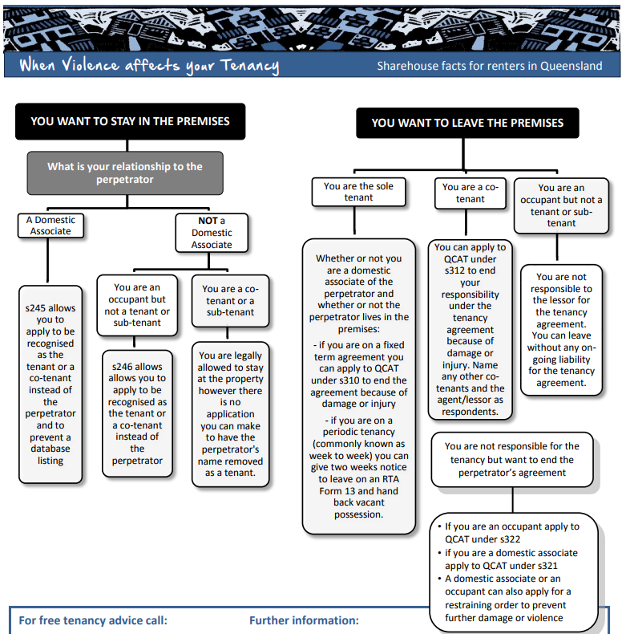

Slide 20
Debt Disputes

Slide 21
Ending The Tenancy Right
Tips for Tenants
Give written notice (RTA form 13) or termination order from QCAT
Pay rent to the final handover day, and ask for copy of rent ledger
Leave the place clean, same condition to the start of your tenancy (not liable for fair wear and tear)
Take photos and keep copies of your receipts
Fill in an Exit Condition Report (RTA form 14a), reconcile with entry condition report and keep a copy
Return the keys promptly to the agent or lessor, take photos of keys handed in
Lodge a Refund of Rental Bond (RTA form 4) with the RTA.
If you terminate a tenancy agreement before the end of a fixed term lease, your lessor or agent may seek compensation from the tenant/s for lost rent income or reletting fees.
The lessor or agent must act reasonably to reduce (mitigate) loss.
Compensation claims by the lessor for “break lease costs” can often be dealt with as part of the bond refund process.

Slide 22
Bond Refunds
When a tenancy ends any party can apply to the RTA for the bond.
Sign and lodge a Refund of Rental Bond (form 4) with the RTA
The RTA will act on the first bond claim form they receive
The RTA will send the other party a notice of claim.
The other party has 14 days to lodge a Form 16 to dispute the claim.
If agreement cannot be reached QCAT can hear bond disputes. OR
If a party fails to dispute a claim by the due date the RTA will release the bond according to the first bond refund form they received. OR
If all parties sign an agreed form 4 the RTA can release the bond.
If you agree to release bond money to the lessor or agent, confirm it is in “full and final settlement of all claims” and write this on the form.
Under the Act parties have 6 months to lodge claims in QCAT for alleged breach of agreement (eg: repairs, cleaning, break lease etc)

Slide 23
Dealing with tenancy disputes & debts
It is important to deal with tenancy disputes when they happen. Unresolved disputes can result in bond and compensation claims when the tenancy ends.
Solve disputes when they arise. Gather evidence. Seek advice
Talk with the other party.
Put requests, disputes or agreements in writing.
Apply to the RTA for telephone mediation – use an RTA form 16
Apply to QCAT for a final decision if no agreement.
Keep copies of any evidence, documents or decisions.
When moving out contact the RTA to claim your bond –RTA form 4.
Under the RTRA Act parties have 6 months to bring an application to the Tribunal about an alleged breach of the agreement. However for liquidated debts, like rent arrears, a 6 time limit may apply.

Slide 24
Disputing Rent Arrears
Request a rent ledger from lessor/agent in writing, they have 7 days to provide the ledger.
Draft up your own ledger, and reconcile against the lessor/agent’s ledger.
Dispute in writing, follow up with a RTA Form 16 Dispute Resolution Request
If co-tenant/perpetrator owes money – possible minor debt application (QCAT Form 3).
If rent arrears over the bond amount, request the tenant is not listed on a tenancy database.

Slide 25
Disputing Damage to premises
Keep copies of evidence such as Entry Condition Report RTA form 1 and Exit Condition Reports RTA form 14A.
Take photographs - note items on entry condition report or ask QPS to take photos if in attendance.
Use RTA Dispute Resolution process to dispute lessor’s claims, requesting copies of their evidence, such as photos, quotes and invoices.
Think about depreciation if damaged item old and due for replacement.
If insurance company pursuing tenant then consider the financial hardship provisions under the General Insurance Code of Practice.
Notes:
Evidence vital
Standard of premises is contained in the RTRA Act – same condition as the start of the tenancy except FWT

Slide 26
Disputing Breaklease Claims
Lessor/agent have a duty to mitigate loss and act reasonably
Tenant has onus of proof of failure to mitigate loss – keep copies of advertisements, correspondence
Lessor cannot act unreasonably and refuse to sub-let or transfer tenancy
Use RTA dispute resolution process to negotiate full and final settlement

Slide 27
Debt Disputes –hardship resources
Note hardship programs by energy retailers – list of energy suppliers and their hardship policies
http://www.communitydoor.org.au/cost-of-living/can%E2%80%99t-pay-an-energy-bill
Note Home Energy Emergency Assistance Scheme for one off emergency assistance payments up to $720 once every 2 years
https://www.qld.gov.au/community/cost-of-living-support/home-energy-emergency-assistance-scheme
https://www.qcoss.org.au/sites/default/files/HEEAS%20grant%20form%20(from%20February%202017).pdf
Note financial hardship provisions under the General Insurance Code of Practice if insurance claims against tenant for damage go to link for the process
http://codeofpractice.com.au/for-consumers/financial-hardship
Centerlink Crisis Payment is a one-off payment from Centrelink equivalent to one week's payment that does not have to be repaid. Claims must be submitted within 7 days after the event that led you to claim.
http://www.domesticviolence.com.au/pages/financial-assistance.php
Financial counsellor referrals from the Financial First Aid hotline on 1800 007 007.

Slide 28
Tenancy databases

Slide 29
Definition s457
A database containing personal information that is related to or arises from occupation of a premises under a residential tenancy agreement.
Is not an internal database.
Notes:
S. 284B refers to ‘internal databases’ as being exempt however there is no definition of an internal database.

Slide 30
Quick Facts Tenancy Databases
Tenants can only be listed by agents/lessors for a lawful reason allowed under the Act s459 and regulations s15-19.
Tenants can only be listed after the tenancy has ended.
Only tenants named on the agreement can be listed.
Tenants must be informed about proposed listings and given 14 days to object.
Notes:
An agent is restricted by law from listing a tenant unless all of the above have occurred.

Slide 31
Quick Facts Tenancy Databases
Tenants can dispute proposed or existing listings.
Tenants can apply to QCAT to seek removal of listings that do not comply with the Act or are unjust.
Tenants must not be listed for more than 3 years (after 3 years database listings should automatically be removed)
When applying for a rental property agents must notify tenants if the agent becomes aware the applicant is listed on a database.

Slide 32
Approved Reasons for listing
Tenant owes money over the bond amount and
there is a QCAT order (or RTA agreement) as evidence of the outstanding debt, or
tenant abandoned the premises and there is a QCAT order for an outstanding debt above bond amount
or during the tenancy the tenant was given a breach notice for rent arrears and did not remedy the breach prior to ending the tenancy (rent arrears would have to be in excess of the bond amount)
OR QCAT made an order to terminate the tenancy
- for tenant objectionable behaviour s345, or
- for tenant repeated breach of agreement s347

Slide 33
Dispute database listings
Tenants can write to the agent and database operator to dispute the listing and request removal in 14 days.
Tenants can also apply to QCAT for an urgent hearing to seek an order the listing be removed.
To apply to QCAT tenants need to fill in a QCAT form 2
Name both the listing agent and database operator as respondents.
Attach evidence of the listing, or proposed listing
State why the listing is unlawful, incorrect, ambiguous, unjust, or out-of-date, and should be removed.
Request a QCAT order that the listing agent and database operator immediately remove the listing

Slide 34
Applying to QCAT
s462 - to dispute a proposed database listing and prevent listing.
s460 - if listing is in breach of listing rules (must apply within 6 months of becoming aware of the listing), or
s461 - if listing is inaccurate, incomplete, ambiguous, unjust or out-of-date , apply to have listing removed.
Under s461 tenants can dispute (remove) an unjust listing if
the tenant was not involved in the act or omission that led to the listing or
Examples: a listing related to DV, ill health, or circumstances out of the tenant’s control
the listing is unjust given the circumstances, or
the tenant is now suffering homelessness or severe hardship due to the listing.

Slide 35
Tenancy database tips
Obtain a copy of your listing ( obtain a copy form the listing agent or database operator);
QCAT Form 2 - all applications are urgent – no NURD required, 4 copies, filing fee $25.45 or apply for a waiver ;
Name both the listing agent and the database operator as respondents;
Evidence debt paid or listing unjust;

Slide 36
Contacts
Tenancy Advice 1300 744 263
Hours of operation: 9am to 5pm Monday to Friday
Evening advice: 5pm – 7pm Tuesday and Wednesday
Information, referral, advice, advocacy, helpdesk (3832 9447)
https://tenantsqld.org.au/
Factsheets and information, Tenancy Advice and Referral and Helpdesk
https://qstars.org.au/
Factsheets and information, Tenancy Advice and Referral
www.qcat.qld.gov.au
Forms, fact sheets, decisions, daily hearing lists
www.rta.qld.gov.au
Forms, fact sheets, dispute resolution, legal investigations

Slide 37
Additional Resources
Magistrates Court of Queensland, Domestic and Family Violence Protection Act 2012 Bench Book http://www.courts.qld.gov.au/__data/assets/pdf_file/0020/435026/dv-bench-book.pdf
Queensland Police, Operational Policies Manual, Chapter 9 Domestic Violence https://www.police.qld.gov.au/corporatedocs/OperationalPolicies/Documents/OPM/Chapter9.pdf

Slide 38
Notes:
Final page

