Slide 1
Enduring Powers of Attorney Education for Attorneys

Slide 7
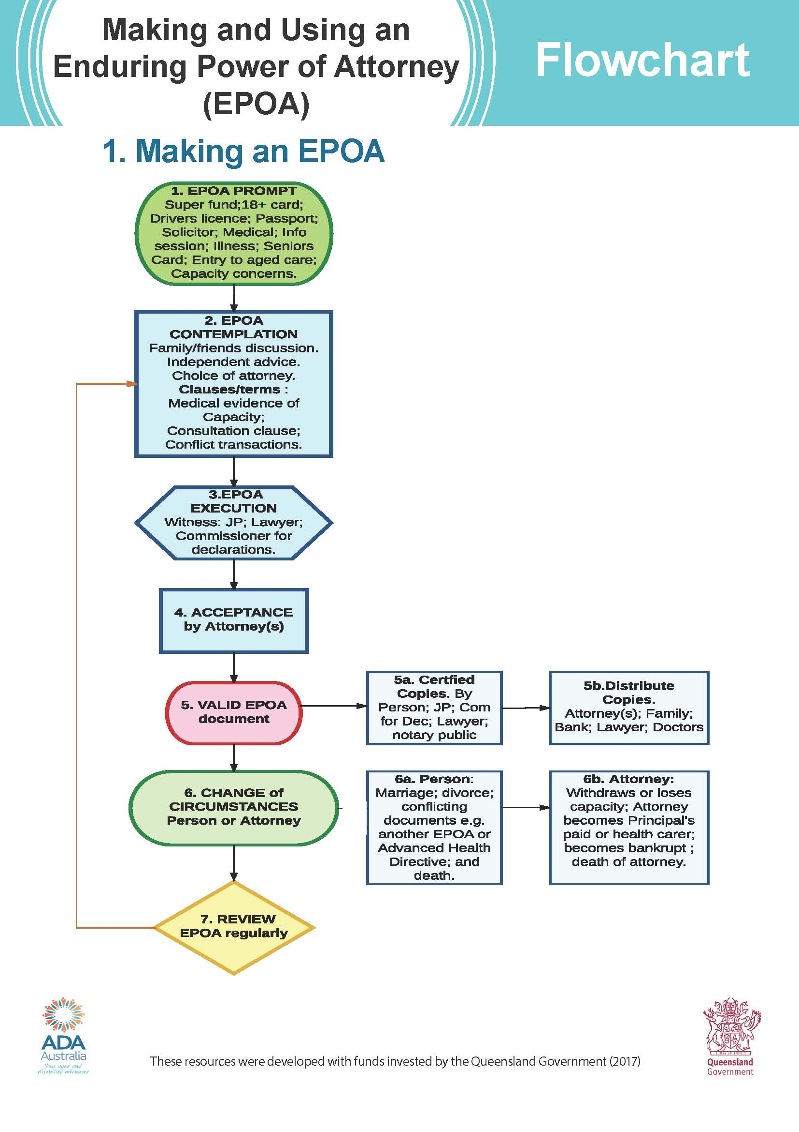
Resources available for Intake / Triage / Third parties relying on EPOA

Slide 8
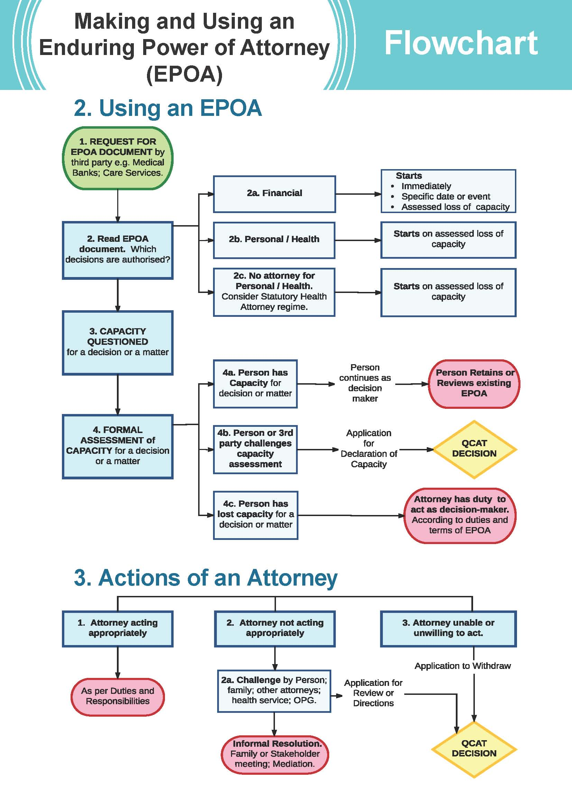
Easy to read diagrams

Slide 9
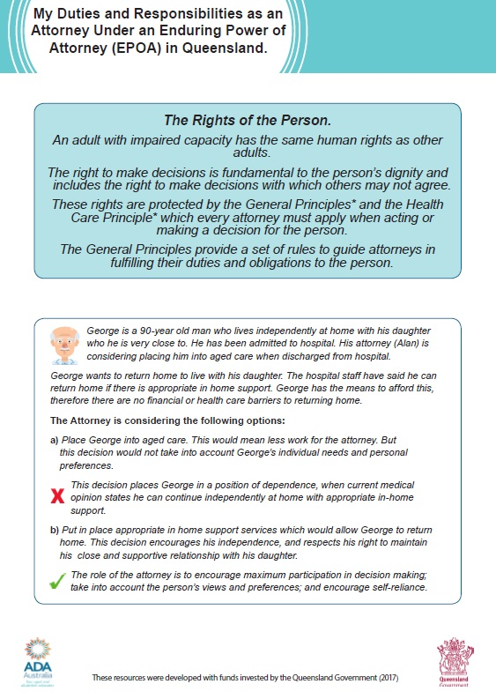
Typical examples used to explain appropriate decision making support

Slide 19
Access to online resources
https://adaaustralia.com.au/resources/ada-resources/
https://www.qld.gov.au/seniors/legal-finance-concessions/wills-estate-planning
https://www.qld.gov.au/law/legal-mediation-and-justice-of-the-peace/power-of-attorney-and-making-decisions-for-others/power-of-attorney

