Slide 1
Taking a strategic approach to community legal education
James Farrell
Community Legal Centres Queensland
8 March 2018
CLCs Queensland conference
Notes:
Introduce myself.

Slide 2
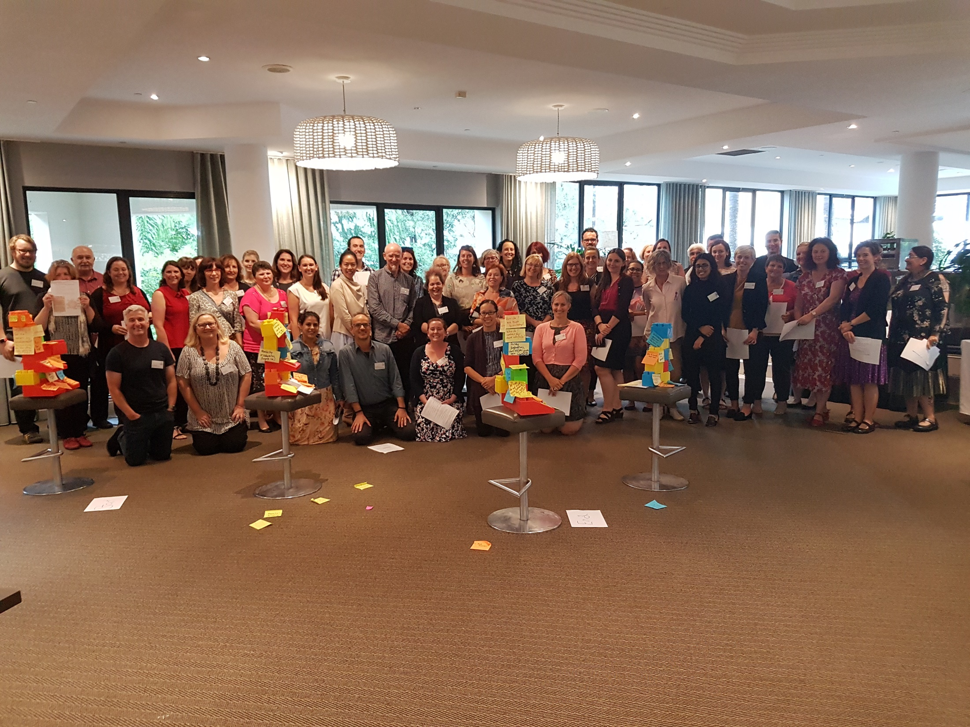
Community Legal Education Masterclass
Brisbane
6-7 March 2018

Slide 3
CLE masterclass – learning objectives
Explore different ways to deliver CLE (‘ideas’)
Best practice
Engaging techniques
New products and technology
Resources (ways to deliver CLE efficiently)
Networking, collaboration, partnerships
Understand adult learning
Cultural issues in CLE
Evaluation – what works, and why?

Slide 4
Workshop program
Tuesday
Introduction: What is good CLE?
James Farrell, CLCs Queensland
Principles of adult learning
Andrew Fussell, TAFE Queensland
‘Chit chat’ showcase
Community development
John Jablonka, NT Legal Aid Commission
Rob Lachowicz, RAILS
Communication skills
Daniel Scoullar, Social Change Projects
Wednesday
Technology and design thinking
Laura Spalding, The Legal Forecast
‘Chit chat’ showcase
The School Lawyer
Vincent Shin, WEstJustice
Working in partnership
Lottie Turner, Health Justice Australia
Evaluation
Rosslyn Monro/Carly Hanson, CLCs Queensland
Your one ‘takeaway’
Notes:
10.05-10.10 Explain where each of these things will fit on the agenda

Slide 6
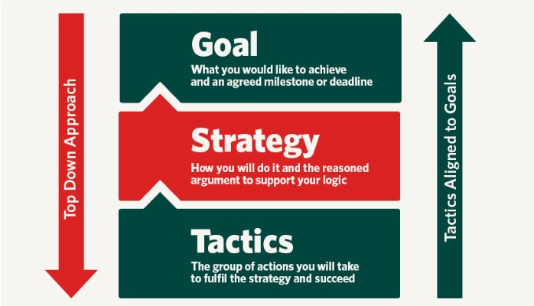

Slide 7
Today: looking at 3 strategic themes
SMART planning
Adult learning principles
Evaluation

Slide 8
Developing SMART objectives for CLE

Slide 9
We identify a solution
Develop a divorce factsheet
Produce an app on motor vehicle accidents
Give a school talk about sexting
Hold a wills workshop at the local library

Slide 11
Specific
Well defined
Clear to anyone that has a basic knowledge of the project
Measurable
Know if the goal is obtainable and how far away completion is
Find out when you have achieved your goal
Attainable
Describes how the goal will be achieved
Within the availability of resources, knowledge and time
Realistic
ensuring that your goal matters to you, and that it aligns with other relevant goals (ie strategic plan)
Is relevant to the client group/audience
Time-Based
Enough time to achieve the goal
Not too much time, which can affect project performance

Slide 12
25% of older people at XYZ senior citizens group review their will for currency within 3 months of attending our session
Hold a wills workshop at the local library
Notes:
Let’s test this one together

Slide 13
Young people at XYZ local high school can articulate to their peers why sexting gets them into trouble with the law after attending our workshop
Give a school talk about sexting
Notes:
Do this with your table

Slide 14
Produce an app on motor vehicle accidents
At least 100 people in Queensland will download our smartphone app, which steps drivers through their legal obligations immediately following an accident (and leave a 4 or 5 star rating)
Notes:
Do this by yourself

Slide 15
Develop a divorce factsheet
New family law clients will be provided with a 1page factsheet when they book into their appointment with us, so they can bring any relevant documents to their legal appointment, where the divorce application can be completed
Notes:
(extra, might not need this one)

Slide 16
Principles of adult learning

Slide 17
Principles of adult learning
Motivation
Learning Styles
Relevance and Immediacy
Prior Learning and Experience
Context – The Whole and Its Parts
Learning Environment
Participation and Practice.

Slide 18
Motivation
Motivation
Learning Styles
Relevance and Immediacy
Prior Learning and Experience
Context – The Whole and Its Parts
Learning Environment
Participation and Practice.
Internal factors may include:
The desire to seek knowledge
To be challenged
To achieve greater job satisfaction
To satisfy an inquiring mind.
External factors may include:
Wanting to prevent or settle a legal problem
To achieve greater job satisfaction
Secure professional advancement
To increase job related skills.
Notes:
What are some motivations that might encourage people to come to one of your CLEs?

Slide 19
Learning styles
Motivation
Learning Styles
Relevance and Immediacy
Prior Learning and Experience
Context – The Whole and Its Parts
Learning Environment
Participation and Practice.
Visual learners prefer images, pictures, diagrams, films and videos or demonstrations.
Auditory learners learn best through the process of listening and talking.
Kinaesthetic learners learn by doing.
Notes:
Use kahoot

Slide 20
Relevance and immediacy
Motivation
Learning Styles
Relevance and Immediacy
Prior Learning and Experience
Context – The Whole and Its Parts
Learning Environment
Participation and Practice.
Learning is enhanced when the learner is aware of the relevance of the content and when it is ‘immediately’ applicable to their situation or needs.

Slide 21
Relevance and immediacy
Motivation
Learning Styles
Relevance and Immediacy
Prior Learning and Experience
Context – The Whole and Its Parts
Learning Environment
Participation and Practice.
Focus the content of activities around the current interests and concerns of participants
Clearly state the purpose and learning outcomes, and identify points of relevance, when promoting and introducing the activity
Encourage participants to consider how the new knowledge or skills will assist them to achieve their goals, or to address personal or professional issues
Encourage the participants to apply the content to their own or comparable situations by using techniques such as case studies, role plays, questions and discussion and
Develop resources that people can easily access if and when they need them.
Notes:
Ask group to give examples

Slide 22
Prior learning and experience
Motivation
Learning Styles
Relevance and Immediacy
Prior Learning and Experience
Context – The Whole and Its Parts
Learning Environment
Participation and Practice.
It’s important to incorporate the rich experience that adult learners bring with them into your training sessions. People come to learning situations with a wide range of experience, knowledge, skills, values and perceptions. These can provide the basis for valuable personal and co-operative learning.

Slide 23
Prior learning and experience
Motivation
Learning Styles
Relevance and Immediacy
Prior Learning and Experience
Context – The Whole and Its Parts
Learning Environment
Participation and Practice.
Conduct a needs assessment to uncover group members’ experiences and expectations
Recognise the experience of participants or the target group in the design and delivery of activities
Do your research. Are there specific characteristics of the target group or individual participants that should be considered?
Acknowledge ‘up-front’ that participants may have relevant experience and knowledge and that this may enhance personal and group learning
Ask participants to tell you what they know or about relevant situations or experiences they have encountered throughout session

Slide 24
Prior learning and experience
Motivation
Learning Styles
Relevance and Immediacy
Prior Learning and Experience
Context – The Whole and Its Parts
Learning Environment
Participation and Practice.
Relate the content and strategies used in the activity to the past experience and/or current situation of participants
If appropriate, create peer sharing opportunities by facilitating small group discussions
Try to identify and pre-empt possible barriers and challenges, such as bad experiences with previous learning situations or a perception that it is impossible to change things and
It may be appropriate to take a pro-active approach and plan to constructively raise and address issues. Alternatively, consider how you will deal with certain issues or scenarios should they arise.
Notes:
Speak on tables about needs assessments, etc
Do you talk to your community?
Do you rely on your perceptions, or info from third parties?

Slide 25
Context – the whole, and its parts
Motivation
Learning Styles
Relevance and Immediacy
Prior Learning and Experience
Context – The Whole and Its Parts
Learning Environment
Participation and Practice.
People prefer to have a sense of the ‘big picture’, an overview of the topic and how it will be explored before exploring specific components in more detail. This approach provides a context and a framework onto which participants can place and fit together the component parts.

Slide 26
Context – the whole, and its parts
Motivation
Learning Styles
Relevance and Immediacy
Prior Learning and Experience
Context – The Whole and Its Parts
Learning Environment
Participation and Practice.
Provide a general introduction to the topic, issue, expected new knowledge or skills and outline how these will be explored in smaller parts
Present aspects of the topic in a logical sequence, review content and check participant understanding prior to moving on to the next aspect
Ensure that the various parts are drawn together and linked back to the ‘big picture’ at the end of the activity
A visual presentation, such as a diagram, may assist in showing the relationship between the whole and the various smaller parts.
Notes:
Mark me on this – feedback welcome

Slide 27
Learning environment
Motivation
Learning Styles
Relevance and Immediacy
Prior Learning and Experience
Context – The Whole and Its Parts
Learning Environment
Participation and Practice.
When learning something new, adults may feel vulnerable. The use of low-risk activities, reassurance and building on incremental successes can help learners to feel more comfortable. Concepts and skills should also be presented moving from simple to complex and from group-supported to solo.

Slide 28
Learning environment
Motivation
Learning Styles
Relevance and Immediacy
Prior Learning and Experience
Context – The Whole and Its Parts
Learning Environment
Participation and Practice.
Set achievable learning objectives
Plan sessions to start with basics and work towards the more complex
Establish expectations / ground rules
Use an outline to guide participants towards intended outcomes
Provide an environment that promotes sharing and co-operative learning, not competition
Avoid words and actions that may embarrass individuals
Encourage questions and ideas from participants that speak up
Promote a supportive and non-judgemental environment
Encourage and expect them to take responsibility for their own learning
Provide a physical environment is conducive to learning and when appropriate resources are available.
Notes:
Talk to your table about how you provide a good learning environment

Slide 29
Participation and practice
Motivation
Learning Styles
Relevance and Immediacy
Prior Learning and Experience
Context – The Whole and Its Parts
Learning Environment
Participation and Practice.
Adults learn best when training moves beyond ideas (cognitive) and feelings (affective) to incorporate actions (behavioural) as well. Providing opportunities for participants to participate in learning activities and to practice new skills or apply knowledge assist people to learn more effectively.

Slide 30
Participation and practice
Motivation
Learning Styles
Relevance and Immediacy
Prior Learning and Experience
Context – The Whole and Its Parts
Learning Environment
Participation and Practice.
Directing participants to discuss ideas with a partner or their group every 10 minutes or so
Using guiding questions to facilitate discussions
Facilitate activities that encourage active participation and application of new skills and knowledge – discussions, questions, problem-solving exercises, completing relevant documents, and role-plays
Use case studies or scenarios and invite learners to describe, apply or implement what they’ve learned
Ask participants to record their new learning and the steps to be taken to implement their new knowledge. Have them share these with the group to encourage use of their action plans.
Balance quantity with quality. It may be more effective to address less points well through input and encouraging active participation, rather than more points, most of which may be quickly forgotten.
Notes:
When we move into evaluation, we’ll be looking at this
Also (kind of) describes when I asked you to develop SMART objectives

Slide 31
Principles of adult learning
Motivation
Learning Styles
Relevance and Immediacy
Prior Learning and Experience
Context – The Whole and Its Parts
Learning Environment
Participation and Practice.

Slide 32
Evaluation How do we know it worked?

Slide 33
How do we evaluate CLE?
Video – Who’s Who in the District Court
Review the effectiveness of the CLE by reference to the CLE project outline areas, eg:
Audience
Strategies
Needs
analysis
Communication
Evaluating CLE | 33
Notes:
https://www.youtube.com/watch?v=s5c2aIKzYec&feature=youtu.be

Slide 34
Evaluation Plan: SMART objective
SMART objective | KEQ | Data | Tools / Methods | Who? / When?
By delivering CLE on EPAs to residents in the Restful Nursing Home, 25% of participants will check that their EPA is current in the next month
Evaluating CLE | 34
Notes:
Allocate a SMART objective to each group from day 1 (put on white board / flip chart)
Each group writes their SMART objective into the Evaluation plan worksheet
This example is worked through as a group, not individually

Slide 35
Evaluation Plan: Key Evaluation Questions (KEQs)
KEQs are the questions we ask to tell us if something has been completed or a change has occurred
KEQs need to be formulated at the same time as the SMART objective so evaluation methodology can incorporated into CLE implementation
Evaluating CLE | 35

Slide 36
Key Evaluation Questions
Some suggested categories of questions:
Appropriateness
Was the initiative appropriate to the identified need?
Is this initiative appropriate for our CLC to undertake/ are we best placed to do this?
Does this initiative align with the goals of our CLC?
Effectiveness
Did the initiative achieve the intended outcomes?
Is the initiative producing worthwhile results or meeting objectives?
Is the situation or problem better or worse as a result of the initiative?
Evaluating CLE | 36

Slide 37
Key Evaluation Questions
Some suggested categories of questions:
Efficiency
Is this cost effective for us to do given the impact or outcomes?
Would another approach provided the same results for less cost?
Sustainability
What is the capacity to build on the initiative?
What needs to be put in place to sustain the benefits?
Evaluating CLE | 37

Slide 38
Evaluation Plan: KEQs
SMART objective | KEQ | Data | Tools / Methods | Who? / When?
By delivering CLE on EPAs to residents in the Restful Nursing Home, 25% of participants will check that their EPA is current in the next month | Did the CLE address an identified need? (Appropriate) Did participants check that their EPA was current in the next month? (Effective) Was this type of CLE the most effective use of resources for the outcome? (Efficient) Should we deliver the CLE to the retirement village? (Sustainable)
Evaluating CLE | 38
Notes:
Participants develop Key Evaluation Question
Groups share – lollies for participation

Slide 39
Evaluation Plan: Data
Quantitative examples – number of participants, number of downloads, install numbers, webpage hits
Sources of data can be quantitative and/or qualitative
Qualitative examples – participant feedback, stakeholder / partner feedback, stories
Ideally a mix of both
Evaluating CLE | 39

Slide 40
Evaluation Plan: Data
SMART objective | KEQ | Data | Tools / Methods | Who? / When?
By delivering CLE on EPAs to residents in the Restful Nursing Home, 25% of participants will check that their EPA is current in the next month | Did the CLE address an identified need? (Appropriate) Did participants check that their EPA was current in the next month? (Effective) Was this type of CLE the most effective use of resources for the outcome? (Efficient) Should we deliver the CLE to the retirement village? (Sustainable) | Information about the residents' knowledge of EPAs & their legal needs Number of participants booked into CLE; participant feedback about future intention Number of hours to develop and provide the CLE; participant feedback about its usefulness Participant numbers; Retirement village legal need
Evaluating CLE | 40
Notes:
Participants develop data requirements against KEQ in the evaluation plan
Groups share – lollies for participation

Slide 41
Evaluation Plan: Methodology Toolbox
Choice of methodology dependent upon:
The Key Evaluation Question you are trying to answer!
Existing capability
Availability and accessibility of data
Data collection capacity
Ethical consideration
Access to different clients, stakeholders, users
Evaluating CLE | 41

Slide 42
Evaluation Plan: Methodology Toolbox
Examples:
Surveys
Interviews
Focus Groups
Observations/site visits
Document review
Case studies
Ranking exercises
“I” statements
What else can we add to the methodology toolbox?
Evaluating CLE | 42
Notes:
Question to the group – lollies for participation

Slide 43
Evaluation Plan: Who & When
SMART objective | KEQ | Data | Tools / Methods | Who? / When?
By delivering CLE on EPAs to residents in the Restful Nursing Home, 25% of participants will check that their EPA is current in the next month | Did the CLE address an identified need? (Appropriate) Did participants check that their EPA was current in the next month? (Effective) Was this type of CLE the most effective use of resources for the outcome? (Efficient) Should we deliver the CLE to the retirement village? (Sustainable) | Information about the residents' knowledge of EPAs & their legal needs Number of participants booked into CLE; participant feedback about future intention Number of hours to develop and provide the CLE; participant feedback about its usefulness Participant numbers; Retirement village legal need | Interviews CLASS data; Survey Record of project hours; Survey Interviews | Key nursing home staff prior to CLE planning and delivery Internal analysis of CLASS data up to 3 months after CLE; Participant survey questions about intended next steps after CLE Internal analysis of project hours compared with outcome discussions at operational planning; Participant survey about CLE usefulness after CLE CLE participants after delivery; Retirement village residents committee prior to decision to deliver CLE
Evaluating CLE | 43
Notes:
Participants to complete the Tools / Methods and Who and When columns for their SMART objective – groups share

Slide 44
Today: looking at 3 strategic themes
SMART planning
Adult learning principles
Evaluation

Slide 45
Vincent Shin
‘The School Lawyer’

