Slide 1

Understanding the impact of phone and internet issues in Queensland

Slide 2


Agenda
The Telecommunications Industry Ombudsman
What’s happening in complaints
What’s happening in Queensland
The impact of phone and internet problems in Queensland
Making a difference

Slide 3

The Telecommunication
Industry Ombudsman
Providing a fair, independent, and accessible dispute resolution service for Australian consumers and the telecommunications industry – that complies with Benchmarks for Industry Based Customer Dispute Resolution

Slide 4






Benchmarks for Industry-based Customer Dispute Resolution
Independent
Accountable
Accessible
Efficient
Fair
Effective

Slide 5

Our scope
Fair and independent complaint resolution
Information and analysis
Complaints:
Residential Consumer
Small Business
Systemic

Slide 6
Our mandate
Legislation
Part 6 TCPSS Act 1999
Telco Act 1997
CSG Standard
Company documents
Constitution
Terms of reference

Slide 7
The telecommunications industry
Dispute Resolution
Telecommunications Industry Ombudsman
Regulator
Australian Communications and Media Authority (ACMA), along with the government, sets policy, regulates the industry
Industry Peak Body
Communications Alliance
Consumer Peak Body
Australian Communications Consumer Action Network (ACCAN)

Slide 8
What’s happening in complaints
1
Changing pattern – and increasing demand
Impact of complaints about services delivered over the national broadband network
What we see – complaint handling
2
3

Slide 9
National complaint volume over time
FY17

Slide 10
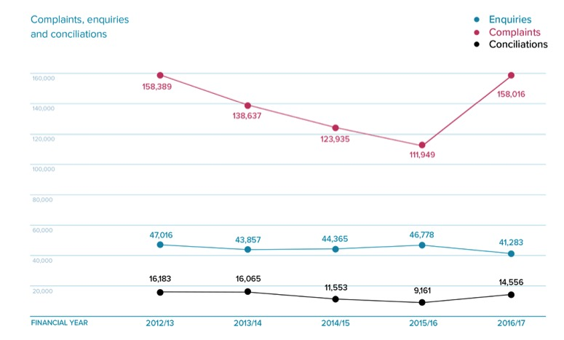
National complaint volume over time
*Estimate only

Slide 11
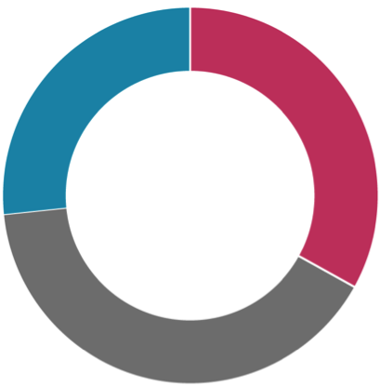
National phone and internet complaints
Landline phone services
41,824 (26.5%)
Mobile phone services
52,300 (33.0%)
Internet services
63,892 (40.4%)

Slide 12
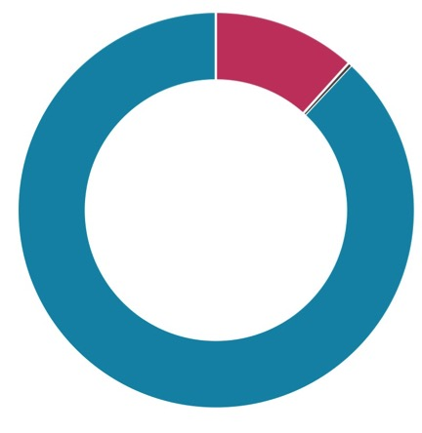
Who complains across the country
Small Business
18,789 (11.9%)
Residential Consumers
138,816 (87.8%)
Not for Profit
411 (0.3%)

Slide 13
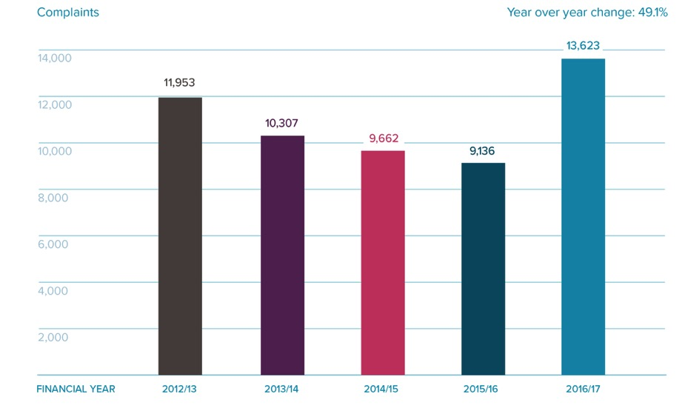
Phone and internet complaints in Queensland

Slide 14
Top ten Queensland postcodes for phone and internet complaints
Postcode | Postcode | # complaints 2016/17
6210 | Mandurah | 469
6112 | Armadale | 393
6065 | Wanneroo | 355
6030 | Clarkson | 333
6163 | Hamilton Hill | 332
6107 | Cannington | 311
6164 | Atwell | 253
6056 | Swan View | 228
6155 | Canning Vale | 226
6061 | Balga | 188

Slide 15
Top complaint issues in Queensland
1 | Customer service
2 | Billing and payments
3 | Faults
4 | Complaint handling
5 | Contracts
6 | Connection
7 | Credit management
8 | Transfer
9 | Privacy
10 | Directories

Slide 16
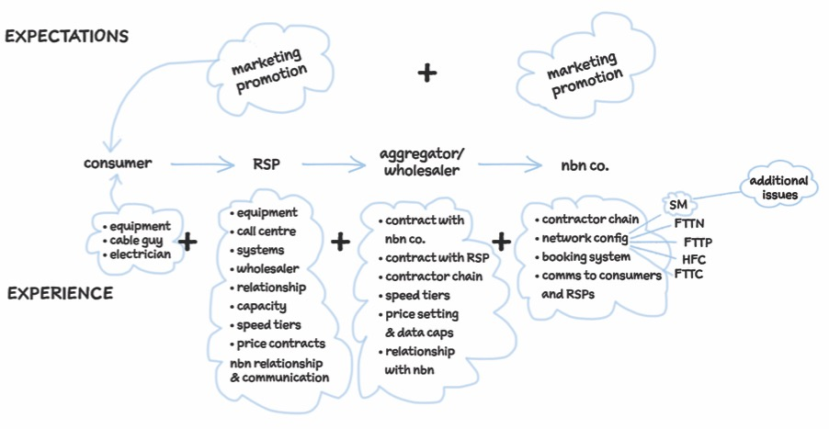
NBN expectations vs experience

Slide 17
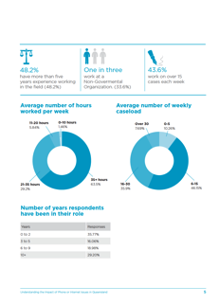
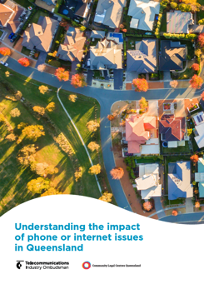

Understanding the impact of phone and internet issues in Queensland

Slide 18
Survey overview
Partnership between Telecommunications Industry Ombudsman and Community Legal Centres Queensland
To understand the phone and internet issues of community legal sector workers’ clients
The survey looked at preconceived problems, barriers to complaining, and possible solutions

Slide 19
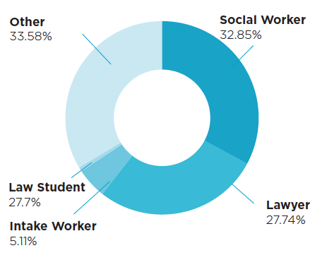
Community legal sector workers in Queensland
Who answered the survey

Slide 20
Community legal sector
workers in Queensland
Where respondents work
Brisbane and South East Queensland | 62.04%
South West and Darling Downs | 7.30%
Cairns and Far North Queensland | 6.57%
Central West (includes Gladstone and Rockhampton) | 4.38%
Mount Isa and North West (includes Townsville) | 3.65%
Mackay and Whitsunday | 2.19%
Wide Bay Burnett | 1.46%
Other | 12.41%

Slide 21
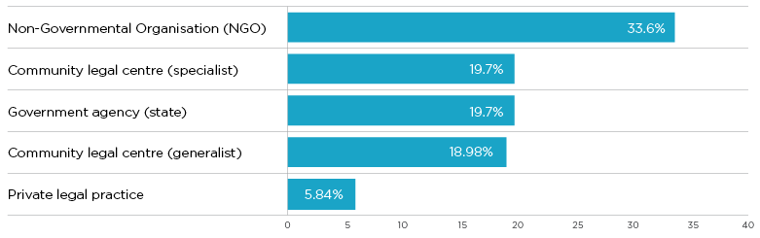
Community legal sector
workers in Queensland
Types of organisations where respondents work
Other types of organisations includes Legal Aid Queensland (0.73), peak body or professional association (0.73%) and federal government agency (0.73%).

Slide 22
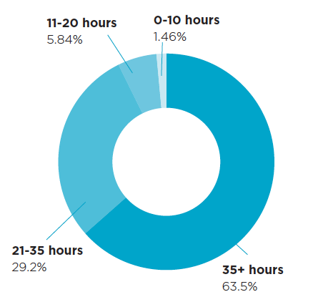
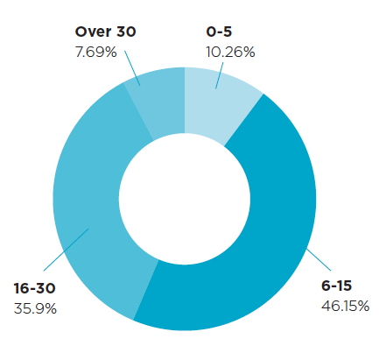
Community legal sector
workers in Queensland
Average number of hours worked per week
^{Average weekly caseload}

Slide 23
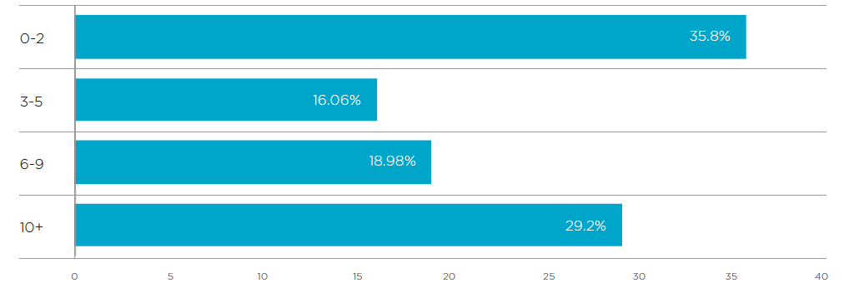
Community legal sector
workers in Queensland
Number of years respondents have been in their role

Slide 24
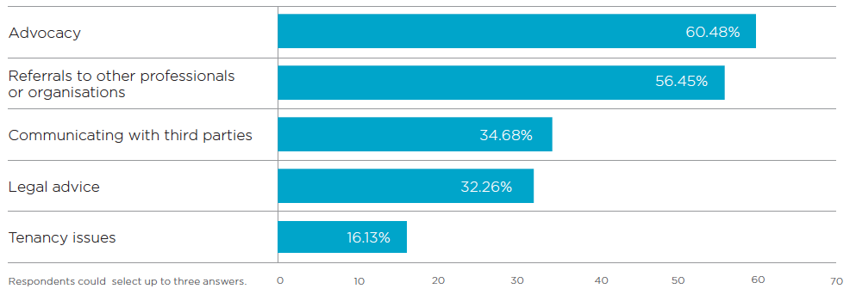
How community legal sector
workers assist their clients
Most common assistance given to clients
Other areas of assistance include court representation (13.7%), family law issues (12.9%),
dispute resolution (9.7%) and community legal education (8.9%).

Slide 25
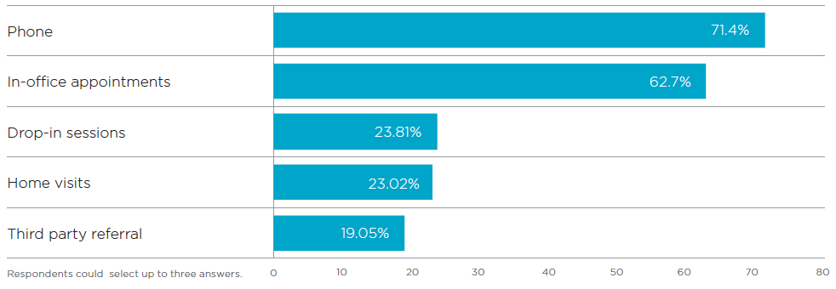
How community legal sector
workers assist their clients
How clients access community legal services
Other ways clients access community legal services are through presentations (7.1%) and online resources (6.35%).

Slide 26
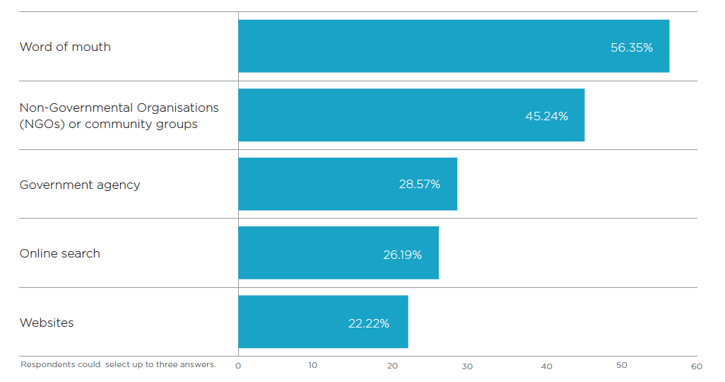
How community legal sector
workers assist their clients
How clients hear about community legal services
Other ways clients hear about community legal services include medical professionals (14.3%),
posters or flyers (8.7%), members of parliaments, senators or councilors (3.97%), newspapers (3.2%), ombudsman (2.4%) and radio (0.79%).

Slide 27
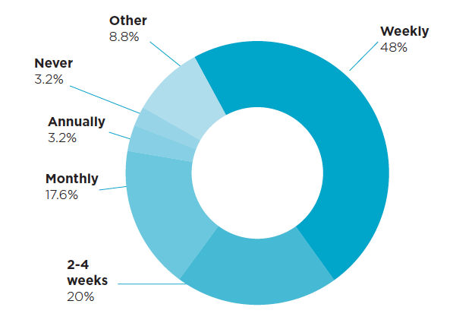
Phone and internet issues
Frequency of problems

Slide 28
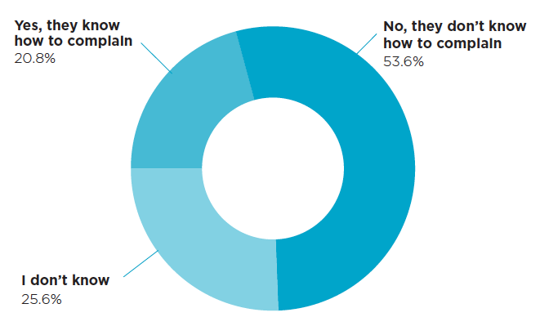
Phone and internet issues
Clients’ understanding of how to complain
I don’t know whether they know how to complain

Slide 29
Phone and internet issues
The most common phone or internet issues
1 | Unable to pay for phone or internet service
2 | Increasing debt
3 | Legal action for debt recovery
4 | Not enough money coming in to cover required spending
5 | Misunderstanding their contract
Other issues include late bill payments and extensions, bad relationships with phone or internet providers, overselling, problems moving house and language or cultural barriers.
*Respondents were asked to rank statements from a list of 10 choices.

Slide 30
Phone and internet issues
The most common reasons stopping clients from complaining about their phone or internet service
1 | People don’t know they can complain
2 | People don’t know who to contact to complain
3 | Lack of confidence
4 | People don’t understand their phone and internet contracts
5 | Lack of knowledge
Other reasons include not understanding phone or internet bills, language and cultural barriers and repercussions from a phone or internet provider.
*Respondents were asked to rank statements from a list of 10 choices.

Slide 31
Phone and internet issues
Additional problems that arise
from phone or internet issues
1 | Debt
2 | Mental health issues
3 | Unemployment
4 | Housing
5 | Physical health
Other problems include loss or suspension of phone or internet services, relationship breakdown, family violence, poor credit rating, legal problems and poor financial management.
*Respondents were asked to rank statements from a list of 10 choices.

Slide 32
Phone and internet issues
Solutions identified to help
avoid phone or internet problems
1 | Tighter regulation of phone or internet services
2 | A variety of payment plans
3 | Financial education
4 | Clear information from phone or internet providers
5 | Restrictions on overselling
Other solutions include tighter regulation of credit, better IT skills, availability of consumer information, information delivered in a variety of languages and cultures, and regulation on phone or internet services advertising.
*Respondents were asked to rank statements from a list of 10 choices.

Slide 33
Lessons from complaints

Slide 34

Making a difference
Wendy*
A breach of privacy

Slide 35

Making a difference
Andrea*
Repayment and debt collection

Slide 36
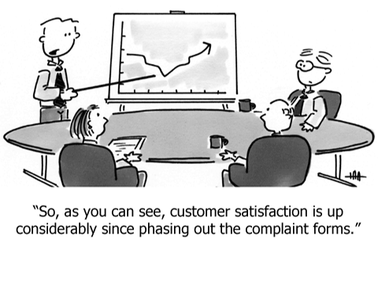
Your questions

