Slide 1

I
GOING PAPERLESS
South West Brisbane Community Legal Centre’s
Paperless Advice Clinic Pilot
Presented by Jim Gibney (February 2018)

Slide 2
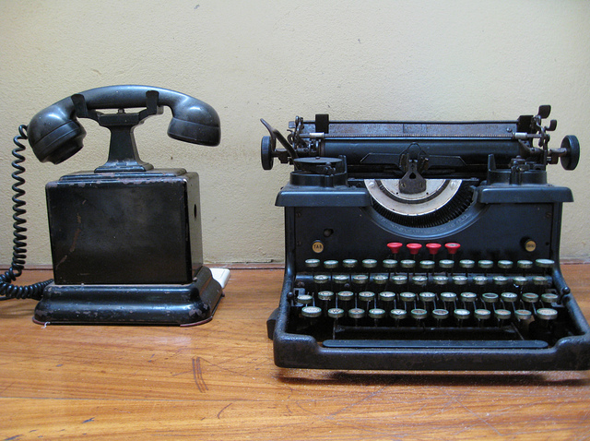
ASSUMPTIONS
The way things are going – remember?
The time has come in CLC’s – in the 1980’s we used to dictate letters
Development of a functional data base: NIS CLSIS CLASS
Economic & efficiency imperatives – Community legal practice is lean – we cannot afford inefficient operational systems
Not possible to operate a CLC TOTALLY paperless - yet
But what about operating paperless Advice Clinics ?

Slide 3

The Real Problem with “going paperless”
How to make the leap?
How to manage the change without bombing your clinics?
And how to move to paperless without “burning” your workers?
Following is the story of the paperless pilot at SWBCLC
maybe some pointers here for you????

Slide 4
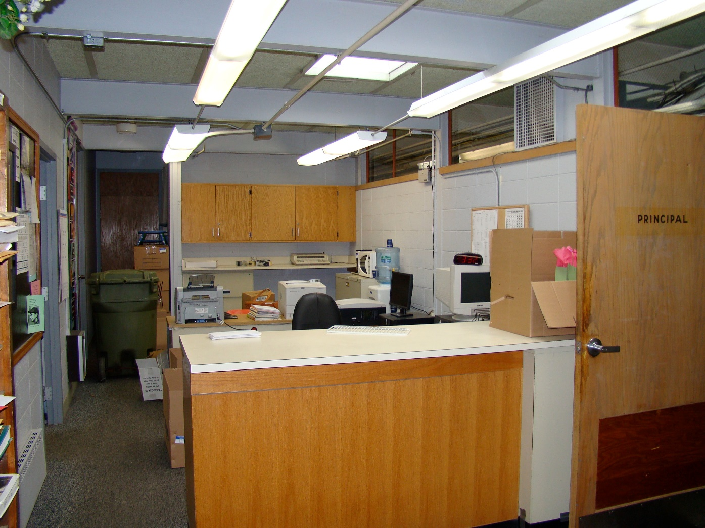
SWBCLC – the context

Slide 5

The SWBCLC team
Smart people
Outcome oriented – what could work here?
Willingness to change (if necessary – but got to get the work done)
But also a few oldtimers – “not all change is good”
The role of the New comer –
SCOPING OUT – setting some seeds?

Slide 6
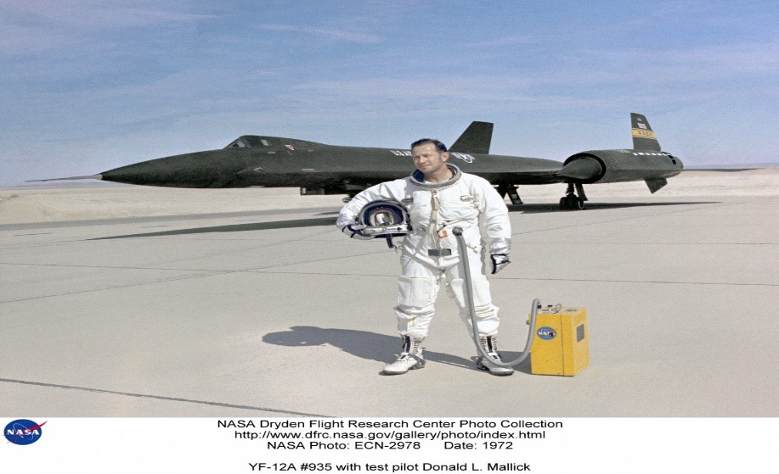
How to engineer a substantial change in the fundamental operating system ?
Without putting the established operation in jeopardy?
Manage the resistance to/fear of change in the workplace
Building sense of a project
Listening to key workers (every worker in a CLC) – promoting buy in to the conversation
Suggesting a PILOT PROJECT
– to run a preliminary pilot test

Slide 7

Obtain approval (ie authority) for the pilot project
Management committee
Who will lead the pilot project?
Who will wear it if it “fails”
Someone other than the Director?
Avoid putting your core players at risk? How ?

Slide 8

At SWBCLC we decided to open an entirely new clinic to embody the paperless pilot

Slide 9

Separate paperless pilot clinic
BUILD YOUR PILOT CLINIC
RESOURCES AVAILABLE
Rooms
Time of operation – daytime (why?)
Recruit volunteers
Establish booking calendar
supervision of volunteers (model?)
Intake workers at front line

Slide 10

Training
Build a paperless pilot team
Invite employed staff to the training
Recruit volunteer project leader
Train up the project leader first
Work up 4 week training program/ plan
We trained 6 volunteer solicitors + 2 students
End with a dummy run with fictitious clients (use test site in CLASS)
Especially the employed intake workers (+ data entry staff)
Also encourage employed lawyers to attend training
Establish link to
NACLC CLASS

Slide 11

Launch the paperless pilot clinic
Start with one client per solicitor every 90 minutes
Provide clear booking calendar to each volunteer solicitor
Allow time to record as you go straight into CLASS
Resist going ahead with next client before CLASS record entered and signed off by supervisor
MOST IMPORTANT:
create clients in CLASS before live clinic begins
Provide plenty of supervision / support – How?
Manage client expectations very carefully – ie brief clients upfront: stress at beginning what the process is – we work in a team – we workshop your problem

Slide 12

After a few clinic sessions – change the settings to suit
90 min interviews -> 60 minutes
Reset booking calendar
Consider feedback of Front counter staff
review content settings – eg too much family/DV law? Too little consumer? Crime? Motor vehicle? Centrelink? EPOA? - does this suit your solicitors?
Recheck your process with volunteers
Give feedback about recording in Class – change if necessary

Slide 13
Out comes for SWBCLC paperless clinic
20 paperless pilot clinics
Now running 5 rooms with one volunteer solicitor each room
4 clients per solicitor
20 client advice interviews each Tuesday morning –> follow-up in pm
Interview start times now staggered – better access to supervisor
Intake procedure to book & create client in CLASS – 8 minutes
Half of our volunteer lawyers got jobs – trained new vols on the job
Employed staff included in some clinics – now they are trained & using CLASS direct entry for their own advice clinics

Slide 14
Takeaway lessons from SWBCLC pilot?
Major change to how front end intake must be done – create client at first contact (avoid writing it down !!!!) – enter directly to avoid double handling- will give efficiency overall: 6 – 8 mins with practice
Imperative to develop team ethic & team to stick to the agreed process
Best to have supervisor sign off on CLASS record – then print off advice summary and hand to client
Develop/ tutor a style of writing advice summaries in Action screens
Have a way of evaluating/ reporting progress to whole centre: report & use results to expand paperless operation throughout practice

Slide 15
Questions? Discussion?

