Slide 1
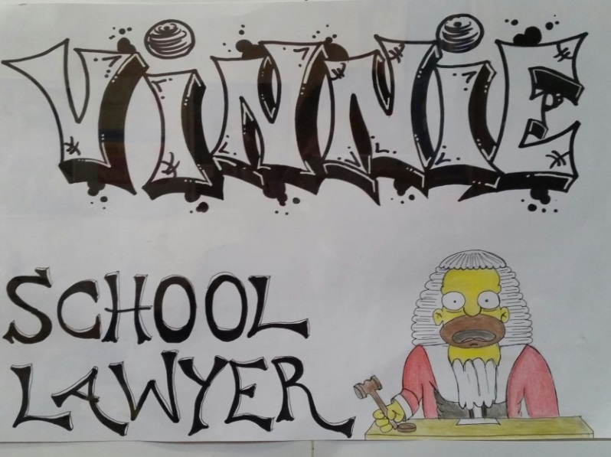
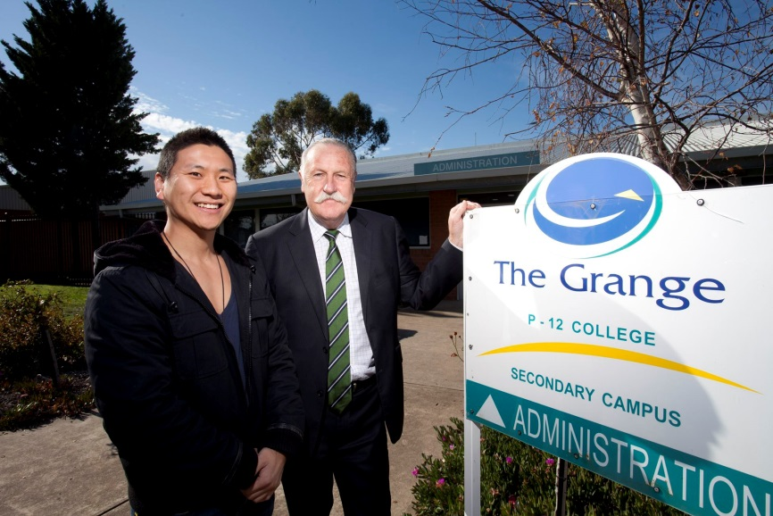
School Lawyer Project
Vincent Shin,
School Lawyer at The Grange P-12 College, Hoppers Crossing

Slide 2
Who is the school lawyer?
3rd year lawyer
Out of home care and secure welfare services
Private sector
ABC - Australian Story

Slide 3
The Grange P12 College & Warringa Park School
Grange (3.5 days)
1600-1650 students (180 staff)
Large migrant population
Low SES
Large indigenous population
Warringa Park (0.5 days)
Intellectual disabilities – IQ less than 70

Slide 4
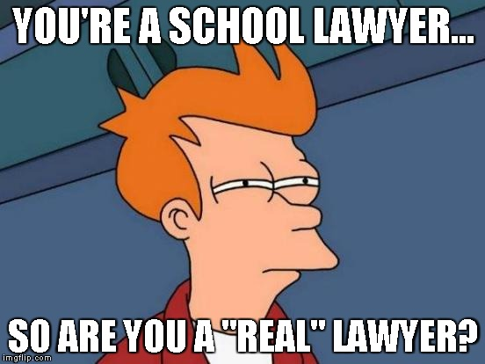

Slide 5
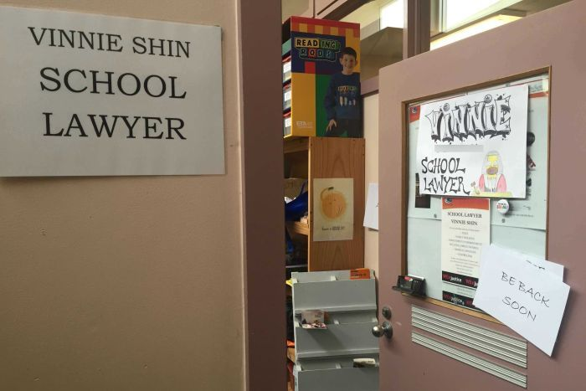
How does the school lawyer project work?
Casework
CLE
Special legal events

Slide 6
Casework
Family violence
Employment law
Infringements
Crime

Slide 7
Community Legal Education
Consent and age of consent
Sexual harassment and sexual assault
Bullying/cyber bullying
Sexting
Criminal law
Employment rights
Rights and responsibilities when using public transport
Dealing with police
Criminal records and crime

Slide 8
Community Legal Education
Community Legal Education
Consent and age of consent
Bullying/cyber bullying
Sexting
Criminal law
Employment

Slide 9
The High School Lawyer

Slide 10
Special Legal Events
Special legal events
Bring your bills
November No Violence/ No Violence No way
Mock trial

Slide 11
Engagement, rapport and promotion of service
Assembly
Classes
Engagement at recess and lunch

Slide 12
Benefits
Access to justice
Would not have seen a lawyer
Holistic services
Proximity and location

Slide 13
Brain break

Slide 14
Funding
Philanthropic trusts
Newsboys Foundation
Jack Brockhoff Foundation
RE Ross Trust
Helen Macpherson Smith Trust
Slater and Gordon Community Fund
Kimberley Foundation

Slide 15
Services Deed/MOU
Lander and Rogers

Slide 16
Limitations/challenges
“I don’t help you sue the school”
Student vs student
External agency

Slide 17
Outcomes
External evaluator – Emma Pritchard

Slide 18
Learnings
Students reluctant to enforce legal rights
VCE or year 11 and 12 students difficult to deliver CLE
Engaging parents was challenging
Importance of set up period
Sustainable and ongoing funding options are available

Slide 19
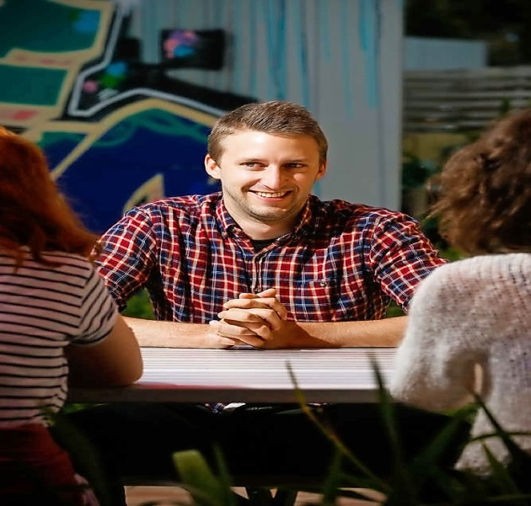
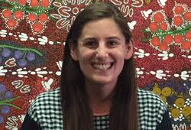
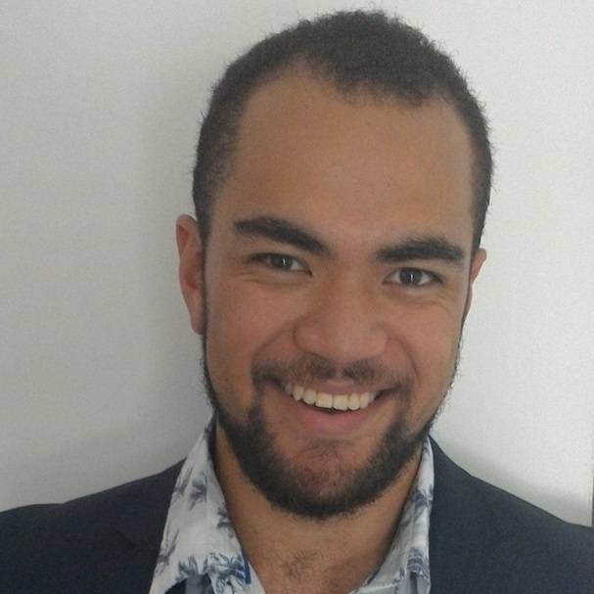
School lawyers taking over the world?
Angus Woodward
(Big gussy)
The Cottage
Monique Hurley (Monners)
Wyndham Central College
Semisi Kailahi (Semmie)
Tarneit Senior College

Slide 20
Looking into the future
Social Ventures Australia Framework

Slide 21
Quote from a student

Slide 23
Questions?

