Slide 1
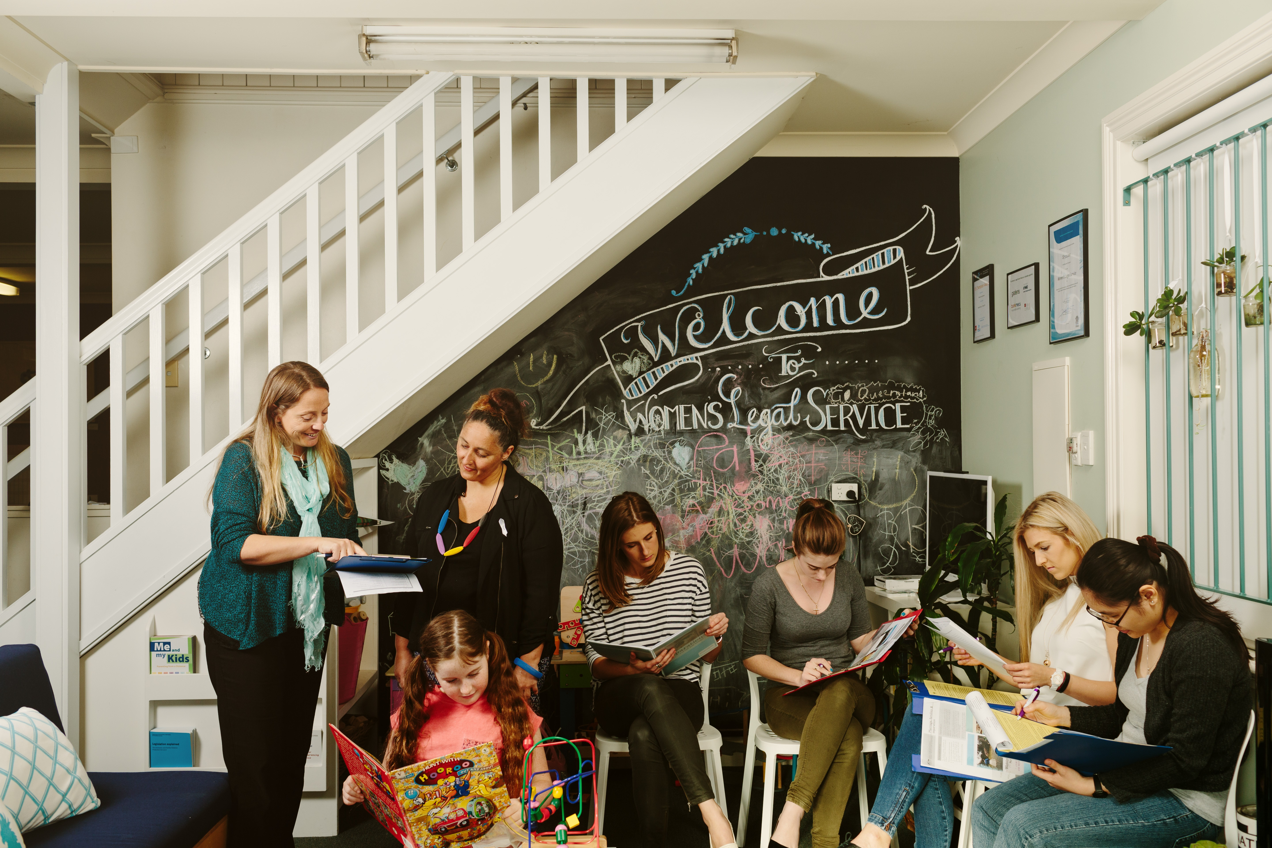
Remote volunteering project CLCQ Conference 8 March 2018
Women’s Legal Service Queensland

Slide 2
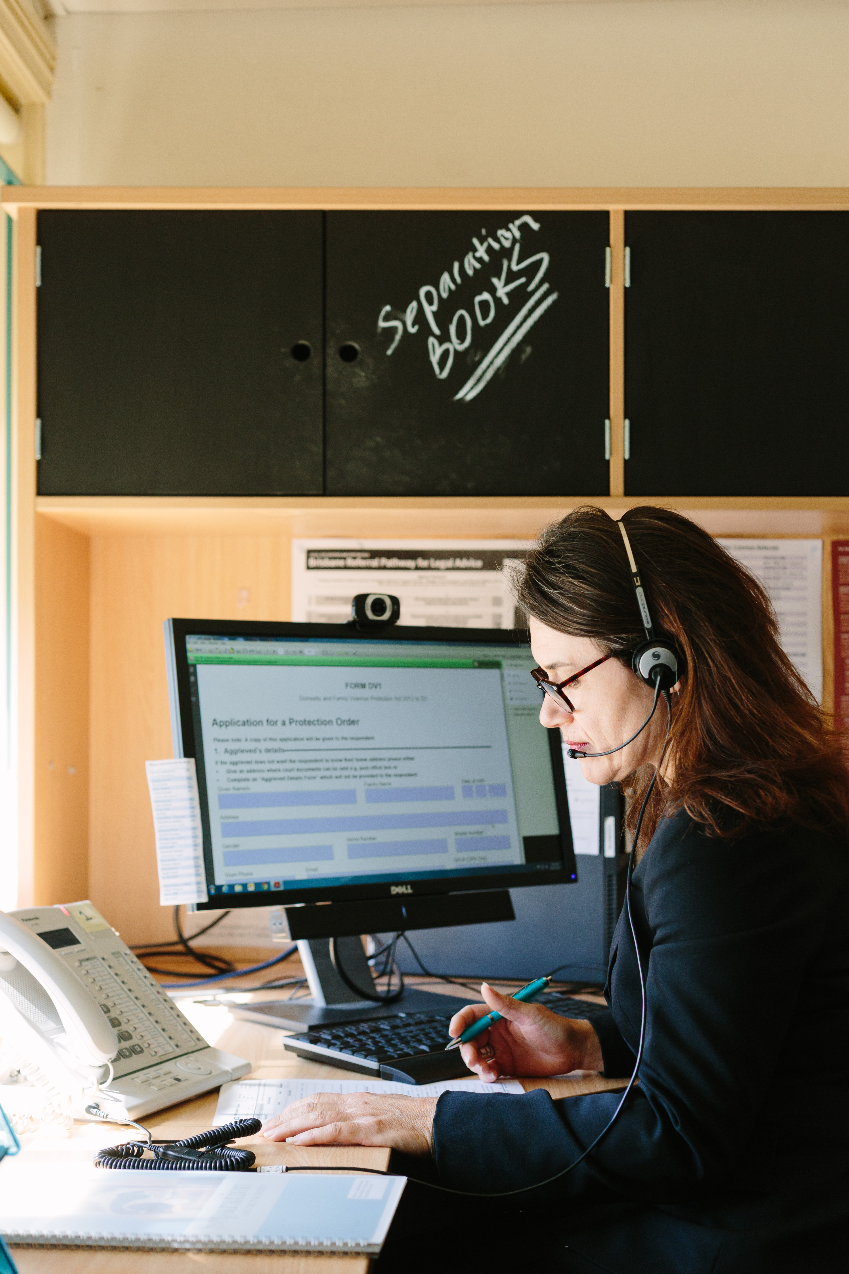
Why start a remote volunteering programme?
Flexible
Expand volunteer pool
Assist more clients
Increase access to legal information and advice by developing IT infrastructure options so women are not disadvantaged by where they live

Slide 3
Potential problems
Quality control
Control of client information
Administrative burden
Service disruption from volunteers cancelling at the last minute
IT issues

Slide 4
Starting small

Slide 5
Setting up appointments
Telephone appointments only
Three monthly roster
Clients given 2 hour time frame in which they will be called
Appointments will be sent to volunteer for conflict checking the day before the appointment
Volunteer sent reminder at the start of the week
Remote appointments are for new clients only
Appointments are filled by the Helpline the day before

Slide 6
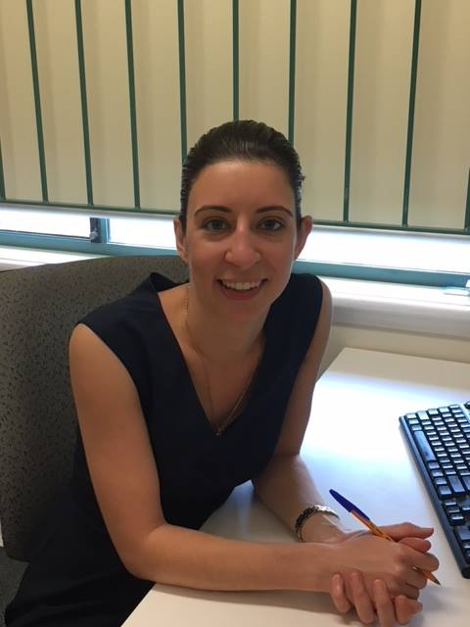
Giving advice
Volunteer emailed electronic intake forms with client details and brief outline of the matter
Advice can be typed directly into the form
Volunteer can either print out the form and sign or insert an electronic signature
Intake is then emailed back to WLS for checking and sign off by principal lawyer
Notes:
Children under 18 cannot get DVOs against their parents or family members, but can be named as protected persons on an another persons DVO.
Parents cannot get DVOs against their children.
Violence in relation to children under 18 is considered to be within the scope of child protection system

Slide 7
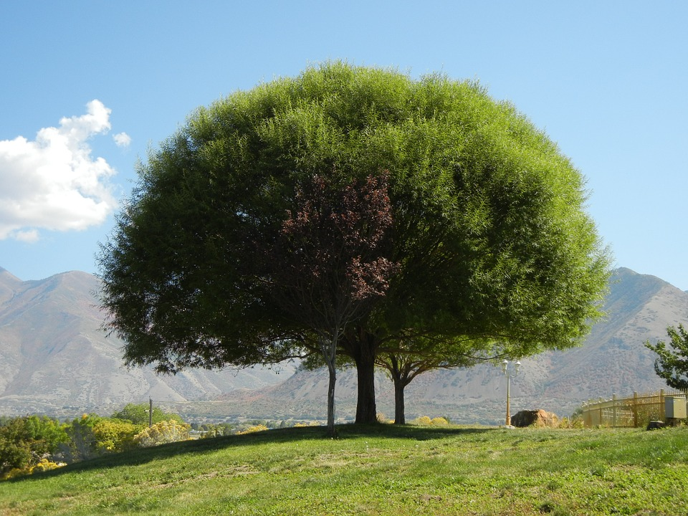
Getting bigger

Slide 8
Developing
Received a one off grant from a benevolent fund to:
Employ additional staff:
2 days/week - Lawyer
1 extra day - volunteer coordinator
Create a Volunteer Platform for all induction and training
Notes:
Children under 18 cannot get DVOs against their parents or family members, but can be named as protected persons on an another persons DVO.
Parents cannot get DVOs against their children.
Violence in relation to children under 18 is considered to be within the scope of child protection system

Slide 9
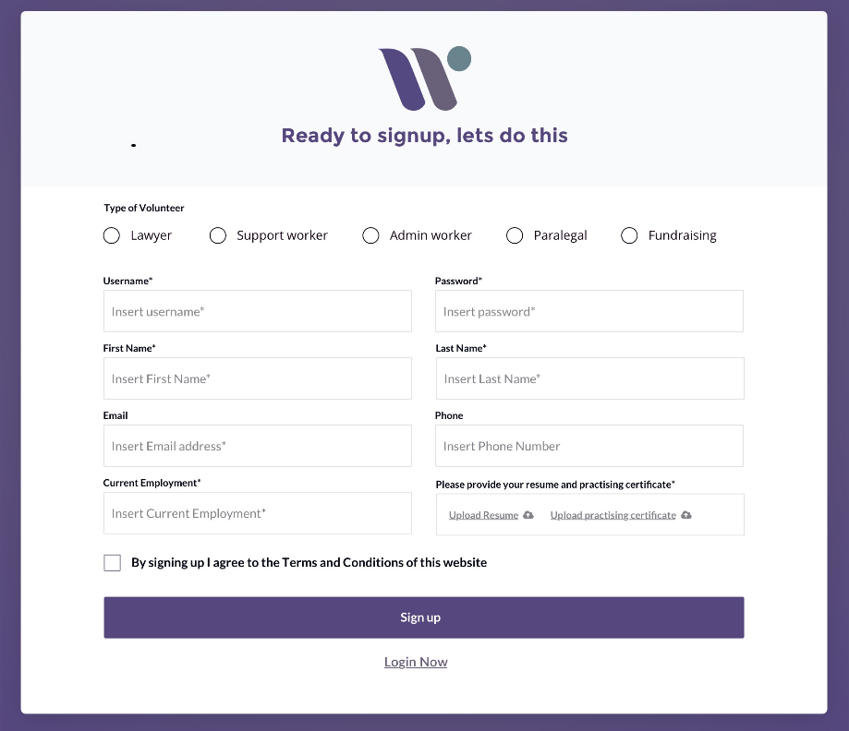
Induction and Training
Volunteer portal linked to WLS website:
Register interest
Upload Resume and Practising Certificate
Once confirmed by WLS staff, volunteer receives personal log in details
Four modules to complete
Notes:
Children under 18 cannot get DVOs against their parents or family members, but can be named as protected persons on an another persons DVO.
Parents cannot get DVOs against their children.
Violence in relation to children under 18 is considered to be within the scope of child protection system

Slide 10
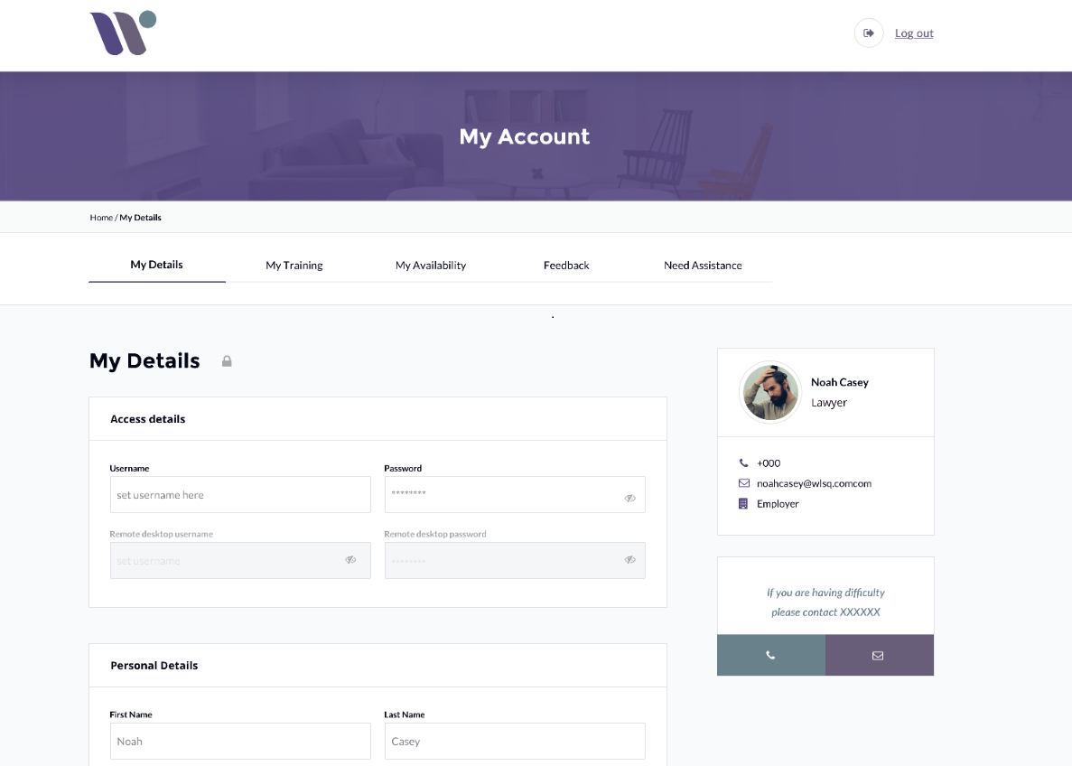
Induction and Training
Personal Info, Training, Calendar, Feedback

Slide 11
Induction and Training
Training material consists of:
Overview of WLS – philosophy and values
Roles of volunteers
Video and interactive powerpoints
Quizzes to complete for each section
Domestic Violence training
Privacy, confidentiality and conflict policies
Precedent emails

Slide 12
Giving advice
Volunteers given log in details for WLS remote desk top.
Access to a separate drive (V drive) and their own subfolder.
In their subfolder will be their appointments.
Advice recorded electronically, signed electronically and saved back into their subfolder.
Supervising solicitor accesses subfolder, signs off, completes any follow up.
Once advices are checked they will be moved into another part of our system waiting for CLASS data entry.
Once entered, the volunteer will not have access to the intake sheet again.
Notes:
Children under 18 cannot get DVOs against their parents or family members, but can be named as protected persons on an another persons DVO.
Parents cannot get DVOs against their children.
Violence in relation to children under 18 is considered to be within the scope of child protection system

Slide 13
Expectations
6 remote volunteers by June 2018
12 remote volunteers by December 2018
3 extra client advices per day – so an extra 390 Women will receive free legal advice by the end of 2018
Notes:
Children under 18 cannot get DVOs against their parents or family members, but can be named as protected persons on an another persons DVO.
Parents cannot get DVOs against their children.
Violence in relation to children under 18 is considered to be within the scope of child protection system

Slide 14
www.wlsq.org.au

