Slide 1
Winning CLC campaigns – Make Renting Fair

Slide 3
Social Change Projects
Communications consultancy working with organisations, campaigns and communities to create change
Expertise in strategy development, campaigns, media, marketing, social media, writing/editing and training
Our goal is to support the people who make our community more just, compassionate and sustainable
Clients include the No to Homophobia Campaign, Federation of Community Legal Centres, East Timor’s Human Rights Ombudsmen, Inner Melbourne Community Legal, Tenants Union of Victoria, Australians for Affordable Housing and the Human Rights Law Centre
www.socialchangeprojects.com.au www.linkedin.com/in/danielscoullar

Slide 5
The problems

Slide 6
The problems
Problem #1
Number of renters increasing fast – 1/3 of all Victorians
People renting for longer and longer periods
Fundamental shift in rental market due to housing affordability crisis means laws are no longer fit-for-purpose
Problem #2
Department-led review of 20-year-old RTA underway
Lack of political leadership despite progressive government
Lack of community, sector and media awareness
Renters with zero political visibility and influence
Property/real estate industry lobbying against change

Slide 7
The plan

Slide 8
Plan on a page
Objectives: (1) Win positive changes to the RTA (2) Defeat negative changes being pushed by industry/department
Theory of change: Make the RTA a political issue for marginal ALP MPs and ministers to prompt attention/intervention
Decision makers: CAV Minister, Department Secretary, Premier’s Office, DPC, Cabinet Ministers
Key influencers: Relevant ministers, marginal ALP MPs, supporter organisations, community members in targeted areas, unions, local government, ALP members, other parties
Tools/Tactics: Build broad coalition, smart lobbying, engage other parties, create public profile and debate, gain media coverage, make cost-effective use of available tools and outside help (on a tight budget)

Slide 9
12 months of Make Renting Fair
Supporter database of over 10,000 Victorians
Over 65 supporter organisations
All MPs contacted multiple times, over 30 meetings
4,500 petition signatures; 3,000 people sent 21,000 emails
Extensive media coverage with strong local focus
2,500 Facebook fans, over 230,000 reached
Development of campaigning capacity for Tenants Victoria plus new media and political relationships
Make Renting Fair NSW plus QLD, WA and others to come
Beginnings of a national movement around renters rights and expanding our understanding of home beyond ownership

Slide 11
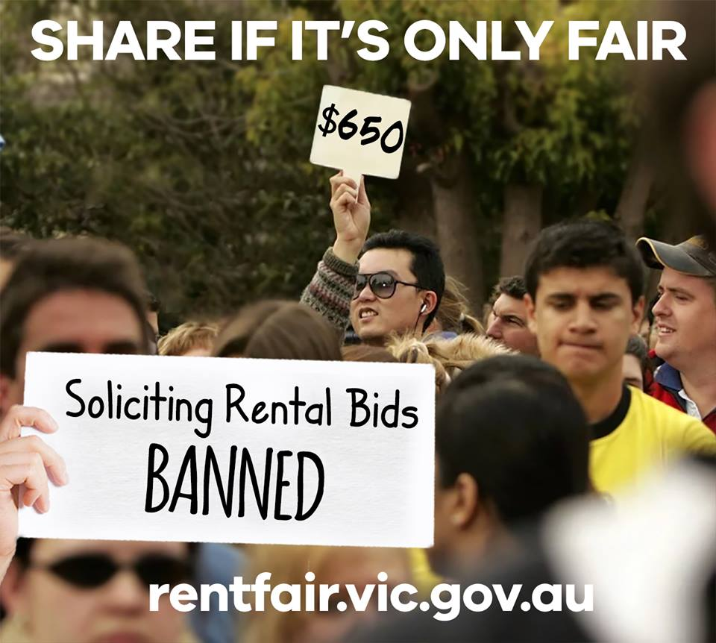
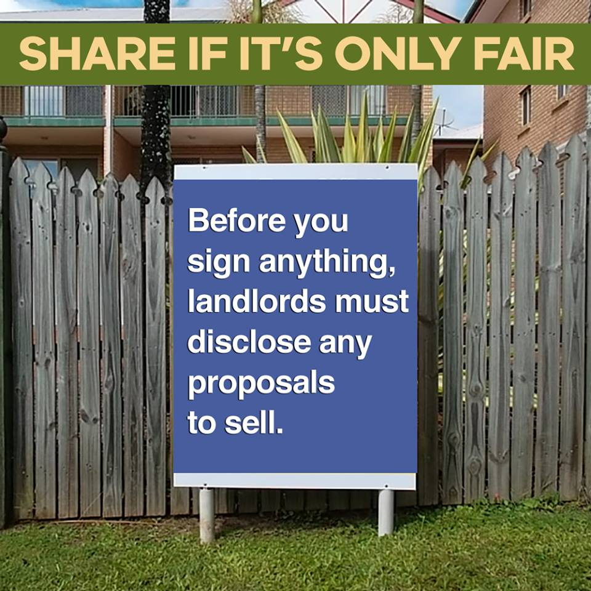

Slide 12
Rent Fair Victoria (AKA the promises)
Landlords must give a reason to end a tenancy
Limit the use of the ‘end of fixed term’ notices to vacate
Stop false, misleading or deceptive representations
New pre-contractual disclosure of plans to sell and asbestos
New long term leases
Create a Vic Commissioner for Residential Tenancies
Introduce a public landlord blacklist
14 day automatic bond repayment
Updated bond cap & up-front rent cap for most properties
Faster repairs reimbursement
Limit rent increases to once each year
Crack down on rental bidding
Pets (more) welcome in rental properties
Tenants can make minor modifications without approval
Disclaimer: We are yet to see the details or the legislation

Slide 13
Summing up

Slide 14
Summing up
Strategy. Plan. Follow-through. Evaluation.
Test theory of change and stakeholder assumptions
Strong stories win campaigns – framing and messaging
Data and evidence play are also important
Good design gives you credibility at first sight
The ‘Wizard of Oz’ effect - create a broad coalition
Use the tools that are available: Supporter database, campaign website, politician contact functionality, email/SMS, social media, traditional media, networks
Share what you know and learn what you don’t
Budget/Resourcing plan – You don’t need big bucks to win
It’s not rocket science…

Slide 15
Daniel Scoullar 0402 596 297 / daniel@socialchangeprojects.com.au

