Slide 1
Update from NACLC NACLC’s priorities for 2018
Community Legal Centres
Queensland Conference
Thursday 8 March 2018

Slide 3
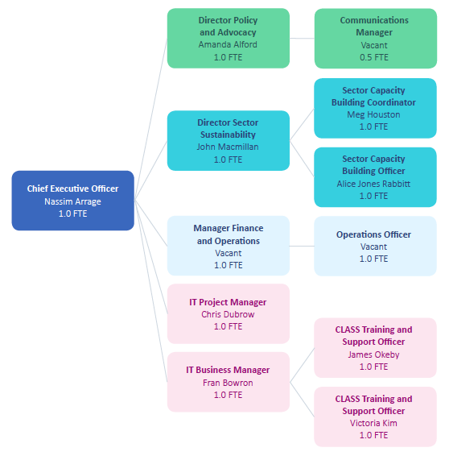
t

Slide 4
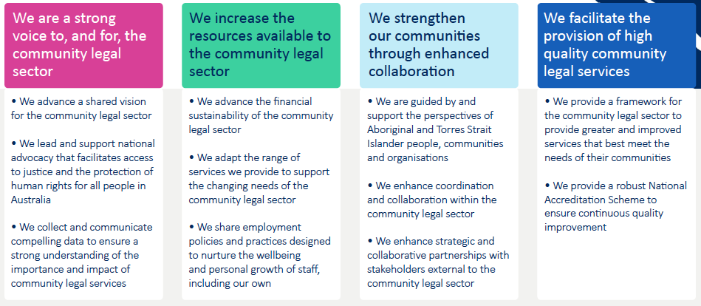
Ensuring a Thriving
Community Legal Sector
Strategic Plan 2018 – 2021

Slide 5
v
We are a strong voice to, and for,
the community legal sector
National Position Papers - including
Good practice collaborative service planning
Work and identity of legal assistance providers
Hallmarks of good CLC service delivery
Sector funding and administration
NPA & ILAP Reviews
Funding Equal Justice follow through
Communication and media strategy
Data and research
Consolidation of data and information
National Data Standards
National Research Agenda

Slide 6
v
We increase the resources available
to the community legal sector
Existing products and services
Insurances
Online legal resources
Standards and performance pathways (SPP)
New products and services
New insurance offerings
Linked to policy and strategy development
CLASS
National position paper on Sector Workforce Strategy

Slide 7
v
We strengthen our communities
through enhanced collaboration
Improved collaboration on, and governance of, NACLC work priorities
Ongoing collaboration across legal assistance sector
National Aboriginal and Torres Strait Islander Legal Services (NATSILS)
National Family Violence Prevention Legal Services (NFVPLS)
National Legal Aid
Collaboration with other NGOs and peaks
Implement NACLC Reconciliation Action Plan
National CLCs Conference

Slide 8
v
We facilitate the provision of high
quality community legal services
Strategy for the long-term sustainability and growth of the sector
Implement the vision set though position papers
Implement Phase 2 of the National Accreditation Scheme (NAS)
Develop NAS Phase 3

Slide 9
Any questions?
Feel free to email me:
john_macmillan@clc.net.au

