Slide 1

Lessons from the Royal Commission
8 March 2018
Warren Strange
Executive Officer
knowmore legal service

Slide 2
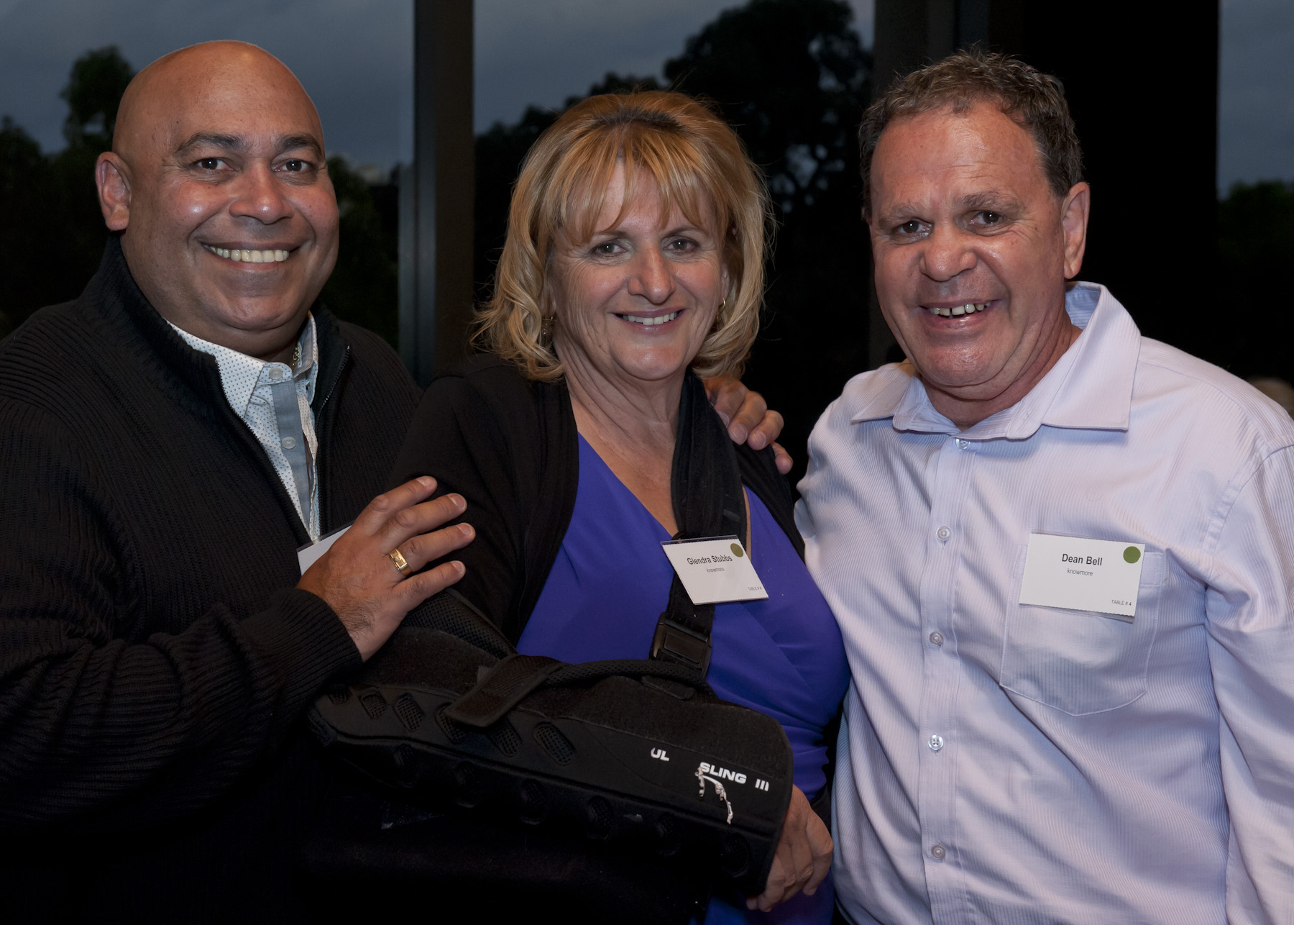
Acknowledgement of Country
knowmore and NACLC acknowledge the Traditional Owners of the lands across Australian upon which we work, and particularly today the Turrbal and Jagera peoples.
We pay our respects to Elders past and present, and also to future generations.
knowmore’s Aboriginal and Torres Strait Islander Engagement Team

Slide 3
Outline
A quick update on knowmore’s work relating to the Royal Commission
The Commission’s recommendations about service delivery to survivors and lessons for our sector
Some observations around ‘trauma-informed practice’
Implementation of the Commonwealth Redress Scheme and knowmore’s future role
Reflections/questions

Slide 4
knowmore – who are we?
An independent, national legal service providing free legal assistance for people engaging or considering engaging with the Royal Commission
Funded by the Commonwealth, through the AGD
Established by, and operates as a program of, NACLC (the National Association of Community Legal Centres)
Offices in Sydney, Melbourne & Brisbane
We are a multidisciplinary, trauma-informed service consisting of lawyers, social workers/counsellors, Aboriginal and Torres Strait Islander engagement advisors and administrative staff.
Notes:
knowmore is independent of the Royal Commission, independent of government and independent of any church or other institutional body. We are a program of the National Association of Community Legal Centres.
Funding is separate and additional - funding did not come out of the existing CLC funding pool.
First office opened in Sydney – Royal Commission is based in Sydney. Other offices now established in Brisbane, Melbourne, and Perth.
Specifically funded to travel to other parts of Australia to provide advice and information. Work with the ATSILS and FVPLS

Slide 5
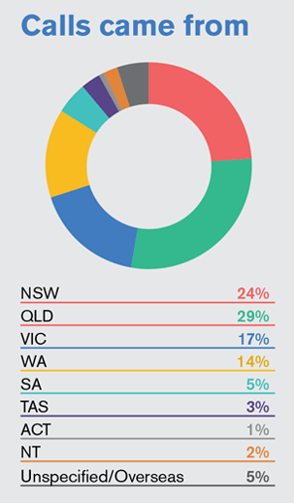
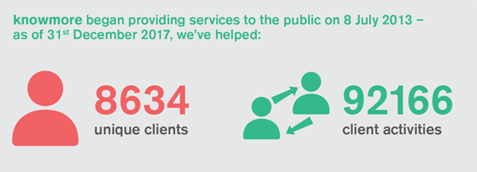
knowmore – to 31 December 2017

Slide 6
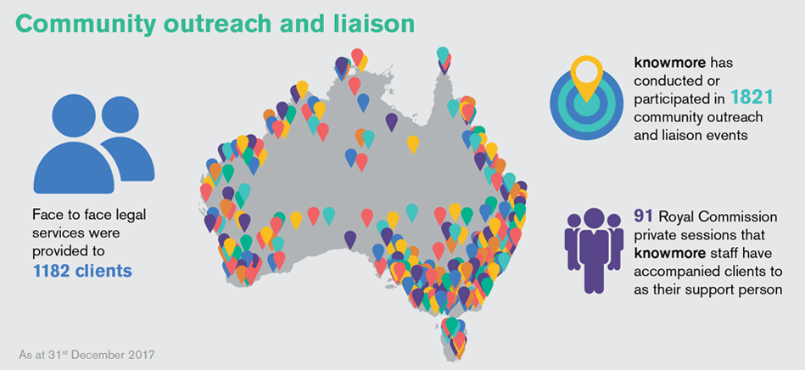
knowmore – to 31 December 2017

Slide 7
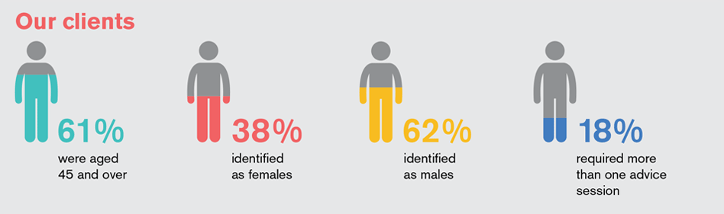
knowmore – to 31 December 2017

Slide 8
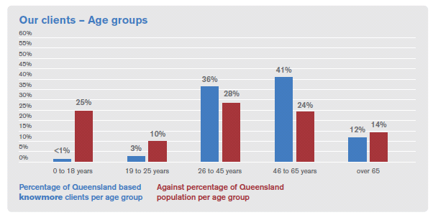
knowmore’s QLD clients
– to 31 December 2017

Slide 9
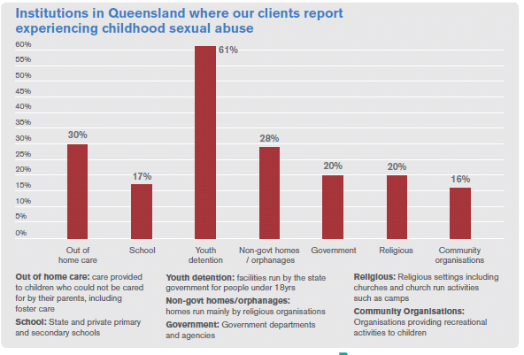
knowmore’s QLD clients
– to 31 December 2017

Slide 10
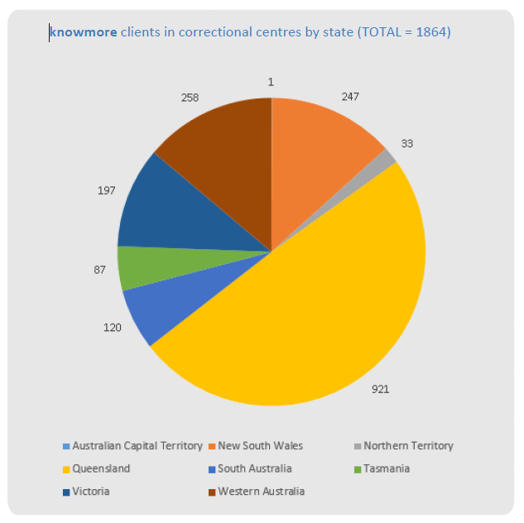
knowmore clients in Correctional Centres
– to 31 October 2017

Slide 11
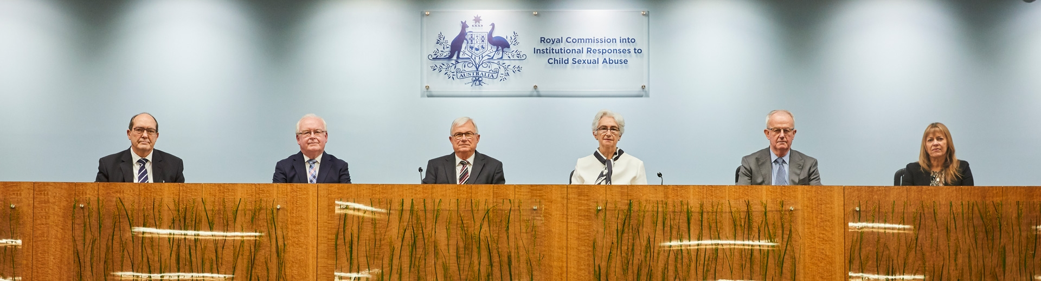

Slide 12
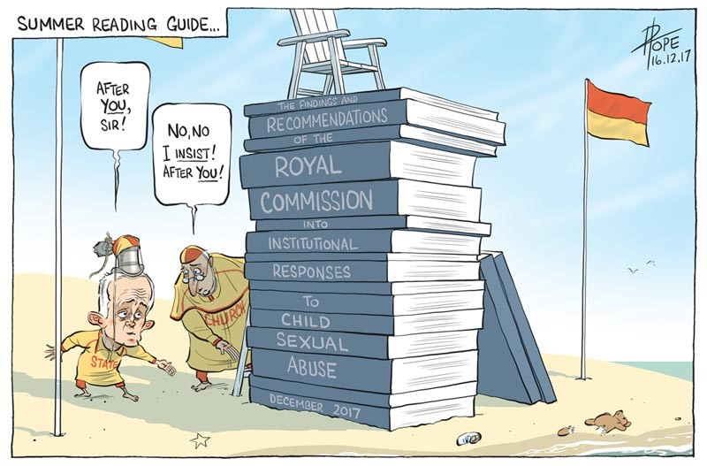

Slide 13
The Royal Commission’s Final
Report
Over 8,000 private sessions. 57 public hearings. 59 research reports.
Final report – 17 volumes. Earlier reports
Volume 9 – Advocacy, support and therapeutic treatment services for clients
Recommendation 9.4 – establish a legal advice service for survivors of institutional child sexual abuse
Services should be trauma-informed, collaborative, available, acceptable and high quality

Slide 14
The Royal Commission’s Final
Report – service principles
Collaborative – clients with complex and multiple needs. Integrated services and coordinated transitions
Available – ongoing support; choice; flexible and adaptive services
Accessible – safety. Non-discriminatory. Physically and geographically accessible. Affordable
Acceptable – recognition of diversity. Culturally appropriate. Sensitive to CALD backgrounds, disability, gender and sexuality

Slide 15
The Royal Commission’s Final
Report – service principles
High quality – informed by evidence; well-trained and supported; outcome focused; accountable; subject to ongoing evaluation
Trauma-informed – a framework for service provision where the practices, policies and culture of the organization and its staff are responsive to the impacts of trauma on service users

Slide 16
Trauma-informed practice
A couple of thoughts …
External professional supervision
Mentoring & wellbeing

Slide 17
Redress
Implementation – the Commonwealth Redress Scheme
4 November 2016 announcement:
The Turnbull Government is today announcing a Commonwealth Redress Scheme for survivors of institutional child sexual abuse and is inviting states, territories and other non–government institutions to join in the Commonwealth scheme to deliver redress to the survivors of these wrongs
Institutional Redress hemes

Slide 18
The CRS
Key features
The CRS will offer:
  A direct personal response
  Access to counselling and community based supports
  Monetary payment of up to $150,000 (exempt from current or future government payments and income tests)
To be established in 2018. Phone line and referral services in March (?), scheme to open on 1 July 2018
Institutional Redress hemes

Slide 19
The CRS
Key features (cont.)
No forced participation of non-Commonwealth institutions – an ‘opt-in’ approach, including for State Governments and NGOs
‘Funder of last resort’ approach if institution no longer exists (but only if Government has ‘shared responsibility’)
A life of 10 years, subject to review
Those who received past redress not excluded, but past relevant payments taken into account
Institutional Redress hemes

Slide 20
The CRS
Ongoing funding of legal and support services
Announcement on 19 February 2018 of funding for legal support services to help survivors access redress under the CRS
Funding to be provided to knowmore of $37.9 million over three years
Additional funding for redress support services - $52.1 million
Institutional Redress hemes

Slide 21
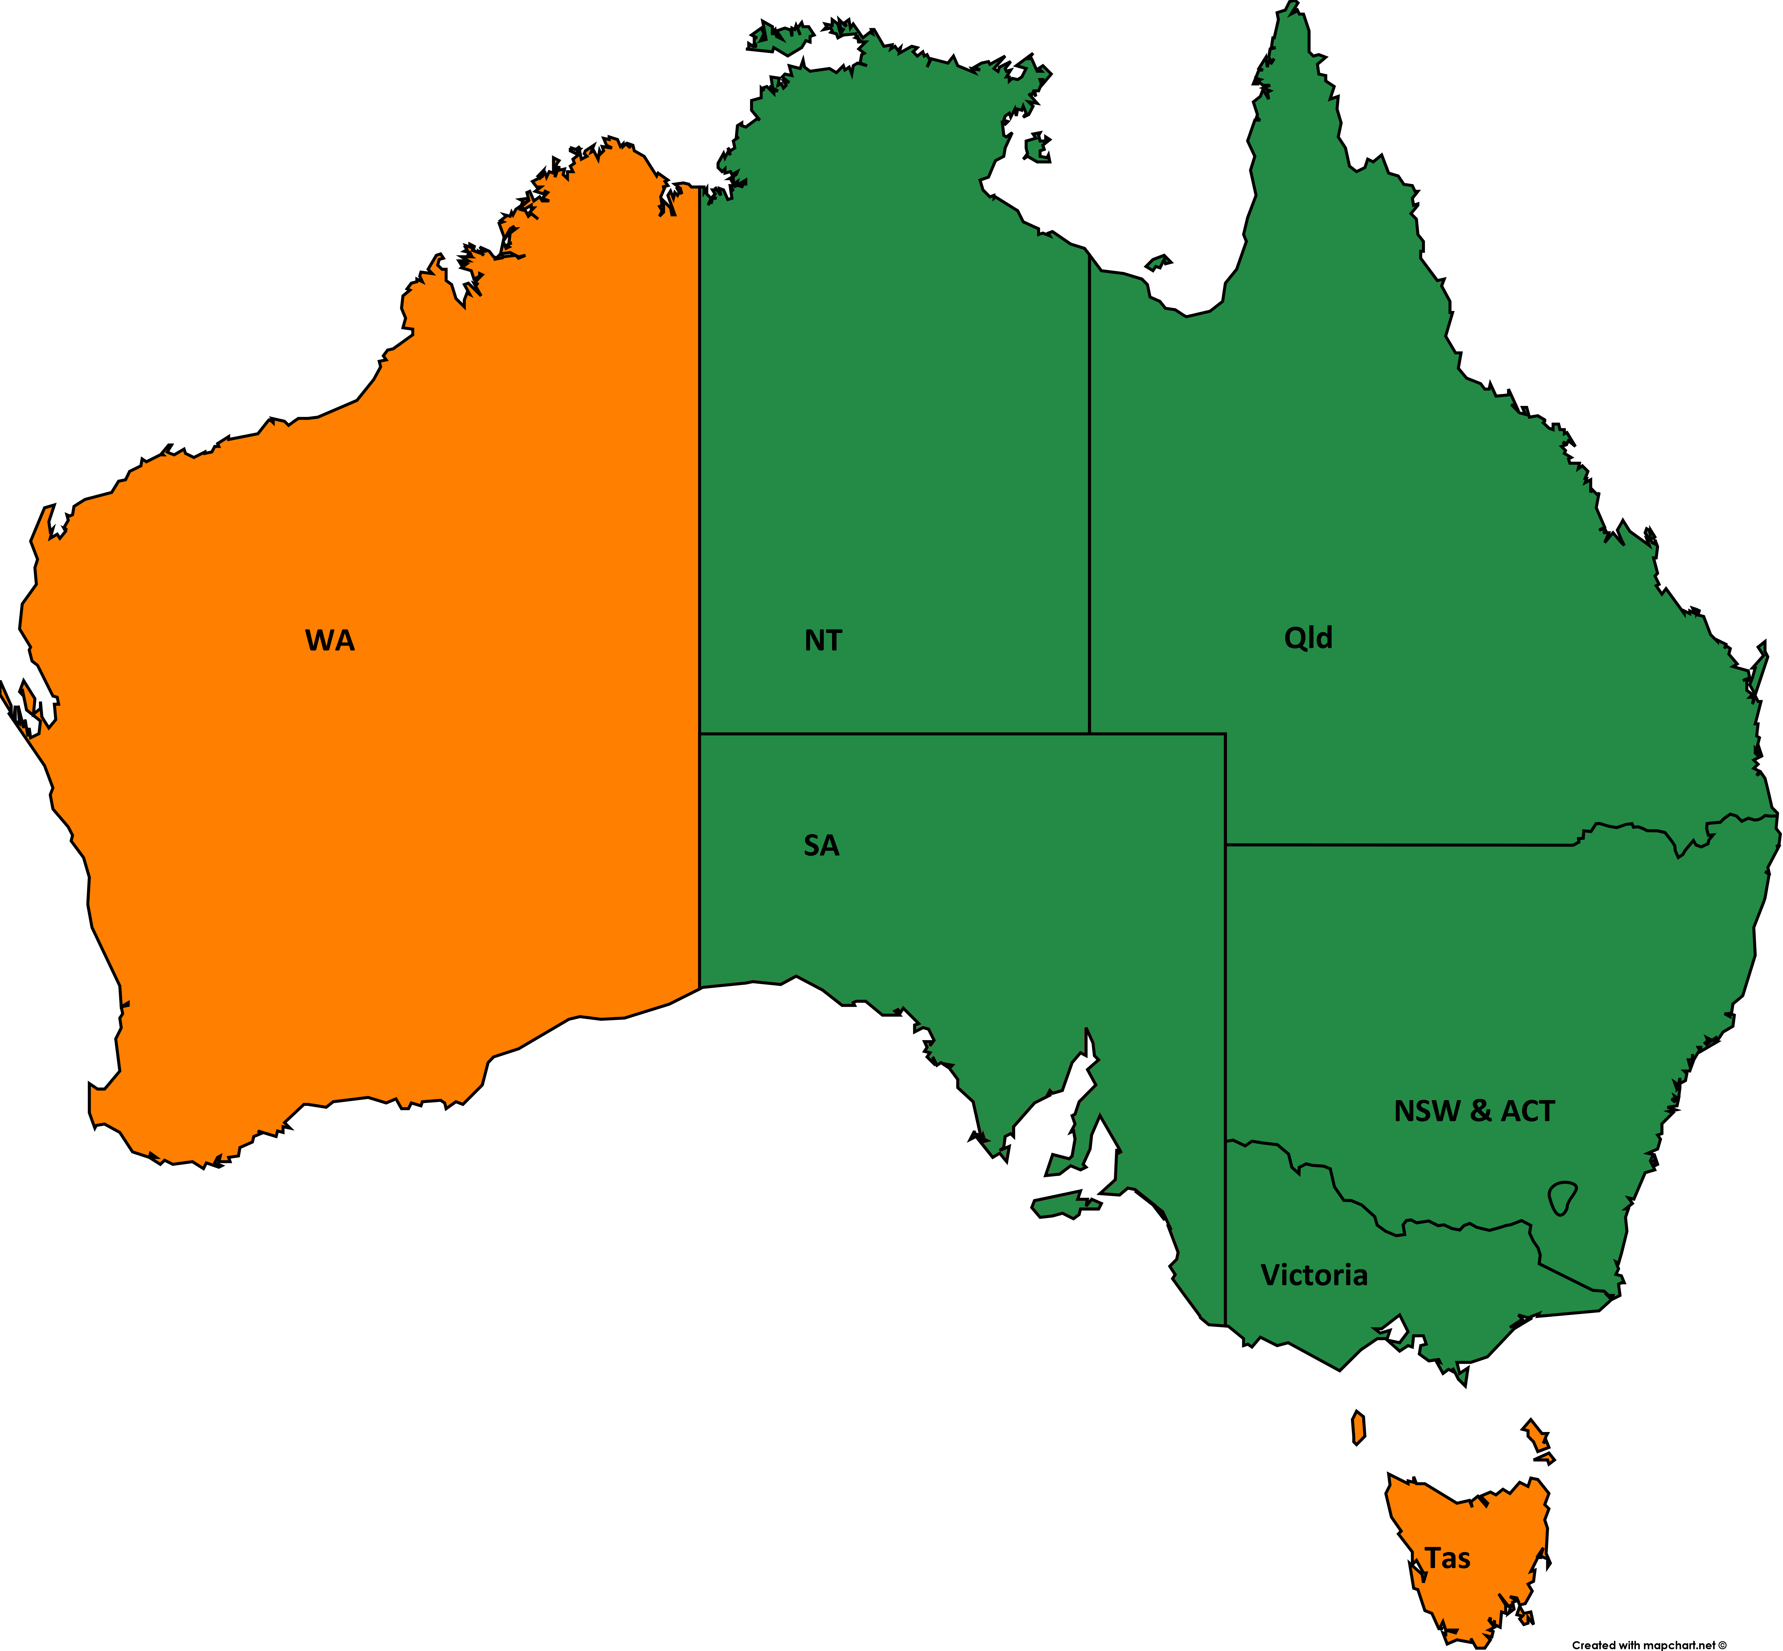
The CRS
The key issue – who is ‘opting-in’ ?
Institutional Redress hemes

Slide 22
The CRS
Commonwealth Redress Scheme for Institutional Child Sexual Abuse Bill 2017
Issues include:
  Eligibility – excluding some survivors due to criminal convictions / non-citizens
  Institutional responsibility
  $150,000 cap (cf recommended $200,000)
  Acceptance period for offers
  Funder of last resort
  Payment nominees
Institutional Redress hemes

Slide 23
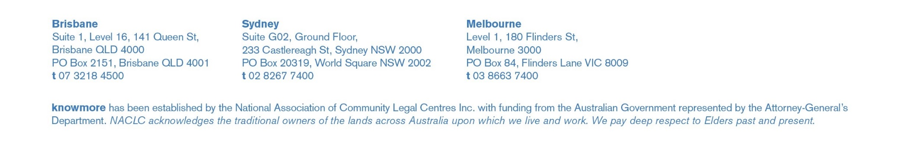
Contact Us
Warren Strange
Executive Officer
07 3218 4500
warren.strange@knowmore.org.au
FREECALL 1800 605 762
Web: www.knowmore.org.au
Prue Gregory
Principal Lawyer
02 8267 7400
prue.gregory@knowmore.org.au
Catherine Browning
A/Managing Lawyer, Brisbane
07 3218 4500
catherine.browning@knowmore.org.au

Slide 24
Questions ?

