Slide 1
Pe Cha Ku Cha Chit Chat
Seeing
Hearing
Doing
CLE
Community
participation
Disrupt
Notes:
Hi friends please join me on a journey
of RAILS legal education with refugee communities
Participation is a key
to good CLE
so lets start this chit chat with a cha cha
Softly and Not too fast
CHA CHA CHIT CHAT

Slide 2
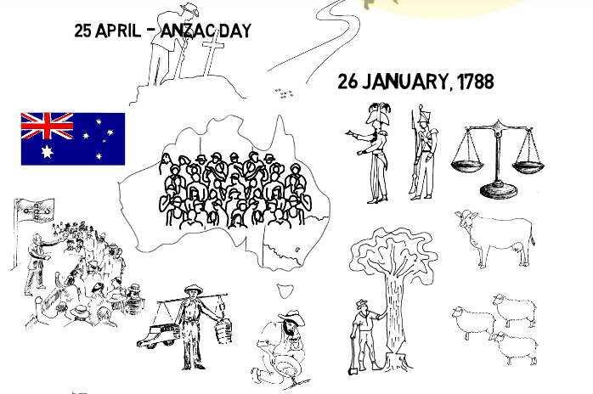
acknowledge
First
Law
Sacred
Notes:
AS Cha Cha Chit Chat beat happening
First law of this land is Aboriginal law
For 50,000 years maybe many many more.
Then Captain Cook took a look at this sacred South land.
Put a flag in the sand at Possession Island.
A few years later a fleet of tall ships
sailed into Sydney with a mob of convicts .
Britain planted their law, Arthur Phillip Governor.
Created a colony. Ignored the tribal law.

Slide 3
embed
key
messages
where
to get help
1300 651 188
Call Legal Aid before it’s too late
Confidential free advice
Lawyer’s there are very nice
Notes:
Now lets do some clapping on the 2 and 4
2 3 4 1 2 3 4
1300 651 188 call Legal Aid before it’s too late
Confidential free advice
Lawyer’s there are very nice
I have students come up years later saying – hey you’re the 1300 651 Legal Aid rap

Slide 4
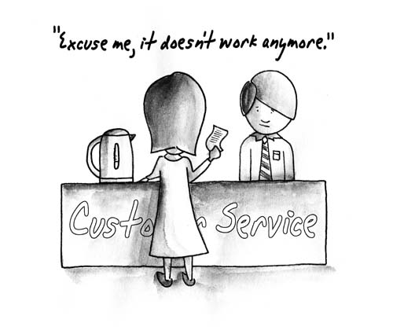
Learning to say it
Rhythm
And
Poetry
Notes:
Rhyming and repeating helps us remember
And gives confidence to say it
- And it’s fun Wanna join me?
Good day, how’s it going? I bought this from your store
Here’s the receipt, there’s a problem, it’s not working anymore
So to be fair you must repair, replace it or refund
That’s consumer law. It covers everyone
For many groups CLE is firstly about getting legal help
And learning to express your legal rights

Slide 5
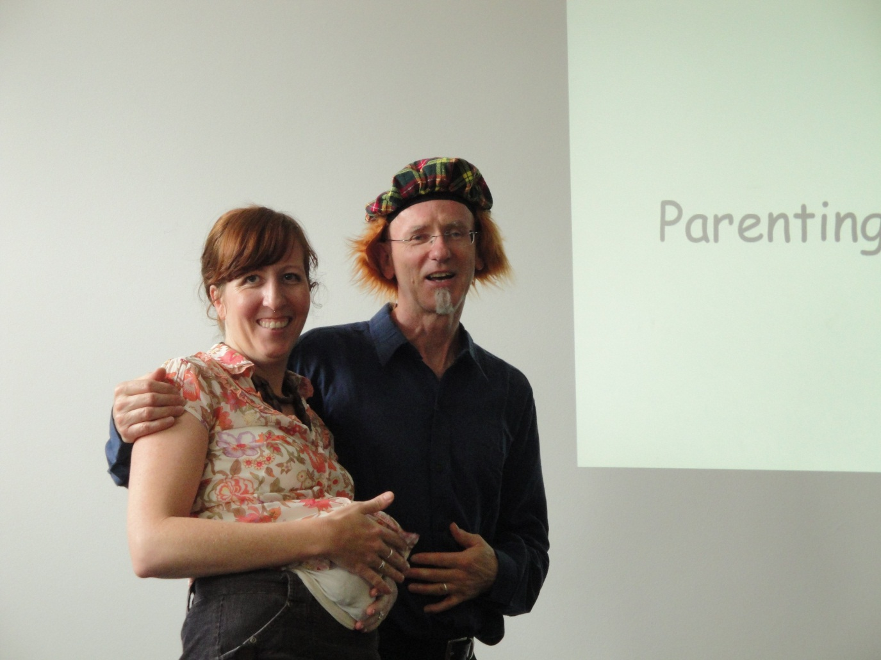
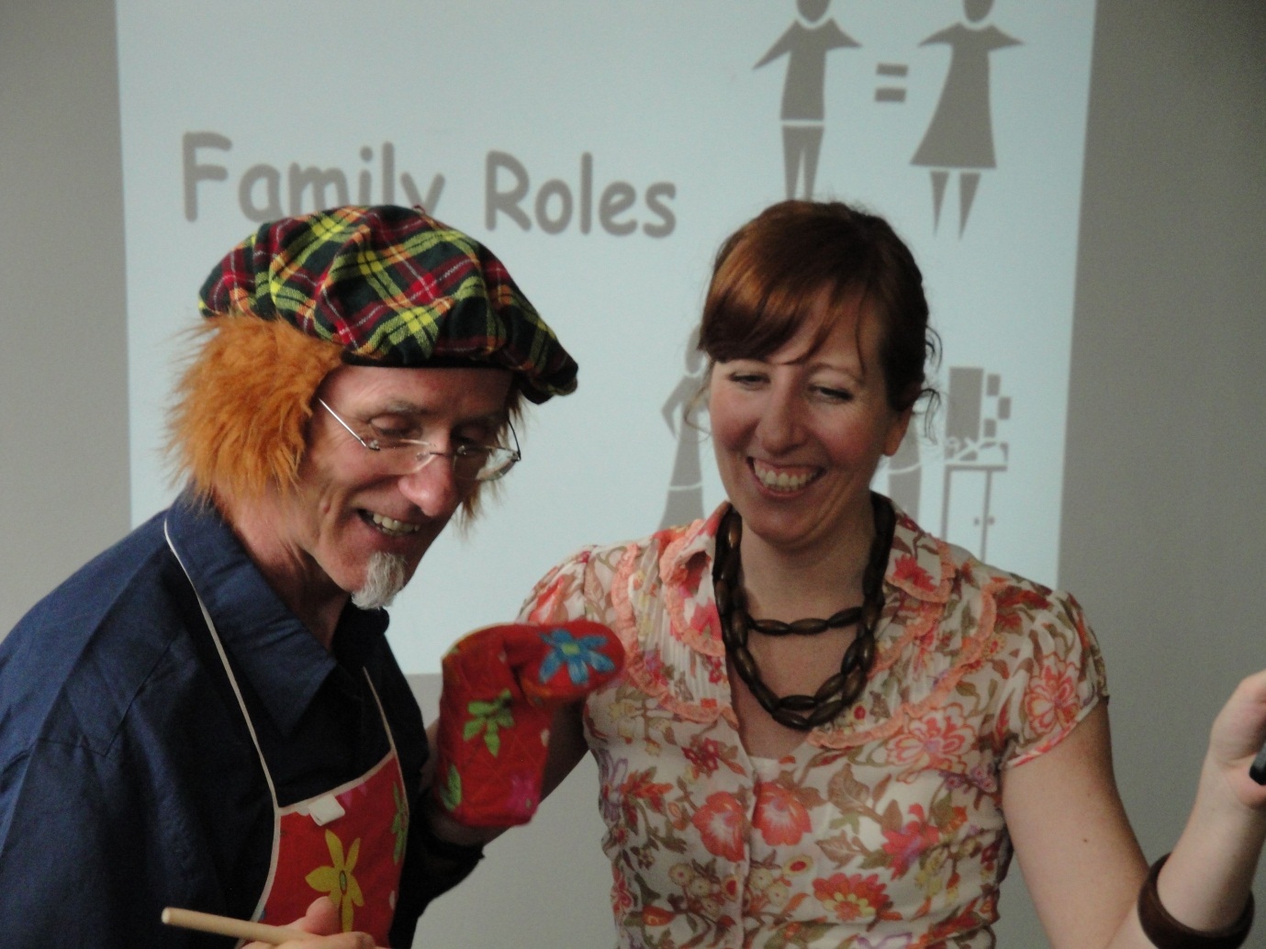
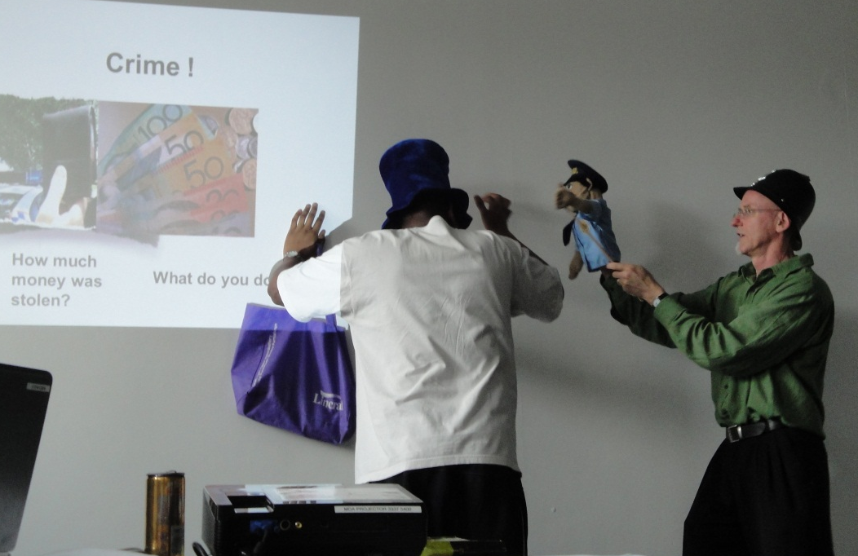
Notes:
Key concerns for new communities are:
- needing to learn English
- and where culture clashes around family and law
We found a good way to dialogue about sensitive info
Is to use story and drama
Serious stuff is dealt with
But in a fun way
and it’s memorable
.
Evaluations 6 months on –
showed these types of workshops and their key messages
were the ones most remembered

Slide 6
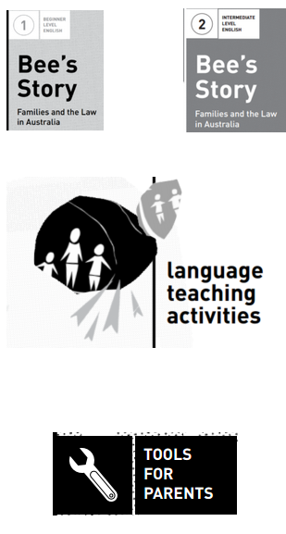
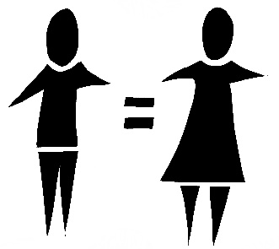
Go with
the community
Collaborate
Notes:
We go where the communities are at -
So we collaborated with TAFE and ESL classes
to develop ‘Family Peace’
a language learning resource about family law
with stories and activities in different levels of English
Used characters and images that were generic
This was 2010
before the excellent ‘What’s the law’ kit Legal Aid did for new arrivals
Family Peace is still used today

Slide 7
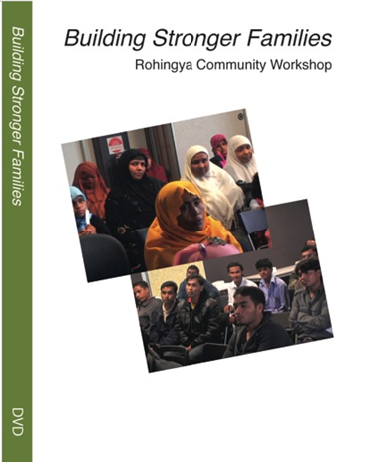
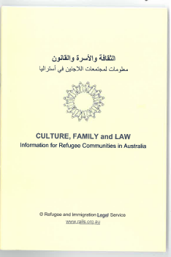
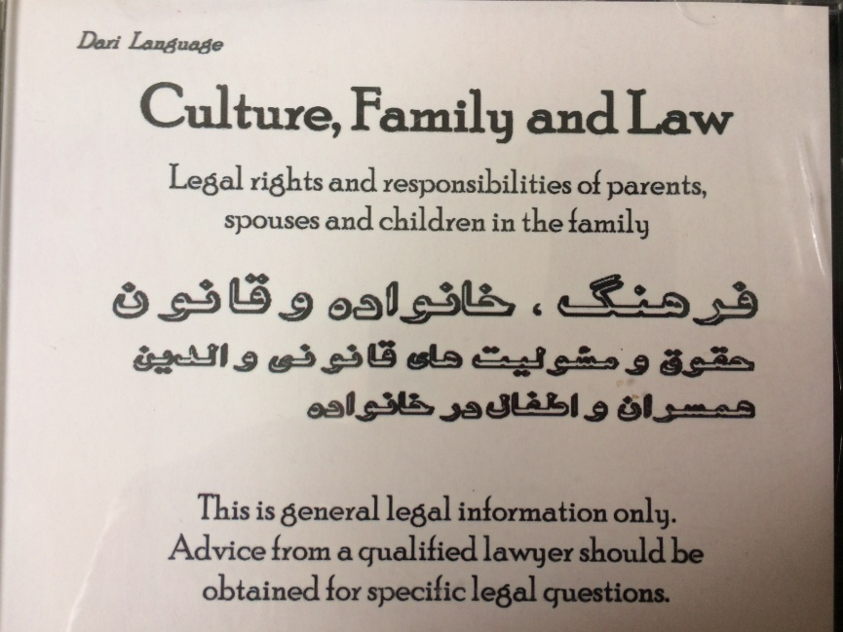
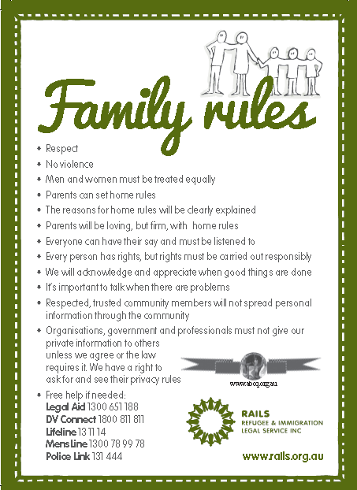
Respect Culture
Notes:
Working on communities key expressed needs
we developed more resources in their languages and English
booklets, CD’s, videos, fridge magnets
We went deeper and explored cultural differences
While being firm on the reasons behind human rights
For example, the Building Stronger families video came from workshops
with the entire Brisbane Rohingya community
And a respected Islamic scholar
We learnt to badge things positively - Frame It as Stronger Families rather than DV
.

Slide 8
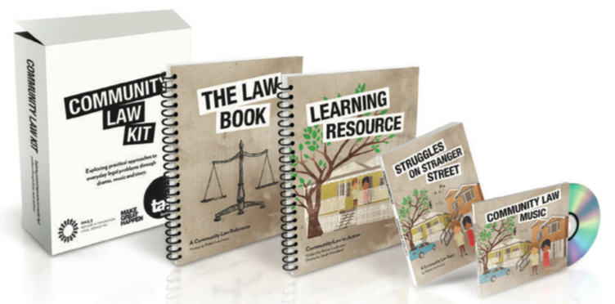
consumer,
rent,
credit, debt, neighbour disputes,
cars,
admin review, bullying, discrimination harassment
police
courts
Notes:
Then we deepened our collaboration with TAFE
And in partnership with Griffith School of Applied Theatre
we developed a story and drama based resource
Exploring all everyday legal problems -
We learn through drama and dialogue
what to do, say and write
to assert rights, prevent problems and get help when needed.
Information is made generic enough to be longer lasting and to apply nationally.
We planned to mentor TAFE teachers in drama techniques.
But there was no funding
TAFE still selling it.

Slide 9
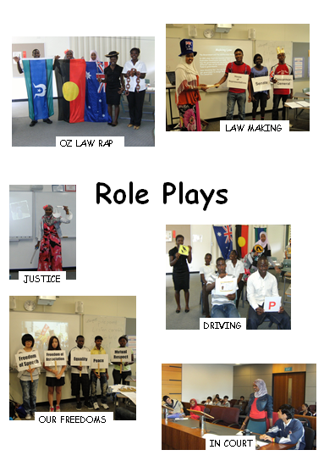
Notes:
We’ve worked intensively with youth -
started at Milpera, an intensive language transition school – 10 years ago
For new arrivals going into secondary school
and worked at other ESL schools
We started with spending more time on legal system principles
but feedback was to make it more practical, so we reshaped the program
We used role play and began to develop jingles for legal messages

Slide 10
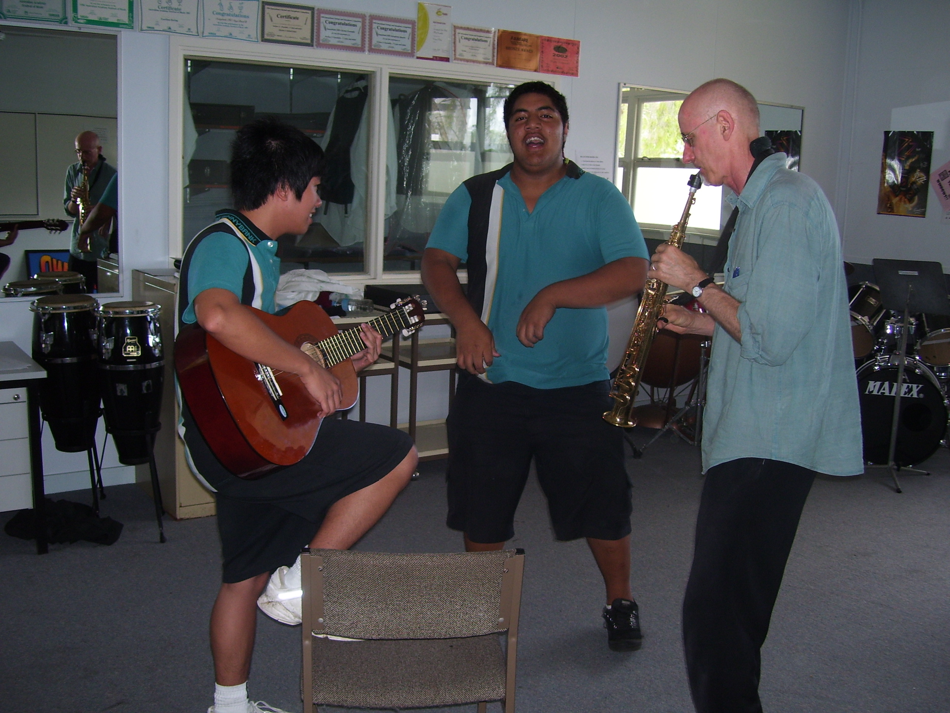
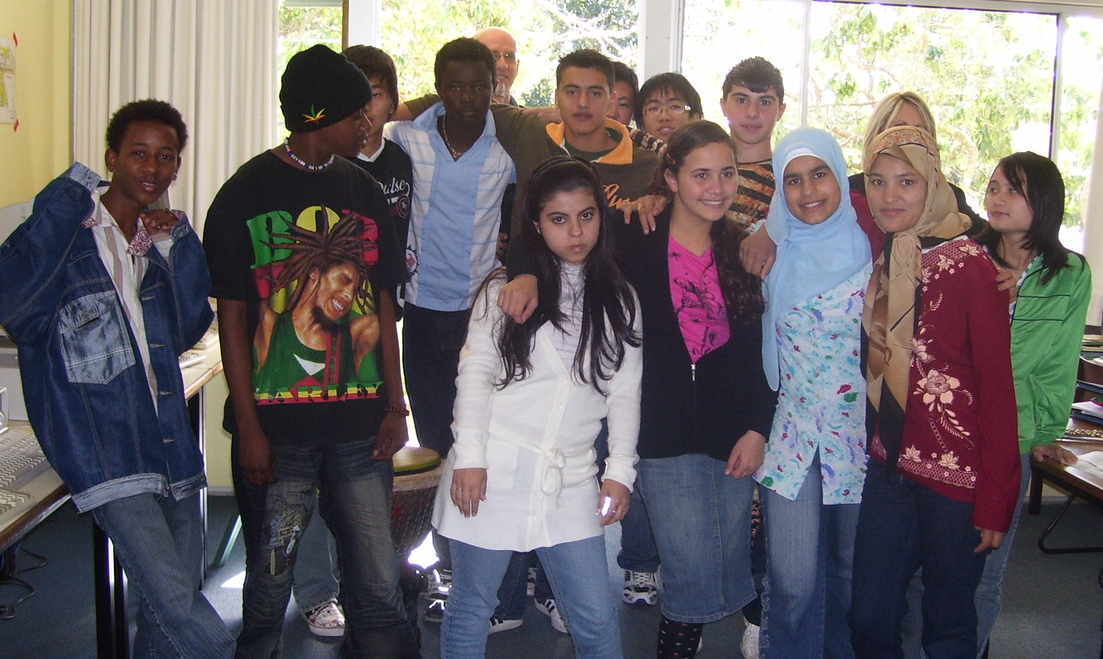
Notes:
With Milpera and other ESL schools in Bribane we developed Beat the rap - a DVD
of 3 songs a 15 minute music video about rules, relationships.
and rights and responsibilities with police and courts
There’s no dialogue in the movie – the images show the messages - like a mime almost.
The songs are background, but have key messages too
That video still has students glued to a story of romance, jealousy and conflict
and a court drama
“Peace Keeper Fighting Violence and Beat the Rap
.

Slide 11
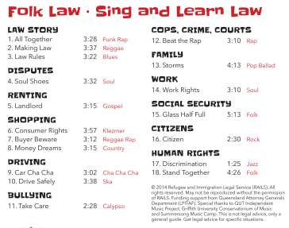
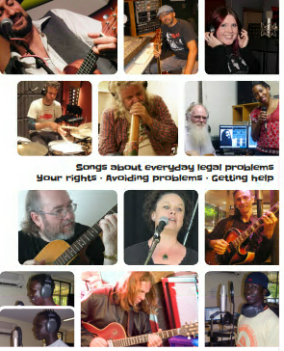
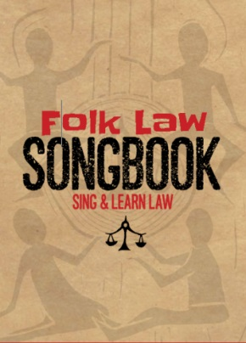
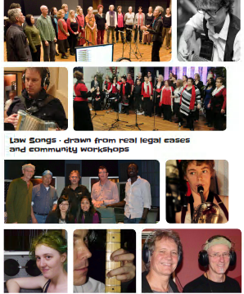
’
Notes:
Folk Law CD helps us sing, and learn about everyday legal problem
Folk Law – was huge collaboration -
18 original songs – in a range of popular music styles.
Plus a Songbook with music charts and info on how to play ukulele
The songs are catchy and easy to play
Music is at the heart of culture. It passes on stories,
it promotes language learning, memory and self-expression.
Music nourishes the soul. It allows us to share, and helps us unite.
------

Slide 12
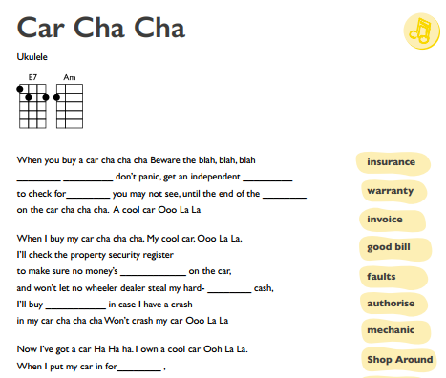
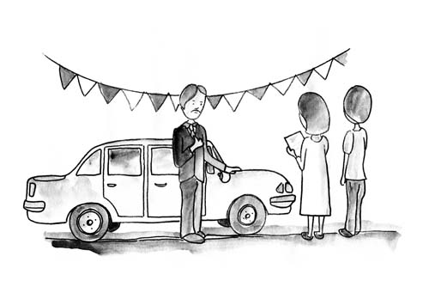
Singing
Writing
Notes:
(GET UKE)
students sing along and learn language
In keeping with Pecha Kucha Cha Cha
– lets to a bit of Car Cha Cha

Slide 13
Haiku
575 syllables
Learn it
in your
body
Discrimination
Ignorance and prejudice
1 2 3 4 5
Notes:
further in keeping with Japanese theme
Lets learn a Haiku ( poem of 5 7 5 syllables)

Slide 14
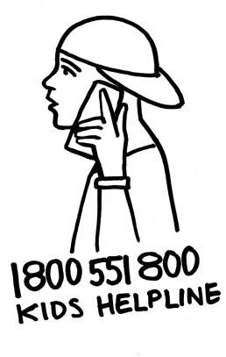
BEAT BOXING
Sup Sup? Check
Sup tin up? Check
No problem too big No Problem too small
Got worries? Give Kids Help Line a call
if you're under 25 eighteen hundred fifty five eighteen hundred . Uhh
is the number to dial to get support for a while1800 55 1800
Notes:
And our Jingle raps with young people got more complex
Try it out - - RED is the emphasis
Added beat boxing

Slide 15
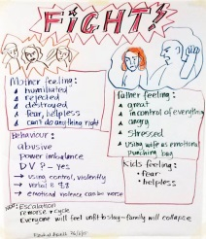
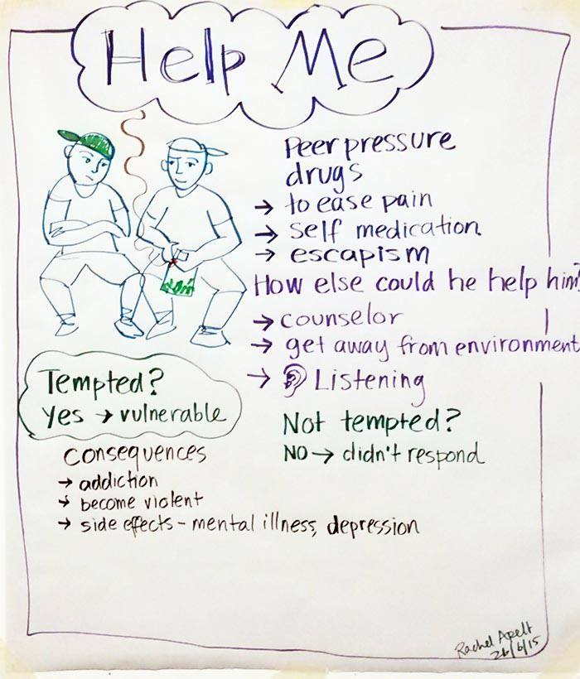
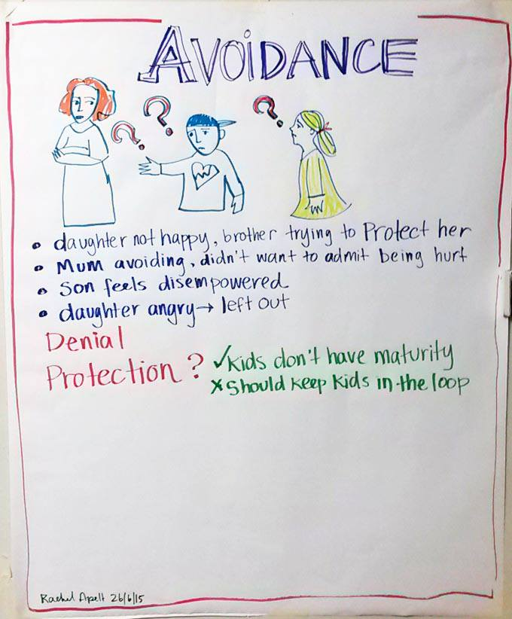
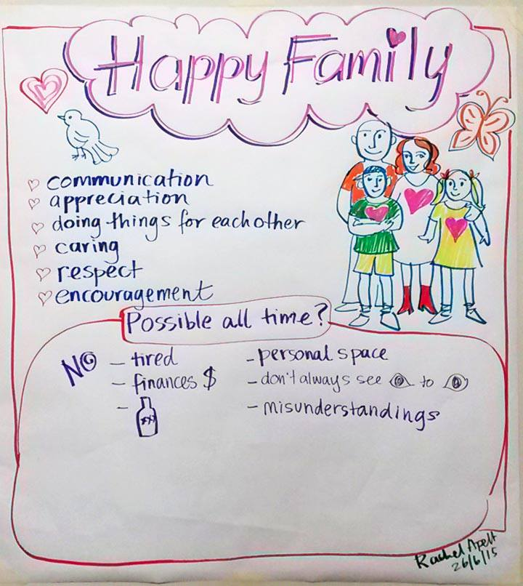
Notes:
Two years ago we produced ‘Help Me’
a forum theatre piece in collaboration with QACC and many services
Where audience have a facilitated dialogue In-between each scene
about what is happening
and then they question the actors in character (Mum, Dad , 2 kids) in a Hot Seat
The audience then reshape and role play the scenes (in a ‘Community ripple’)
as to what they would do to practically deal with the many complexities of DV

Slide 16
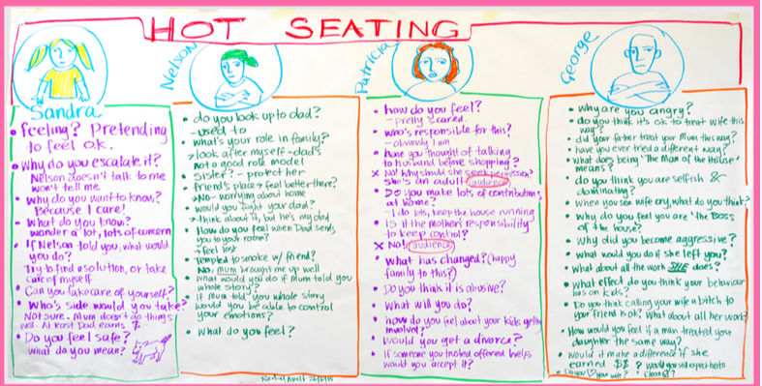
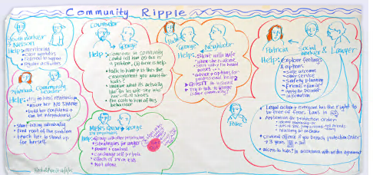
Notes:
-----------
Worked with Graphic recorder
We did three great shows– 2 years ago – and still remembered by community
We also did Help lIne raps in Swahili, Arabic and Dinka
Was funded by LAQ and DSS – Funding stopped for live shows
But there’s a video and facilitator’s dialogue guide on RAILS website
It’s a great process.
I know there’s good stuff other CLE groups have done around this.
Community Leaders have started a DV project and we may be linking in with this …

Slide 17
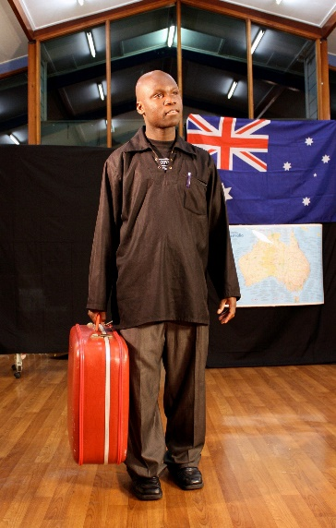
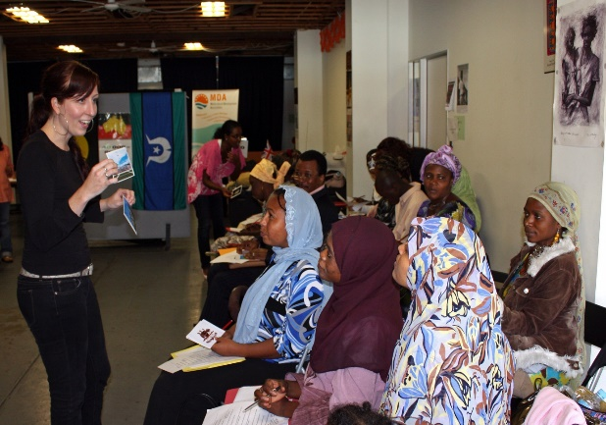
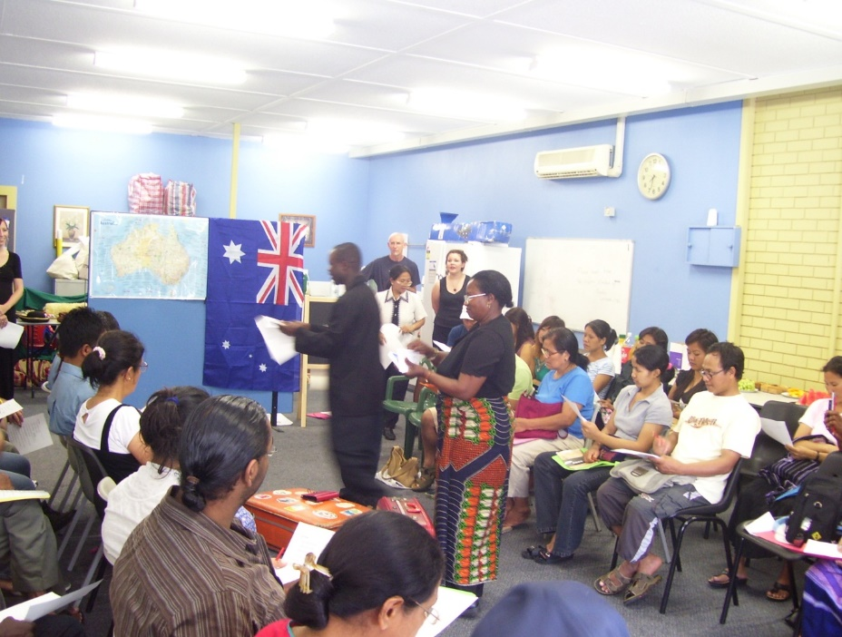
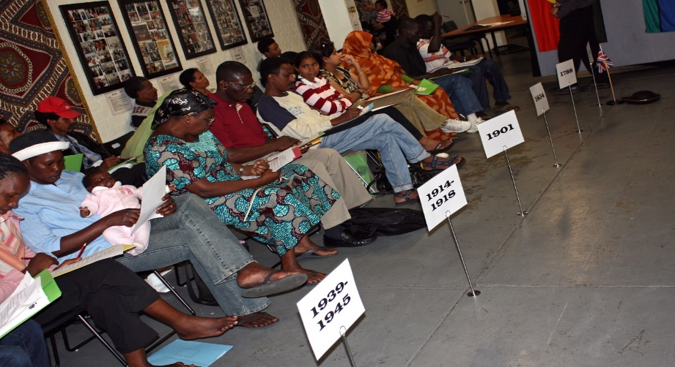
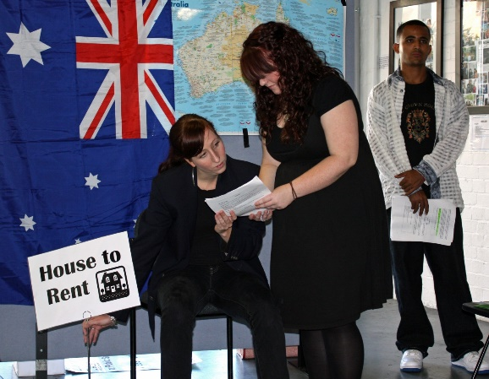
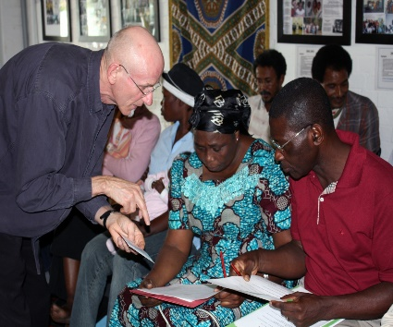
Notes:
We’ve done other theatre – Around the Citizenship test
We did a video as a resource
but the citizenship test kept changing
and it’s still changing
In this project we’ve partnered with Reconciliation Queensland
Aim is to raise awareness of new citizens and connection to first nations peoples
This is vexed project as we now have controversial extreme vetting for some citizenship applicants

Slide 18
Haiku
Respect whatever
your sex, colour, culture, creed
You can complain to
the Human Rights Commission
Human Rights for all
embed
in your
bod
1 2 3 4 5

Slide 19
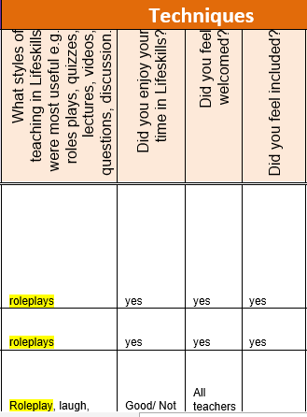
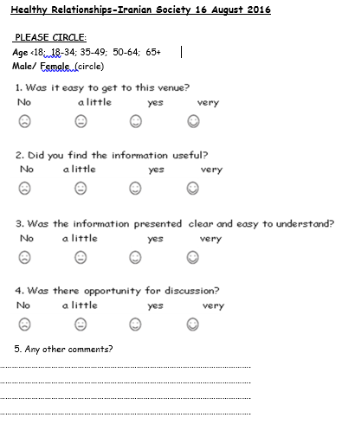
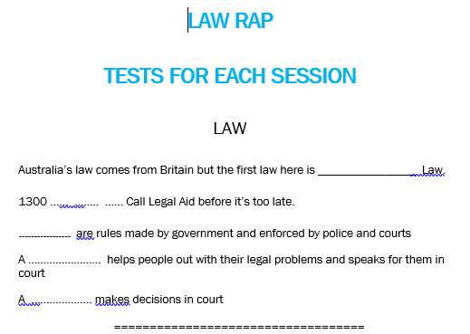
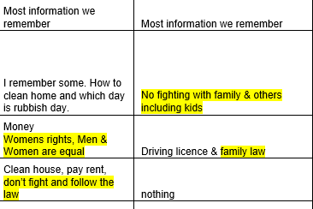
What did we learn?
In our heads, hearts, hands
Notes:
Evaluations … - It’s hard to evaluate preventative legal education
With interpreted and low level English workshops we
we have smiley faces and comments at end of workshops
Settlement agencies have done some follow ups 6 month after workshops
But that’s done not often
For school ed do surveys at start and end of each term
And Test exams for students
Feedback from community workers and teachers is valuable
And anecdotes from the community

Slide 20
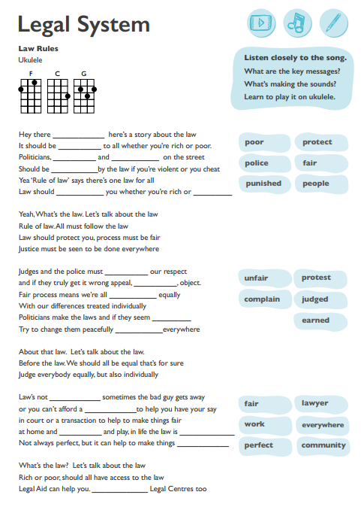
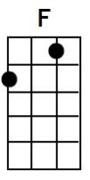
What’s the law?
Let’s talk about the law
Rich or poor, should all have access to the law
Legal Aid can help you. ___________ Legal Centres too
20
Notes:
Thanks for participating
You do great work as legal educators – and all power to you
C F G F G

