Slide 1


Slide 2
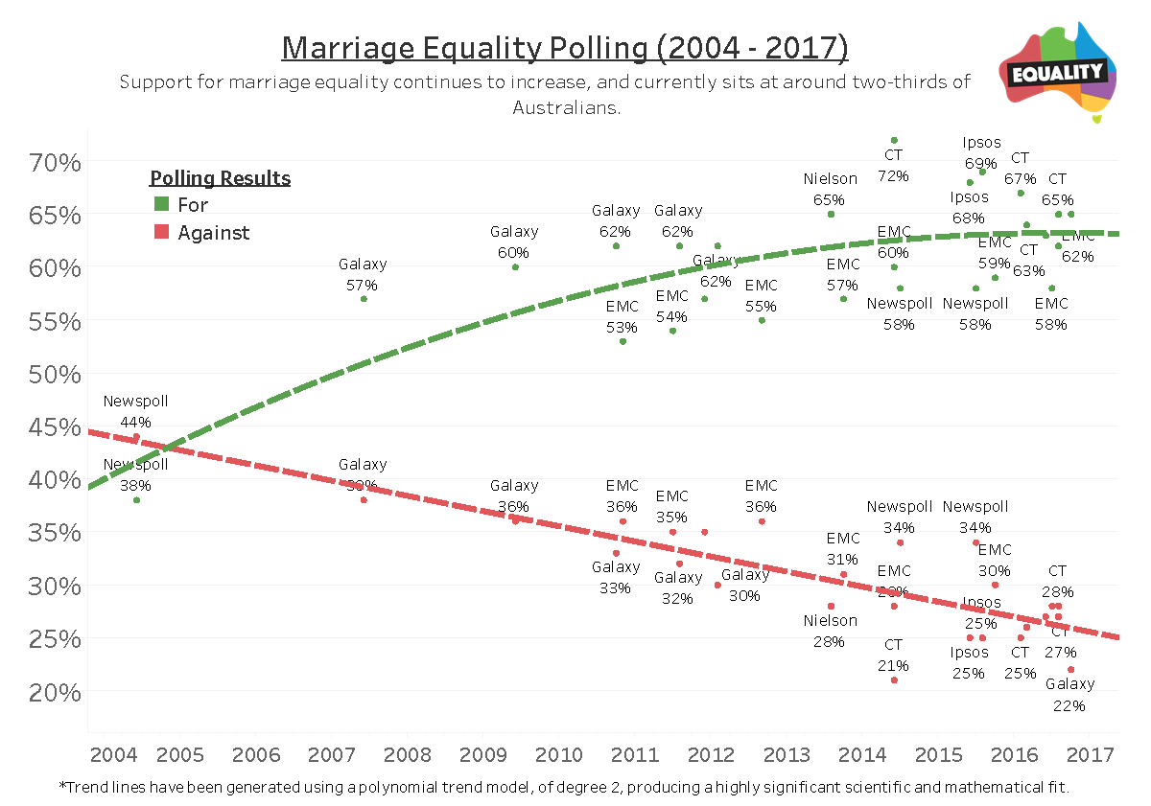

Slide 3


Slide 4
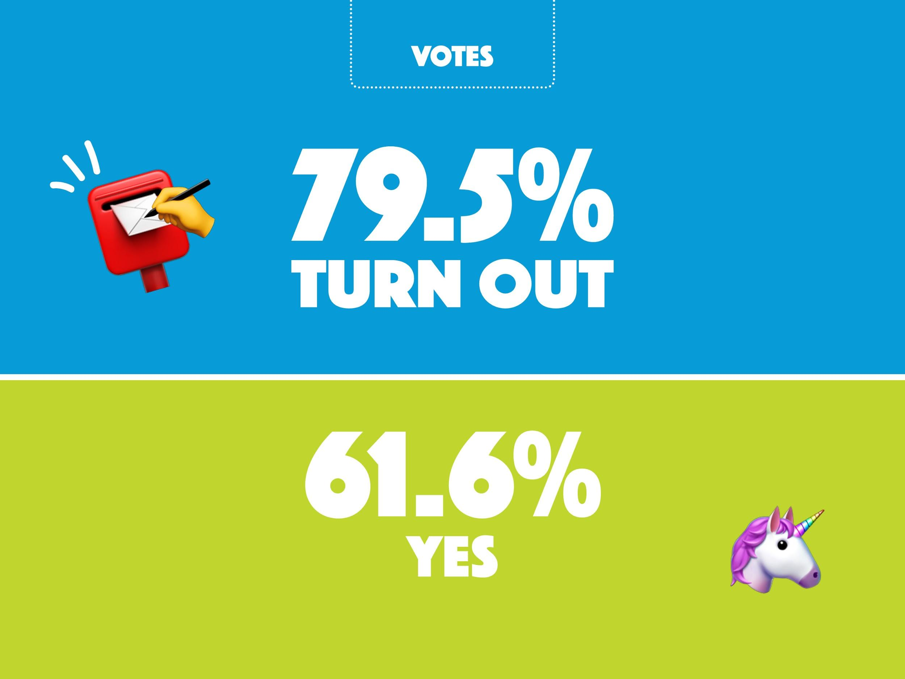

Slide 5
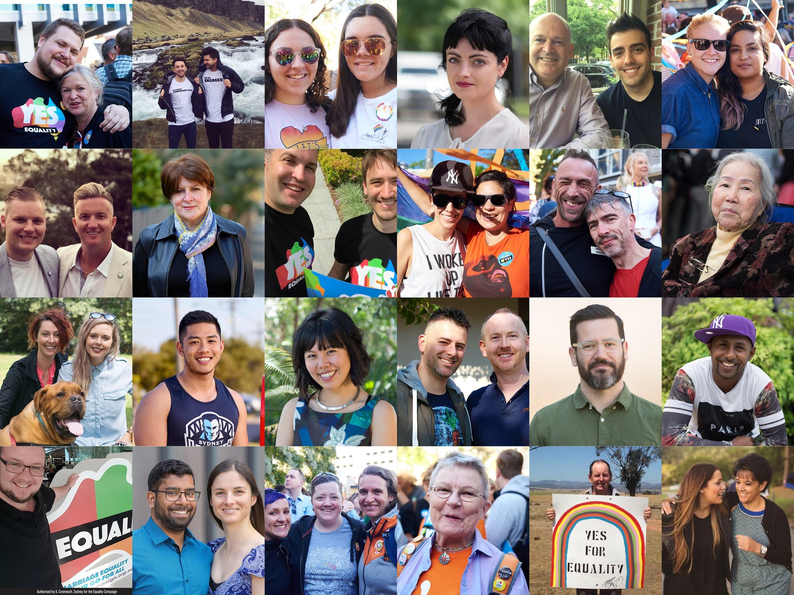

Slide 6
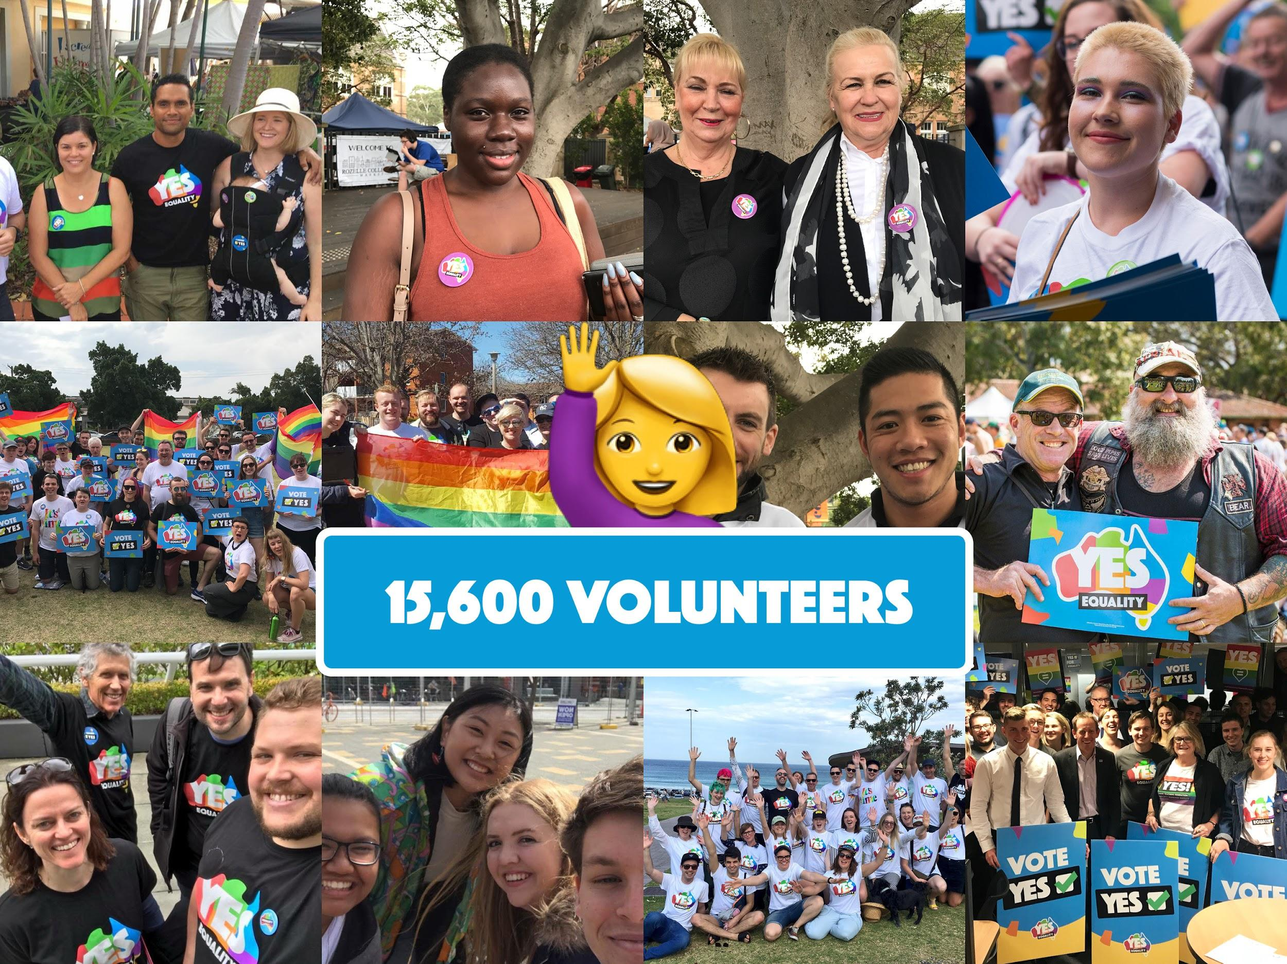

Slide 7
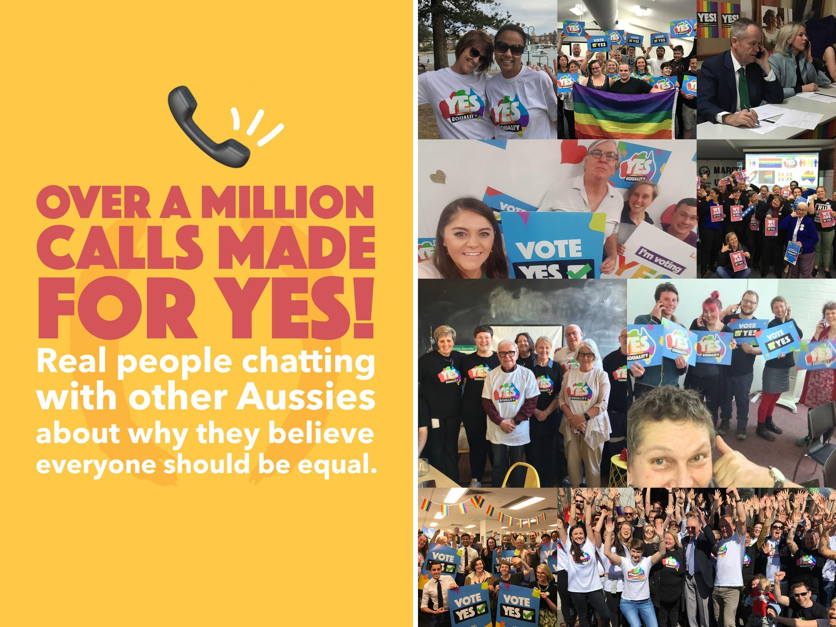

Slide 8


Slide 9
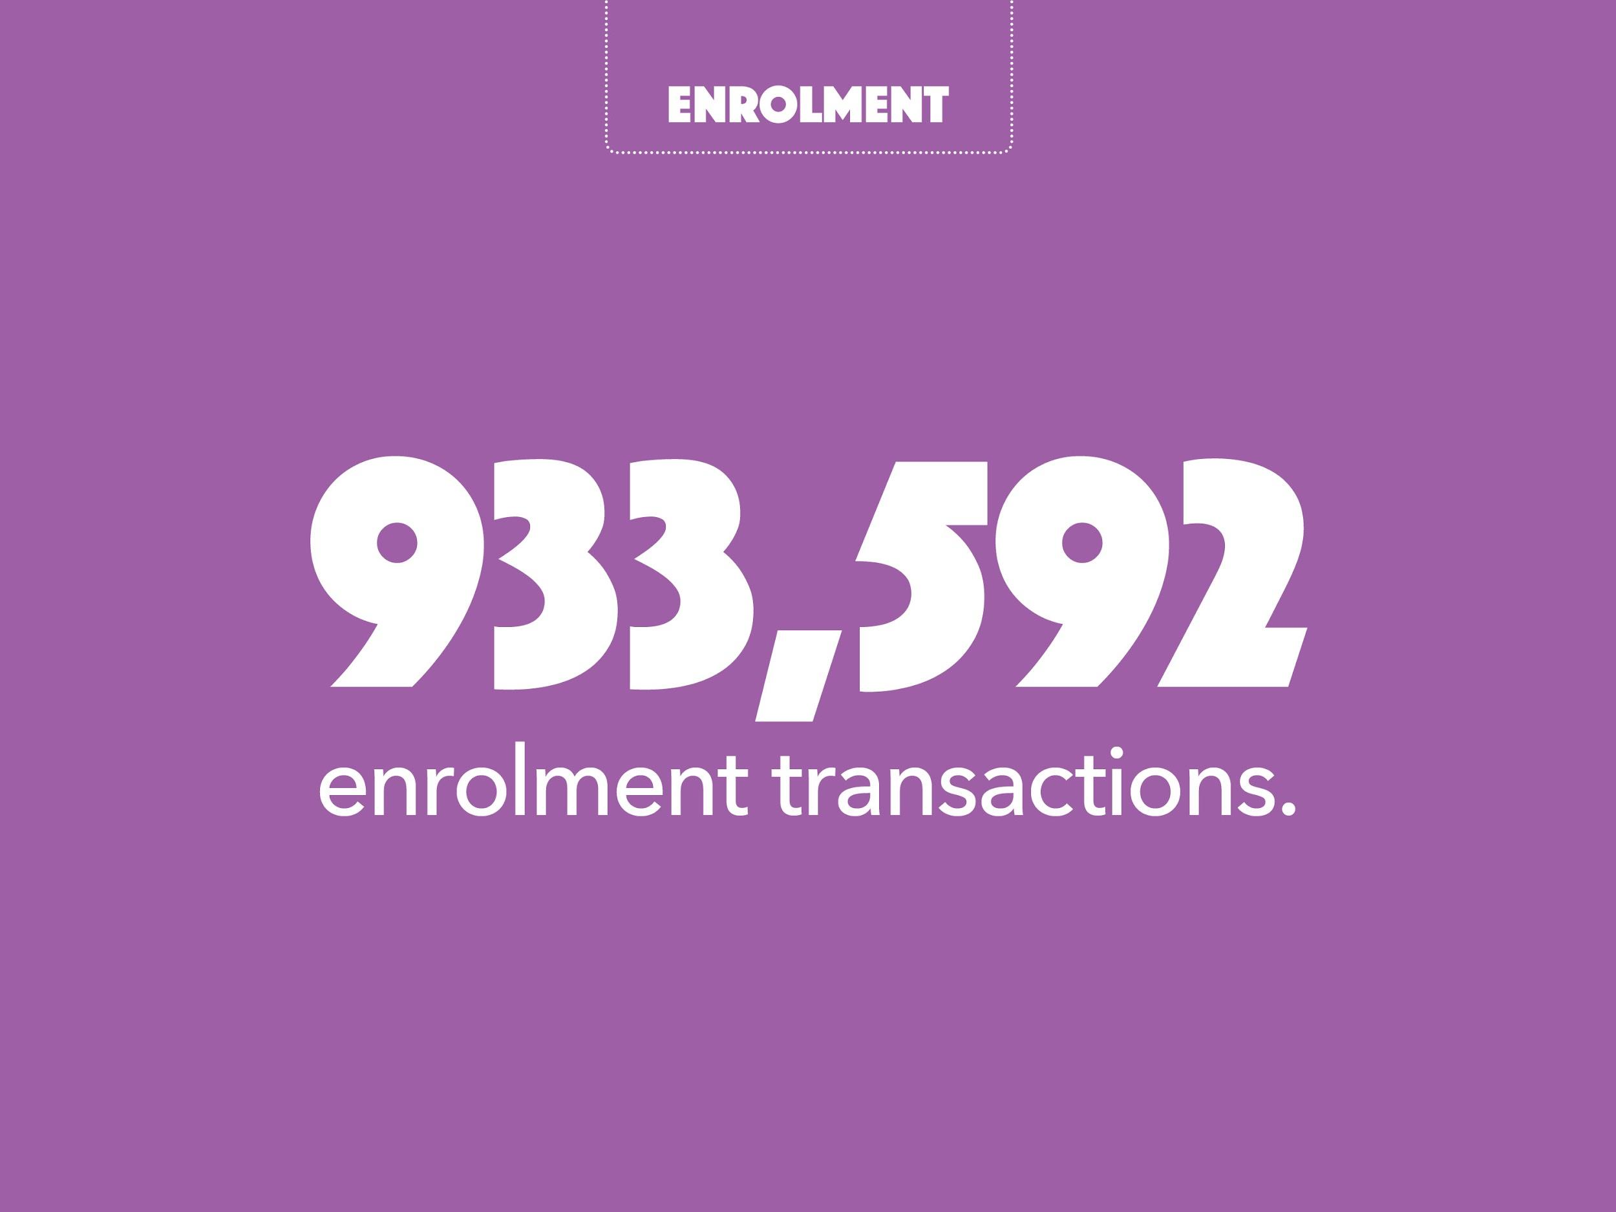

Slide 10


Slide 11
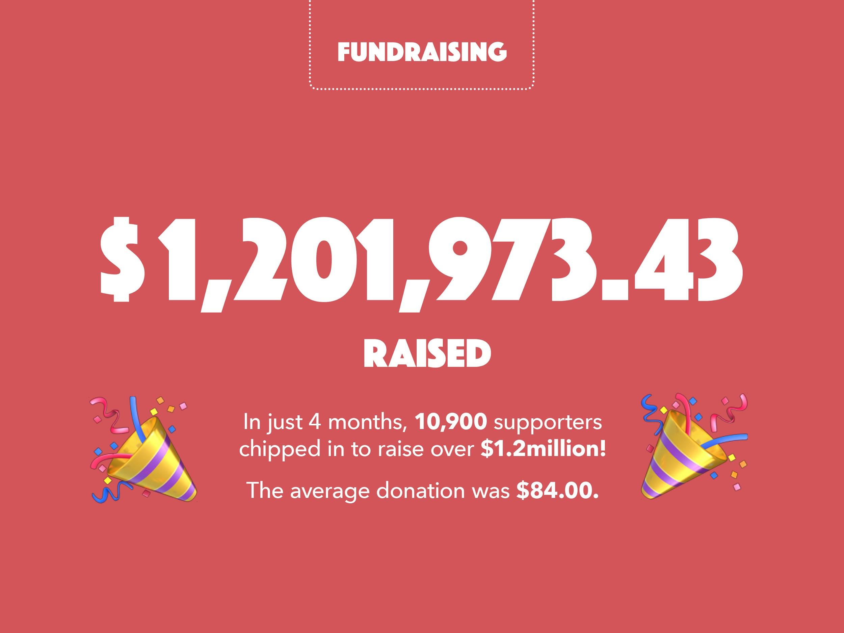

Slide 12
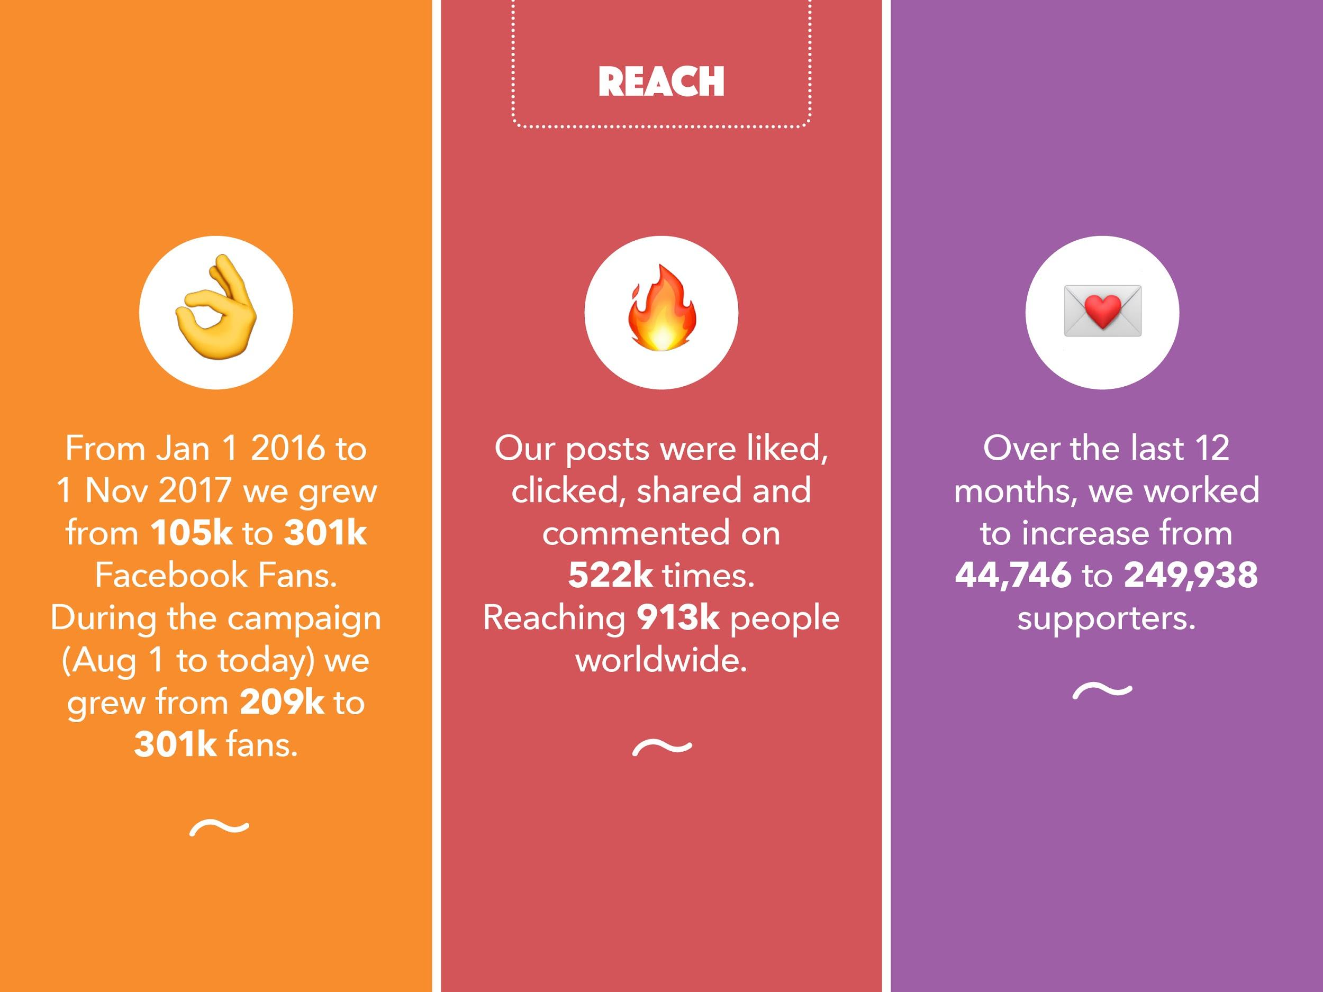

Slide 13
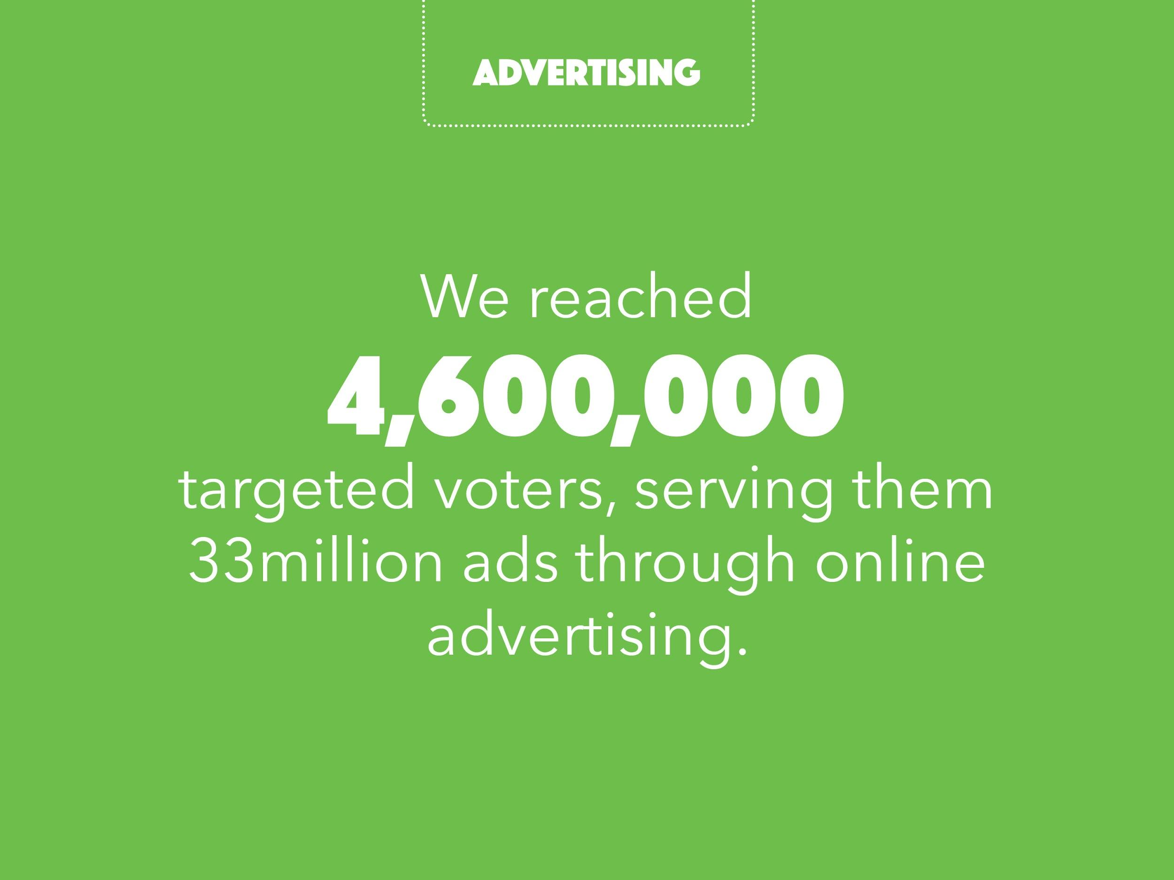

Slide 14
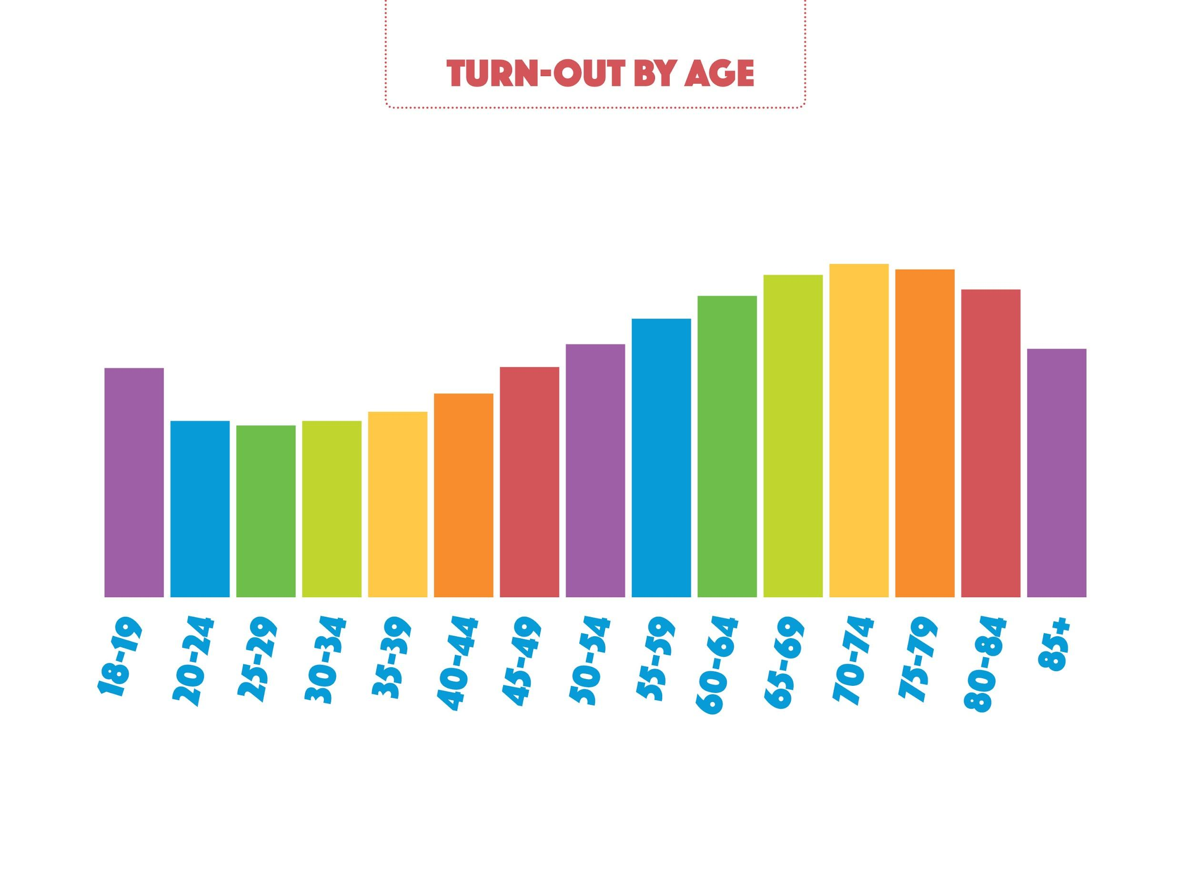

Slide 15
Key Lessons learned through YES
Spend time working on your shared purpose. Allocate plenty of planning time to reach agreement on strategy and tactics.
Words matter. Finding the right message is incredibly powerful, so invest in research and testing.
People connect with other people and their stories, not facts and figures. Talk about who and why, before you talk about what and how.

Slide 16


