Slide 1
Supporting Victims through Police referrals
A/Sen Sgt Chris Stafford, Police Referrals
11 April 2018

Slide 2
Overview
QPS obligations to victim support
Changes to Police Referral System
Community Legal Centres involvement
Notes:
Legislation changes enacted in 2017 has put increased focus on QPS strategies and actions to support victims.
This presentation will outline those changes and the nexus between QPS’ response to the legislation and the Police Referrals Program
It is important to emphasise the commitment of members to supporting victims – rather than being solely focussed on offenders. Sometimes this requires a cultural shift by members, and the recent change in legislation provides an opportunity to put a spotlight on how we respond, as a Service.
This presentation will hopefully assist you in championing the change with those at the frontline.
Essentially this presentation is about how we can:
support you to ….
support your troops to ….
support victims

Slide 3
Proactive prevention will reduce risk of re-victimisation and future offending
Notes:
We all know that the impact of offenders is far reaching.
This impact has been highlighted by the Not Now, Not Ever Report and the Carmody Child Protection Commission of Inquiry.
The Commission highlighted that domestic violence is a key parental risk factor associated with child abuse and neglect, and a contributor to over-representation of Aboriginal and Torres Strait Islander families in the child protection system.
Notably, the Commission found children living with family violence are more likely to be victims or perpetrators of abuse
Presenters story: I know from my own experiences the positive outcomes that come from proactive interventions when working with victims of circumstance. In particular, one experience resonates from my time working in Mackay District where a series of interventions, I believe, ensured that kids growing up in a young family avoided being caught up in offending behaviour.
I’m sure we all have our own stories of the positive impacts policing makes to the lives of victims, and I encourage you to share that perspective with your troops as part of promoting QPS proactive response to supporting victims of crime.

Slide 4
Notes:
Is it realy the Police job to do this.
Over 1 million contacts per year
PACFAB experience in 1998 being told we shouldn’t be spending our time on social work, we are police officers not social workers.

Slide 5
Operationally – It makes sense
Victim rehabilitation - leads to
More resilient person, which leads to;
Reduced re-victimisation
Proactive prevention can prevent further harm by resolving situations before they escalate
Stronger witness through prosecution process
Police productivity through reduced calls for service
Community satisfaction arising from positive/supportive interactions with Police
Manages QPS risk
Notes:
Key message: There is a benefit across policing by taking a victim centred approach
Speaker points:
Crime doesn’t just occur. There are a range of underlying issues impacting on the lives of individuals that can significantly increase the likelihood of them either offending or being a victim of crime, eg drug and alcohol abuse, mental illness or experiencing domestic violence
By using Police Referrals to direct at-risk clients to relevant support services, there is an opportunity for these issues to be addressed. Pro-active prevention means at-risk clients are engaged to achieve more sustainable outcomes.
The impact of these individuals being assisted has a direct impact on QPS responses. We can expect stronger witnesses through prosecution processes, reduced recidivism and revictimisation. Overall, this equates to reduced repeat calls for service and therefore more productive use of police time.

Slide 6
Strategically- It makes sense
Notes:
Key message: The way Police interact with Victims of Crime is a recurrent theme within the QPS Strategic Plan 2017-2021
Speaker points:
Our two Strategies under Make the Community Safer
The two Performance Indicators on the left hand side about community satisfaction and public perception.

Slide 7
Legislatively – It is a requirement
March 2017 | Mental Health Act
 | Bail Act
May 2017 | Domestic Family Violence Protection Act
July 2017 | Victims of Crime Assistance Act
December 2017 | Evidence Act
Notes:
Key message: In 2017 there were a number of changes to legislation that created a greater onus on Police in their dealings with victims.
Speaker points:
Bail Act – Section 11 and 16 in relation to changes to Bail Conditions and Refusal of Bail.
Domestic and Family Violence Protection Act. - Multiple changes from way Police deal with DFV incidents through PPNs, new National DV Orders Recognition and information sharing. For us in particular S169F providing police the power to provide referral information to Specialist DFV Service Providers without the persons consent.
Victims of Crime Assistance Act - Places an onus on Police to be proactive in keeping victims of an Act of Violence informed
- Creation of the Charter of Victims Rights
- Added victims of all DFV, Elder Abuse and Dangerous Drive causing death or GBH to defn of Victim
- All Victims of Crime to be able to provide Victim Impact Statement at time of sentencing
Evidence Act - Sexual Assault Counselling Privilege – Informed consent to release documentation, police are required to ensure that the victim has been offered legal support in making a decision re consent.

Slide 8
Member’s Obligations under the Charter
Treat victims with respect, courtesy, compassion, dignity and privacy.
Inform victims about any services and remedies available to them
Inform victims about the Police investigation, charging and prosecution processes
Inform victims of bail applications, outcomes and release arrangements and conditions
Connect victims with Service Providers for Court Support and Victim Impact Statements
If a victim is eligible provide information regarding application to register with the Corrective Services’ Victims Register
Notes:
Key message:
All QPS members have obligations under the Charter of Victims’ Rights – which are included within the legislation
Speaker points:
Informing victims of and services available to them is achieved through offering a referral. Ensure that all declined offers are recorded in QPRIME as a declined Victim Assist referral.
Similarly if an offer for court support is declined ensure the declined referral is recorded in QPRIME as a decline Court Support referral.

Slide 9
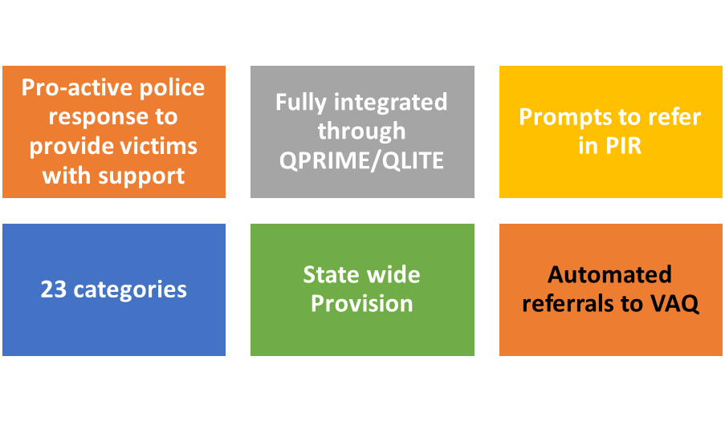
Police Referrals being leveraged
Notes:
Key message:
The Police Referral Program is now well established and is being leveraged to ensure that QPS meets its legislative obligations
Speaker points
Referrals program includes
450 service providers statewide
Victim Assist Queensland
Network of providers continually refreshed
on advice of funding agencies
on advice of Districts and local police

Slide 10
Referral Issue Categories
Aged support
Alcohol misuse
Court support
Crime prevention
Disability support
Domestic and family violence (aggrieved)
Domestic and family violence (respondent)
Drug misuse
Gambling
Homelessness
Identity theft
Legal advice
Mental health
Neighbour disputes
Office of Fair Trading
Parenting children/youth
Personal counselling
Road trauma
Sudden death support
Suicide prevention – non-emergency
Support for youth
Victim assists –information and financial assistance for violent crimes
Victims support
Notes:
23 Categories with 68 sub-categories

Slide 11
Notes:
For every offence, there can be multiple victims
In Queensland in 2015/16 there were 30,997 reported offences against the person
In addition, there were 29,838 Domestic Violence Applications (Police and Private applications)
While there can sometimes be a tendency for the frontline to think there is not enough time to focus on the victim …. clearly the message is embedded in the strategic plan that this is a key part of keeping the community safe.

Slide 12
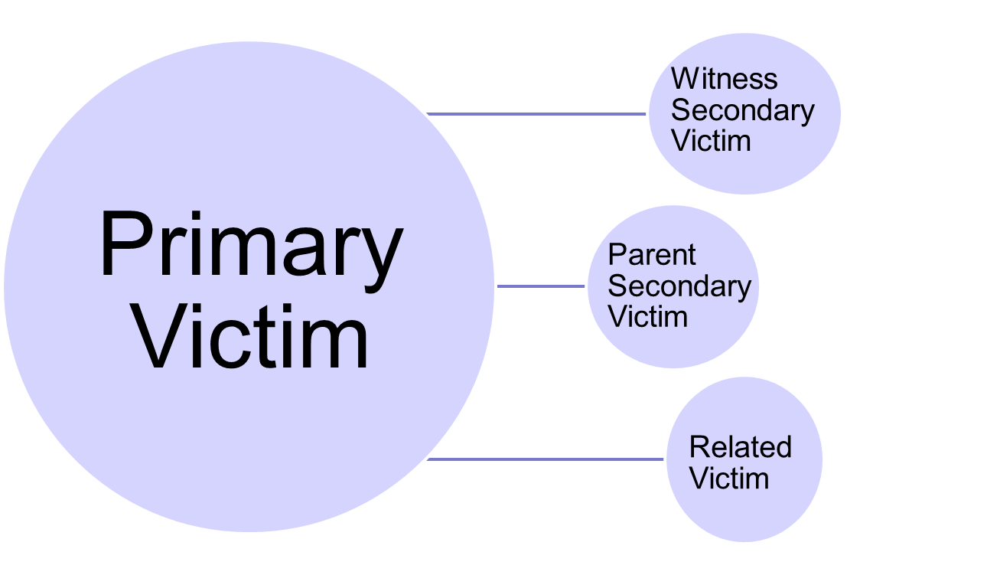
Who is a Victim of an Act of Violence?
* Injury is Physical or Psychological
Notes:
Key point: The term “Victim” does not only refer to the person who has been injured
Speaking points:
Primary victim: directly injured by the act of violence.
Witness secondary victim: injured because they saw or heard the act of violence. (eg child witness to DFV, witness to Armed robbery)
Parent secondary victim: the parent or primary carer of a victim (who is under 18) injured as a result of becoming aware of the act of violence.
Related victim: close family members and financial dependants of a person who has died as a direct result of the act of violence. This may include the person’s partner/spouse, child, brother/sister, or parent.

Slide 13
Definition of An Act of Violence broadened within new legislation
Defined as: ‘A crime or series of related crimes, whether committed by one or more persons, that has occurred in Queensland and directly resulted in the death or injury to one or more persons.
GBH & all other physical assaults
Stalking, Kidnapping or deprivation of liberty
Sexual Offences
Burglary with violence or robbery
All homicide & attempted homicide
Child Abuse
Domestic and family violence
Dangerous operation of a motor vehicle causing GBH or death
Notes:
Key point: The range of offences covered in the definition of an Victim of an Act of Violence was increased with the amendments in July 2017.
Speaking points:
Highlight Victims of DFV, Elder Abuse and Dangerous Operation of a motor vehicle causing GBH or death as new offence categories.
Include stats of how many victims (approx. 30,000 offence against the person and 30,000 DFV Applications) versus how many referrals made to VAQ (less than 1,000)

Slide 14
Changes to Police Referral System

Slide 15
Victim assist referral automated for some categories
Notes:
Key Message:
DV Aggrieved referrals and Victim Support – Sexual Assault Referrals will automatically be sent to Victims Assist Queensland
Speakers points:
Automated responses only provided where it is safe to do so
All funded providers have a shared obligation to comply with expectations of charter. In the case of DV and Sexual Assault, these specialist services have ability to assist victims in accessing VAQ services.

Slide 16
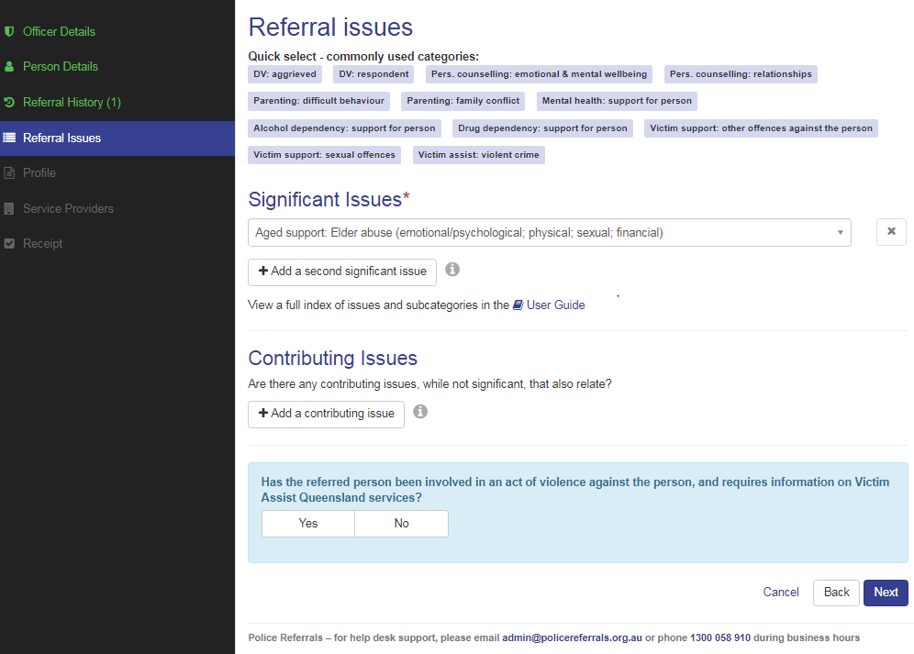
Some categories prompted
Notes:
Key message: Some categories prompted
Speaker points:
Victim Assist question is prompted when the significant or contributing issue selected is any of the following:
• Aged support – elder abuse
• Court support for victims of crime – court support
• Legal Advice
• Sudden death support (family/friends
• Victim support – other offences against the person
• Victim support – victim of offender with mental illness

Slide 17
Police to nominate if contact required
Notes:
Key message: Capacity to submit referral as ‘make contact’ or ‘provide info only’
Speaker points:

Slide 18
Capacity to deselect automated referral
Notes:
Key message: Capacity to deselect if client does not wish referral to be automatically sent to Victim Assist Queensland
Speaker points:

Slide 19
Declined referrals should be recorded
Notes:
Key Message
Declined referrals should be recorded
Speaker Notes
New functionality has recently been released in QPRIME that captures the Referral type for declined referrals.
As QPS has an obligation under the Charter of Victims’ Rights to provide information on support services, it is important that the offer of a referral is made. Where a victim declines the offer, then the Declined Referral should be recorded in QPRIME.
Remember that under the Charter, victims are encouraged to make complaints where they do not believe the Charter has been adhered to. Recording the offer of a referral is an important risk mitigation to cover individual officers in the event of a complaint.

Slide 20
Sexual Assault Counselling Privilege
New sub-category under Legal Advice
Will go direct to Legal Aid Queensland
Notes:
LAQ sub contracting women victims to Women’s legal service
Currently going to LAQ as Legal Advice – Criminal

Slide 21
Community Legal Centres involvement

Slide 22
WHO IS CURRENTLY INVOLVED IN POLICE REFERRALS??

Slide 23
WHO IS CURRENTLY INVOLVED IN POLICE REFERRALS??
Aboriginal and Torres Strait Islander Women’s Legal Service
Bayside Community Legal Service Inc.
Cairns Community Legal Centre
Caxton Legal Centre inc
Central Queensland Community Legal Centre
Goondiwindi Community Legal Service
Junkuri Laka Community Legal Centre
North Qld Women’s Legal Service – Cairns & Townsville
Queensland Indigenous Family Violence Legal Service
TASC National – Toowoomba
Taylor Street Community Legal Service
Townsville Community Legal Service
Women’s Legal Service
YFS Legal

Slide 24
Think you should be part of the network?
Contact Details:
Chris Stafford
Acting Senior Sergeant
Police Referral Services
Domestic, Family Violence & Vulnerable Persons Unit
Community Contact Command | Queensland Police Service
Email: Stafford.ChristopherC@police.qld.gov.au
Thank You.

