Slide 1
Community Legal Centres, Qld
Lynn Smith | 10 May 2018

Slide 2
About this session
Rental sector
RTA services
Popular tenancy topics
Dispute resolution
Investigations
Q&A

Slide 3
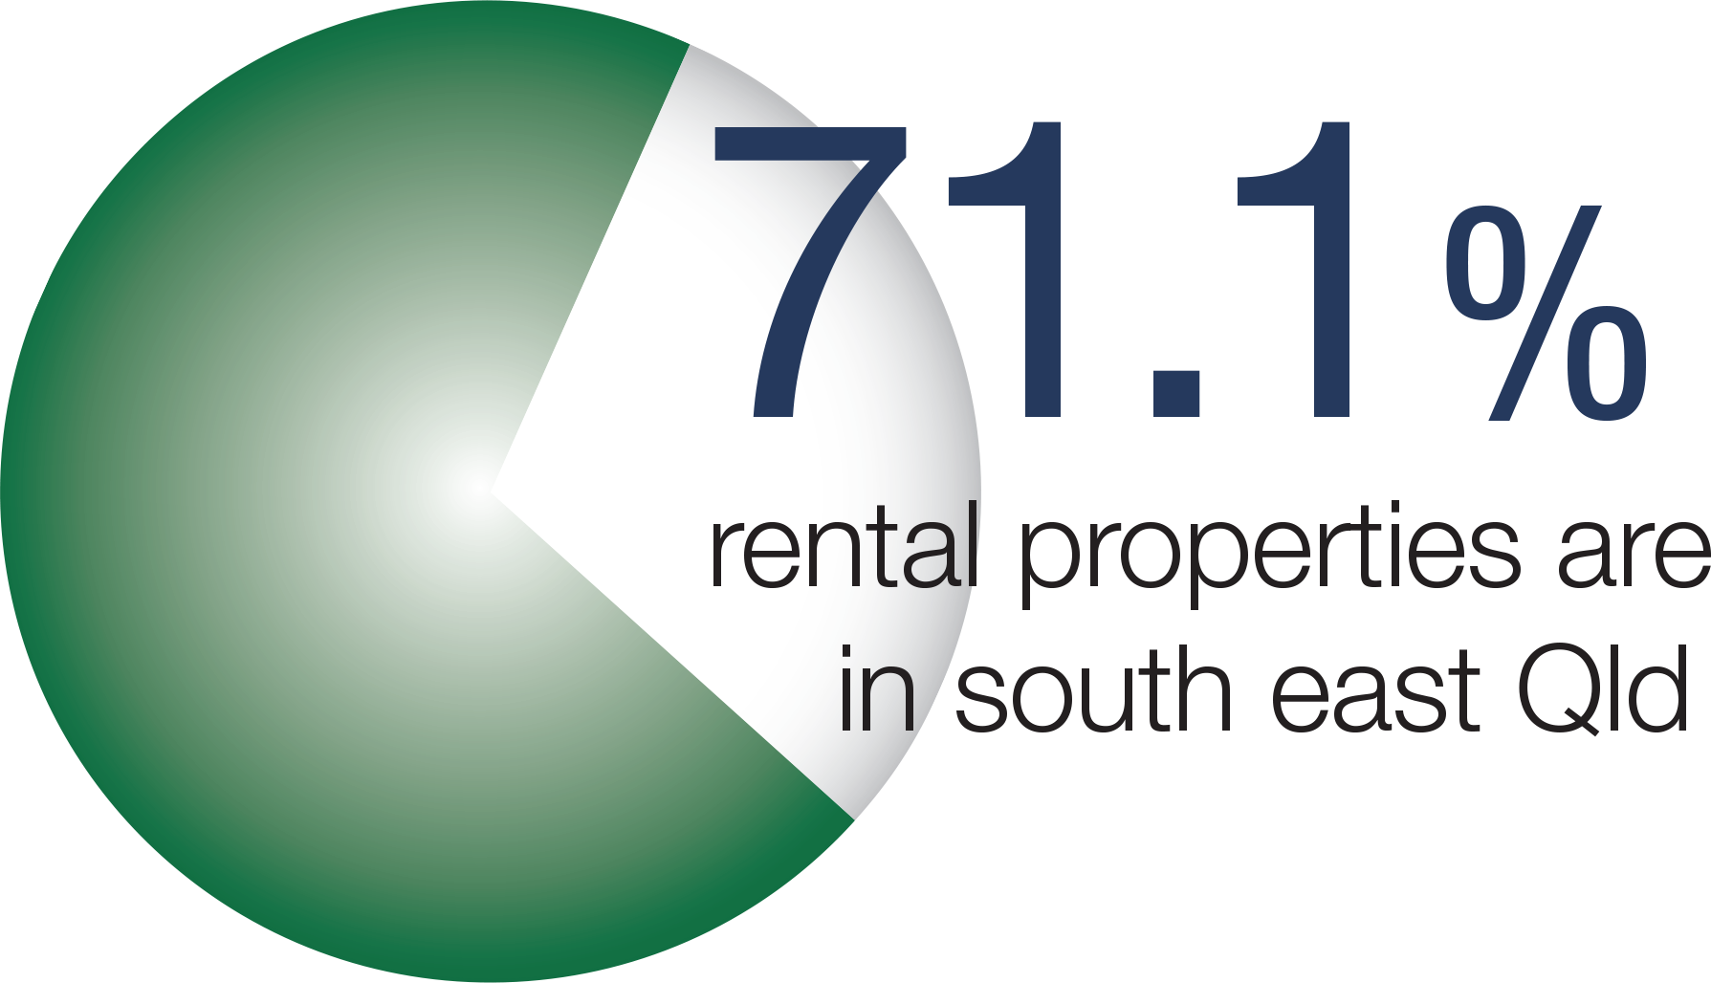
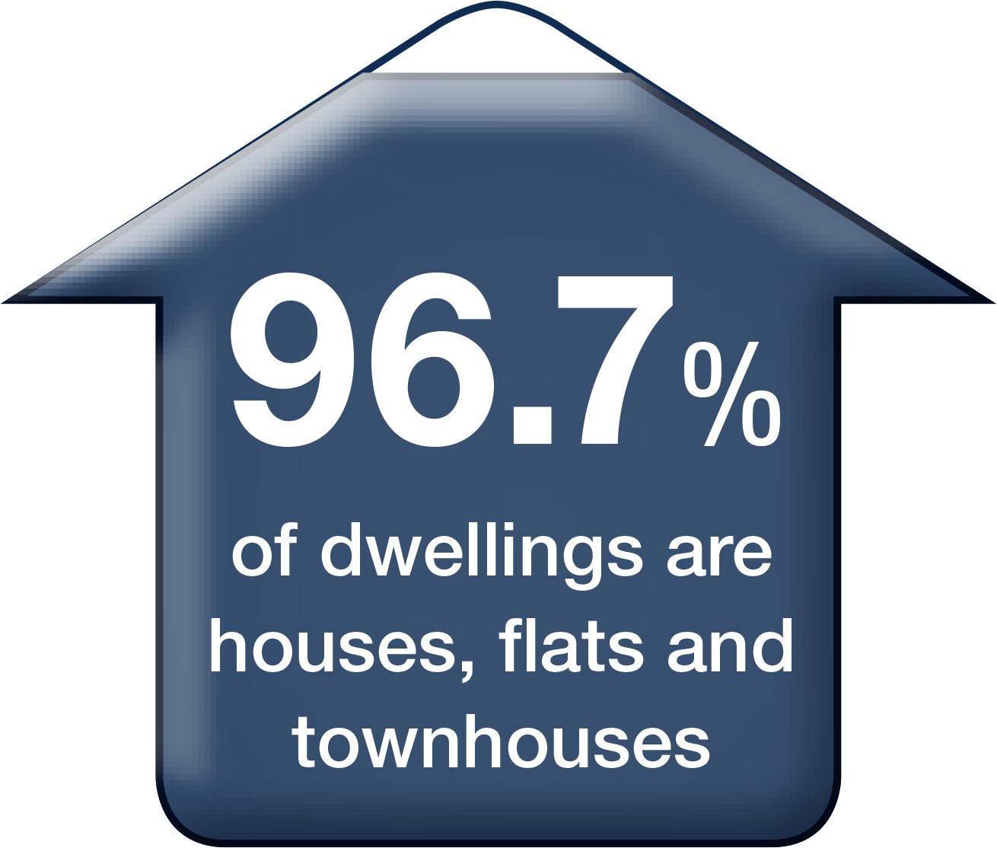
Rental sector
ABS 2016; RTA 2017

Slide 4
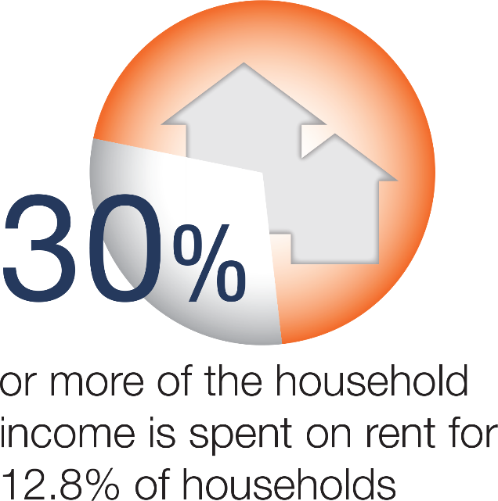
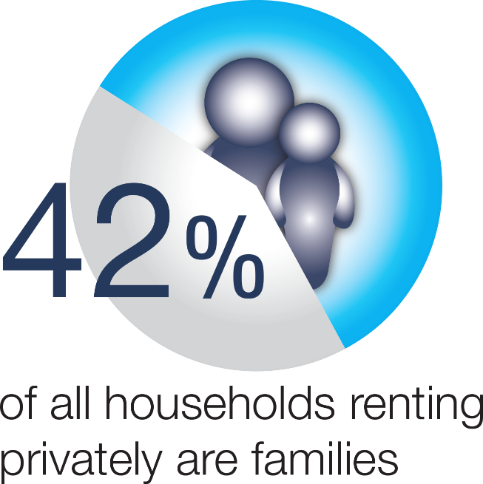
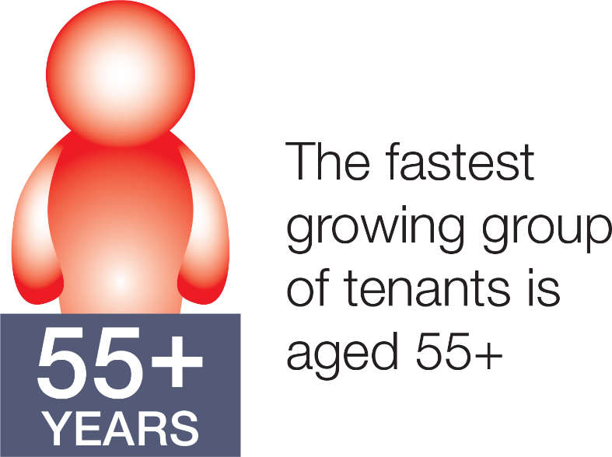
Rental sector
ABS 2016; RTA 2017

Slide 5
What does the RTA do?
Administers the Residential Tenancies and Rooming Accommodation Act 2008 and Regulations
Tenancy information
Bond management
Dispute resolution
Investigations and prosecutions
Policy and education services

Slide 6
Who does
the RTA
help?
Tenants & residents
Lessors
Agents
Peak industry bodies
Community sector groups
Other Government agencies

Slide 7
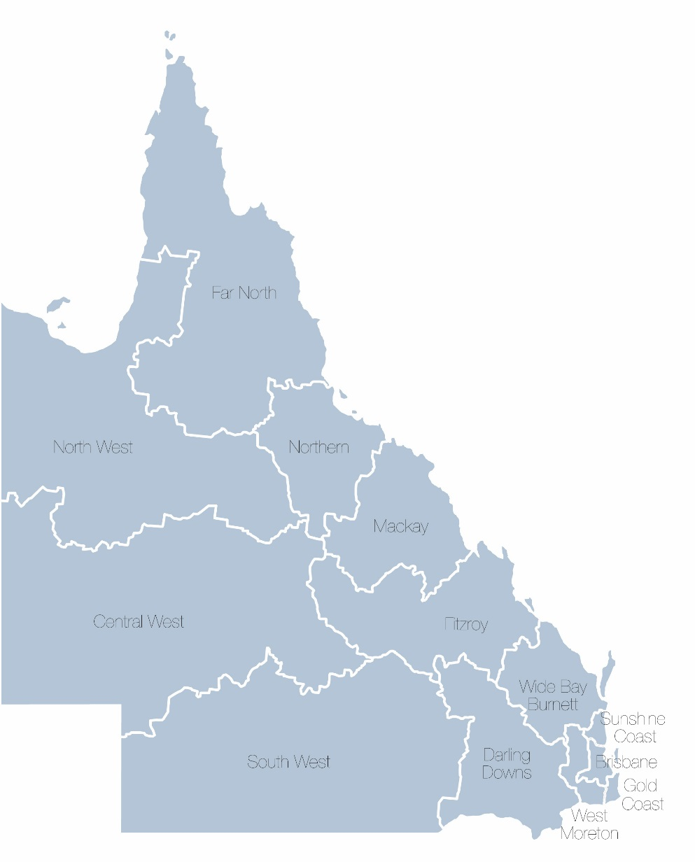
The RTA today
Currently:
Total number of bonds held – 600,540
Total value of bonds held – $842.5m
Avg. value of a bond – $1,402.90
Avg. number of calls received – 1762 per day
Avg. number of disputes received – 107.7 per day
Website visits – 9,700 per day
Investigations receive avg. 3.83 files per day
Policy and Education
as at 28 February 2018

Slide 8
Common Enquiries
to the RTA

Slide 9
Common
enquiries to the RTA
Bond enquiries
Bond claims
Ending a tenancy
The vacating process
Rent / rent arrears
Entry to the rental premises
Maintenance & repairs
Water charging

Slide 10
Bond enquiries
Lodging a rental bond
“How to” claim a rental bond
Progress of a bond claim/dispute
Bond information only
Update client information

Slide 11
Bond claims
Quickest and easiest way to refund a rental bond – all parties (both tenant and lessor/agent) sign an agreed Refund of Rental Bond form
Bonds are paid into Australian bank accounts
At the end of the tenancy, either party to the rental bond can make a claim through the refund process
Notice of Claim process allows the other party an opportunity to dispute the claim if they do not agree
Important RTA has client up-to-date contact details

Slide 12
Ending a tenancy
“With grounds” or “without grounds”
How a tenancy can end
Notice in writing
Timeframes
Ending a fixed term agreement early
Compensation loss of rent and reasonable re-letting expenses

Slide 13
Ending a tenancy - hardship
Excessive hardship
Loss of job/income
Work transfer
Health
Divorce
Urgent application direct to QCAT
Case by case basis - applicant must be able to show or substantiate they would face excessive hardship if the tenancy is not ended
Domestic violence – urgent application
Excessive
hardship
application

Slide 14
The vacating
process
Exit condition report vs Entry condition report
Tenant is to return premises same condition at the start of the tenancy, less fair wear and tear
Recommend taking photos at the start and the end
Check rent payments – get a copy of rent ledger
Refund of rental bond (Form 4) – ensure RTA has up-to-date contact details

Slide 15
Rent or Rent arrears
Rent payments
Rent ledger/receipts
Breach process for non-payment
Notes:
.

Slide 16
Entry to the rental premises
Reasons for entry
Entry notice (Form 9)
Timeframes
Notes:
.

Slide 17
Maintenance and repairs
Lessor’s obligations
Tenant’s obligations
Emergency repairs vs routine repairs
Notice to remedy breach (Form 11)

Slide 18
Water charging
The Act allows for all water usage to be passed onto tenants where:
the property is individually metered for water, and
the agreement provides that the tenant pays for water, and
the property is water efficient
Water bills should be issued to tenants in a reasonable timeframe

Slide 19
Dispute resolution
Notes:
CLICK

Slide 20
Self resolution
RTA’s dispute resolution service
QCAT
Notes:
.

Slide 21
Accessing the RTA’s free dispute resolution service
Dispute resolution request (Form 16)
Complete the form, sign and send to the RTA
Contact details for all involved in the dispute
Provide a brief outline of what the dispute is about (attach a page if need be)
Information and dispute request form available at
rta.qld.gov.au/Disputes
Notes:
CLICK

Slide 22
Common disputes received
Repairs and maintenance
Ending a tenancy
Rent arrears
Entry
Bond distribution
Compensation (excess of bond)
Non-lodgement of bond

Slide 23
Form 16 Dispute Resolution Request
Assessment
Suitable – progress to a telephone conference
Unsuitable – closed OR NURD issued
Dispute intake and case assessment

Slide 24
Assessing the file
Number of parties
Client willing to engage in process
Complexity and type of issues
Minor or trivial matters
Contact details
Availability of parties
Previous disputes
Level of conflict
Dispute intake and case assessment

Slide 25
Conciliation process
Telephone conferencing
The parties to the dispute own the dispute outcome
Client may have a support person
Interpreter service

Slide 26
Role of the conciliator
Conciliator is impartial
Confidential and voluntary process
Facilitate and help conduct negotiations
Promote open exchange of information
Provide information on the operation of the Act
Notes:
.

Slide 27
Resolved or unresolved
Resolved
Bond – agreed refund form is signed by all parties
Tenancy – a conciliation agreement is signed by all parties
File is finalised
Unresolved
“Notice of unresolved dispute” is issued to the person who lodged the dispute
Non-urgent application to QCAT
Important timeframes apply

Slide 28
Application checklist
Lodge a fully completed application form plus appropriate number of copies and pay filing fee
Relevant information (tenancy paperwork; notices; photos; diary notes; written correspondence)
qcat.qld.gov.au
If application relates to bond money – ensure QCAT receipt details are sent to RTA by due date on Notice of unresolved dispute
Applying to QCAT

Slide 29
Investigations
Notes:
CLICK

Slide 30
Disputes vs Investigations
Tenancy and bond disputes
Breaches of terms of the tenancy agreement
If not resolved through Conciliation proceed to QCAT
Form 16 Dispute Resolution Request form
Investigation into alleged breaches of the penalty provisions of the RTRA Act
Magistrates Court
Pro-active and re-active complaints to the RTA

Slide 31
RTA
Investigations unit overview
Purpose
Empowering people to understand and comply with the rental market regulations
Function
Ensuring compliance with Queensland residential tenancy legislation
125 penalty offences under the RTRA Act

Slide 32
Investigations team
815
cases finalised in 2016-17
Reactive and proactive cases
Complaint received from an aggrieved party
Internal referral from Contact Centre
May refer or accept referrals from
Office of Fair Trading
Queensland Police Service
Queensland Fire and Emergency Services
Two year limit timeframe from offence date

Slide 33
Most common investigations
Non-lodgement of bond or late lodgements
Unlawful entry
Unlawful recovery of possession
Contracting out of the legislation (special terms)
Photos used in advertising without written permission
Conducting “open house” inspections without written permission
No written agreements and entry condition reports

Slide 34
Action that can occur
If a complaint is substantiated, the RTA can:
Provide education
Issue a warning letter
Issue a Penalty Infringement Notice (PIN)
Commence prosecution

Slide 35
Complaint process
Contact the RTA for an Investigations request form
Complete and provide evidence/information and submit to the RTA
The investigator may seek further information
Depending on the matter, the investigator may ask for a witness statement from the complainant

Slide 36
1300 366 311
Phone
Call the RTA client service team
rta.qld.gov.au
Website
Find RTA resources, videos, publications, forms

Slide 37
Questions?
Notes:
ENDS

