Slide 1
Technology, Law and New Ethics.
Fabian Horton
@fabianhorton

Slide 2
‘Soon companies will need a CPO; Chief Philosophical Officer.’
Prof. Toby Walsh
The Promise of Artificial Intelligence
(Speech delivered at The Legal Innovation and Tech Fest conference, Sydney 4 June 2018)

Slide 4
Ethics
Tech
Law
Society

Slide 5
Three main questions
What is technology?
Is technology neutral?
Is technology autonomous?
Why are these questions important?
Notes:
The answer isn’t really the point; it is how we approach the ‘technology question’

Slide 6
What is technology?
Articles, devices (Instrumental)
Data
Systems: modes of production
Human system: military, government, industry

Slide 7
Tools
Data
Processes
Systems
Notes:
Technology is an ongoing process in which as ‘tools’ are used they create the processes and systems that further increase efficiency.

Slide 8
Is tech neutral?
If we treat tech as neutral, that engenders a certain response, and visa-versa.
Can the “use” of technology be separated from its “purpose”?

Slide 9
GUNS DON’T KILL PEOPLE
PEOPLE KILL PEOPLE

Slide 10
Is tech autonomous?
What is the driving force in social change; technology or humans?
This is a question about the relationship between humans and technology.
It deals with social change. (Technological Determinism)

Slide 11
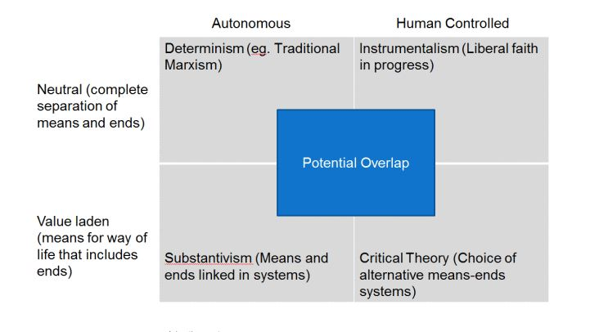

Slide 12
“Technology leads a double life, one which conforms to the intentions of designers and interests of power and another which contradicts them—proceeding behind the backs of their architects to yield unintended consequences and unintended possibilities.”
Jacques Ellul

Slide 13
Thought exercises
Does Facebook change the way we relate to each other or does the way we relate to each other determine what becomes popular in Facebook?
Has LinkedIn changed business networking?
Does hyperconnectivity change the way we think?

Slide 14
Law Tech Domains

Slide 15
Legal Code Disrupt
Legal Profession Disrupt
Legal Culture Disrupt
Notes:
Three ways in which law is disrupted. The ‘three legal disrupts’ is a framework for conceptualising the different domains of the law that are effected by technology.

Slide 16
The three law-tech domains
Law of technology domain – Legal Code Disrupt
Tech and legal industry domain – Legal Profession Disrupt
Tech-law culture domain - Legal Culture Disrupt

Slide 17
Applying the law-tech framework
Do we look to regulate the manufacturing of the technology or its use?
Do we take a cultural approach and use educational means?
Are there systems that can be changed or improved?

Slide 18
Applying the law-tech framework
Do we look to regulate the manufacturing of the technology or its use?
Do we take a cultural approach and use educational means?
Are there systems that can be changed or improved?

Slide 19
Types of law-tech ethics
The extension by technology of known legal ethical issues
The creation by technology of new ethical concerns and their extended legal consequences
The question of ethical oversight of emerging technologies.

Slide 20
Extension by technology
Responses to some problems are relatively settled.
Development of the issues continues as new facts arise.
Technology’s advancement is incremental.
Small advancements can create new problems in well known ethical areas.

Slide 21
Creation by technology
New technologies, new issues.
The problems are sometimes created inadvertently (not due to primary functions of the technology).
Can have direct legal consequences.

Slide 22
Oversight of emerging tech
Tech and culture do not develop at the same rate (culture lag).
Can create a disconnect between a technology and ethical norms relating to it.

Slide 23
“The automation of factories has already decimated jobs in traditional manufacturing, and the rise of artificial intelligence is likely to extend this job destruction deep into the middle classes, with only the most caring, creative or supervisory roles remaining.” Prof. Stephen Hawking Guardian. July 2016

Slide 24
“One more robot per thousand workers reduces the employment to population ratio by about 0.18-0.34 percentage points and wages by 0.25-0.5 percent..” Robots and Jobs: Evidence from US Labor Markets Daron Acemoglu, Pascual Restrepo NBER Working Paper No. 23285, March 2017

Slide 25
Imperatives
Lawyers have an extremely important role to play, but in many ways it will be different a different role.
There needs to be a paradigm shift in how we think about the law and its role in a hyper-connected digital world.
If lawyers are to be heard work needs to start now, otherwise decisions will be made for us.

Slide 26
Thank you
Fabian Horton
fhorton@collaw.edu.au
@fabianhorton
College of Law Melbourne, Australia

