Slide 1
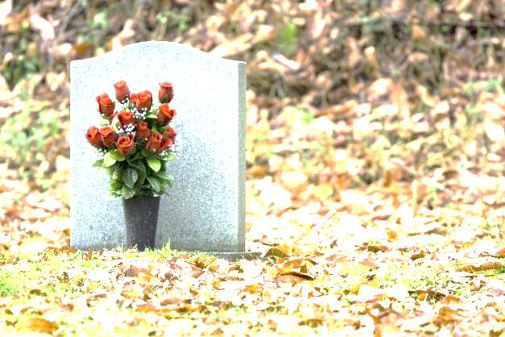
Pitfalls and challenges with self-made Wills CLCQ Webinar
Carolyn Devries
CEO
New Way Lawyers
Jennifer Claridge
Managing Lawyer
New Way Lawyers

Slide 2
Training summary
Many individuals are reluctant to seek the services of a lawyer to make a Will. There is all too often a perception that:
making a Will is a straightforward and simple process that can be done on a DIY basis;
engaging a lawyer will be too expensive.
This webinar covers three case studies where individuals held one or both of these perceptions and therefore prepared a DIY Will. In these three case studies none of the Wills met the requirements to automatically be recognised as a formal and valid Will and it was necessary to make an application to the Court to try to have the DIY Will recognised as being valid. The application to the Court ended up being at a much higher cost than what it would have been if a professional will had been made, with the assistance of a lawyer, in the first place.

Slide 3
Case Study 1

Slide 4
Background
The deceased had two children from her first marriage. She subsequently divorced her first husband.
The deceased married her second husband. There were no children from her second marriage.
In March 2016 the deceased was scheduled to have surgery after being diagnosed with cancer. On 21 March 2016, in the lead up to the surgery the deceased typed a purported Will on her computer, printed it and signed it in front of her second husband.
The deceased had not made any Wills prior to 21 March 2016.
On 11 July 2016 the deceased passed away.
New Way Lawyers was engaged to act on behalf of the deceased’s second husband.

Slide 5
The Purported Will
LAST WILL AND TESTAMENT
I ________________ of ________________, ALEXANDRIA HILLS QLD 4161 being of
sound mind and health do hereby bequeath all my worldly goods to my darling husband
________________of __________________ ALEXANDRIA HILLS, QLD 4161 to be sole executor
of all my estates and bank accounts
SIGNED _____________________
NAME _____________________
ADDRESS _____________________
ALEXANDRIA HILLS QLD 4161
DATE

Slide 6
What was done right with the purported Will?
The deceased included her address by way of identification
The purported Will included a date on which it was made
The purported Will contained a reasonably clear and effective distribution clause
The purported Will contained an appointment of executor
The purported Will was signed by the deceased

Slide 7
What was wrong with the purported Will?
The purported Will does not contain an attestation clause
The purported Will was not witnessed

Slide 8
Competing Outcomes
Purported Will Valid Purported Will Not Valid
Husband of the deceased Husband of the deceased inherits
inherits the entire estate $150,000 and the household chattels and 1/3 of the rest and residue
Two adult children of the deceased share the remaining 2/3 of the rest and residue

Slide 9
Participant Poll
Was the purported Will made 21 March 2016 held to be the valid Will of the deceased or was the deceased’s estate administered per intestacy?
The Will made 21 March 2016 was held to be valid
Or
Estate administered per intestacy
The purported Will made 21 March 2016 was ordered to be valid.

Slide 10
What was the process for obtaining an order that the purported Will was the valid Will
1. Form 103 Notice of intention to apply for a grant advertised and sent to Public Trustee
2. Application for Grant of Probate
Form 101 – Application for Probate;
Form 105 – Affidavit of the Applicant and Exhibit A (copy of purported will dated 21 March 2016), Exhibit B (certificate of death), Exhibit C (copy of marriage certificate); Exhibit D (copy of drivers licence of deceased). The Affidavit also
included a lengthy description of the circumstances surrounding the making of the
purported Will and the reasons that the purported Will was not witnessed.;
Form 104 – Affidavit of Publication and Service, including Exhibit A (Notice of intention to apply for a grant);

Slide 11
What was the process for obtaining an order that the purported Will was the valid Will
3. Interlocutory application pursuant to section 18(2) of the Succession Act
Form 9 - Application;
Form 46 - Affidavit in Support of Application;
Form 49- Notice Proposing Application Without Oral hearing;
Form 59 – Order;
Form 120 - Affidavit of Scripts;
Written Submissions
4. Service of application and supporting documents on Deceased’s adult sons
Service effected and Affidavit of Service filed

Slide 12
What was the process for obtaining an order that the purported Will was the valid Will
5. No response or engagement by the Deceased’s adult sons
6. Hearing of application on the papers
- Order made that the typed document dated 21 March 2016 forms the Will of
the deceased
Grant of probate made in respect of the Will dated 21 March 2016 and the deceased’s spouse appointed as executor
Applicant’s costs incidental to the application paid out of the estate on an indemnity basis.

Slide 13
Cost for obtaining an order that the purported Will was the valid Will
Normally the costs of obtaining a Grant of Probate on a formal and valid Will would be approximately $2,500 including professional fees and disbursements.
In this matter the cost of having the purported Will ordered to be a valid and a Grant of Probate issued was approximately $10,000.
In hindsight it would have been much more cost effective for the deceased to have engaged the services of a lawyer to prepare a professional Will rather than making a DIY Will.
The cost of the process could also have been much higher had the deceased’s 2 adult sons chosen to contest the purported Will and seek to have the deceased’s estate distributed pursuant to intestacy, however this did not occur in this matter.

Slide 14
Case Study 2

Slide 15
Background
The deceased was divorced and had four adult children and a number of grandchildren.
On 22 December 2015 the deceased made a formal and valid Will through a lawyer. The Will appointed two of the deceased’s children as executors. The Will provided for the following specific gifts:
a gift of $10,000 to one daughter; (this was the only gift received by this daughter)
a gift of $5,000 to one grandson;
The Will then provided for distribution of the rest and residue of the deceased’s estate equally between the three other children with the provisions of section 33N to apply.
On 19 May 2016 the deceased prepared a handwritten document on the back of a receipt purporting to be a new Will.
In or around May or June 2016 the deceased informed each of his children by telephone that he had made a new Will.

Slide 16
Background
In or around June or July 2016 one of the children, who was an executor and residuary beneficiary of the formal Will made 22 December 2015 found the purported handwritten Will of the deceased while cleaning his unit and encouraged the deceased to go to a lawyer to have the Will correctly drafted.
The deceased passed away 22 November 2016
New Way Lawyers was engaged to act on behalf of the executors of the Will made 22 December 2015

Slide 17
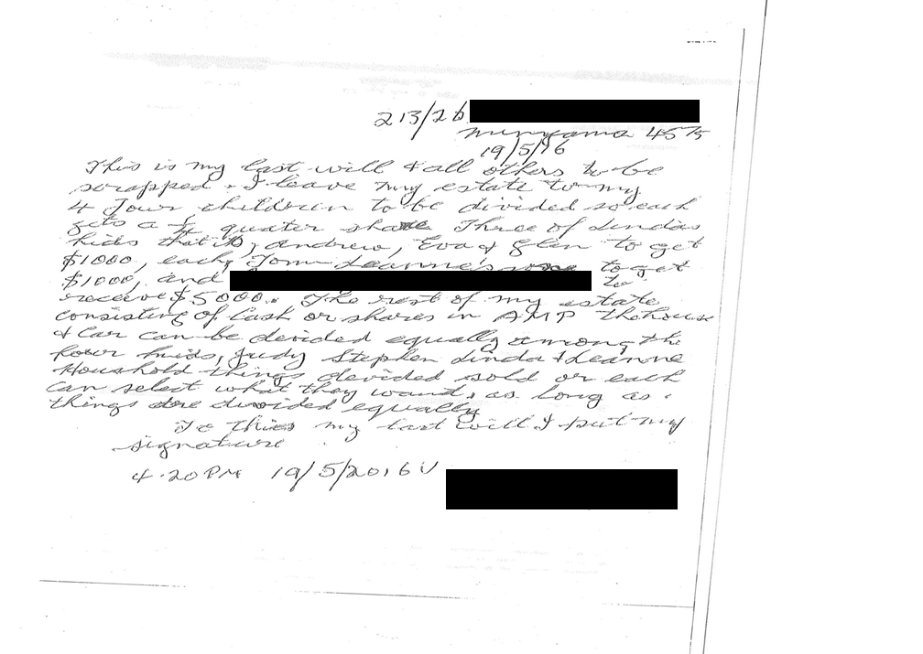
The Purported Will

Slide 18
The Purported Will
Minyama
19/05/16
This is my last will & all others to be scrapped. I leave my estate to my 4 four children to be divided so each gets a ¼ share. Three of Linda’s kids that is, Andrew, Eva & Glen to get $1000, each, Tom Leanne’s son to get $1000 and to receive $5000. The rest of my estate consisting of cash or shares the house and car can be divided equally among the four kids, Judy, Steven, Linda Leanne Household things divided sold or each can select what they want, as long as things are divided equally
To this my last Will I put my signature
4:20pm 19/05/16
Street Address
Name of beneficiary
Signature

Slide 19
What was done right with the purported Will?
The deceased included his address by way of identification
The purported Will included a date on which it was made
The purported Will included a revocation clause
The purported Will contained a reasonably clear and effective distribution clause
The Will included an attestation clause
The purported will was signed by the deceased

Slide 20
What was wrong with the purported Will?
The purported Will did not appoint an executor
The purported Will was not witnessed

Slide 21
Competing Outcomes
Purported Will Valid Previous Formal Will Valid
Specific gifts to grandchildren Specific gifts to one daughter and one grandson
Rest and residue divided Rest and residue divided between between four children the 3 other children equally
equally

Slide 22
Participant Poll
Which Will was upheld by the Court as being the valid Will of the deceased?
Formal Will made 22 December 2015
Or
Purported Will made 19 May 2016
The purported Will made 19 May 2016 was ordered as being the valid Will of the deceased.

Slide 23
What was the process for obtaining an order that the purported Will was the valid Will
Notice of intention of claim received
Child who was to receive specific gift only under the formal Will dated 22 December
2015 provides notice of intention to lodge a caveat against any application for probate
with respect to the formal Will dated 22 December 2015 and or/ make a family
provisions claim against the estate if the formal Will dated 22 December 2015 is
propounded.
Agreement reached between children to follow testamentary Intentions in purported Will
dated 19 May 2016
3. Agreement reached regarding who will be administrators of the estate
Agreement eventually reached, after some dispute, for children named as executors in the
formal Will dated 22 December 2015 to be applicants for Letters of Administration with
the purported Will dated 19 May 2016. Child who had been left out of formal Will had
wanted to apply as application but others did not agree.

Slide 24
What was the process for obtaining an order that the purported Will was the valid Will
4. Form 103 Notice of intention to apply for a grant advertised and sent to Public Trustee
Dispute about assets of the estate including a campervan that was allegedly sold by the child left out of the formal Will dated 22 December 2015 when she was attorney for the deceased
Affidavits sought from each of the beneficiaries under the formal Will dated 22 December 2015 and from each of the beneficiaries under the purported Will dated 19 May 2016 consenting to follow the testamentary intentions in the purported will dated 19 May 2016

Slide 25
What was the process for obtaining an order that the purported Will was the valid Will
7. Application for Letters of Administration with the Will
Form 101 – Application for Letters of Administration with the Will;
Form 106 – Affidavit of the Applicants and Exhibit A (copy of purported will dated 19 May 2016), Exhibit B (certificate of death), and Exhibit C (copy of former Will dated 22 December 2015);
Form 104 – Affidavit of Publication and Service, including Exhibit A (notice of intention to apply for a grant).

Slide 26
What was the process for obtaining an order that the purported Will was the valid Will
8. Interlocutory application pursuant to section 18 of the Succession Act
Form 9 - Application, dispensing with the requirements under section 10 of the Succession Act;
Form 46 - Affidavit in Support of Application;
Form 49- Notice Proposing Application Without Oral hearing;
Form 59 – Order;
Form 120 - Affidavit of Scripts;
Written Submissions
Form 46 – Affidavits from each of the beneficiaries under the formal Will dated 22 December 2015 and from each of the beneficiaries under the purported Will dated 19 May 2016, bar 3 beneficiaries, consenting to follow the testamentary intentions in the purported will dated 19 May 2016.

Slide 27
What was the process for obtaining an order that the purported Will was the valid Will
8. Service of application and supporting documents on interested parties
Service of application and supporting documents on interested parties
9. Matter listed for Oral Hearing
10. Remaining 3 beneficiaries who had not provided an Affidavit in support of Interlocutory Application subsequently provide Affidavit.
11. Oral Hearing before Judge
Ordered that the purported testamentary document of the deceased made 19 May 2016
be recognised as the Will of the deceased
Letters of Administration be granted to the Applicants
Applicants costs be paid out of the deceased estate on an indemnity basis

Slide 28
What was the key legislation, case law and evidence supporting the outcome
COURT MAY DISPENSE WITH EXECUTION REQUIREMENTS FOR WILL, ALTERATION OR REVOCATION
Section 18 of the Succession Act provides:
This section applies to a document, or a part of a document, that—
(a) purports to state the testamentary intentions of a deceased person; and
(b) has not been executed under this part.
The document or the part forms a will, an alteration of a will, or a full or partial revocation of a will, of the deceased person if the court is satisfied that the person intended the document or part to form the person’s will, an alteration to the person’s will or a full or partial revocation of the person’s will.
In making a decision under subsection (2) , the court may, in addition to the document or part,
have regard to—
(a) any evidence relating to the way in which the document or part was
executed; and
(b) any evidence of the person’s testamentary intentions, including evidence of
statements made by the person.
(4) Subsection (3) does not limit the matters a court may have regard to in making a decision under subsection (2) .
(5) This section applies to a document, or a part of a document, whether the document came into existence within or outside the State

Slide 29
What was the key legislation, case law and evidence supporting the outcome
The principles concerning the operation of the Succession Act were most recently collected by Brown J in Re Nichol; Nichol v Nichol & Anor [2017] QSC 220 at [6]-[9]:
[6] In Lindsay v McGrath, the Queensland Court of Appeal adopted the conditions for the execution requirements of a will to be dispensed with, as outlined by Powell JA in Hatsatouris v Hatsatouris. Those requirements are:
(a) was there a document,
(b) did the document purport to embody the testamentary intentions of the relevant deceased;
(c) did the evidence satisfy the Court that either, at the time of the subject document being brought into being, or, at some later time the relevant Deceased, by some act or words, demonstrated that it was her, or his, then intention that the subject document, should without more on her, or his, part operate as her, or his Will?

Slide 30
What was the key legislation, case law and evidence supporting the outcome
[7] Boddice J in Lindsay v McGrath said:
“[60] Great care is to be taken in the evaluation of the relevant evidence. To satisfy the onus, the evidence must show more than that the particular document sets out the deceased’s testamentary intentions or that it is consistent with other statements the deceased made about what he or she wanted to happen to the property upon death. The evidence must establish on the balance of probabilities that the deceased wanted the particular document to be his or her final Will, and did not want to make any changes to that document.
…
[62] Documents which contain only preliminary, tentative or incomplete expressions of a deceased’s testamentary intentions, or which on the evidence are demonstrated to have been prepared for consideration, further thought, deliberation or possible provision, will not suffice for the purposes of s 18 as the evidence will not establish the document in question embodied the settled testamentary intentions of the deceased.”

Slide 31
What was the key legislation, case law and evidence supporting the outcome
[8] The court must also be satisfied that the deceased had testamentary capacity at the time of creating the document. In determining whether the deceased had testamentary capacity at the time he created the unsent text message, the onus is on the respondent. Boddice J in Konui v Tasi & Anor stated:
“A presumption of testamentary capacity does not exist in the absence of a formally executed Will. The onus of proving testamentary capacity where there is an informal Will lies on the party seeking to convince the court the deceased intended the informal document to constitute his or her Will.”
[9] In examining the evidence, the court must have regard to the fact that the evidence is to be evaluated in accordance with the principle in Briginshaw. When an informal document is to be admitted to probate, Briginshaw dictates that reasonable satisfaction should not be obtained by “inexact proofs, indefinite testament, or indirect inferences.”

Slide 32
What was the key legislation, case law and evidence supporting the outcome
The following was put forward to support the application
1. The 2016 Will constitutes a document within the meaning of section 5 of the
Succession Act. It is hand-written by the deceased on a piece of paper.
2. The 2016 Will purported to state the deceased’s intentions about what was to be
done with his property upon his death. That is apparent from:
- the terms of the 2016 Will in which the deceased sought to make various gifts
(that is dispositions) to his four children and five grandchildren;
- the fact that the document says, “my last will” on two occasions;
the fact that the deceased signed the 2016 Will next to the words “To this my
last will I put my signature”.

Slide 33
What was the key legislation, case law and evidence supporting the outcome
The following was put forward to support the application
It is clear from the terms of the 2016 Will that it was intended by the deceased to
represent how he wished his property to be distributed upon his death (and
certainly, not during his lifetime).
3. The evidence establishes that the deceased formed the intention that the 2016 Will
operate as his will:
-in about May or June 2016 (at about the date of the 2016 Will), the deceased
informed the Applicants that he had made a new will; and
- in about June or July 2016, the Applicants discovered the 2016 Will at the
deceased’s home. One of the Applicants “encouraged the deceased to go to a
lawyer to ensure that the 2016 Will was correctly drafted”. However, there is no
evidence that the deceased heeded this advice (from which it may be inferred
that the deceased did not wish to make any changes to the 2016 Will).

Slide 34
What was the key legislation, case law and evidence supporting the outcome
The following was put forward to support the application
4. Critically, that the deceased explicitly told the applicants that he had made a
new will at about the date of the 2016 Will strongly suggests that the deceased
intended that Will to operate as such. The 2016 Will addresses the disposition of
assets and was specifically identified as the deceased’s “Will” (twice).
5. Further, the Court also ought to be satisfied that the deceased had testamentary
capacity at the time he made the 2016 Will:
- in the lead up to the making of the Will the deceased and Applicants had daily interactions and in those interactions the deceased was “able to recall
past events without fault and was able to note any pending or upcoming
future events easily”;
- when the deceased was subsequently admitted to hospital in September 2016 and October 2016 , he was assessed cognitively and passed all
cognitive tests easily”;

Slide 35
What was the key legislation, case law and evidence supporting the outcome
The following evidence was put forward to support the application
- there is otherwise, no evidence which suggests that the deceased did not have the testamentary capacity on 19 May 2016.
- while there is no medical evidence (which is not a pre-requisite to establishing capacity), the surrounding circumstances indicate the deceased was able to function and think normally

Slide 36
Alternative process (1)
Application for Probate on formal Will dated 22 December 2015
Deed of Family Arrangement varying terms of formal Will dated 22 December 2015 to reflect purported Will dated 19 May 2016 and preparation of an indemnity for Executors
This alternative process was not considered appropriate in this matter due to the level of distrust and behavior of the child who had been left out of the formal Will dated 22 December 2015.

Slide 37
Alternative process (2)
Application for Probate on formal Will dated 22 December 2015
Family Provisions Claim Filed By Daughter Left Out of Will
3. Settlement of Family Provisions Claim to reflect terms of purported Will dated 19 May
2016
This alternative process was not considered the most cost effective process therefore it wasn’t pursued.

Slide 38
Cost for obtaining an order that the purported Will was the valid Will
Normally the costs of obtaining Letters of Administration with the Will would be approximately $3,500 including professional fees and disbursements.
In this matter the cost of having the purported Will ordered to be a valid Will and a Grant of Probate issued was approximately $17,000.
In hindsight it would have been much more cost effective for the deceased to have engaged the services of a lawyer to update his Will rather than making a DIY Will.
The costs in this matter were so high because of the level of distrust of one of the parties and also the failure of some parties to sign an affidavit agreeing to Letters of Administration of the Will dated 19 May 2016 until after the matter had been listed for oral hearing. Although all parties subsequently signed affidavits agreeing to Letters of Administration of the Will dated 19 May 2016, 3 parties delayed doing this until a few days before the matter was listed for oral hearing and therefore the hearing was unable to be vacated. This increased the costs of the matter.

Slide 39
Case Study 3

Slide 40
Background
The deceased made a professional Will using the services of a lawyer on 25 October 1999.
On 17 April 2002 the deceased made a codicil to the Will dated 25 October 1999, the effect of the codicil was simply to update the address of the deceased and to correct the spelling of the name of the deceased’s step daughter. The codicil did not change the substantive provisions of the Will.
The deceased passed away on 29 September 2014.
Sometime between 25 October 1999 and 29 September 2014 a number of redactions and handwritten amendments were made to the Original Will of the deceased dated 25 October 1999.
At the time of the death the original codicil dated 17 April 2002 could not be found – only a copy could be found.
New Way Lawyers was engaged to act on behalf of the executors of the Will.

Slide 41
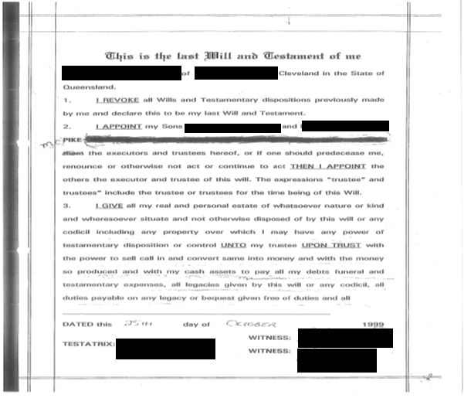
Amended Will
Deceased blacked out one of the named executors
Deceased underlined parts of the Will

Slide 42
Amended Will
Deceased blacked out one of the named beneficiaries

Slide 43
Amended Will

Slide 44
What was the process for obtaining a Grant of Representation
Obtaining a copy of the original Will (which had not been amended) to show the nature of the amendments that had been made to the Will
Renunciation of executor obtained
Renunciation of executor obtained who had been struck out of Will by deceased (executor consented to renunciation)

Slide 45
What was the process for obtaining a Grant of Representation
3. Application for Grant of Probate
Form 101 – Application for Probate;
Form 105 – Affidavit of the Applicant and Exhibit A (copy of will dated 25 October 1999 and copy of codicil dated 17 April 2002 ), Exhibit B (certificate of death), Exhibit C (copy of marriage certificate); Exhibit D (copy of drivers licence of deceased);
Form 111 – Affidavit of Plight and Condition (the Affidavit included a lengthy description of the circumstances surrounding the amendments made to the Will);
Form 104 – Affidavit of Publication and Service, including Exhibit A (Notice of intention to apply for a grant).

Slide 46
What was the process for obtaining a Grant of Representation
4. Interlocutory application pursuant to section 18(2) of the Succession Act
Form 9 - Application, dispensing with provision of original codicil;
Form 46 - Affidavit in Support of Application;
Form 49- Notice Proposing Application Without Oral hearing;
Form 59 – Order;
Written Submissions
5. Hearing of application on the papers
Order made for a grant of probate in respect of the Will dated 25 October 1999 and 17 April 2002

Slide 47
Cost for obtaining a Grant of Representation
Normally the costs of obtaining a Grant of Probate $2,000 including professional fees and disbursements.
In this matter the cost of having to do an Affidavit of Plight and Condition and an Interlocutory Application regarding the absence of the original Codicil added approximately another $2,500 to the cost of obtaining the Grant.
Again, it would have been much more cost effective for the deceased to have engaged the services of a lawyer to update their Will rather than making handwritten amendments and in light of the original codicil not being available.

Slide 48
Tips and Pointers

Slide 49
Tips and Pointers
Here are some practical tips and pointers for dealing with matters that involve self made Wills
Set expectations with the client (whether acting of the executor / administrator or beneficiary at the start
Process for obtaining a grant of representation is going to be more complex than usual and may involve court appearances
Time frame for obtaining a grant of representation and administering the estate is going to be longer than usual
Cost are going to be higher than usual
Increased likelihood of family provisions claims
Consider all the possible strategies and processes for resolving the matter as often there will be more than one option

Slide 50
Tips and Pointers
Here are some practical tips and pointers for dealing with matters that involve self made Wills
Sometimes the most cost effective approach to dealing with issues arising from self made wills, where a Grant of Representation is required, will be to lodge a simple application for a Grant and allow the Registry to issue a requisition notice and then address the requisition.

Slide 51
Questions

Slide 52
Notes:
Interaction Between The Encounter Community Outreach Program, the Journey Legal Services Program and

