Slide 1
CLCQ Webinar Human Rights Advocacy

Slide 2
Format of Webinar
1. Context & Background: Bill (10 minutes)
2. The Tool: Jessica (15 minutes)
3. Engaging in Advocacy: Bill (15 minutes)
Questions: Remaining Time

Slide 3
1.1. Context
National Social Security Rights Network
Regularly engaging in law and policy analysis and commentary
Identified that international human rights norms apply to the Australian domestic context
Identified that a contextual, multi-faceted approach was needed

Slide 4
www.nssrn.org.au

Slide 5
1.2. Background
Identified need within National Social Security Rights Network (mid 2017)
Initial mapping process (mid 2017)
Initial Scoping Paper at NSSRN Conference (late 2017)
Agreement within NSSRN to proceed (late 2017)
Reach out to pro bono partners Wotton Kearney (early 2018)
Co-design of the Tool (early 2018)

Slide 6
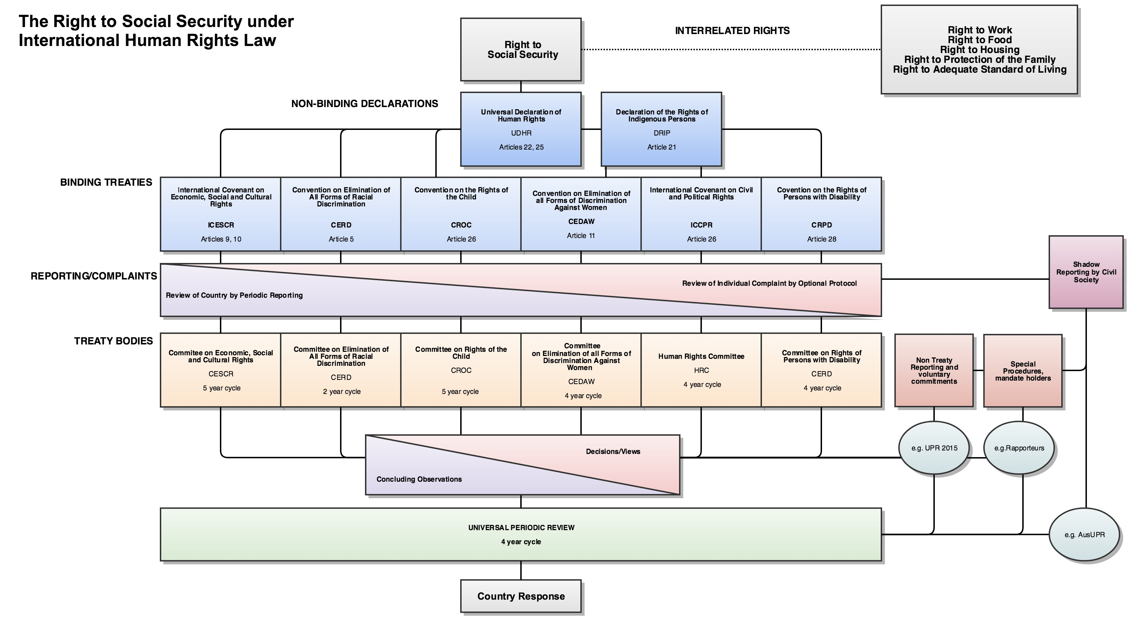
1.3. Mapping Rights

Slide 7
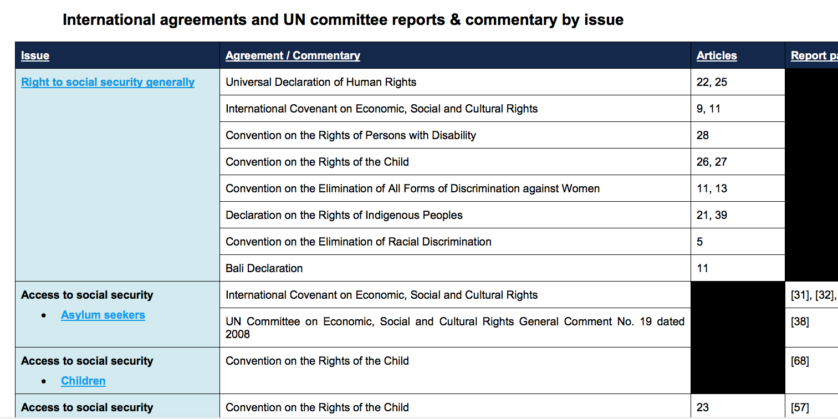
1.4. Tool Design

Slide 8
2.1. The Tool
Introduction
General Rights
Specific groups
Asylum seekers
Children
Persons with disability
Indigenous persons
Women in RRR areas

Slide 9
2.2. Thematic Areas
Thematic areas
Family violence
Robo-debts
CDEP, Work for the Dole
Drug testing
Family assistance
Income management
Adequacy of payments
Paid parental leave
Self-determination

Slide 10
3. Advocacy
Undertake a similar design process to the NSSRN
Identify Rights Base
General rights
Specific rights
Thematic issues
Identify Reporting Structures
Member states/Signatories
Optional Protocols, Individual Complaints
General comments
Thematic mandates/Special procedures

Slide 11
3. Advocacy
Network Engagement Opportunities:
All networks of NACLC have the opportunity to design their own tool based on general rights, specific rights and thematic issues
All networks of NACLC have the opportunity to feed into shadow-reporting processes (Human Rights Network) and special procedures
Work with other like-minded or thematically linked NGOs
Join networks already engaged in advocacy for mentoring and guidance
Add weight to shadow reports through endorsement

Slide 12
3. Advocacy
Targeting domestic issues through International human rights obligations provides another layer to commentary
It gives you a range of substantive and normative issues to assess domestic measures
It informs domestic processes with international best practice, contemporary approaches and global jurisprudence
It introduces you to thematic research from a range of cultural, disciplinary and political perspectives

