Slide 1
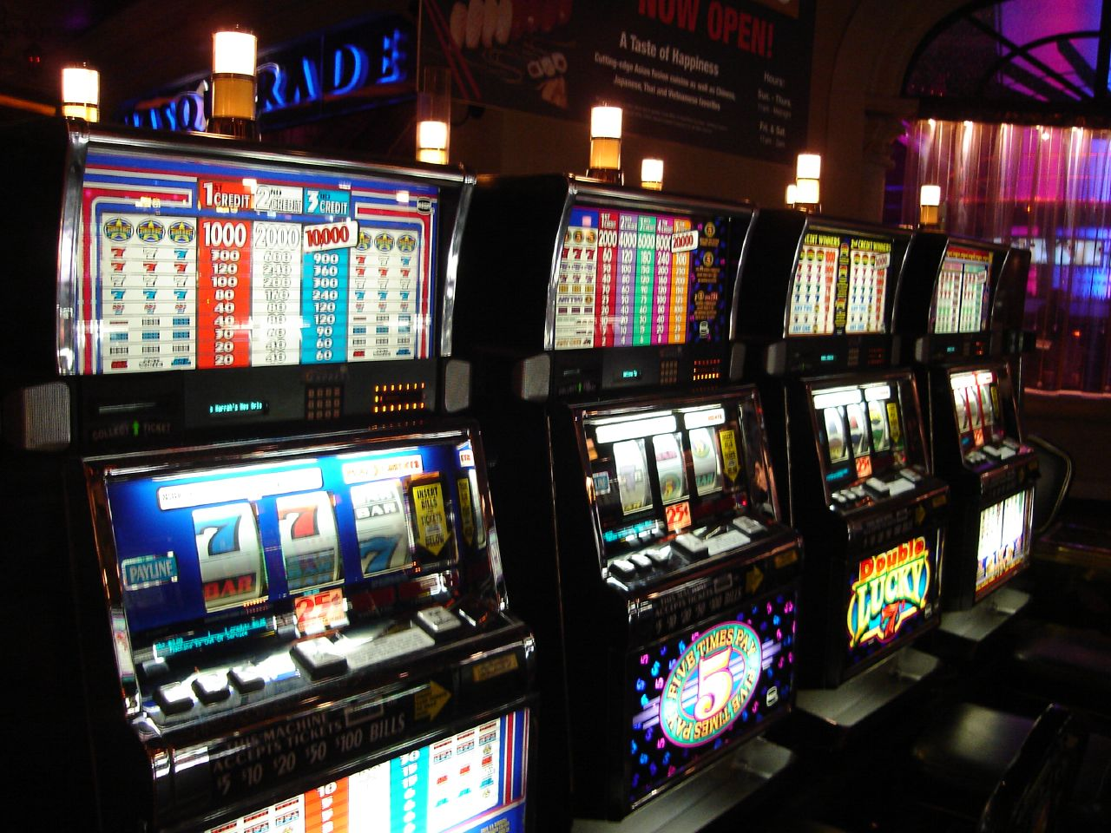
Problem Gambling and Community legal QLD
Webinar
RAQ Maroochydore / Gympie

Slide 2
Notes:
2

Slide 3
Webinar Goals
Understand the impacts of gambling in contexts of individual, social, health and financial
How to screen and refer for gambling related issues
Understand the unique position legal services are in screening for gambling and feel confident in doing screening and referring
Notes:
3

Slide 4
Main Points
Gambling is a health problem with complex presentation and wide reaching impacts
Shame and stigma inhibit help-seeking and screening, however screening is simple
Referring and accessing help is simple and designed to reduce shame and stigma
Notes:
4

Slide 5
Gambling Defined
Gambling generally involves voluntarily staking an item of value (usually but not always money) on the outcome of an uncertain event. While there are virtually limitless forms of gambling, four main categories of legal gambling can be identified.

Slide 6
4 Main Types
Gaming: Gaming is the exchange of money on the outcome of a game. This category includes card games, poker machines, two-up, and casino games such as baccarat and roulette.
Betting: Betting is staking money on the outcome of a future event including horse racing, sporting events and elections.
Lotteries: Lotteries are the distribution of money by ‘lot' or number e.g., Instant ‘scratch' cards, raffles, lotto, and bingo.
Speculation: Speculation is gambling on business, insurance or stock markets.
N.B. Speculation is no longer usually considered to be a form of gambling, although some would disagree

Slide 7
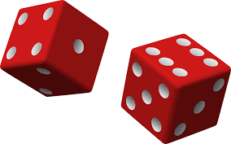
Why?
Why Do
People
Gamble?
Boredom -
Something
to do
Excitement
Adrenalin
Thrill of
a Win
Depression
Relationship
Breakdowns
Arguments
Socialising
Belief in
Luck
Escapism
Entertainment
Financial
Hardship
Notes:
Before the slide use the white board to get the group to map out why? -then use the slide

Slide 8
Case Studies
A. Single parent, working part-time, feeling lonely goes to a venue for lunch and a ‘flutter’ on the pokies
B. Man in early 20’s has an injury and can no longer play football. Begins wagering to continue the feelings of excitement and participation
C. Married woman in violent relationship, goes to a venue to feel safe
Notes:
8

Slide 9
Total Australia Gambling Expenditure
2015 – 2016 = $23.65 Billion (Queensland Government Statisticians Office)

Slide 10
Gambling & Public Health
Costs minimum $4.7 billion, up to$8.4 billion /yr
Estimated prevalence rates are between 0.5% and 1.0%, with a further 1.4–2.1% at risk of problems developing, equating to over 395 000 Australians
Problem gambling negatively impacts between 5 – 10 surrounding people
Productivity Commission. Gambling. Productivity Commission Inquiry Report vol. 1, no. 50. Canberra: Productivity Commission, 2010
Notes:
What are the real odds of winning?
The odds of winning differ for different types of gambling activities and it’s important to be realistic:
1st division in Gold Lotto (one game): 1 in 8,145,060
Top prize on a poker machine (playing maximum lines): up to 1 in 7,000,000
1st division in Powerball (one game): 1 in 76,767,600
The trifecta in a 13 horse race: 1 in 1,716
The 10 number jackpot on Keno (one game): 1 in 8,911,711

Slide 11
People who Play the Pokies at Least Weekly in Australia
One third of regular pokie-players are moderate - high risk- approx. 15% each.
Moderate – high risk players contribute over 70% of revenue
Notes:
11

Slide 12
Problem Gambling & Ripple Effect
Gambling
Individual
Family + Friends
Work
Finance + Economy
A person is said to have a problem with gambling if they continue gambling despite evidence that their gambling is causing personal, social, family, occupational or legal problems
(Milton, 2001)

Slide 13
Some of the Harmful Effects of Problem Gambling
Health
Stress, low self-esteem, depression, anxiety, physical illness, suicide.
Work or Study
Absenteeism, poor academic performance, job loss.
Financial
Inability to pay bills, rising debts, asset loss, bankruptcy.
Legal and Criminal
Theft or fraud.
Interpersonal
Family neglect, domestic violence, relationship breakdown.
Gambling Venues
Staff developing gambling problems – high prevalence.
Cost to the Community
Financial pressure on charities, government funds and legal system.
Notes:
13

Slide 14
Harmful effects
People with problem gambling experience high rates of co-occurring conditions, including depression, anxiety, substance use disorders
One in five problem gamblers attempt to kill themselves, this is about twice the rate of other addictions

Slide 15
Case Studies
Increased cigarette smoking, regular thoughts of suicide, low focus at work, pay advances, services cut, lying to family and friends, loans for bills & asking for extra $, shame, guilt, anxiety, low sleep & poor diet
B. High stress, thoughts of suicide, withdrawing, not paying bills, pay-day loans to pay out pay-day loans, lying to partner and parents, aggressive behaviours when questioned
C. Increased cigarette smoking, alcohol use, drug use, high anxiety, suicide attempts and hospitalisation, continuing domestic violence, loss of child custody
Notes:
15

Slide 16
The Majority of problem gamblers in Australia never seek assistance
8 - 15%
Help Seeking Behaviour
Gambling 2010 Productivity Commission Report
Notes:
16

Slide 17
Why do the majority of problem gamblers choose not to seek help?
Notes:
17

Slide 18
Seeking help
High risk players seek help when harm is imminent or has begun. Eg, legal procedings, divorce, suicide attempt.
Unwillingness to acknowledge problem, due to shame for self and for family
Treatment seen as a last resort when negative impacts are great and unavoidable
Gainsbury, Hing, Suhonen, 2014

Slide 19
Seeking help
Fear of stigma, shame and denial
Low understanding of treatment process
Wanting to solve problem alone, ashamed
Psychological barriers most salient, also most difficult to overcome from public health perspective
Gainsbury, Hing, Suhonen, 2014

Slide 20
Gambling and legal cross over representation in prisons
Moderate-high risk found to be as high as 70% in prison populations
High risk found to be as high as 10% of prison population
Compared to 0.5% - 2.1% of moderate to high risk in the general population
Turner, Stinchfield, McCready, McAvoy, Ferentzy. 2016

Slide 21
Gambling and legal presentation
Divorce and property settlement
Domestic Violence
Theft
Fraud
Drug and alcohol related crimes
Assault
Hodgins, Stea & Grant, 2011

Slide 22
Case Studies
A. Undeclared earnings to Centrelink and ATO, over $70 000. Sought help when legal consequences imminent
B. Stole over $20 000 from employer, who reported him to police. Sought help on release from prison on insistence from partner and parents
C. Began selling ice to pay for gambling, serving time in prison. Sought help to regain custody of child
Notes:
22

Slide 23
How to Help
People experiencing problems with gambling often feel ashamed about their gambling and will conceal the behaviour and associated consequences.
A non-judgemental and gentle approach that addresses both the gambling and potential harms is required
Motivational interviewing techniques improve the likelihood of change

Slide 24
Direct questioning & Screening
Direct questioning aims to:
normalise problem gambling as a health issue
introduce the topic of gambling in a non-confronting, non-personalised manner
offer screening for gambling if required
Implement direct, concise screening questions about gambling as part of your intake interview.

Slide 25
The Problem Gambling Severity Index (PGSI)
The following questions relate to gambling behaviour in the past 12 months.
Thinking about the past 12 months …
Have you bet more than you could really afford to lose?
Have you needed to gamble with larger amounts of money to get the same feeling of excitement?
When you gambled, did you go back another day to try to win back the money you lost?
Have you borrowed money or sold anything to get money to gamble?
Have you felt that you might have a problem with gambling?
Has gambling caused you any health problems, including stress or anxiety?
Have people criticised your betting or told you that you had a gambling problem, regardless of whether or not you thought it was true?
Has your gambling caused any financial problems for you or your household?
Have you felt guilty about the way you gamble or what happens when you gamble?
Never = 0; sometimes = 1; most of the time = 2; almost always = 3 https://www.gamblinghelponline.org.au/
A score greater than 8 indicates probable problem gambling

Slide 26
Help is available
Notes:
Free face-to-face counselling is available for problem gambling across Australia by calling 1800 858 858
A free, confidential, 24/7 helpline (1800 858 858) is available in every state and territory, and provides counselling, information and referral for gamblers and concerned family members. Self help booklets and printed service information are also available from these helplines
Online services appear attractive to those who experience high levels of shame and stigma. Accessed most often by young men, 70% of people accessing this service have never previously accessed treatment. Compared with other treatment modes, clients state that it is easy to access, easy to talk and convenient. The national online counselling service (www.gamblinghelponline.org.au) is available 24/7 and provides real time chat and email support
A four to six session semi-structured telephone counselling program (Ready to Change) is available in Victoria, Queensland and Tasmania, and can be accessed by calling 1800 858 858
www.gamblinghelponline.org.au/helping-others/assistance-for-professionals.aspx has links to state government resources for professionals
Financial counselling

Slide 27
Gambling Help Service
Sunshine Coast 1800 858 858
Relationships Australia
Referrals:-
Gamblers, their families and friends, and gaming venue staff receive free counselling.
Financial counselling is also available for free.
Gambling help online is available 24/7.
Ph:0467 655 799
Notes:
27

Slide 28
Non-English speakers
Helpline on 1800 858 858 and ask the counsellor to organise an interpreter through the Telephone Interpreter Service – you may need someone to assist you with explaining which language you need translating or
Telephone Interpreter Service (TIS) on 131 450
http://www.gamblinghelponline.org.au/accessing-support/non-english-speakers

Slide 29
Summary
Problem gambling is a significant public health issue in Australia
People with problem gambling experience high rates of co-occurring conditions, including depression, anxiety, substance use disorders and suicidality, impacting at min 5 people around them
Screening for problem gambling can be simple, using tools such as the PGSI and asking ‘has your gambling ever created issues in your life, eg relationships, work, finances and stress?’
When problem gambling is identified, being nonjudgmental and offering referrals for support
There are a range of free accessible support options in Australia, which include face to face, telephone and online modalities.

Slide 30
Community Education & Promotion
Gambling Awareness Week
Training / Community Education
Community
Service Providers
Gambling Venues
Notes:
Add date

Slide 31
Further Personal Account
This is a shocking story of how a free £5 bet led to a full blown addiction to online gambling. How someone who had it all could loose everything, including his job, his family and his home and then find hope and restoration. The fall and rise of a gambling addict | Justyn Rees Larcombe | TEDxRoyalTunbridgeWells
https://www.youtube.com/watch?v=7AN3VLLlkdI
Notes:
31

Slide 32
Questions?
Notes:
32

Slide 33
Thank you

Slide 34
References and Resources
Gainsbury, S., Hing, N., Suhonen, N. (2014). Professional help-seeking for gambling problems: Awareness, barriers, and motivators for treatment. Journal of Gambling Studies, 30, 503-519
Hodgins, D. C., Stea, J. N., & Grant, J. E. (2011). Gambling disorders. The Lancet, 378, 1874–1884
Turner, N. E., Stinchfield, R., McCready, J., McAvoy, S., & Ferentzy, P., (2016.) Endorsement of Criminal Behavior Amongst Offenders: Implications for DSM-5 Gambling Disorder. Journal of Gambling Studies, 32, 35-45.
https://aifs.gov.au/agrc/resources/datasets-and-statistics
http://www.qgso.qld.gov.au/products/reports/aus-gambling-stats/aus-gambling-stats-33rd-edn.pdf
https://www.gamblinghelponline.org.au
www.raq.org.au/
Gambling Help Service ph 1800 858 858
Life Line ph 13 11 14
Gamblers Anonymous ph 0467 655 799
Notes:
34

