Slide 1
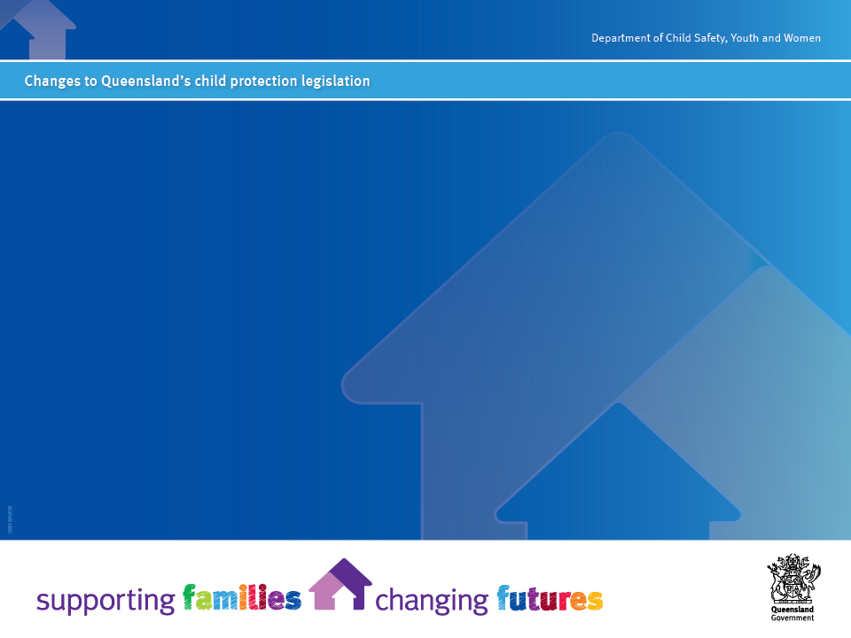
Child Protection Reform Amendment Act 2017
Introduction to the legislation amendments and implementation: Safe Care and Connection and Permanency
September 2018
Presenters: Debbie Jensen- Director, Child Protection Reform Amendment Act Implementation; Keryn Ruska- Legal Officer, OCFOS

Slide 2
Background
The Queensland Government is building a new child protection and family support system through its Supporting Families Changing Futures Reform program.
Underpinning the system will be contemporary legislation that better reflects the role of parents, families, communities, government, non-government and private sector in supporting Queensland children and families, now and into the future.
Based on the recommendations of the Queensland Child Protection Commission of Inquiry, the department has undertaken a comprehensive review of the Child Protection Act 1999 (the Act).
The Child Protection Reform Amendment Act 2017 (the Amendment Act) was passed by Parliament in October 2017 and assented in November 2017.
To address the outcomes and minimise impacts on frontline staff, the Department of Child Safety, Youth and Women (the department) will be taking a staged approach to allow for operational requirements to be planned and in place prior to the commencement of the provisions.
Amendments are commencing in three stages, with the first two having come into effect on 29 January and 23 July 2018. A final stage, which will require greater transformational change by the department and the sector, is planned for October 2018.

Slide 3
What’s the intent?
The Amendment Act aims to:
promote positive long-term outcomes for children in the child protection system through timely decision-making and decisive action towards either reunification with family or alternative long-term care
promote the safe care and connection of Aboriginal and Torres Strait Islander children with their families, communities and cultures
provide a contemporary information sharing regime for the child protection and family support system, which is focused on children’s safety and wellbeing, and
support the implementation of other key reforms under the Supporting Families Changing Futures reform program, including the Our Way strategy, and address identified legislative issues.
Underpinning all the legislative amendments is an updated paramount principle for administering the Act:
The safety, wellbeing and best interests of a child, both through childhood and for the rest of the child’s life, are paramount (s5A).

Slide 4
Safe Care and Connection…
Intent of changes | What are the objectives and Deliverables? | Key sections of the Child Protection Act 1999
To recognise the rights of Aboriginal and Torres Strait Islander peoples and ensure the connection of Aboriginal and Torres Strait Islander children and young people with their family, community and culture. We have a responsibility to build our collective cultural capability and understanding. We need to build on our relationships with families, communities, organisations and individuals, to ensure the way we work with Aboriginal and Torres Strait Islander children and young people keeps them connected to their cultural heritage, their family, their community and country. We have to place a focus, across the child protection system on culturally sound decision-making is required. | Objectives Ensure connection of Aboriginal and Torres Strait Islander children with their family, community and culture Provide for the right of Aboriginal and Torres Strait Islander people to self determination Better support a child and their family to participate in decision making, particularly cultural decisions Deliverables Delegation of functions and powers under the Act to an appropriate Aboriginal or Torres Strait Islander Entity All decisions made about an Aboriginal and/or Torres Strait Islander child are aligned to the five elements of the Child Placement Principle (Partnership, Connection, Prevention, Participation, Placement) Remove reference to Recognised Entities Introduce the new concept of an Independent Entity Cultural support planning for all Aboriginal and Torres Strait Islander children and young people | Section 5C – additional principles for Aboriginal and Torres Strait Islander children and young people Sections 6, 6AA & 6AB – independent Aboriginal or Torres Strait Islander entity and principles Chapter 4, Part 2A – prescribed delegates for Aboriginal and Torres Strait Islander children Section 83 – placing an Aboriginal or Torres Strait Islander child or young person in care

Slide 5
Safe Care and Connection
Is an intentional practice approach that:
Recognises the right of Aboriginal and Torres Strait Islander peoples to self-determination
Considers the long term impacts of decisions on a child’s identity, connection with family and community
Includes all five elements of the Child Placement Principle

Slide 6
What are the legislative changes?
Section 5C
new principle that recognises the right of Aboriginal and Torres Strait Islander peoples to self-determination
consideration of the long-term effect of a decision on a child’s identity and connection with the child’s family and community,
Including all five elements of the Aboriginal and Torres Strait Islander Child Placement Principle
Section 51B
a case plan for an Aboriginal and Torres Strait Islander child to include details about how the child will be supported to develop and maintain connections with their family, community and culture
Section 83 has also been amended to strengthen the requirement to place children with family.

Slide 7
Self determination
Aboriginal and Torres Strait Islander children and families:
have expert knowledge about their own lives
provide the primary source of cultural advice
Self-determination is to be applied throughout all decisions

Slide 8
The child placement principles- s5C
Prevention- that a child has the right to be brought up within the child’s own family and community;
2. Partnership- that Aboriginal or Torres Strait Islander persons have the right to participate in significant decisions under the Child Protection Act about Aboriginal or Torres Strait Islander children;
3. Placement- that, if a child is to be placed in care, the child has a right to be placed with a member of the child’s family group [and see also s83 placement hierarchy]

Slide 9
The child placement principles cont’d
4. Participation- that a child and the child’s parents and family members have a right to participate, and be enabled to participate, in an administrative or judicial process for making a significant decision about the child.
5. Connection- that a child has a right to develop and maintain a connection with the child’s family, community, culture, traditions and language, particularly when the child is in the care of a person who is not an Aboriginal or Torres Strait Islander person.

Slide 10
Increasing participation
Introduction of new concept of Independent Aboriginal or Torres Strait Islander entity (to be referred to as the ‘independent person’).
Commencement of Family Participation Program

Slide 11
Legislation
Section 6 outlines who can be an ‘independent Aboriginal or Torres Strait Islander entity for a child’
Section 6AA requires the chief executive, authorised officers and the litigation director to, in consultation with the child and their family, arrange for a person to facilitate the participation of the child and family when making a significant decision.
Schedule 3 includes the definition of a significant decision.

Slide 12
What is an independent entity (independent person)?
A person or organisation chosen by a child and child’s family who can help:
facilitate their meaningful participation in significant decisions made under the Child Protection Act 1999.
provide information about how to engage the child and family in a way that is likely to allow their full participation e.g identify a location appropriate to Aboriginal tradition or Island custom.

Slide 13
The role of the independent person
To support the child and their family feel stronger and supported to say everything they wish to say.
Providing contextual cultural information about things impacting on a parent, to ensure we are accurately understanding the parent’s motivations or actions when forming an assessment.
Helping the child, young person or family explain, cultural factors that may be impacting on a family’s capacity to fully participate in discussions and decisions (creating a culturally safe space).

Slide 14
Significant decisions
A decision that is likely to have a significant impact on a child’s life (Child Protection Act 1999, Schedule 3). The following decisions are considered significant for all children:
decisions about how to keep a child safe (safety planning during an investigation and assessment and OI)

Slide 15
Significant decisions (cont.)
decisions about whether a child is a child in need of protection
decisions about what type of ongoing intervention will be undertaken with a family
a decision to refer a matter to the Director of Child Protection Litigation about an application for a child protection order for the child
a decision about where or with whom a child, subject to a child protection care agreement, assessment order or child protection order granting custody or guardianship to the chief executive, will live (s83(2))

Slide 16
Independent Person: Court (s6AB)
When exercising a power under this Act in relation to an Aboriginal or Torres Strait Islander child, the court must have regard to—
(a) Aboriginal tradition and Island custom relating to the child; and
(b) the child placement principles in relation to the child
To inform itself about (a), the Court may have regard to the views of the independent person, the child or a member of the child’s family.

Slide 17
Exceptions- s6AA(3)
Must arrange independent person unless:
The child or the child’s family does not consent;
It is not practicable because the independent person is not available or urgent action is required to protect the child;
Arranging it is likely to have an adverse effect on the safety or psychological or emotional wellbeing of the child or any other person; or
It is otherwise not in the child’s best interests.

Slide 18
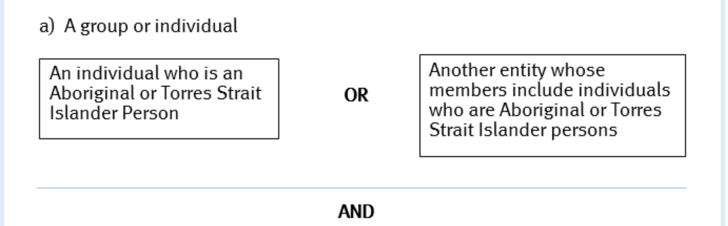
Who can be an independent person?

Slide 19
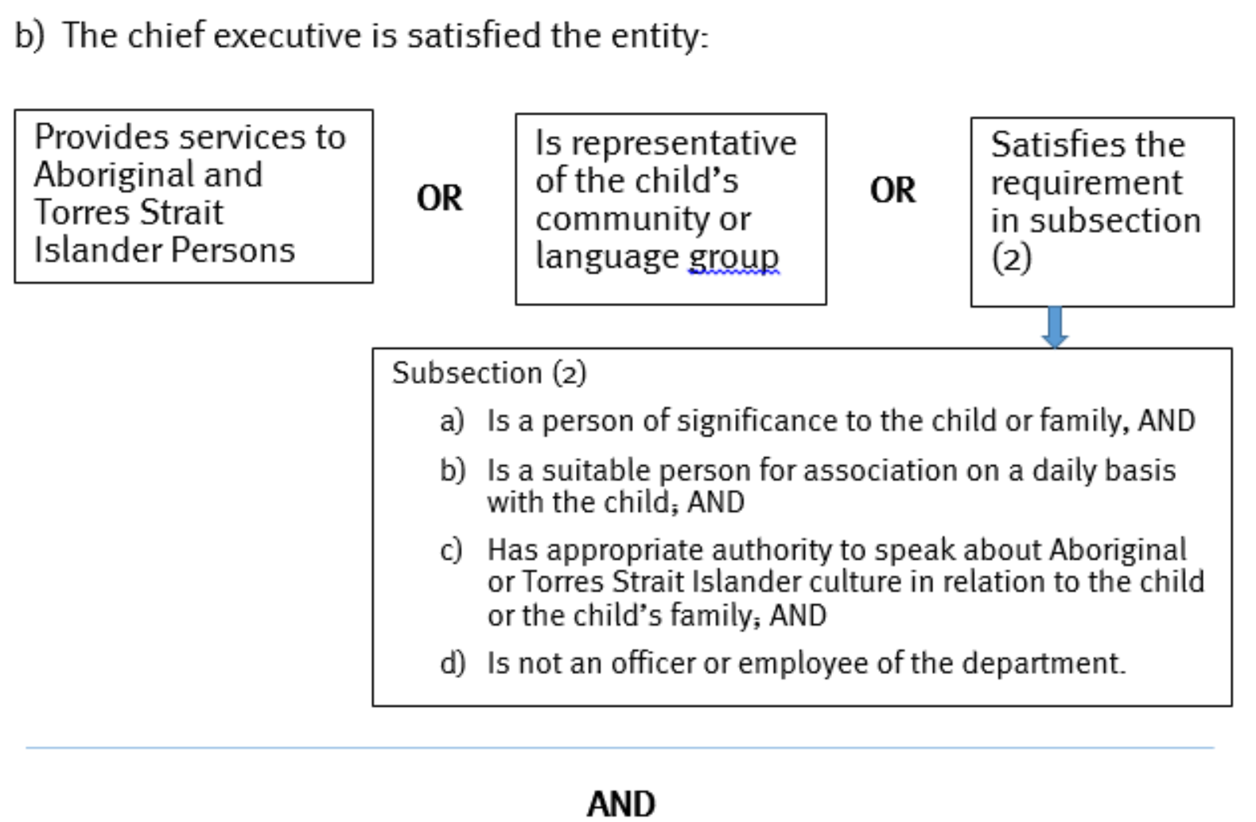

Slide 21
How is suitability assessed?
In determining suitability, a senior team leader will consider the following:
The person is someone who can be an independent person under section 6(a) and 6(b)
information about the person provided by the child and the child’s family and nominated person
child protection history concerning the nominated person
any conflict of interest or other circumstances
specific factors relevant to the decision

Slide 22
Permanency…
Intent of changes | What are the objectives and deliverables? | Key sections of the Child Protection Act 1999
To promote positive long-term outcomes for children and young people in the child protection system through timely decision-making and decisive action toward either reunification with family or alternative long-term care, as well as support for young people who have left care up to 25 years old. From the moment a child or young person comes into contact with the child protection system we will need to think about how each decision we make will impact on their life, both in the short and long-term – for the rest of the child’s life. We must take a collaborative and consistent approach to support and enable decisions that will achieve relational, physical and legal permanency. | Objectives Better promote permanency and stability for a child or young person in care Ensure better long-term outcomes for children and young people who have been in care Simplify court processes for changing a child’s guardian Ensure help is available for a young person in their transition to adulthood up to 25 years of age. Deliverables Amended paramount principle – Safety, wellbeing and best interests of a child both through childhood and for the rest of the child’s life New Permanency Principles including additional principles for Aboriginal and Torres Strait Islander children Permanency goals detailed in case plans New Permanent Care Orders and complaints framework for children and young people on PCOs Prevention of use of consecutive short-term orders beyond two years Transition planning is undertaken with all young people from the age of 15. | Amendment of Section 5A which is the paramount principle New section 5BA – principles for achieving permanency for a child Section 59, 59A, 61, 65AA, Division 3A – permanent care orders New Section 79A – obligations of long-term or permanent guardian Section 51B – what is a case plan (includes permanency in the case plan) Section 62 – duration of child protection orders Sections 51B(1B), 75 – transition to independence

Slide 23
Restriction on consecutive short term orders (s62)
Amended s62 introduces the restriction on consecutive short term orders beyond 2 years except if:
Another short term order (maximum duration 2 years) is in the best interests of the child; and
The Court considers reunification is reasonably achievable in the longer time.
Requires concurrent planning in case plans (new s51B(1A)).

Slide 24
Permanent Care Orders- s59(7A)
The Court must be satisfied that the proposed guardian is:
A suitable person for having guardianship of the child on a permanent basis;
Willing and able to meet the child’s ongoing care and protection needs on a permanent basis; and
Committed to preserving the child’s identity; connection to culture; and relationships with members of the child’s family in accordance with the case plan.
AND the child has been in the care of the proposed guardian, under a CPO granting custody or guardianship to the CEO or the proposed guardian, for 12 months immediately before the making of the application, unless there are exceptional circumstances that, in the best interests of the child, justify the making of the order (s59(7B)).

Slide 25
Permanent Care Orders- additional matters for Aboriginal or Torres Strait Islander children (s59A)
The new s59A requires the Court to have ‘proper regard’ to:
Aboriginal tradition and Island custom in relation to the child; and
The child placement principles (contained in s5C) in relation to the child.
Note: to inform itself about Aboriginal tradition or Island custom in relation to the child, the Court may have regard to the views of the independent entity (independent person), the child or a member of the child’s family (s59A(4))

Slide 26
Permanent Care Orders- additional matters for Aboriginal or Torres Strait Islander children
The Court must be satisfied that:
the case plan includes details about how the child’s connection with his or her culture and community or language group will be developed or maintained; and
the decision to apply for the order has been made in consultation with the child, if the Court considers consultation is appropriate. (s59A(3))

Slide 27
Information Sharing…
Intent of changes | What are the objectives and deliverables? | Key sections of the Child Protection Act 1999
To provide a contemporary information-sharing regime for the child protection and family support system which is focused on the safety and wellbeing of children and young people. It will be easier to decide when it is appropriate to share information and what information can be shared to ensure the safety and wellbeing of children and young people known to the child protection system. Services providing support to a family will be able to share information with each other in the event the family moves from one part of the state to another. A service that was previously working with the family to provide preventative support will be able to share information with another service which begins to work with a family because the child is now in need of protection. | Objectives Implement a contemporary information sharing regime focused on the best interests of children and young people clarify and simplify the provisions in the Act that enable the sharing of relevant information while protecting the confidentiality of the information Deliverables Develop and publish Information Sharing Guidelines that provides advice on when information should be shared and on secure use, storage, retention and disposal of information Enable ‘specialist service providers’ funded by the Queensland or Commonwealth Governments to share relevant information with each other Clarification regarding unborn children and pregnant women Improved capacity to participate in research and projects to build a strong evidence base. | Section 159C – Information Sharing Guideline Chapter 5A – Information Sharing Section 189B – Research

Slide 28
Resources & Contacts…
For more information about the changes to the child protection legislation, go to the Child Safety website:
www.communities.qld.gov.au/childsafety/about-us/legislation
For any questions or concerns, please call the Child Protection Reform Amendment Act Implementation Team on (07) 3238 7689 or email:
CPAreform@csyw.qld.gov.au

