Slide 1
Legal Aid Queensland
Family Advocacy and Support Services
Presented by Melissa Smalley, Legal Aid Queensland,
6 September 2018

Slide 2
This webinar/video is for community legal education purposes only. You may not reproduce, publish, commercially exploit or recreate the webinar/video or any part of the webinar/video. No claim is made as to the accuracy or authenticity of the webinar/video’s content. The webinar/video is provided on the basis all people accessing the webinar/video are responsible for assessing the relevance and accuracy of the webinar/video’s content. Legal Aid Queensland does not accept any liability for the accuracy of the information in the webinar/video or any use of the information contained in the webinar/video.

Slide 3
Outline
How did it come about?
Who can FASS help?
People involved and what they do
Criteria to access the service
Who have we helped? – cases
Making Referrals

Slide 4
Poll
What is your area of work?
(a) lawyer – community legal centre
lawyer – private practice
social worker or support worker
other

Slide 5
Family Advocacy and Support Services

Slide 6
How did it come about?
Commonwealth Government funding initiative, extra funding for FV legal assistance services
Recommendation made by NLA to AG
Funding approved
National service in each state
(different approach under guidelines)

Slide 7
How did it come about?
QLD - Brisbane, Townsville and Cairns
Began 27 March 2017 (Queensland)
2 ½ year project, current funding finishes June 2019
Reviews

Slide 8
Intent
– “Specialist family violence and family law legal assistance would be provided to families affected by family violence, who cannot afford legal representation” (NLA report 30/6/16)
- provide immediate legal and/or support services to clients who have family law issues and have been impacted by family violence in some way (broad definition)

Slide 9
Who can FASS help?
– perpetrators can get assistance too
- “Legal assistance would be available to both victims and alleged perpetrators, as experience demonstrates that such a model promotes victim safety and perpetrator accountability.” (NLA report 30/6/16)

Slide 10
Who can FASS help?
1. Clients with matters in court that day
Similar to current FLDL service but support worker now available to clients
2. Clients requiring urgent legal assistance
Where action needs to be taken immediately or within 72 hours, eg recovery & airport watch list
Filling gap between getting legal aid or seeing private lawyer or community legal centre

Slide 11
Who can FASS help?
No formal means or merit test, but have parameters given funding
Face-to-face services provided at time client attends (no bookings)
no telephone or video interviews
both legal and support services available if needed for both parties in dispute (conflict service).

Slide 12
People involved
Staff for services include:
intake officer
duty lawyer
social support worker.

Slide 13
People involved
Brisbane services involved include:
Legal Aid Queensland
(lawyer & support worker)
Caxton Legal Centre
(lawyer & support worker).

Slide 14
People involved
Townsville services involved include:
Legal Aid Queensland (lawyer)
NQ Women’s Legal Service (lawyer)
Townsville CLS (lawyer)
NQ DV Resource Centre (support worker).

Slide 15
People involved
Cairns services involved include:
Legal Aid Queensland (lawyer)
NQ Women’s Legal Service (lawyer)
Cairns CLC (lawyer)
Cairns DV Service (support worker).

Slide 16
People involved and what they do
Duty lawyer’s (in court) role includes:
advice
document preparation (limited)
more representation than FLDL (limited)
legal aid applications.

Slide 17
People involved and what they do
Duty lawyer’s (not in court) role includes:
advice
letter
simple court document preparation (limited)
legal aid applications.

Slide 18
People involved and what they do
Support worker’s role includes:
risk assessment
safety planning
referrals
counselling
information about applying for a protection order
legal aid applications.

Slide 19
Criteria to access FASS
Family violence
+
Very urgent legal issue
OR

Slide 20
Criteria to access FASS
Family violence
+
In court that day

Slide 21
Criteria to access FASS
Assessing family violence:
Different assessments state to state
Currently 8 questions (if two yes then FV)
Even if historical
Even if other party or some one else involved who is impacted, eg grandparent

Slide 22
Criteria to access FASS
Family violence
+
Very urgent legal issue

Slide 23
Criteria to access FASS
Examples of very urgent legal issues:
recovery (risk to children)
airport watch list (imminent departure)
property injunction
* See guide attached.

Slide 24
Who have we helped?

Slide 25
Who have we helped?
Recovery case examples:
new born babies, violent fathers
father on ice took 1 year old at service station & went on run sending pics of child
father broke in to mother’s house in middle of night, forced her to have sex and took 1 year old child who barely knew him.

Slide 26
Examples of cases
What is not very urgent:
mother didn’t return children after her half school holidays with them, children missing school
father didn’t return 3 year old child after his long weekend with child, saying to mother she will never see child again

Slide 27
Examples of cases
What is not very urgent:
mother has left the father and taken the children after severe DV relationship and wants an urgent order that they can live with her and father has no time
child came to father with bruises so he’s wanting to get urgent order to have children stay with them, so mother can’t take them back.

Slide 28
Who have we helped?
How many people have we helped in Brisbane only:
1/4/17 – 31/3/18
939 clients (legal services)
236 (non-legal services).

Slide 29
Poll
What percentage of clients helped by FASS were male?
(a) 10%
20%
30%
40%

Slide 30
Referrals
Where do clients come from:
Court registry
Legal Aid Queensland front counters
Legal Aid Queensland contact centre
Legal Aid Queensland advice lawyers
Community legal centres
Domestic violence services

Slide 31
Where to get legal help?

Slide 32
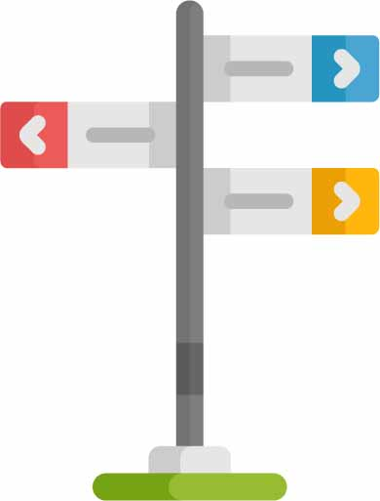
Referrals
How to refer clients:
matters in court that day - refer as you usually would to FLDL service
(in Brisbane intake office on level 1,
or if complex then see next slide )
matters not in court - assess family violence + urgent legal issue.

Slide 33
Referrals
In Brisbane (not in court):
Call Legal Aid
Suellan Walker-Munro – 3917 0418
Sarah D’Alton – 3917 0570
FASSBrisbane@legalaid.qld.gov.au (to send info for conflict check or send docs once approved).
1. conflict check 2. provide details

Slide 34
Referrals
In Cairns and Townsville:
Contact Legal Aid office
Cairns (07) 4437 2900
Townsville (07) 4613 7300.

Slide 35
Referrals
If it is not that urgent (ie no family violence or not in FASS area):
usual referrals for urgent advice and possibly urgent legal aid application.

Slide 36
Referrals
Practical tips when making referrals:
think about your client’s location and situation
client to bring documents if they can
arrange someone to watch children
do not advise client to attend late in day
can be at court for a long time

Slide 37
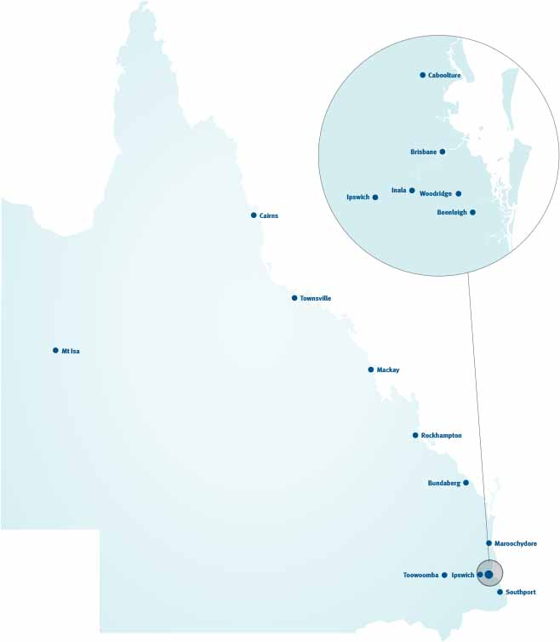
Our office locations
Brisbane (Head Office)
Bundaberg
Caboolture
Cairns
Inala
Ipswich
Mackay
Maroochydore
Mount Isa
Rockhampton
Southport
Toowoomba
Townsville
Woodridge

Slide 38
Contact us
Legal information and referrals
1300 65 11 88
Indigenous information line
1300 65 01 43
Questions about an application you have already submitted
07 3238 3900

Slide 39
Any questions?

