Slide 1
Respect Inc.
Queensland Sex Workers

Slide 3
Presenters:
Presentation:
Elena Jeffreys, PHD (Political Science) UQ
State Coordinator, Respect Inc
Kayla Rose, LLB (Hons) QUT
Secretary, Respect Inc
The laws in Queensland
How the laws are enforced
Decriminalisation of sex work

Slide 4
Criminalisation of sex work in Queensland
Prostitution Act 1999 (Qld)
Criminal Code 1899 (Qld) s 22A
Police Powers and Responsibilities Act 2000 (Qld)

Slide 5
Criminalisation of sex work in Queensland
Prostitution Act 1999 (Qld)
This act is the basis of the Licensing Framework for Brothels in Queensland. Approved brothels are legal, but criminalised if they breach any part of the Brothel Regulations. There are 20 licensed brothels in Qld (19 in South East Qld, 1 in Cairns).
Brothel Regulations specify the permitted location of brothels, limits the number of workers per shift (maximum 8), and defines the number of rooms per brothel (maximum 5).

Slide 6
Penalties for sex work offences
Prostitution Act 1999 (Qld)
Penalty Infringement Notices (PINs) are issued by police for for advertising offences. They are a fine of around $750.
The Prostitution Act 1999 also includes criminal charges - resulting in up to $6,000 in fines and a recorded conviction.
A sex work charge can have huge impact on sex workers’ other career prospects, relationships with family and friends, and makes us vulnerable to police harassment.
Being charged also can result in being outed by the media. This threatens the sex workers personal safety and privacy and has implications for child custody arrangements.

Slide 7
Prostitution Licensing Authority (PLA)
The PLA was established by the Prostitution Act 1999. The PLA can trigger police charges against sex workers.
The PLA have the power to determine what words can’t be used in advertising. However they do not give firm advice about which words can be used.
The lack of clarity around wording for advertising results in hundreds of Police Infringement Notices being issued to sex workers each year.
There is no sex worker representation within the PLA.

Slide 8
Criminal Code 1899 (Qld) s 22A
The Criminal Code 1899 covers all sex workers outside of brothels, about 80% of sex workers.
If convictions it allows for up to $6,000 in fines and criminal record.
The most common charge is ‘Participating in the Provision of Prostitution.’
= working in pairs, sharing resources/overheads, helping each other with advertising.

Slide 9
Criminalisation of sex work in Queensland
3. Police Powers and Responsibilities Act 2000 (Qld)
This Act makes it legal for police to pretend to be a client. They can call sex workers to gather information about our services, then arrest us for:
Doubles bookings
Referrals to other workers
Verbally offering any sex without a condom (ie blow job)
Using a receptionist
Using a driver that another sex worker also uses

Slide 10
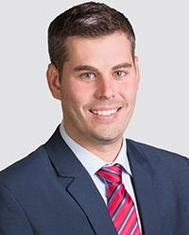
The Police Minister is directly responsible for all activity relating to the laws we have described:
Prostitution Act 1999 (Qld)
Criminal Code 1899 (Qld) s 22A
Police Powers and Responsibilities Act 2000 (Qld)
Police Minister Mark Ryan

Slide 11
How the laws are being policed in Queensland?
Mostly through sex worker advertising.
Any police officer in any police station can monitor sex worker advertisements online and in newspapers, and issue a P.I.N. via text.
Prostitution Enforcement Task Force (P.E.T.F.) is a specialist group of police
Also any police officer in any police station can pose as a client to gain a sex workers’ address or location, attend the location and try to further entrap the worker for the purpose of a criminal charge.

Slide 12
Asian background Sex Workers are especially targeted
Police assume that migrant sex workers are working illegally.
Many Asian background sex workers were born in Australia
Massage parlours are a good option for sex workers who choose not to provide full service.
Sharing resources such as an apartment or hotel room makes good economic sense. Police view this as ‘organised crime’ and trafficking.
The busts continue yet the only trafficking cases making it to court are those brought by sex worker themselves.

Slide 13
Prostitution Licensing Authority
Regularly visits licensed Brothels in Qld
Views sex worker health certificates
Checks how many workers are on premises
Stand around looking at the sex workers on shift

Slide 14
What are the biggest problems with Police Regulation of Sex Work in Queensland?
Deliberate and resource-heavy entrapment of sex workers by police is lawful in Queensland.
Fitzgerald Inquiry recommendations remain unheeded.
Police treatment of sex workers is frankly frightening. Actual crimes remain uninvestigated while police prosecute sex workers for petty crimes instead.
The rate of criminal records being generated against sex workers surely must match the pre-Fitzgerald days…. 100 or more a year for 18 years.

Slide 15
There are 3 internationally recognisable frameworks for the regulation of sex work (UN, WHO, ILO, The Lancet, Kirby Institute, Amnesty International):
Criminalisation, everything is illegal, sex work is a crime
Legalisation/licensing, partially legal but mostly criminalised, sex work is a ‘social ill’, ie Queensland,
Decriminalisation, grants sex workers access to existing protections & justice, sex work is work, ie New Zealand, New South Wales
Notes:
Elena

Slide 17
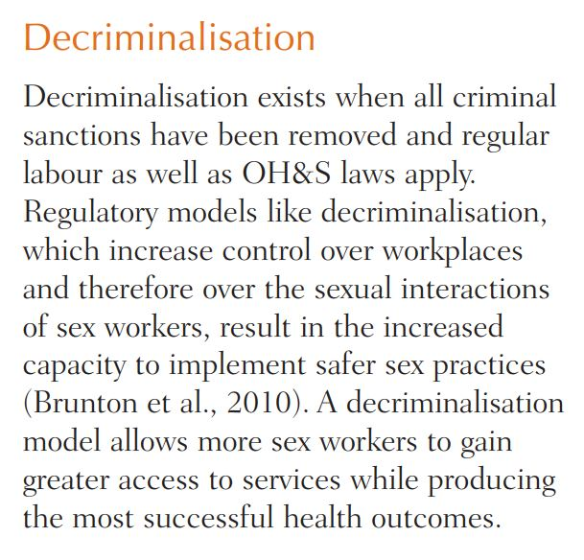

Slide 18
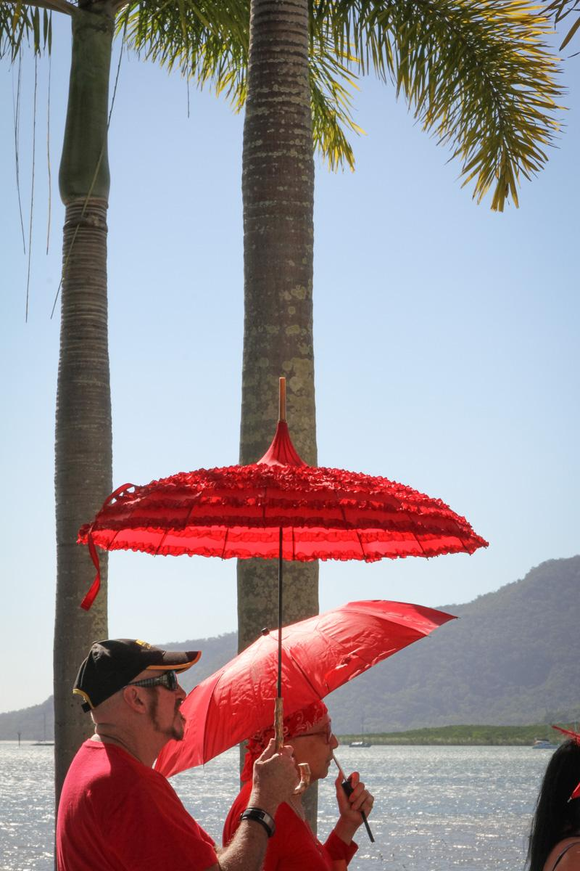
Decriminalisation is not:
Decriminalisation does not:
A lack of regulation
A ‘laissez faire’ approach
The deregulation of sex work
Increase the size of the industry
Increase the number of sex workers
Increase the number of brothels
Notes:
Elena

Slide 21
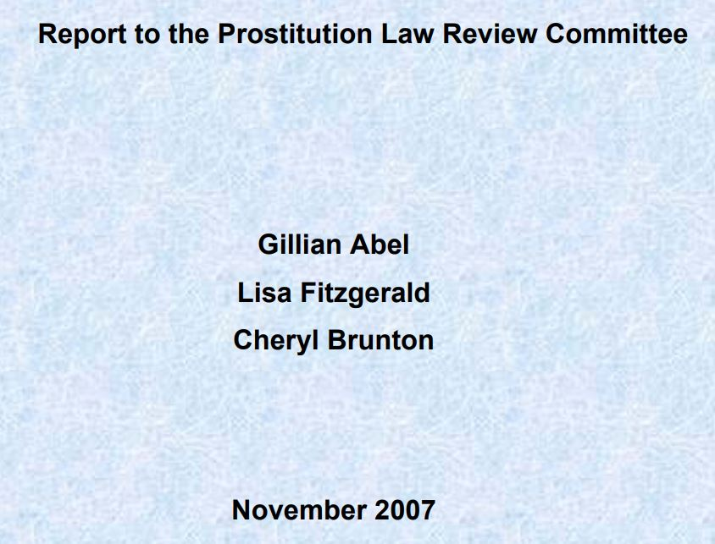

Slide 23
What would decriminalisation mean in Qld?
REMOVE
Police as regulators
Licensing provisions
PETF & PLA
PINS
Entrapment
Criminalisation
Prostitution Act 1999
Criminal Code 1899 s22A
Police Powers & Responsibilities Act 2000
GIVE ACCESS TO
Privacy protections
Anti-Discrimination law
Taxation law
Industrial Relations Act 2016
Workplace Health & Safety Act, Regulations, Codes of Practice 2011
Town Planning regulations
Amenity & Aesthetics regulations
Fair Work Act 2009
Public Health Act 2005
Notes:
Elena

Slide 25
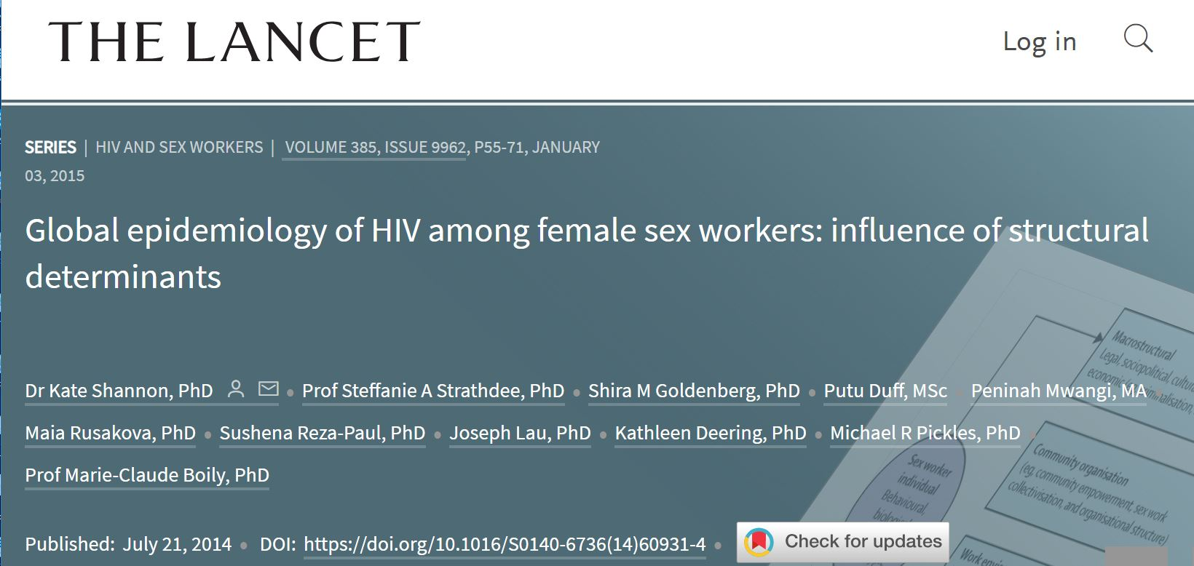

Slide 28
Evidence from decriminalisation in New Zealand shows:
Seventy percent of sex workers are more likely to report crimes. (New Zealand Government. 2008. Report of the Prostitution Law Review Committee on the operation of the Prostitution Reform Act 2003, Ministry of Justice)
Police and the justice system respond more effectively and fairly when crimes are reported. (Abel, G. M. 2014. “A decade of decriminalization: Sex work ‘down under’ but not underground”, Criminology & Criminal Justice 14 (5):580–92.)

Slide 29
Comparisons with other industries
Sex workers are very like:
Hairdressers
Journalists
Lawyers
Plumbers
Graphic Designers
Except sex workers cannot:
Sub-contract
Make referrals
Share overheads
Share phones
Employ a receptionist
Employ a driver
Describe what we do in our ads
Make informed decisions about style of work we want to do

Slide 30
Access to Justice
There are so many barriers to justice for sex workers in Queensland.
Statistics and improved outcomes for sex workers in accessing justice under decriminalisation.
We are currently charged for petty offences
When victims of crime we are basically ignored by police, disbelieved or arrested for sex work

Slide 31
Questions?

