Slide 1
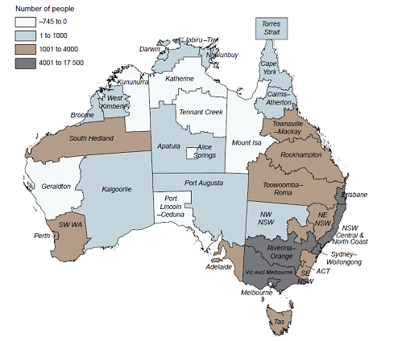
Rapid growth of Aboriginal and Torres Strait Islander populations in urban areas across Australia, with the fastest growth occurring in the SEQ region
Region | ABS 2016 | 2011- 16 Growth | % Growth
South East Qld | 70,735 | 17,467 | 33%
IUIH Footprint in SEQ = 10% of total Aboriginal and Torres Strait Islander population nationally

Slide 2
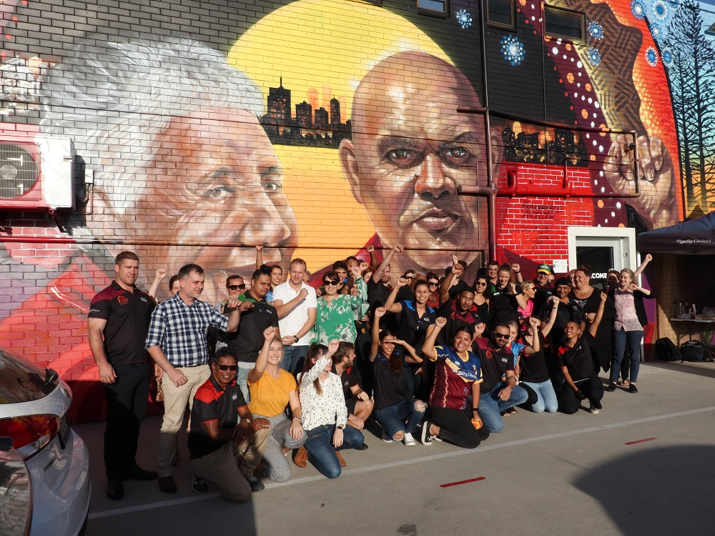
The Institute for Urban Indigenous Health (IUIH) – a regional health ecosystem
IUIH VISION:
Healthy, strong and vibrant Aboriginal and Torres Strait Islander children, families and communities

Slide 3
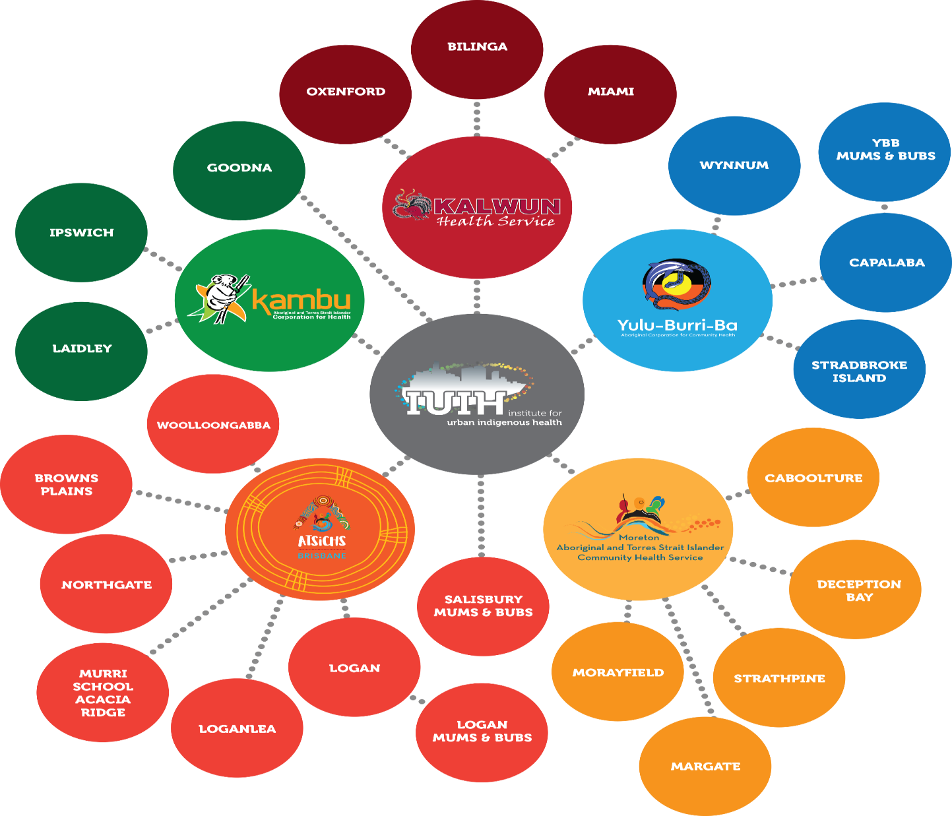
5
clinics in 2008
20
clinics in 2018
Notes:
This slide indicates the locations in which IUIH and it’s 4 member services have health services. To give you some context of the rapid growth of these services, in 2009, there were only 5 primary health care locations and now there are 19, with a 20th on the way. This growth has been critical given the large population and it’s continual rapid growth. In fact by 2031, when government have proposed we have closed the gap, SEQ will have doubled in size to 131 000 and will be the largest region of Aboriginal and Torres Strait Islander people in Australia (CAEPR paper, ANU)

Slide 4
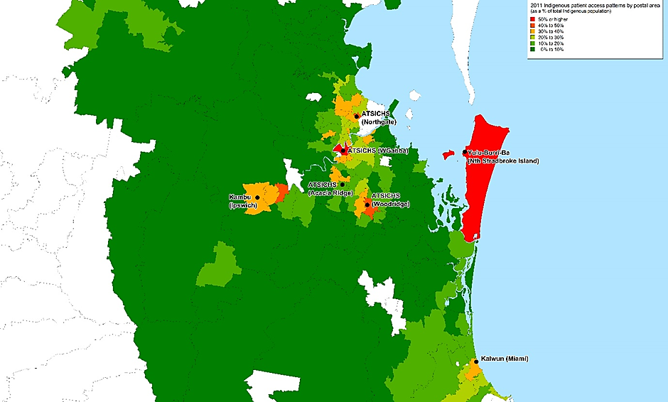
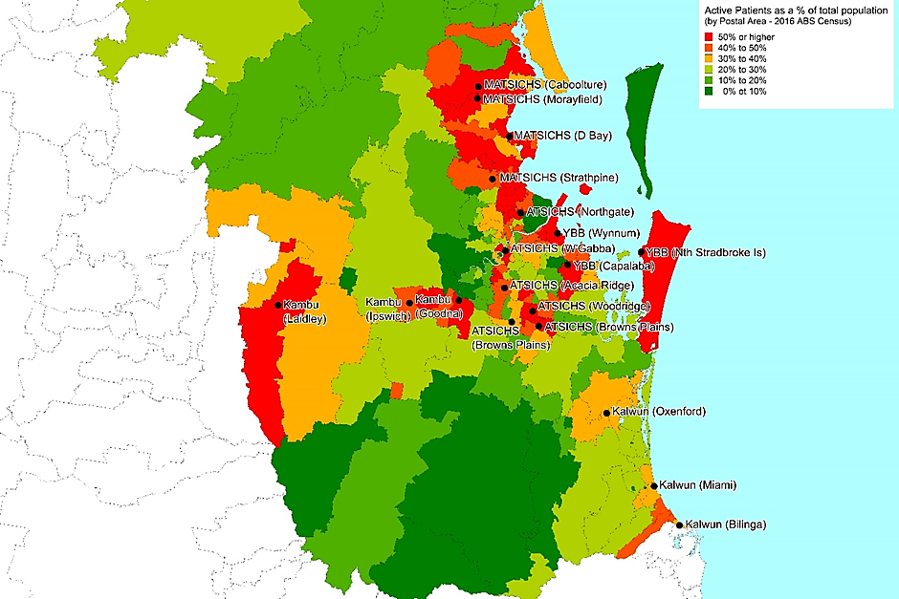
2011
Just under
8000 regular Aboriginal and Torres Strait Islander clients
2018
35,000 Aboriginal and Torres Strait Islander clients

Slide 5
Contribution to the Health Gap
BMI 7.2%
Expanded social support services
Strategies targeting social and cultural connection
Rights and social justice – a health justice partnership
Best start to life – birth, parenting and early childhood education and development
Strategic Workforce Development – training, employment, increased household income
Smoking
10%
Gap due to other unknown factors
Highest school level completed
8.7%
12.3%
38.8%
Employment Status
13.7%
Equalised Household Income
Australian Institute of Health and Welfare 2014d, Australia’s health 2014. Australia’s health series no. 14., Cat. no. AUS 178, AIHW:Canberra.
Notes:
The IUIH was established to INTEGRATE planning, develop and delivery of comprehensive primary health care services to Indigenous populations of SEQ. This vision represented a fundamental shift from ‘community control within the four walls of our clinics’ to community control leadership and support for whole-of-system response…

Slide 7
STRATEGIC PLAN
In keeping with the IUIH Strategic Plan (2017-2020) IUIH articulated in its accompanying Regional Service Plan the strategic action to:
Establish a Health Justice partnership, providing quality legal services within the IUIH Network of primary health care clinics.
Intent is to integrate legal expertise and a justice framework into the delivery of comprehensive health services for vulnerable individuals and families.

Slide 8
Internal Referral Service- “IUIH” GP’s and Allied Health Staff.
Initial Legal focus - Vulnerable families with children.
High influx and referrals/client engagement for legal issues including, but not limited to;
Family law,
Education,
Tenancy,
Debt,
Domestic Violence; and
Elder abuse.
Since inception June 2017, the unit has assisted in over 178 legal matters, including some multiple and extensive engagements with clients.
Due to the legal unit being woven into the very fabric and culture of IUIH and its system of care; mob engagement continues to rise with positive feedback and successful legal outcomes.

