Slide 1
Queensland Policing Response to Domestic and Family Violence
HIGH RISK TEAMS
Domestic, Family Violence and Vulnerable Persons Unit
Community Contact Command

Slide 2
CAVEAT
The information provided in the following presentation is not to be disseminated outside of its intended use.
If you wish to use any of the information contained in the following presentation please contact the Queensland Police Service Domestic, Family Violence and Vulnerable Persons Unit for approval.

Slide 3
OVERVIEW
Not Now, Not Ever Report (2015) Recommendations 74 to 78
  Led by the Department of Communities, Child Safety and Disability Services (DCCSDS)
  Establishment of Integrated Service Response Trials (74)
  Review and Evaluation of Trial Sites and Expansion (75)
  Establishment of High Risk Teams (76)
  Common Risk Assessment Framework (77)
  Enable Information Sharing through Legislation (78)

Slide 4
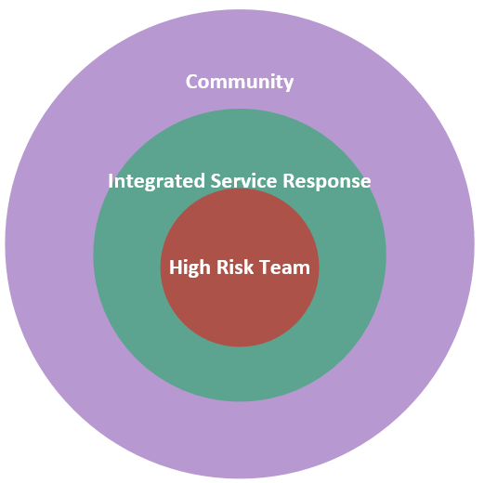
INTEGRATED SERVICE RESPONSE
Benefits
  Reduce secondary victimisation
  Increase focus on victim safety
  Increase perpetrator accountability
Challenges
  Power imbalance
  Difference in approaches
  Resources

Slide 5
REVIEW AND EVALUATION OF TRIAL SITES AND EXPANSION
Conducted by the Office of Women, Department of Communities, Child Safety and Disability Services
Central Queensland University
Individual Agencies may Conduct Internal Evaluations

Slide 6
ESTABLISHMENT OF HIGH RISK TEAMS
Urban Models
  Logan-Beenleigh
  Ipswich
  Brisbane
Regional with Outreach Models
  Mount Isa
  Cairns-Mossman
Discrete (Indigenous) Model
  Cherbourg

Slide 7
COMMON RISK ASSESSMENT FRAMEWORK
Develop a common language and understanding of definitions*
  Developed through Literature Review
  Analysis of Existing Policies
  Review of the Queensland Context in terms of Policy, Legislation and Service Delivery
  Co-Design with Key Stakeholders
Based on Action Research
Risk Assessment Based on both Victims and Offenders

Slide 8
ENABLING LEGISLATION, POLICIES AND PROCEDURES
Domestic and Family Violence Protection Act 2012
  Part 5A, Information Sharing
  169D Sharing Information for Assessing Domestic Violence Threat
  169E Sharing Information for Responding to Serious Domestic Violence Threat
  169G Permitted Uses of Shared Information
Domestic and Family Violence Information Sharing Guidelines (May 2017)
Queensland Domestic and Family Violence Common Risk and Safety Framework (June 2017)

Slide 9
Benefits to the QPS
Reduction in calls for service
Efficient/cost effective use of resources – not continually attending and investigating repeat jobs with same couple
Increased availability of staff to address other policing activities
Increased action and accountability by other agencies eg. Probation and Parole –
tightened supervision conditions.

Slide 10
CAVEAT
The information provided throughout this presentation is not to be disseminated outside of its intended use.
If you wish to use any of the information contained within the presentation please contact the Queensland Police Service Domestic, Family Violence and Vulnerable Persons Unit for approval.

Slide 11
Thank you

