Slide 1
Today’s webinar: Practicalities of Parenting matters with Child Safety Involvement
The interrelationship between family law and child protection
23 January 2019

Slide 2
Acknowledgement of country
Community Legal Centres Queensland acknowledges the traditional owners of the land on which we are holding this presentation, the Turrbul and Jaggara people.
We pay our respects to their elders, past, present and emerging, and acknowledge the important role Aboriginal and Torres Strait Islanders continue to play in our society.
As this presentation is being viewed throughout Queensland, we also pay respect to the traditional owners of the land throughout the country and extend a warm welcome to any First Australians listening to this presentation.

Slide 3
GoToWebinar housekeeping
Facilitator:
Carly Hanson, Sector Development Officer, Community Legal Centres Queensland
Recording:
This webinar is being recorded and will be available on the Staff Training page of our website: https://communitylegalqld.org.au/clc-staff/staff-training-and-cle
PowerPoint / webinar materials:
Emailed prior to today’s session
Available to download from Handouts section of GTW control panel
Questions:
Type your questions/comments into question box on GTW control panel OR
Raise your hand and we will unmute your microphone
Questions will be addressed at the end
Technical help:
Email sdo@communitylegalqld.org.au or use question box in GTW

Slide 4
Legal disclaimer
This presentation is for professional development and education purposes only. The information provided in this presentation is not legal advice and is designed for lawyers and other staff working and volunteering in a community legal centre setting in Queensland.
This presentation and webinar is not to be published or reproduced for commercial purposes without the express permission of the author.
Information is current as at 23 January 2019. Community Legal Centres Queensland does not accept any liability for the accuracy of the information in the presentation.

Slide 5
Keep safe – content note
Community Legal Centres Queensland wants to ensure that community legal centre workers and others accessing these training materials feel safe, and are able to access appropriate and timely help and support.
Some content in these training materials may be disturbing, upsetting or trigger strong/negative emotions for victims and survivors of violence and trauma, and others.
Community Legal Centres Queensland respects your autonomy. If you feel triggered or upset by any of the content or materials provided here, we encourage you to use your discretion as to whether you should continue reading, watching or listening to the material.
You may also wish to access more information and resources, as well as professional support or advice from one of the free and confidential organisations listed on our Keep Safe website page: http://communitylegalqld.org.au/keepsafe.

Slide 6
Practicalities of Parenting matters with child safety involvement
The interrelationship between family law and child protection
Webinar – 23 January 2019
Rikki-Jane Buckland, Solicitor
Skye Worth, Solicitor

Slide 7
Aims of this Webinar
Aimed at providing information and practical advice about the overlap of child protection and family law
Situations where family law and child protection collide
QLD Department of Child Safety, Youth and Women (“Department of Child Safety”) processes where there is a child in need of protection who is suffering or is at risk of suffering harm
Family law court processes where Child Safety are or may become involved and will affect the ability of the Court to make parenting orders
Advising clients about the dual systems – practical tips
Overview

Slide 8
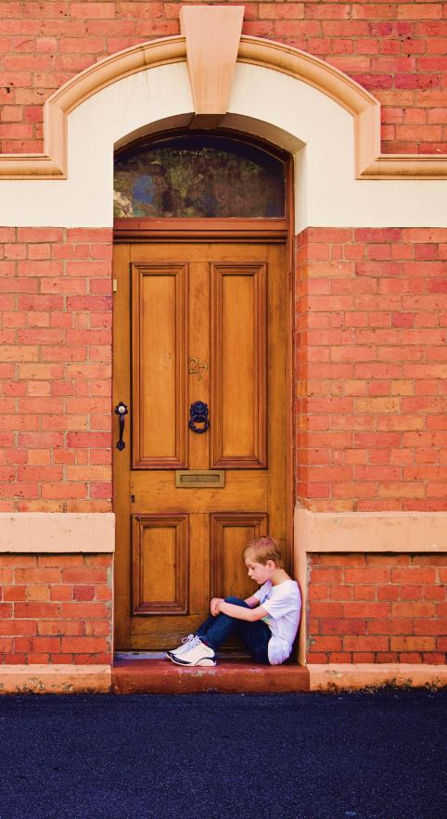
Situations where family law and child protection collide
No orders in place
Child Safety notification and investigation
Allegations of family violence, child abuse or risk of abuse
Child Protection Order in place (under Child Protection Act 1999 (Qld) “CPA”)
Expiry of Order imminent
Whether ongoing protection is needed
Federal Circuit Court / Family Court Order in place (under Part VII of the Family Law Act 1975 (as amended) “FLA”)
Interim order in place and incident happens or is discovered to have occurred
Allegations of family violence, child abuse or risk of abuse happen after Order is made final
Notes:
Thea Brown, Margherita Frederico, Lesley Hewitt and Rosemary Sheehan, Violence in Families – Report Number One: The Management of Child Abuse Allegations in Custody and Access Disputes before the FCA of Australia, Monash University, Clayton, 1998, Chapters 5 and 6; as cited in Belinda Fehlberg and Juliet Behrens, Australian Family Law: The Contemporary Context, Oxford University Press, 2008 at p 91

Slide 9
The Client
Mother
Father
Non-parties (CPA, s113)
Grandparents
Biological/non-biological same sex parents
Foster carers
The child
Importance of conflict checks on all parties

Slide 10
Harm & Risk of Harm
Child Protection Act
Family Law Act
Section 9 - WHAT IS HARM
(1) "Harm" , to a child, is any detrimental effect of a significant nature on the child’s physical, psychological or emotional wellbeing.
(2) It is immaterial how the harm is caused.
(3) Harm can be caused by—
(a) physical, psychological or emotional abuse or neglect; or
(b) sexual abuse or exploitation.
(4) Harm can be caused by—
(a) a single act, omission or circumstance; or
(b) a series or combination of acts, omissions or circumstances.
Section 10 - WHO IS A CHILD IN NEED OF PROTECTION
A "child in need of protection" is a child who—
(a) has suffered significant harm, is suffering significant harm, or is at unacceptable risk of suffering significant harm; and
(b) does not have a parent able and willing to protect the child from the harm.
Section 4 - INTERPRETATION
"abuse " , in relation to a child, means:
(a) an assault, including a sexual assault, of the child; or
(b) a person (the first person ) involving the child in a sexual activity with the first person or another person in which the child is used, directly or indirectly, as a sexual object by the first person or the other person, and where there is unequal power in the relationship between the child and the first person; or
(c) causing the child to suffer serious psychological harm, including (but not limited to) when that harm is caused by the child being subjected to, or exposed to, family violence; or
(d) serious neglect of the child.
Section 4AB - Definition of family violence
(1) For the purposes of this Act, family violence means violent, threatening or other behaviour by a person that coerces or controls a member of the person's family (the family member), or causes the family member to be fearful.
(3) For the purposes of this Act, a child is exposed to family violence if the child sees or hears family violence or otherwise experiences the effects of family violence.

Slide 11
Protection Under the FLA
FLA, s 60CC - How a court determines what is in a child's best interests - (2) Primary considerations are:
(a) the benefit to the child of having a meaningful relationship with both of the child's parents; and
(b) the need to protect the child from physical or psychological harm from being subjected to, or exposed to, abuse, neglect or family violence.
Also see s 60CC(3) (j) and (k), and s 60CG(1)(a) – Court must have regard to any family violence order (and ensure it is consistent)
Notes:
Explanatory Memorandum to the 2006 Amending Bill as cited in Keith Slack FM, The Approach of the Family Law Courts to the Investigation of Allegations of Child Abuse: The Unacceptable Risk Test, 13 August 2010

Slide 12
The Unacceptable Risk Test
FLA, s 60CG(1)(b)
(1) In considering what order to make, the court must, to the extent that it is possible to do so consistently with the child's best interests being the paramount consideration, ensure that the order… (b) does not expose a person to an unacceptable risk of family violence
M v M (1988) 82 ALR 577 - the Court does not have an obligation or a duty to resolve in a definitive way the disputed allegation of sexual abuse. Court must determine whether, on the evidence, that there would be an unacceptable risk to the children if the person about whom the allegations are made is to have contact or supervised contact with the children
B and B (1993) FLC 92-357 - A risk would be unacceptable if it outweighs the benefit of the child maintaining a meaningful relationship with that parent
Balance of probabilities - Evidence Act 1995, s 140 – Civil proceedings standard of proof / Briginshaw v Briginshaw (1938) 60 CLR 336

Slide 13
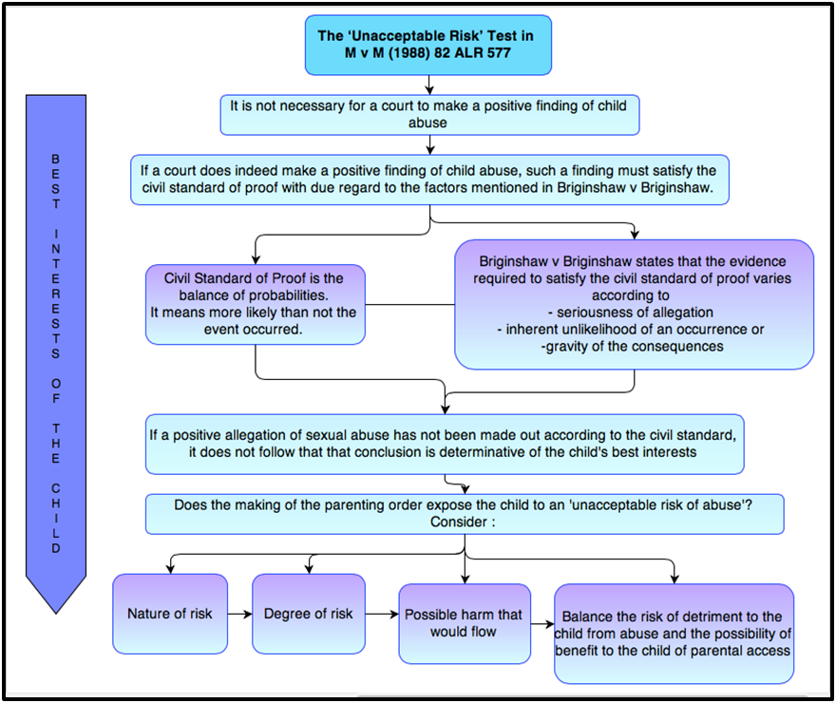
Taken from http://www.familylawexpress.com.au/family-law-brief/children/childabuse/falseallegations-childabuse/unacceptable-risk-standard-of-proof-in-determining-child-abuse-in-family-law/2880/

Slide 14
Child Safety Notifications
Sources:
Reports via Police and Child Safety Intake services
Mandatory Reporting under CPA, s 13G: (s 13E and 13F)
Family court jurisdiction: FLA, s67ZA
Notice of Risk when initiating proceedings in the family law court jurisdiction: FLA, s 67Z and 67ZBA
QLD Child Protection Guide: https://www.csyw.qld.gov.au/about-us/partners/child-family/our-government-partners/queensland-child-protection-guide
Confidentiality of Notifier Details
Protection for Mandatory/family court notification reporters: CPA s197A, FLA s 67ZB

Slide 15
Investigation Process
As part of the investigation and assessment Child Safety will:
determine if the child is safe
investigate allegations of significant harm and significant risk of harm
undertake a holistic assessment of the child and family within their usual home environment
determine if the child is in need of protection
decide whether there are supports that Child Safety or other agencies can provide to the child and family.
If the parents/carers/guardians are unwilling to facilitate the urgent investigation process by consent or it is not practical to seek that consent, then QPS or an officer of Child Safety may apply for a Temporary Assessment Order (duration of 3 days): CPA, s27
Investigation over a period of 28 days may be necessary and a Court Assessment Order may need to be sought: CPA, s44
Child Safety Manual: https://www.csyw.qld.gov.au/childsafety/child-safety-practice-manual

Slide 16
Child Safety Intervention
There are 3 types of ongoing intervention cases:
a support service case
intervention with parental agreement
intervention with a child protection order.
Child Protection Orders
Short (around 2 years) v Long Orders
Directive order
Supervision order
Custody order
Guardianship order
Variation/Revocation – CPA s65

Slide 17
Family Law Jurisdiction
Child Protection Orders override Orders made in the Family courts jurisdiction: FLA, s 69ZK
FLA, s69ZK(1): The Court cannot make a parenting order when a child is under the care of a child welfare law unless:
The order is expressed to come into effect when the child ceases to be under that care or
The order is made in proceedings relating to the child or continuation of which the written consent of a child welfare officer has been obtained.
See Tanner & Wagner [2011] FMCAfam 663 where a maternal grandmother’s application for parenting orders where the child was under a NSW welfare order was dismissed for want of jurisdiction.
When there is a Child Protection Order in place, a child welfare authority can give jurisdiction to the Court to make parenting orders in respect of a child under the care of that authority: Dunstan & Jarrod and Anor [2009] FamCA 480)

Slide 18
Interventions by Child Safety
FLA s 91B allows the Court to request intervention by a child welfare authority (see also s 92A)
Must be consensual – a Court cannot compel Child Safety to intervene as a party to proceedings without its consent: Naber & Grogan [2018] FCCA 1562 (22 January 2018)
Family courts make an order where:
Neither parent/party to proceedings is a viable carer for the child;
A report of harm or risk has been done to Child Safety
There is evidence of prior involvement of Child Safety
An ICL has been appointed
Parental responsibility can be allocated by a judicial officer to a Child welfare authority: Falcon and Anor [2010] FamCA 396,Seldon & Denny and Anor [2010] FamCa 1029
Notes:
Case Notes – Naber & Grogan [2018] FCCA 1562 (22 January 2018), The Family Law Book, 2018, https://www.thefamilylawbook.com.au/

Slide 19
Family court processes to assist where child abuse allegations are made
Mediation not necessary: FLA s60J
Independent Children’s Lawyer (“ICL”) appointment
Family Report process
Subpoena process / Order under FLA s 69ZW for material to be produced
S 67ZBB requires court to take prompt action in cases with allegations (and consider interim/procedural orders re: evidence and the protection of children or parties as Court considers appropriate)

Slide 20
The Magellan List
Family Court of Australia case management system for cases involving serious allegations of physical and sexual child abuse
Fast-tracked process – aims for trial to be listed within 6 months
Referral to Magellan Registrar for consideration
Magellan Team – judicial officers, registrars, family consultants
Appointment of ICL
Procedural or interim orders that must be made to enable child to be protected from harm or risk of harm
Request for intervention of Child Safety authorities and a report about the allegations (the Magellan Report)
Order of a Family Report to be completed

Slide 21
Advising Clients
Advantages and disadvantages to both systems
Accuser or alleged perpetrator
Practical tips for lawyers

Slide 22
Child Protection
Advantages
Disadvantages
Investigative processes not available in FL courts
Timely/urgent intervention
Court not bound by rules of evidence (CPA s105)
Child can be directly involved
Independent Aboriginal or Torres Strait Islander entity
Review processes – QCAT
Ongoing and intrusive intervention
Investigation/intervention at discretion of Child Safety/DCPL/Children’s Court
Consent of both parties required or Court application possible
Lack of support/ supervision after expiry of CPO

Slide 23
Family Law
Advantages
Disadvantages
Significantly less intrusive than CSS
Contravention processes
Magellan program
Intervention by Child Safety
Decision-making benefits to parties (subject to family report recommendations/ICL)
No ongoing support offered to parties
Significant delays and costs, multiple court occasions
Unpredictability
Adversarial nature of proceedings
Evidence rules
Unacceptable risk of harm vs best interests of child

Slide 24
Practical Tips for Lawyers
Advising someone making allegations vs advising someone who has had allegations made against them
Avoid conflict of interest situations
Importance of listening to the client’s instructions
Make appropriate referrals
Give practical advice to clients
Advise them to be mindful of their communication with agencies
Correspondence can be utilised in evidence
Start a diary for communication/appointments/interactions with parties + Email correspondence confirming what was stated on the phone

Slide 25
Practical Tips for Lawyers
Evidence gathering
Caution: subpoena of records and FLA s 61C/s61DA(2) – Parental responsibility
Inform the client about the Unacceptable Risk test and how it works with the best interests of the child principles. Encourage boundaries as opposed to withholding the child from another parent or party.
Urgent application to Federal Circuit Court/Family Court due to allegations
Consider Domestic and Family Violence Protection Act 2012 (Qld), s 78
Correspondence to the other party seeking alternate arrangements
Correspond with Child Safety before the expiry of a Child Protection Order
Disclosure in affidavits

Slide 26
Questions?
Rikki-Jane Buckland, Solicitor
Skye Worth, Solicitor

