Slide 1
Australian Financial Complaints Authority
CLC Qld Annual Conference 21 March 2019
David Coorey Ombudsman
Notes:
I would like to acknowledge the Whadjuk people of the Nyoongar Nation as the traditional owners and custodians of the land on which we meet and their elders past, present and emerging.

Slide 2
Implementation and establishment
Established 1 November 2018
2016 Ramsay Review recommendation to simplify access to external dispute resolution
Merged three predecessor complaints resolution bodies (FOS, CIO, SCT)
One-stop shop – fair, free, independent

Slide 3
Australian Financial Complaints Authority
Slide 3

Slide 4
A new organisation
Leadership:
Chief Ombudsman and Chief Executive David Locke
Independent Chair Helen Coonan
Board with equal representation from consumer and industry
Culture of helpfulness, empathy and service
Proactive, outward-facing engagement ethos
550+ staff across Sydney and Melbourne offices

Slide 5
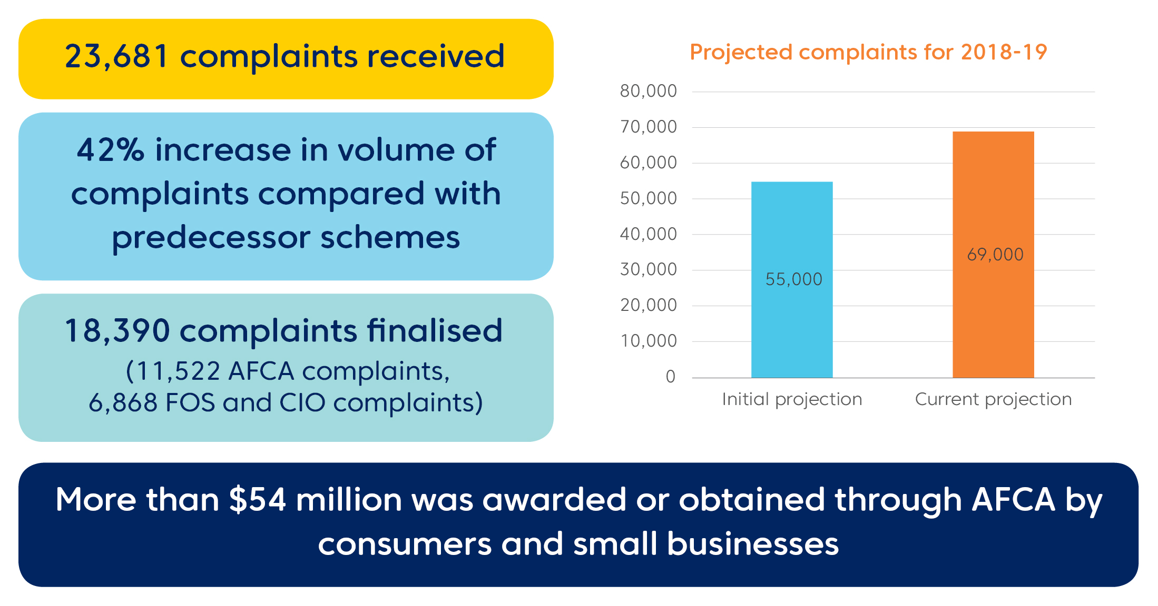
AFCA: The first four months of operations
We are seeing an increase in financial difficulty cases
*This includes matters previously received by AFCA’s predecessor, Financial Ombudsman Service, and resolved by AFCA since 1 November 2018.
Notes:
*This includes matters previously received by AFCA’s predecessor, Financial Ombudsman Service, and resolved by AFCA since 1 November 2018.

Slide 6
What new powers do we have?
Our expanded powers include:
increased monetary limits and compensation amount limits, with no amount limits on superannuation complaints
a ‘small business’ can be up to 99 employees (must be <100)
joinder – AFCA can join any AFCA member to a complaint, and can join individuals to a superannuation complaint.
Slide 6
Notes:
To encompass the jurisdictions of the CIO, SCT as well as FOS, the AFCA Rules expand on FOS’s powers and monetary limits. The intention of the new Rules was to ensure that none of the powers of the predeccesor EDR schemes were eroded.
AFCA’s rules about superannuation complaints are based on the same legislation that governs the Superannuation Complaints Tribunal. This is in order to maintain the scope and nature of the decision-making powers that are well-established in the superannuation industry.

Slide 7
Changes in claims limits and compensation caps
Type of claim | Old FOS limits | New AFCA limits
Most non-superannuation disputes | Monetary limit $500,000 | Monetary limit $1 million
 | Compensation cap $323,500 | Compensation cap $500,000
Dispute about a Small business credit facility | Facility limit $2 million | Facility limit $5 million
 | Compensation cap $323,500 | Compensation cap $1 million
Dispute about a Small business credit facility to Primary Production business (e.g. agriculture, forestry and fishery businesses) | Facility limit $2 million | Facility limit $5 million
 | Compensation cap $323,500 | Compensation cap $2 million
Dispute about whether a guarantee should be set aside where it has been supported by a mortgage or other security over the guarantor’s primary place of residence | Monetary limit $500,000 | No monetary limit
 | Facility limit for small business $2 million | Facility limit for small business $5 million
 | Compensation cap $323,500 | No compensation cap
Insurance stream product disputes | Compensation cap $8,700 per month | Compensation cap $13,400 per month
Uninsured third party motor vehicle claims | Compensation cap $5,000 | Compensation cap $15,000
General insurance broker disputes | Compensation cap $174,000 | Compensation cap $250,000

Slide 8
The Banking Royal Commission
Recommendations related to AFCA
Enhancing AFCA’s ability to obtain information (Recommendation 4.11)
Compensation scheme of last resort (Recommendation 7.1) and redress for past unpaid disputes

Slide 9
The government’s response to the Report related to AFCA
Payment of around $30 million in compensation owed to almost 300 consumers and small businesses for the unpaid determinations of FOS and CIO.
Establishment of a forward-looking compensation scheme of last resort to be administered by AFCA.
Expansion of AFCA’s remit for a period of 12 months to accept applications for disputes dating back to 1 January 2008 (commencing 1 July 2019)
Enhancement of AFCA’s role in the establishment and public reporting of firm remediation activities.
Place an obligation on AFSL holders to take reasonable steps to co-operate with AFCA
Review of funding for legal assistance and financial counsellors, to be led by Louise Sylvan (ACCC’s deputy Chair).

Slide 10
Fairness matrix*
Normative standards – community standards & expectations
-reasonable expectations of customer
Conduct (Vulnerability)
Contract

