Slide 1
Free online legal research tools: how to use them
Presented by:
Kim curran & jeannine goasdoue Research & Business Intelligence

Slide 2
About this session
You will learn TO:
1 | Start researching a topic
2 | Compare versions of Queensland legislation
3 | Find extrinsic material on a Bill or Act
4 | Find legislation on a topic
5 | Find cases which have considered a section
6 | Find cases on a topic

Slide 3
Research planning
Develop a strategy
1
2
3
4
Identify the issues
Make a list of keywords and synonyms
List the resources to search or view
Keep a record of resources you've searched and your search terms

Slide 4
Commentary
Sources
Looseleaf services
Textbooks
Journal articles
In house publications
Legal encyclopedia
Newspapers
Parliament sources
Government publications
A starting point
Google Books
Use your own documents or alerts from your legal service providers like Ashurst
Austlii
Lexology
e.g. Australian Law Reform Commission reports
Newspaper articles can give you public and social opinions on key issues
Committee reports, Hansard debate, and Tabled Papers can all give you explanations of policy decisions

Slide 5
Legislation
Sources to use
Authorised legislation
Queensland Legislation
Interpretation of the section
Queensland Legislation
Queensland Parliament – Hansard
Legislation on a topic
Lawlex

Slide 6
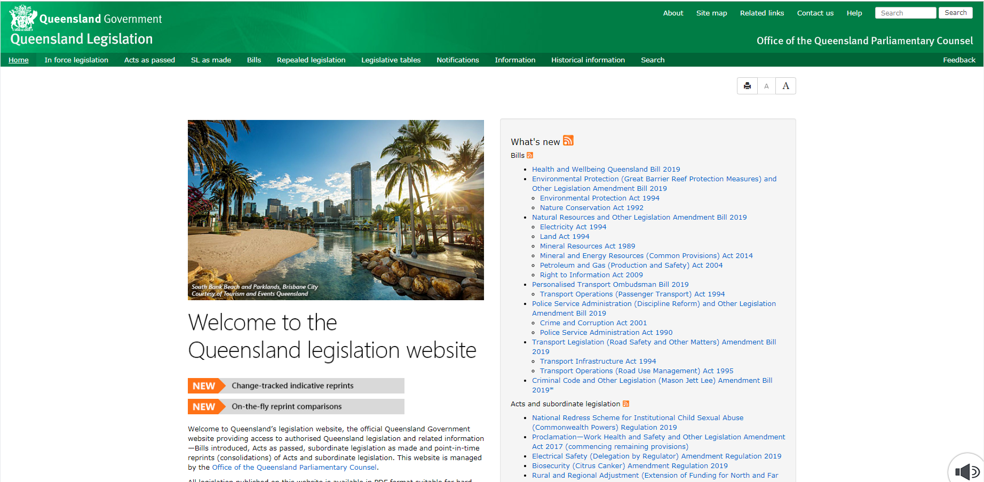
Queensland legislation
Comparative versions

Slide 7
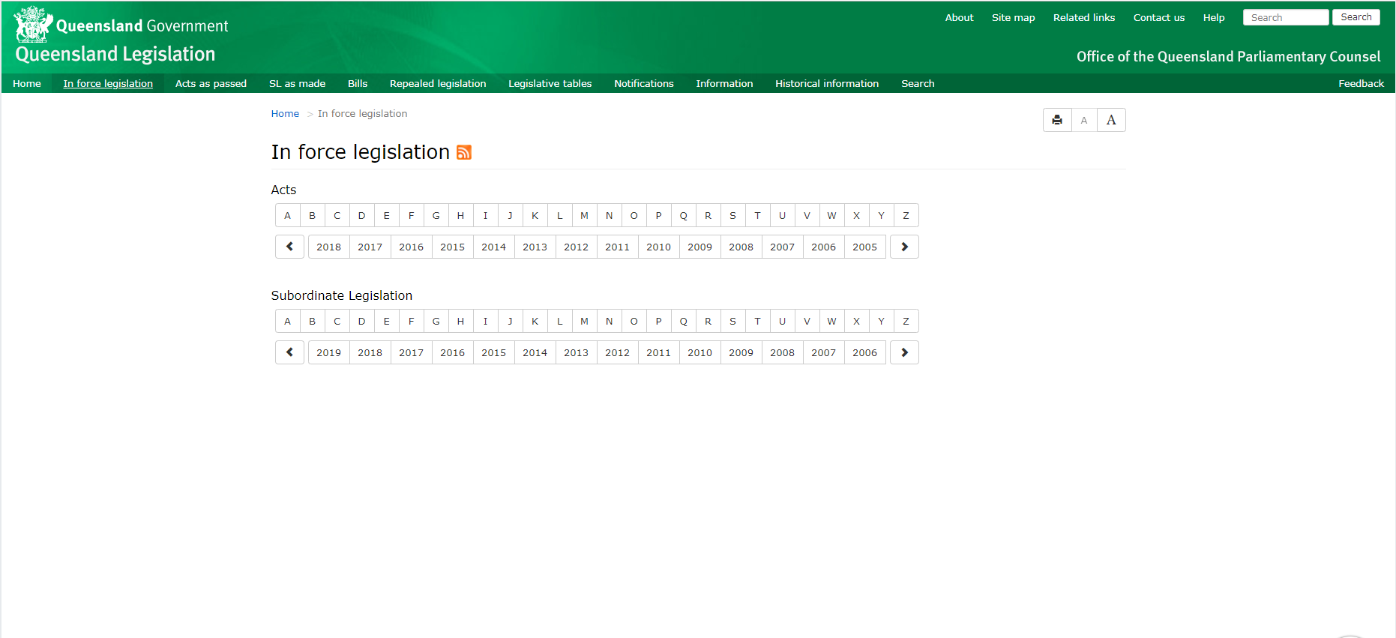
Queensland legislation
Comparative versions

Slide 8
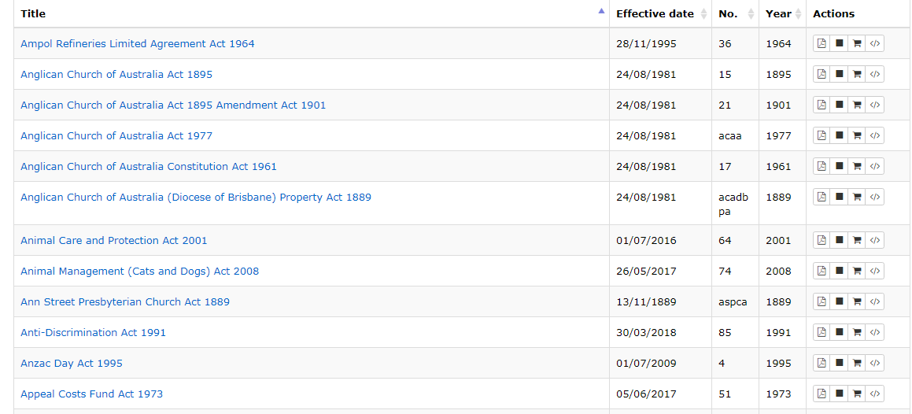
Queensland legislation
Comparative versions

Slide 9
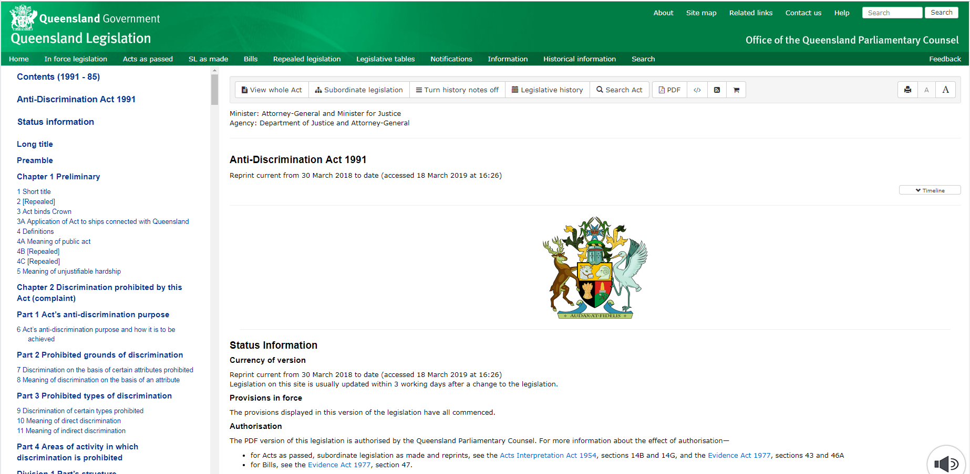
Queensland legislation
Comparative versions

Slide 10
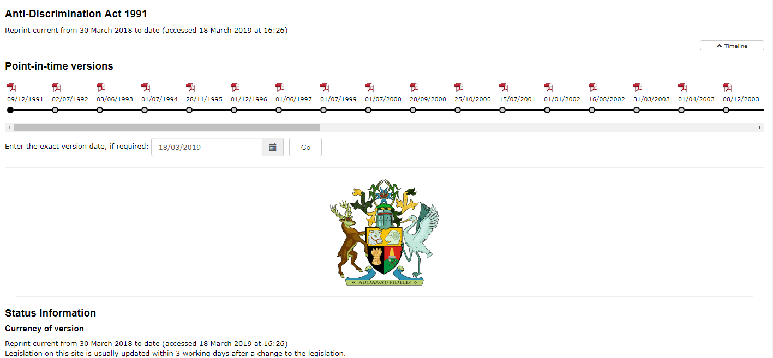
Queensland legislation
Comparative versions

Slide 11
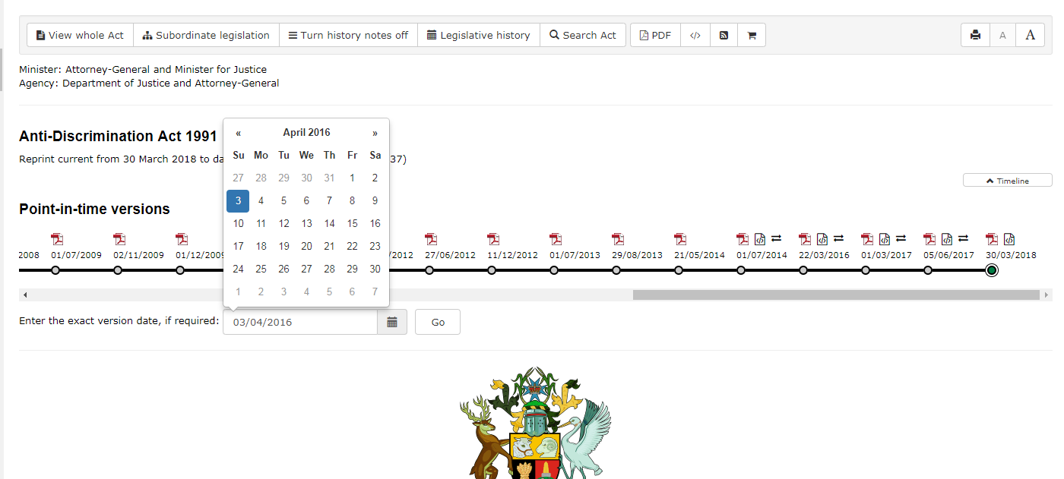
Queensland legislation
Comparative versions

Slide 12
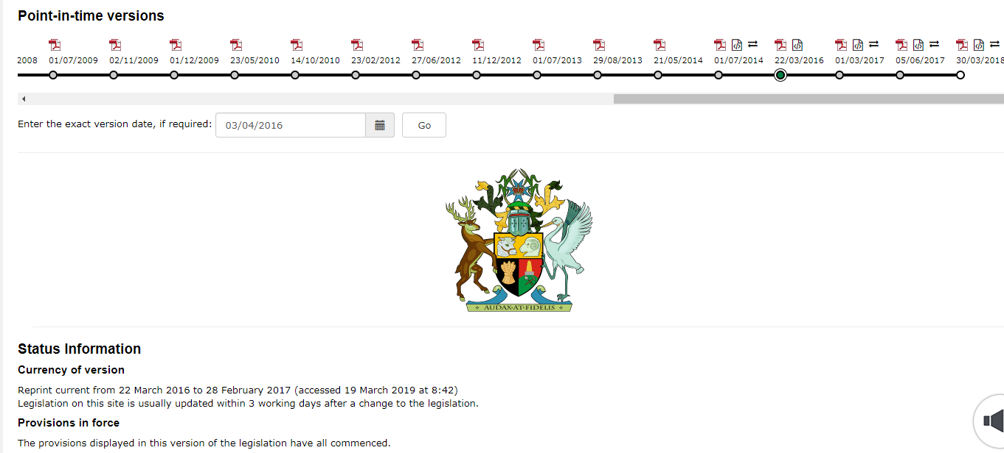
Queensland legislation
Comparative versions

Slide 13
Queensland legislation
Comparative versions

Slide 14
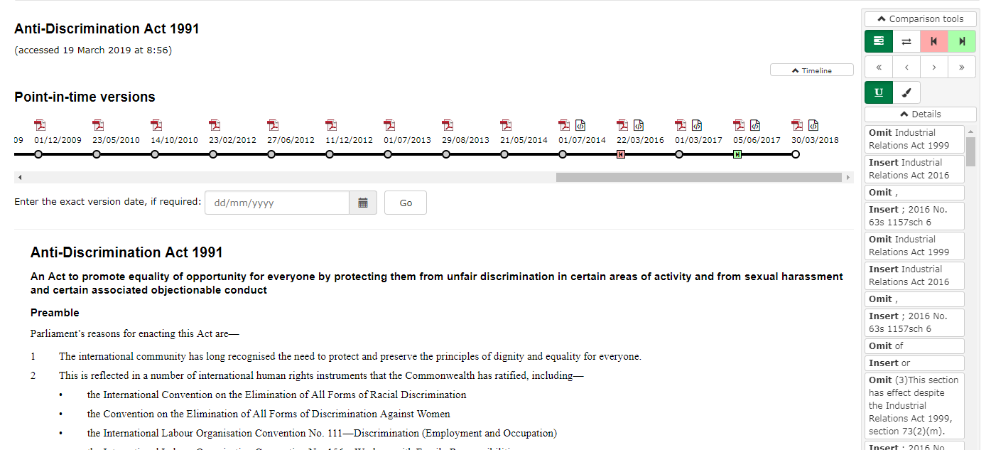
Queensland legislation
Comparative versions

Slide 15
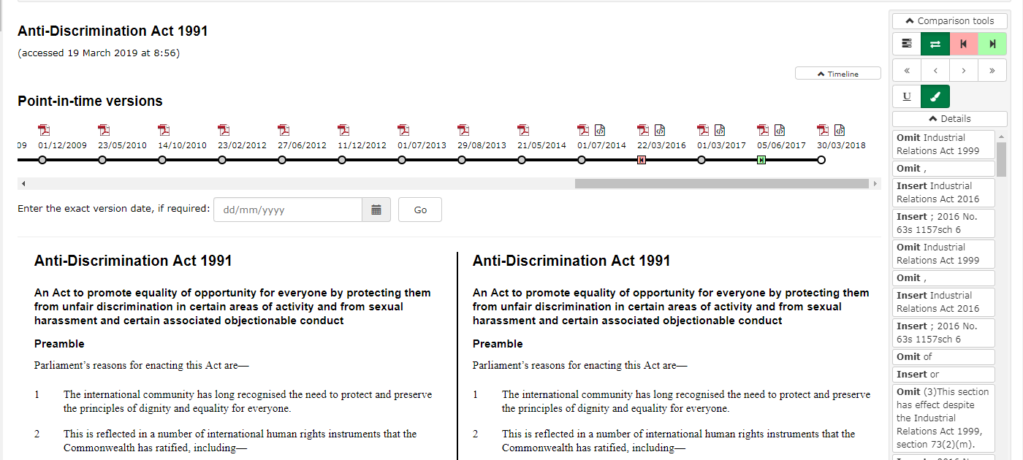
Queensland legislation
Comparative versions

Slide 16
Queensland legislation
Comparative versions

Slide 17
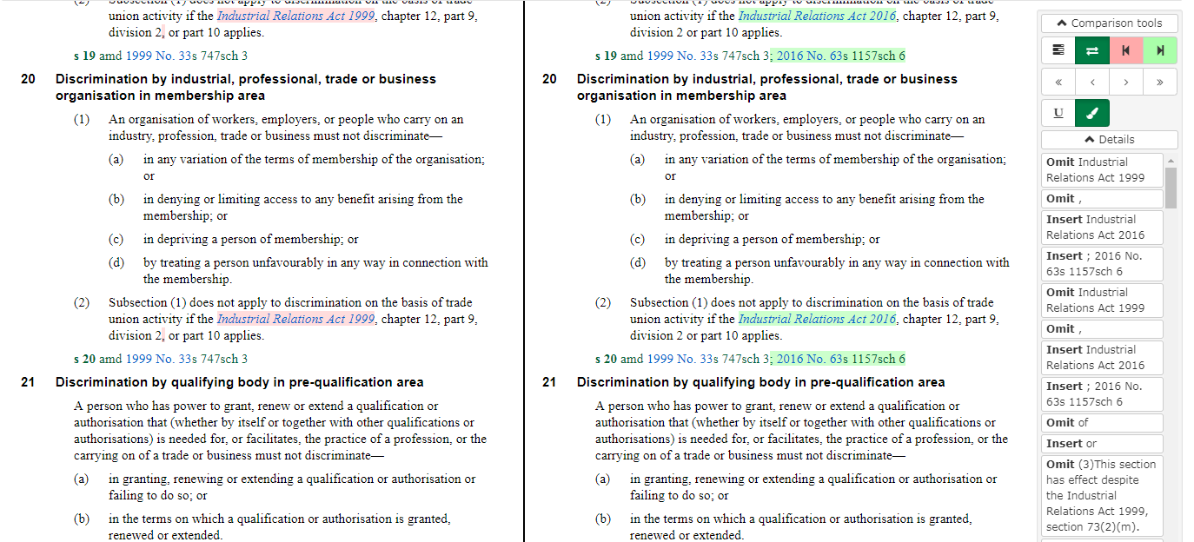
Queensland legislation
Comparative versions

Slide 18
Queensland legislation
Legislative history

Slide 19
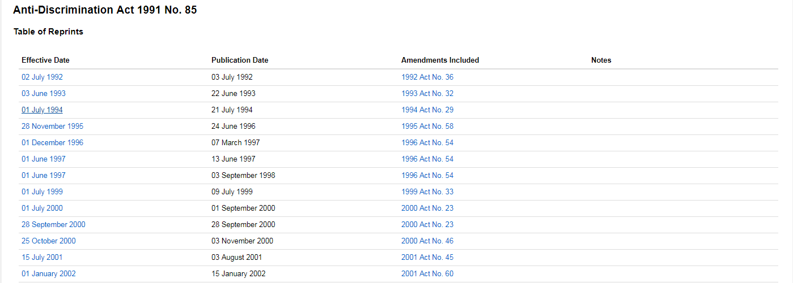
Queensland legislation
Legislative history

Slide 20
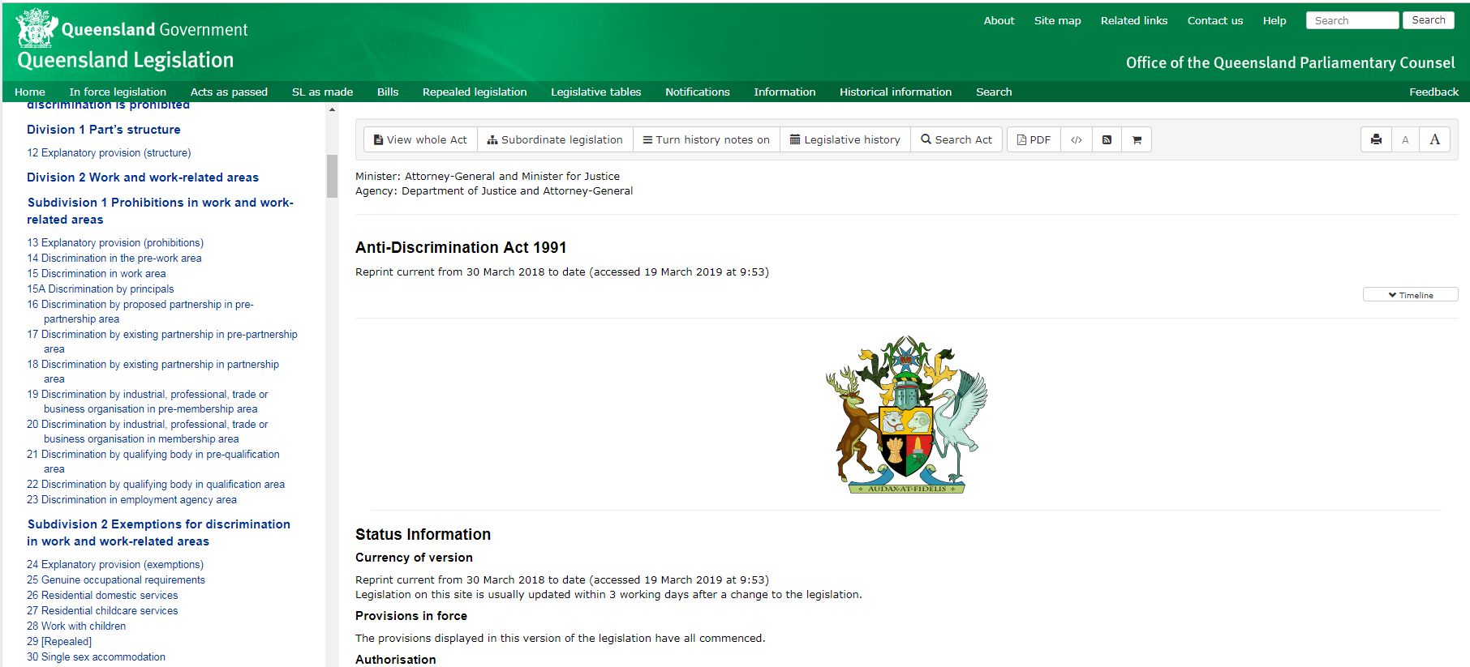
Queensland legislation
section amendments

Slide 21
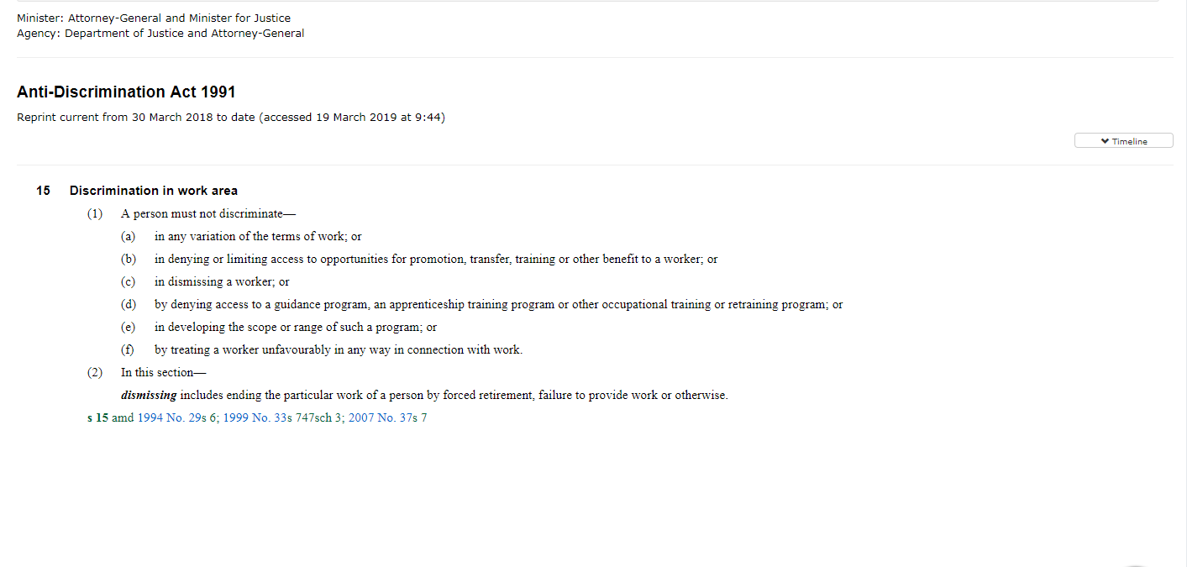
Queensland legislation
section amendments

Slide 22
Queensland legislation
Indicative reprints

Slide 23
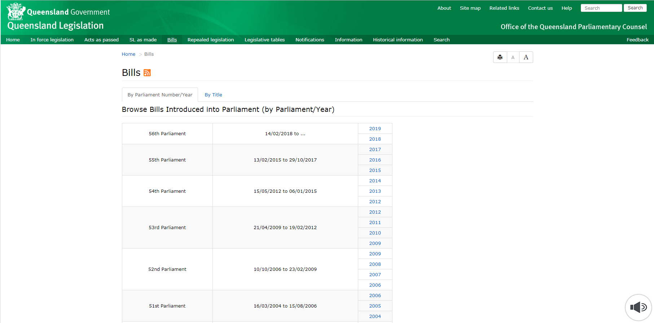
Queensland legislation
Indicative reprints

Slide 24
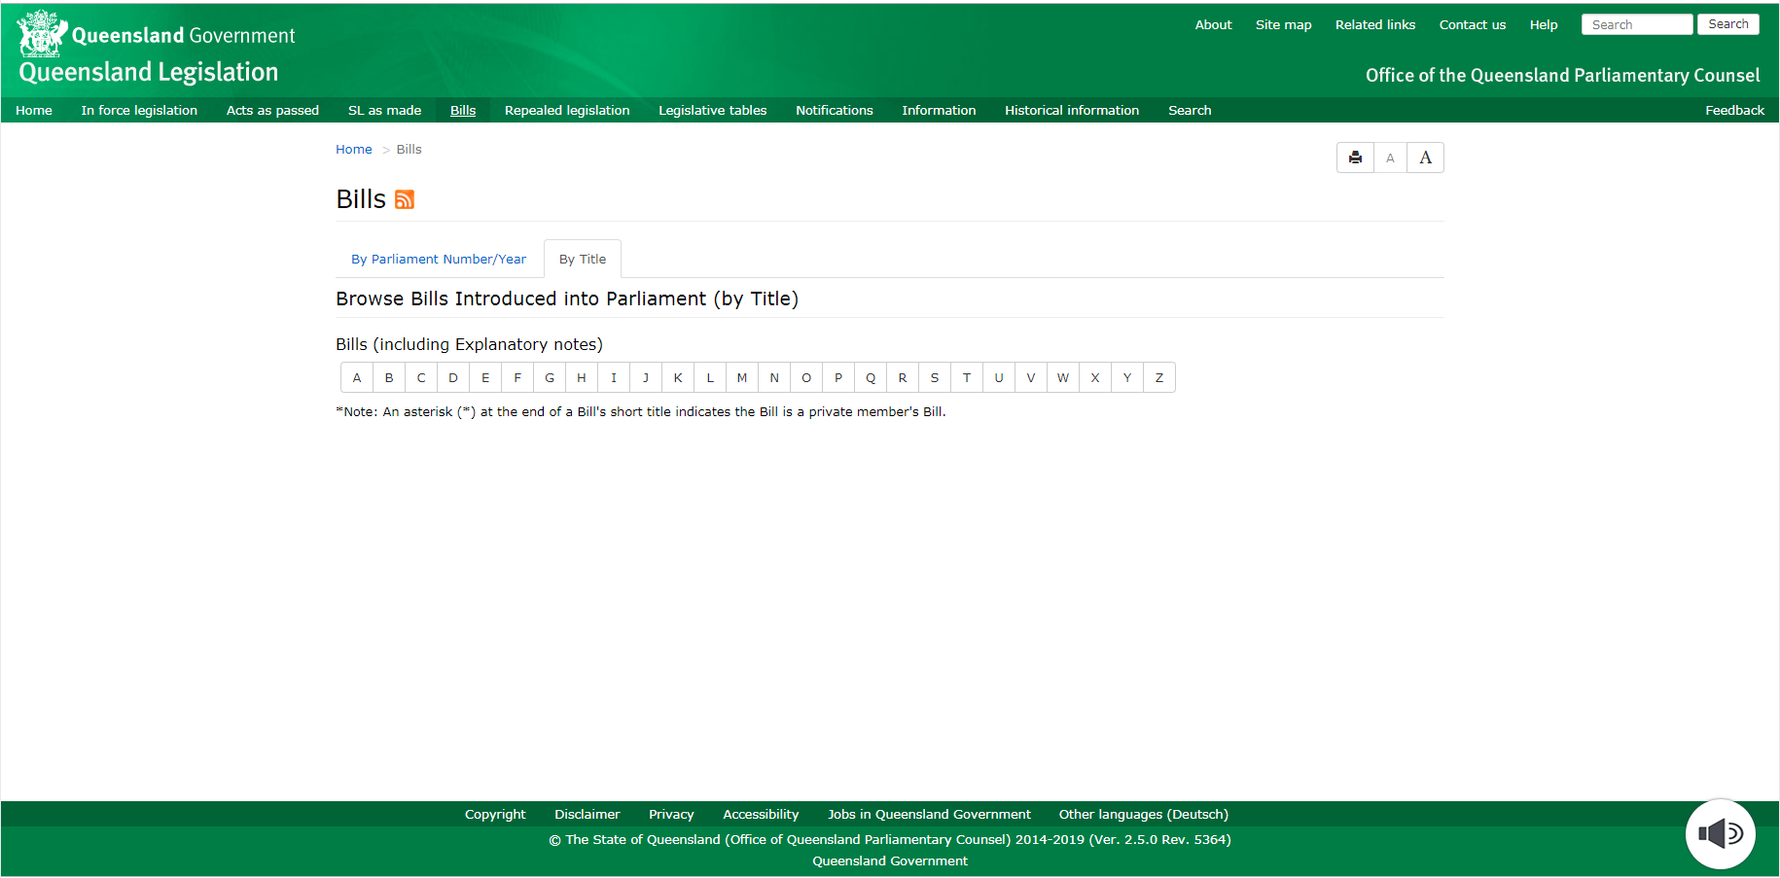
Queensland legislation
Indicative reprints

Slide 25
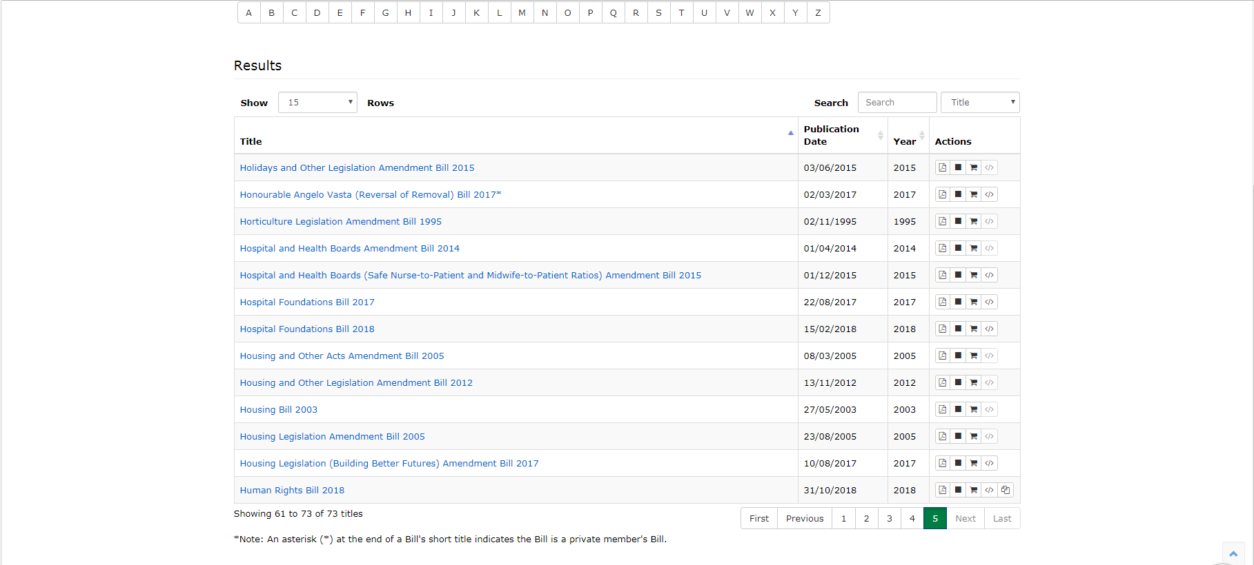
Queensland legislation
Indicative reprints

Slide 26
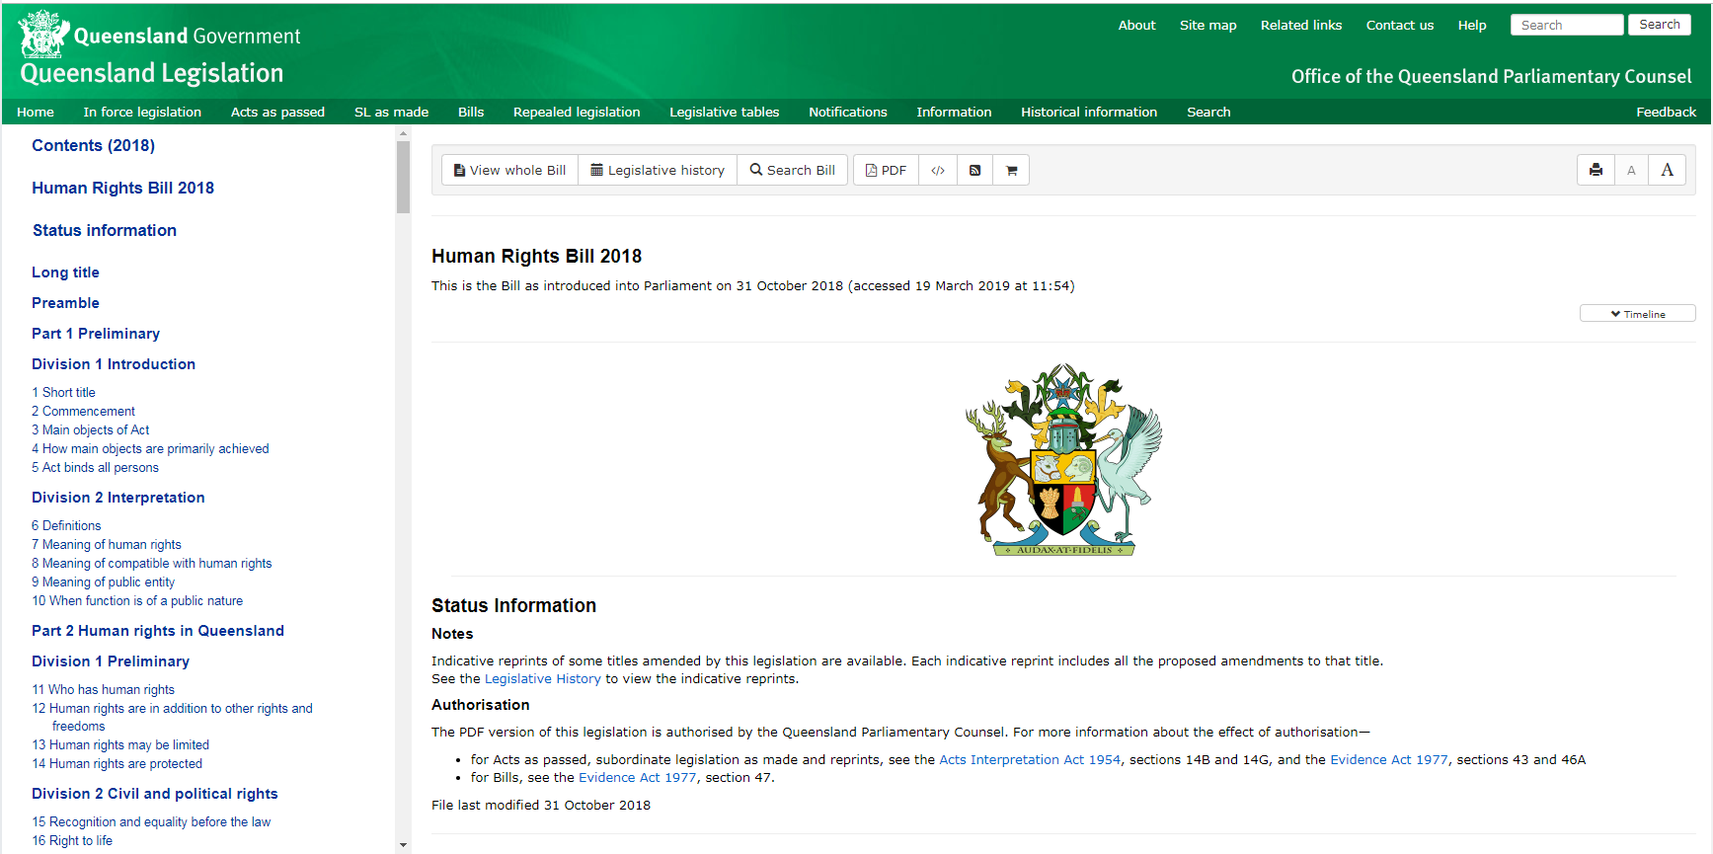
Queensland legislation
Indicative reprints

Slide 27
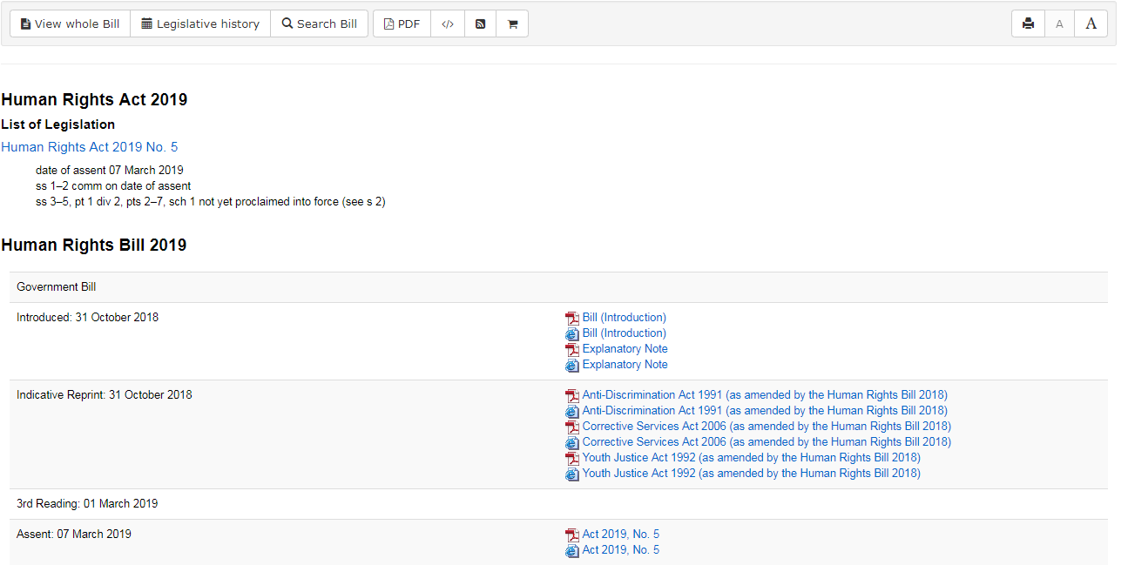
Queensland legislation
Indicative reprints

Slide 28
Queensland legislation
Explanatory notes

Slide 29
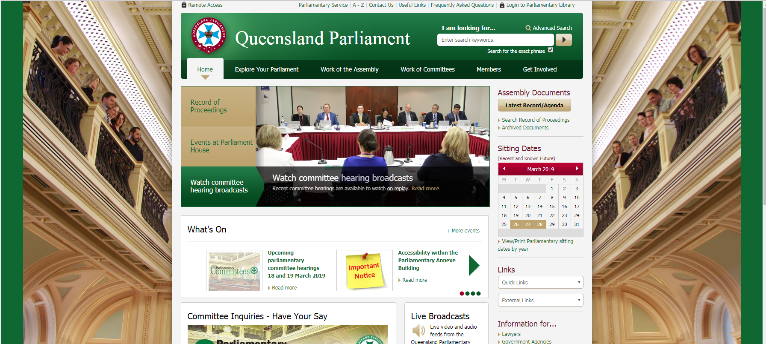
Queensland Parliament
Notice paper

Slide 30
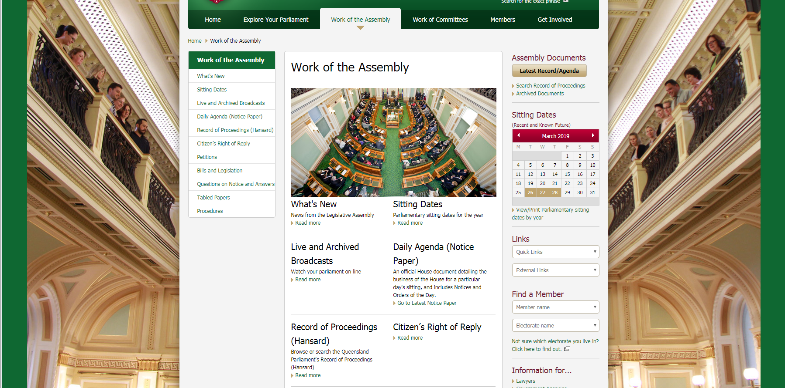
Queensland Parliament
Notice paper

Slide 31
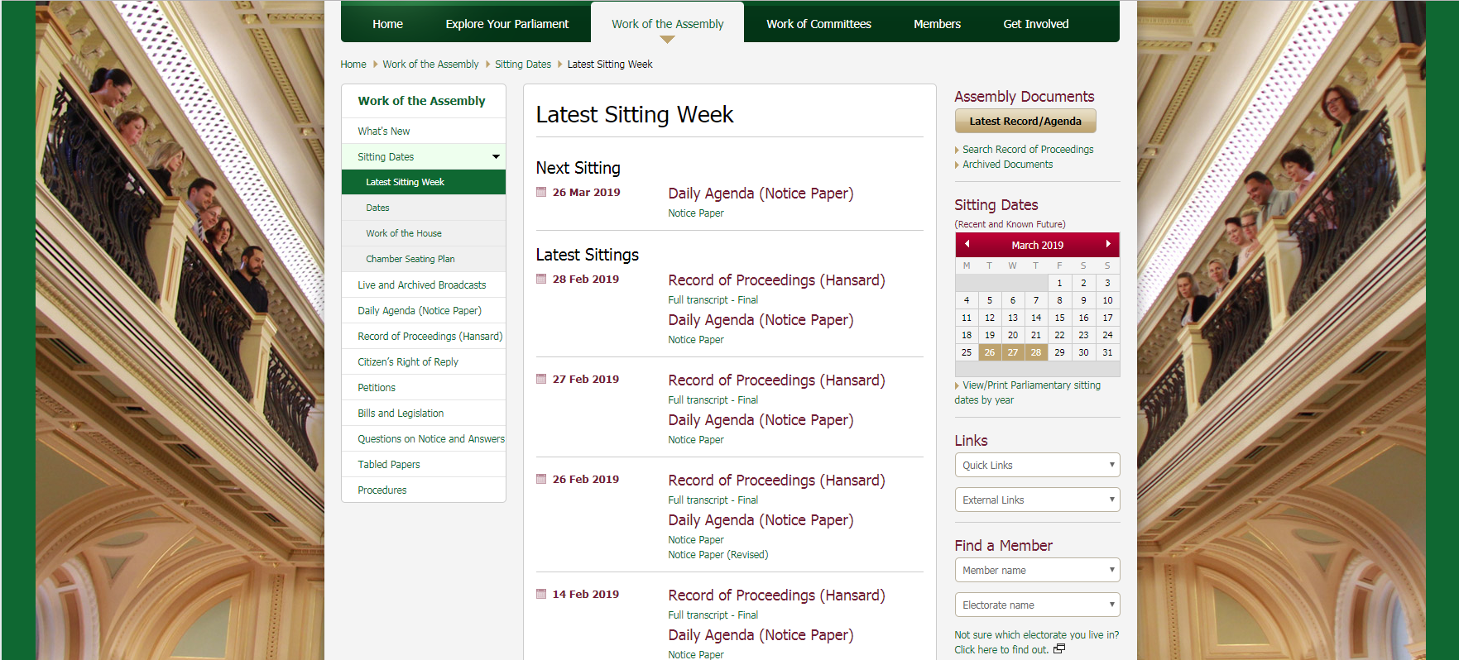
Queensland Parliament
Notice paper

Slide 32
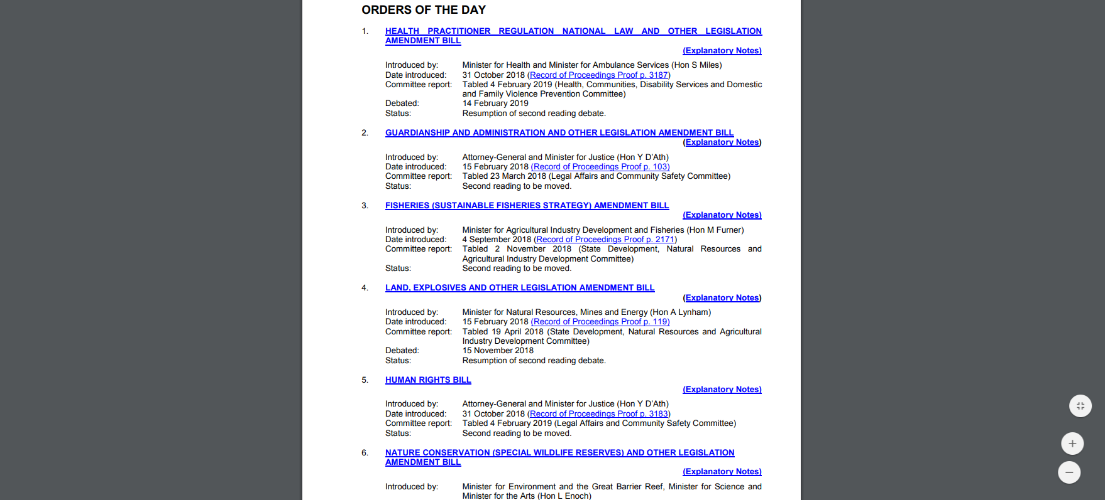
Queensland Parliament
Notice paper

Slide 33
Queensland Parliament
Committee reports

Slide 34
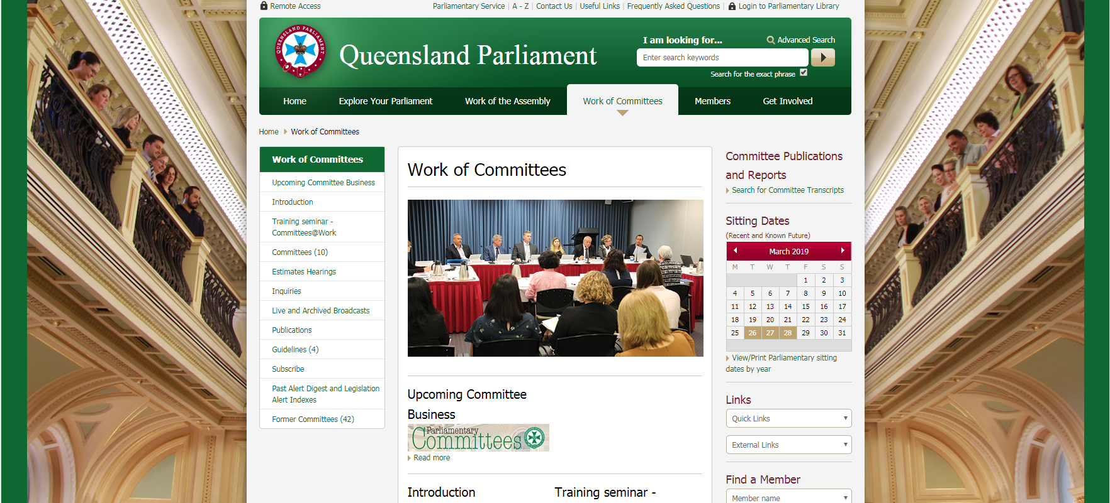
Queensland Parliament
Committee reports

Slide 35
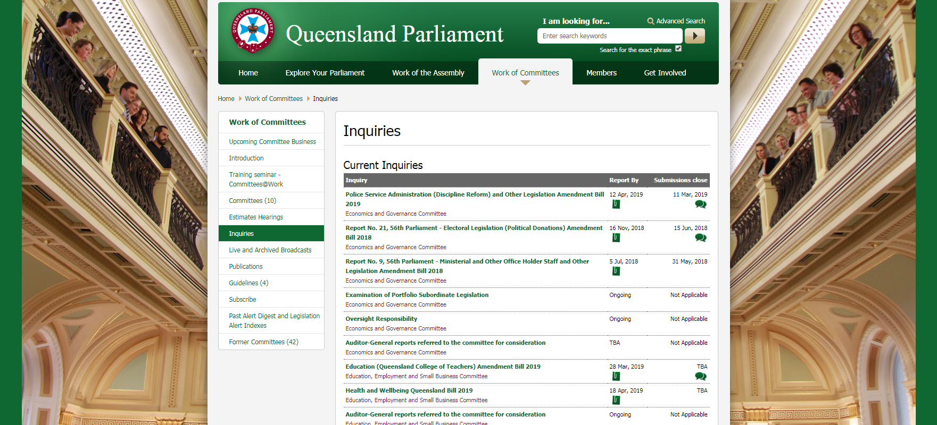
Queensland Parliament
Committee reports

Slide 36
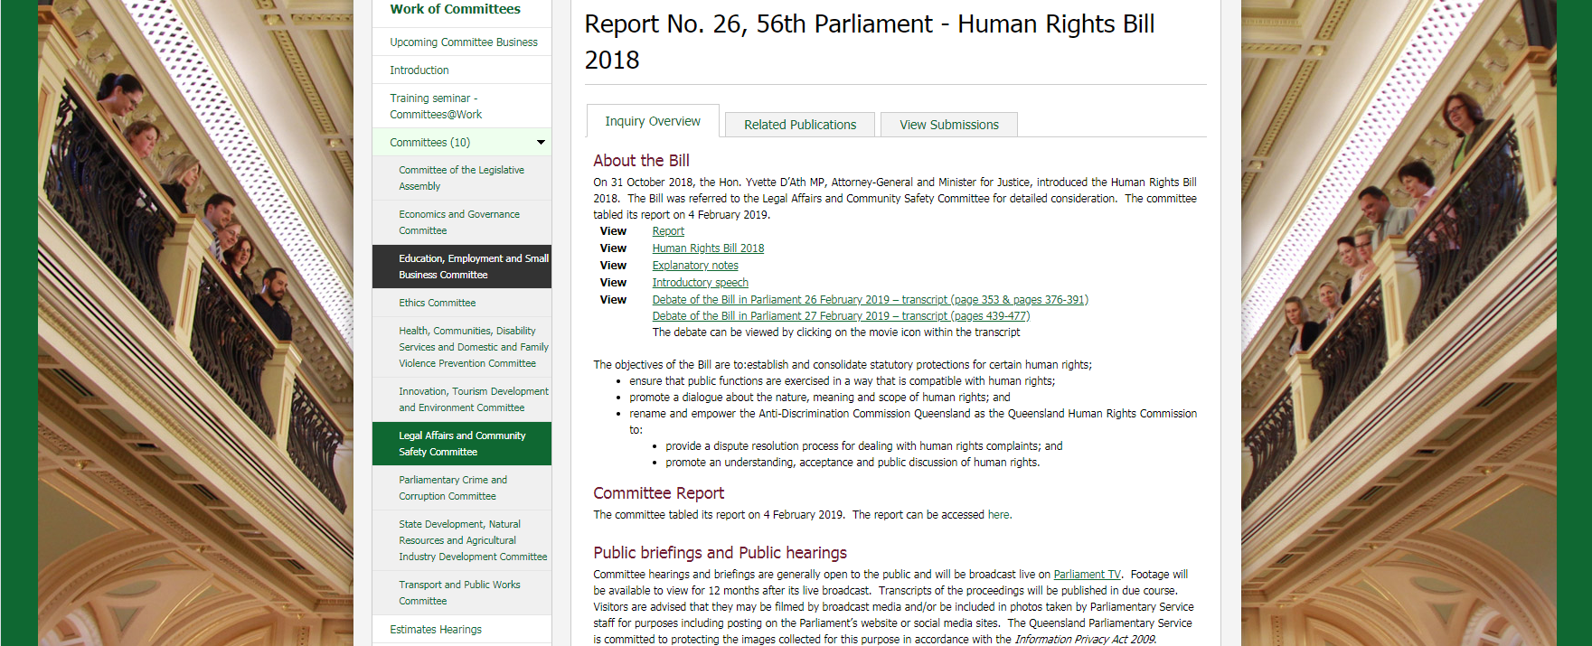
Queensland Parliament
Committee reports

Slide 37
Queensland Parliament
Tabled papers

Slide 38
Queensland Parliament
Tabled papers

Slide 39
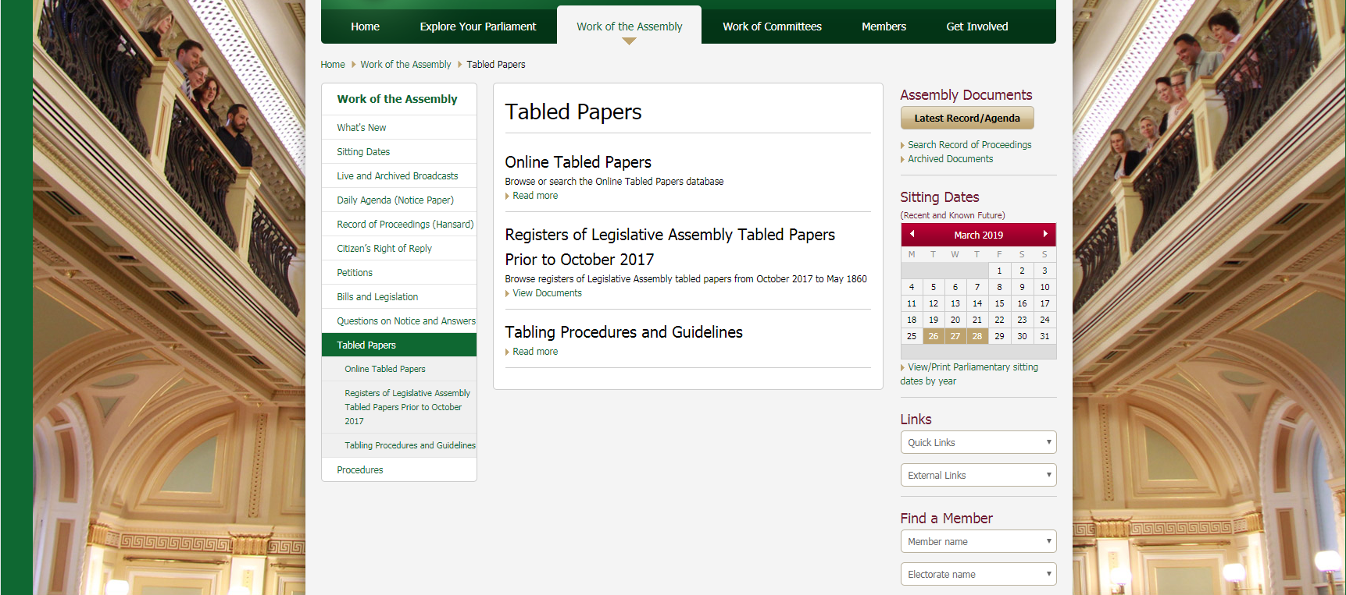
Queensland Parliament
Tabled papers

Slide 40
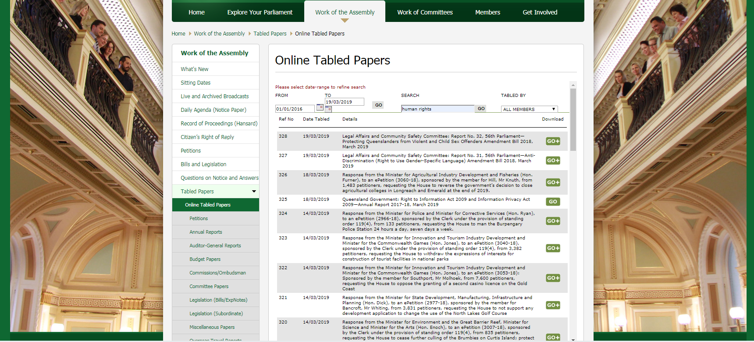
Queensland Parliament
Tabled papers

Slide 41
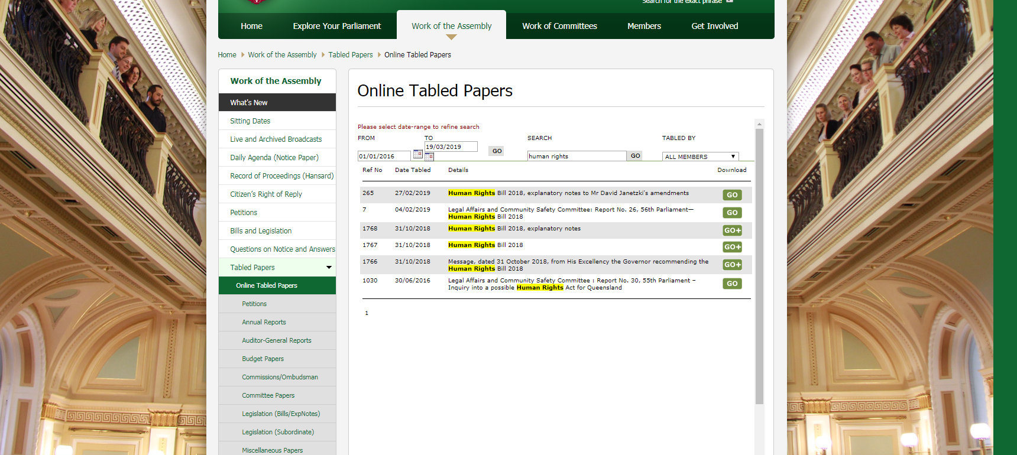
Queensland Parliament
Tabled papers

Slide 42
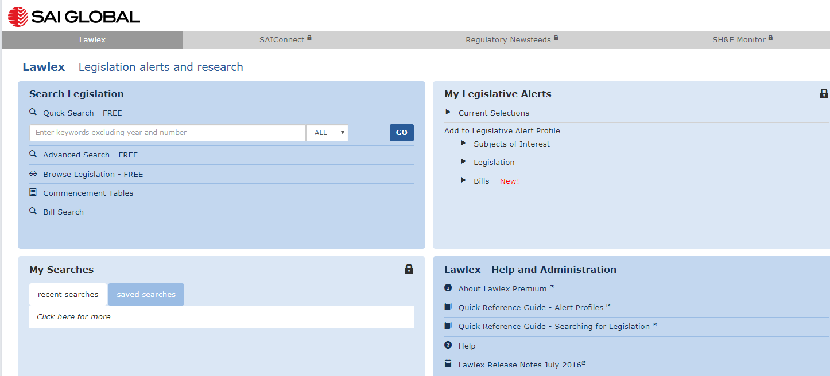
Lawlex
Finding legislation on a topic

Slide 43
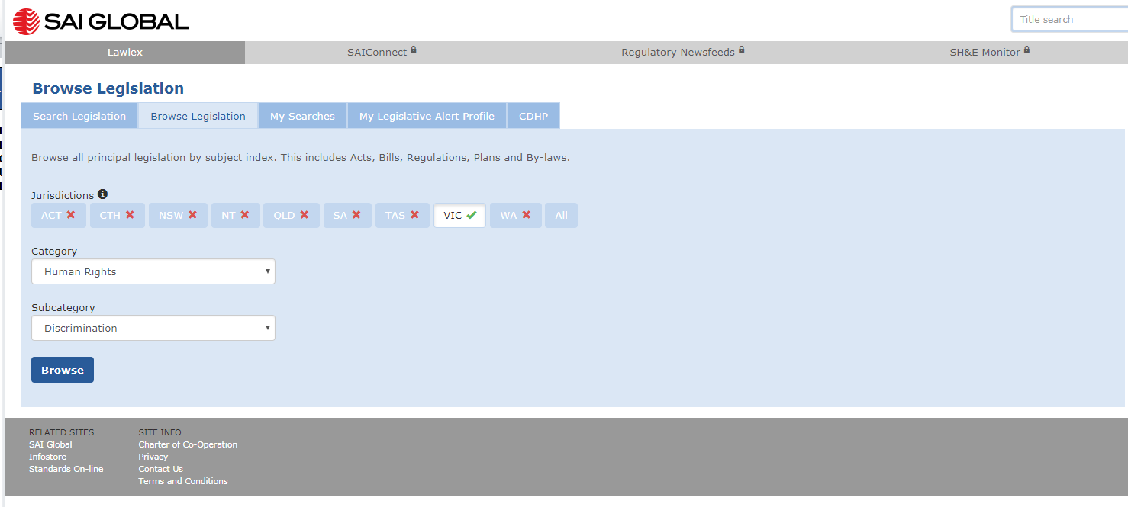
Lawlex
Finding legislation on a topic

Slide 44
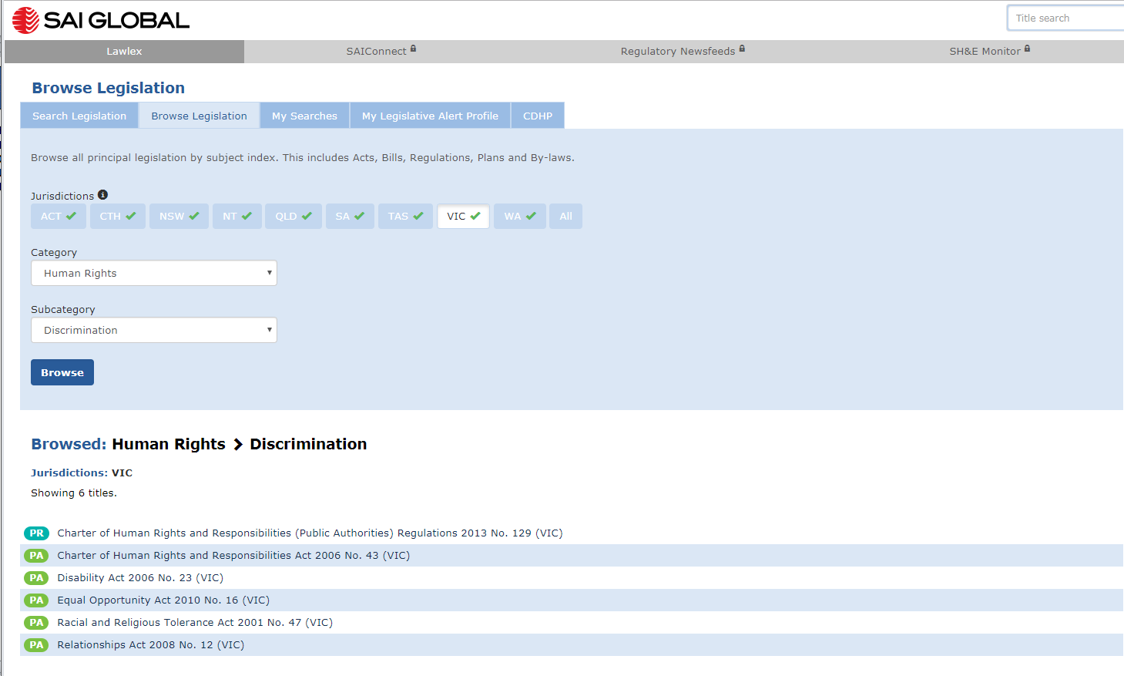
Lawlex
Finding legislation on a topic

Slide 45
Lawlex
Accessing legislation

Slide 46
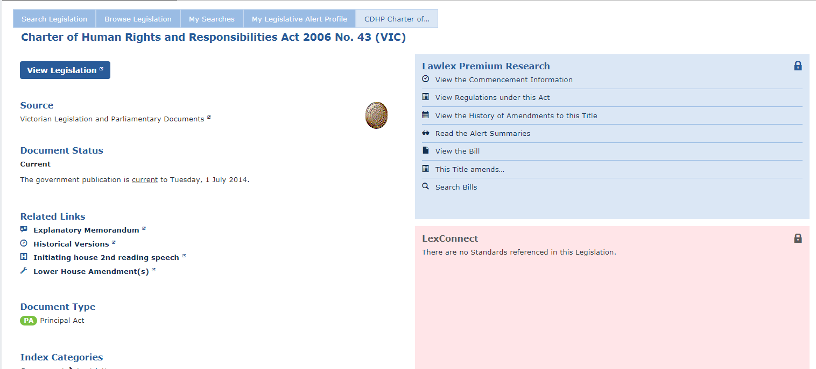
Lawlex
Accessing legislation

Slide 47
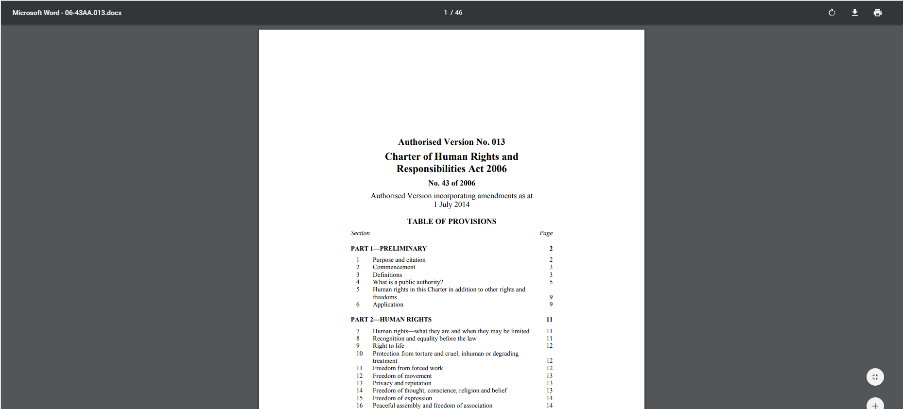
Lawlex
Accessing legislation

Slide 48
Case law
Sources to use
Unreported/ reported
Supreme Court Library Queensland
Queensland Judgments
Consideration of a section
Austlii
Supreme Court Library Queensland
Case law on a topic
Austlii
Supreme Court Library Queensland

Slide 49
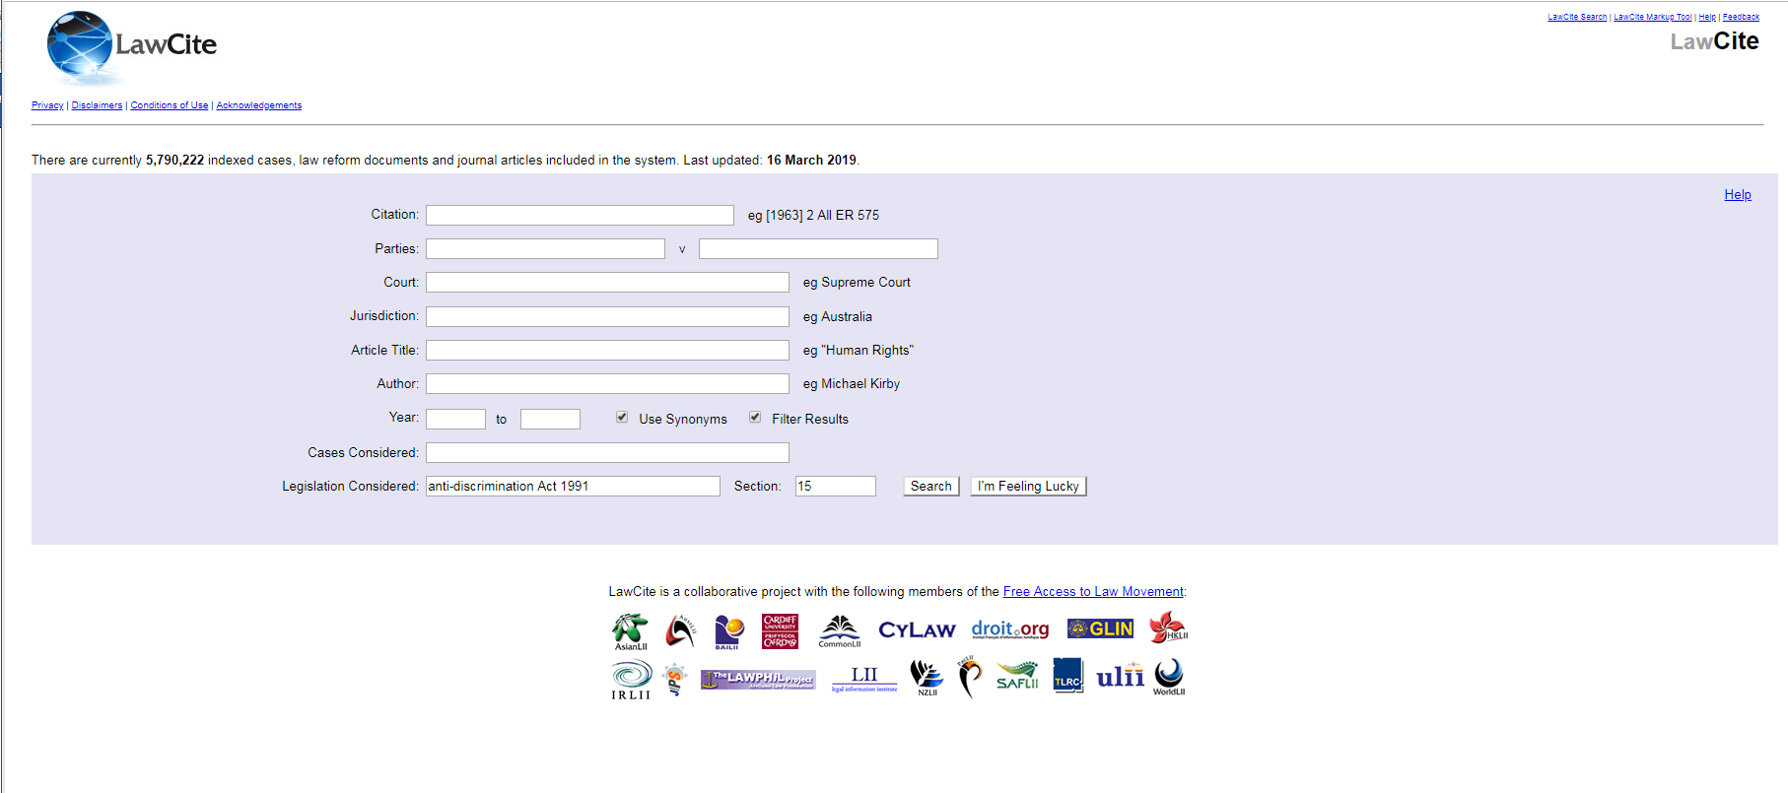
AustLii - LawCite
Cases considering a section of legislation

Slide 50
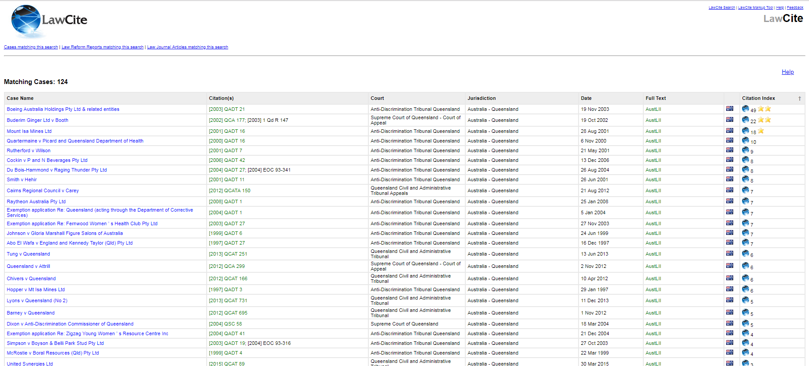
AustLii - LawCite
Cases considering a section of legislation

Slide 51
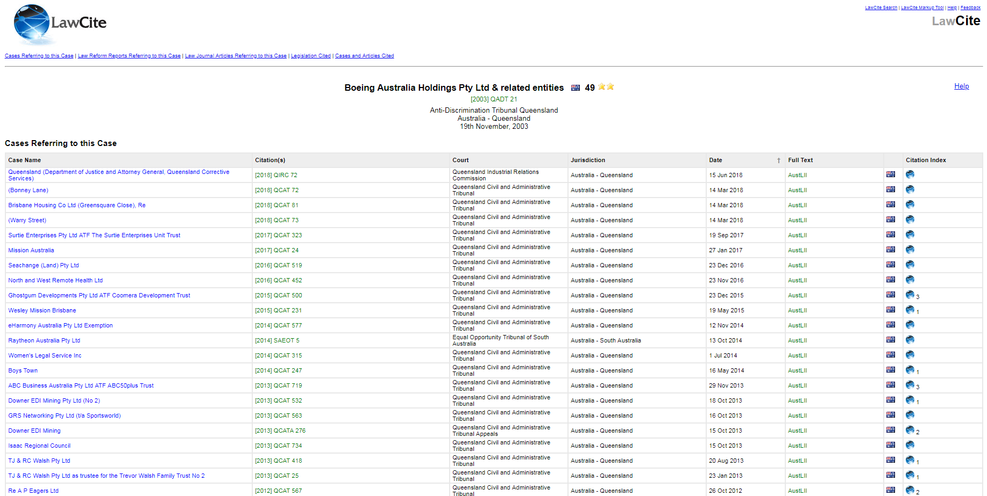
AustLii - LawCite
Cases considering a section of legislation

Slide 52
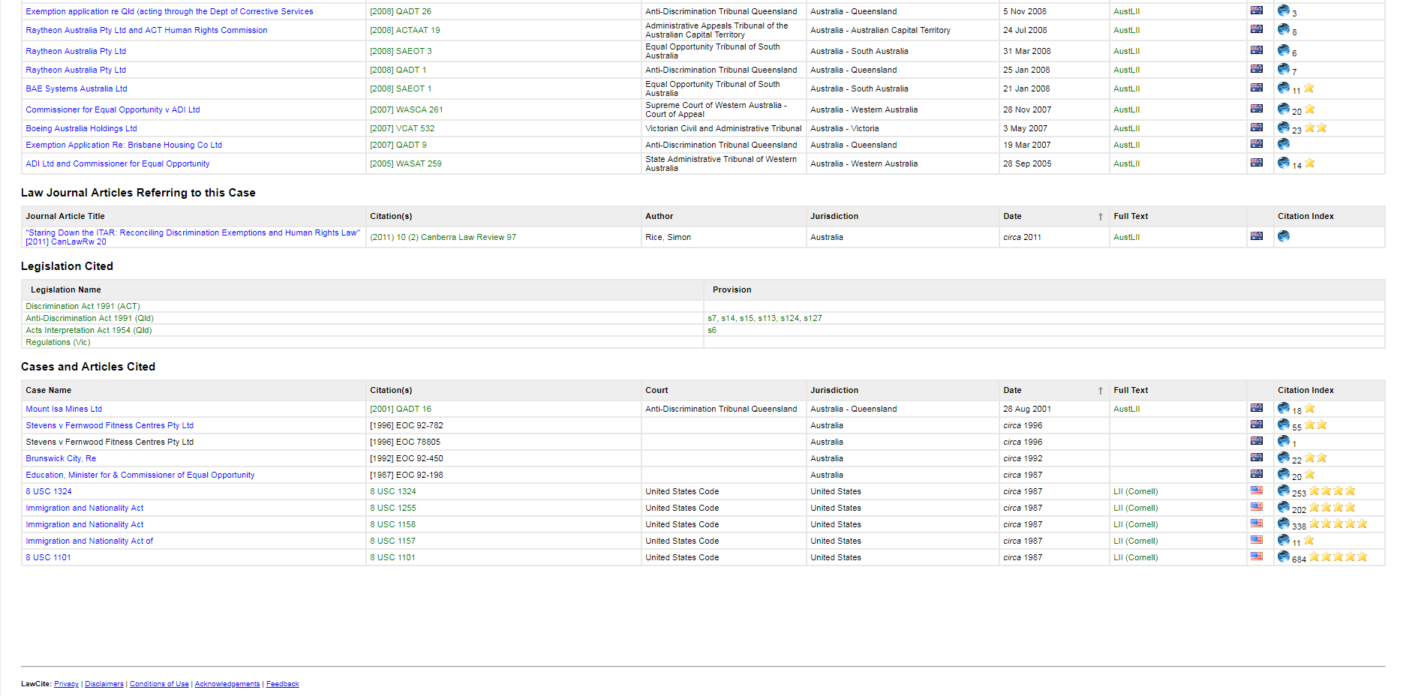
AustLii - LawCite
Cases considering a section of legislation

Slide 53
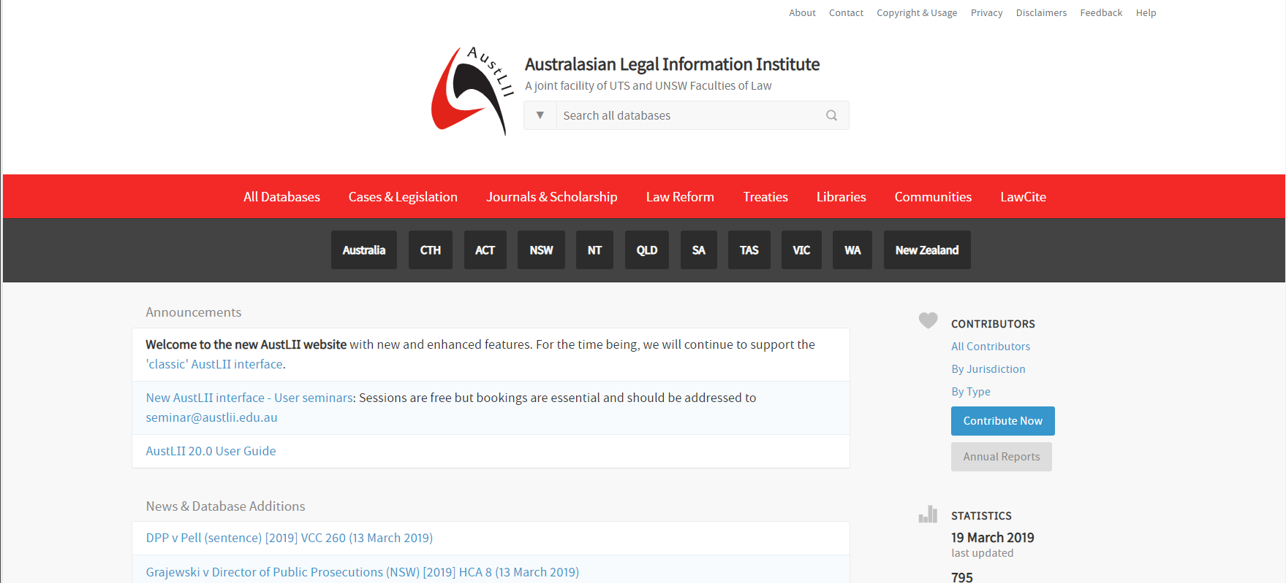
AustLii
Cases considering a section of legislation

Slide 54
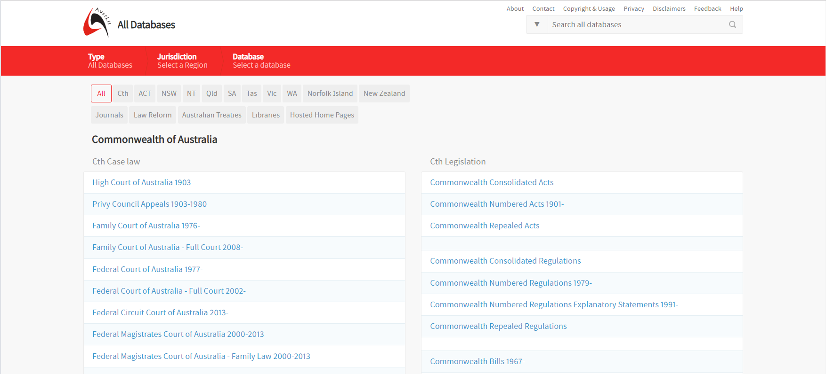
AustLii
Cases considering a section of legislation

Slide 55
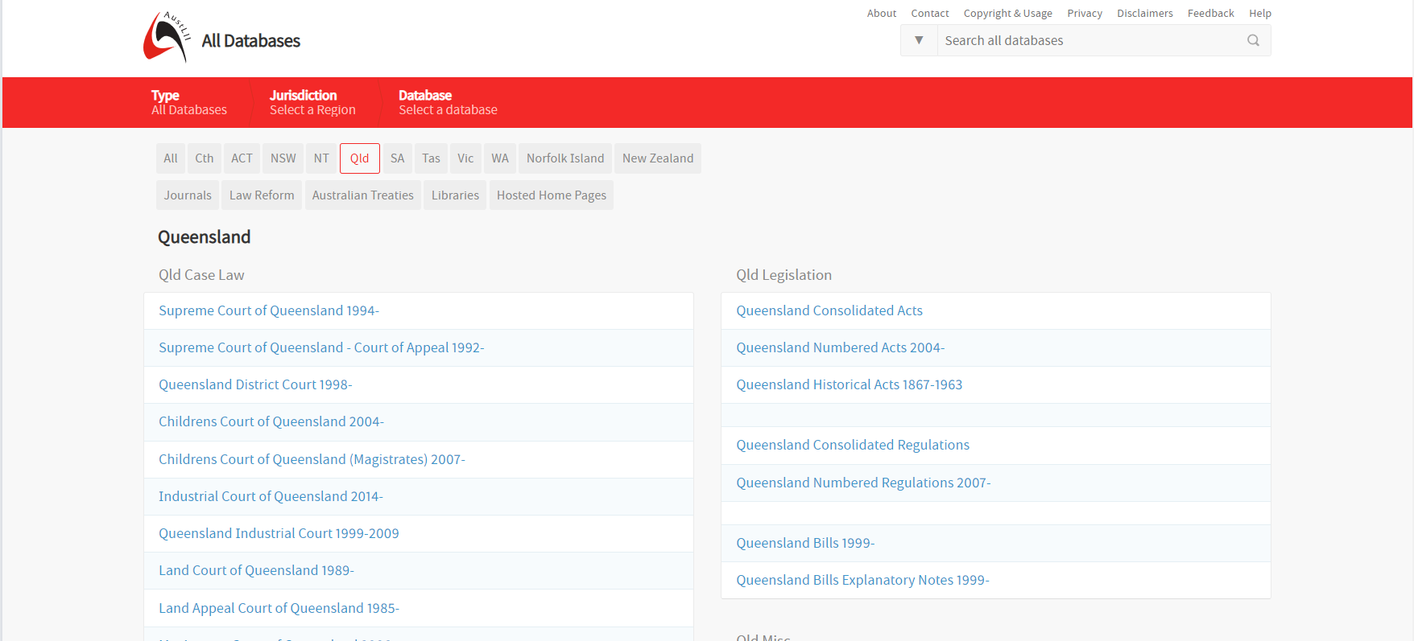
AustLii
Cases considering a section of legislation

Slide 56
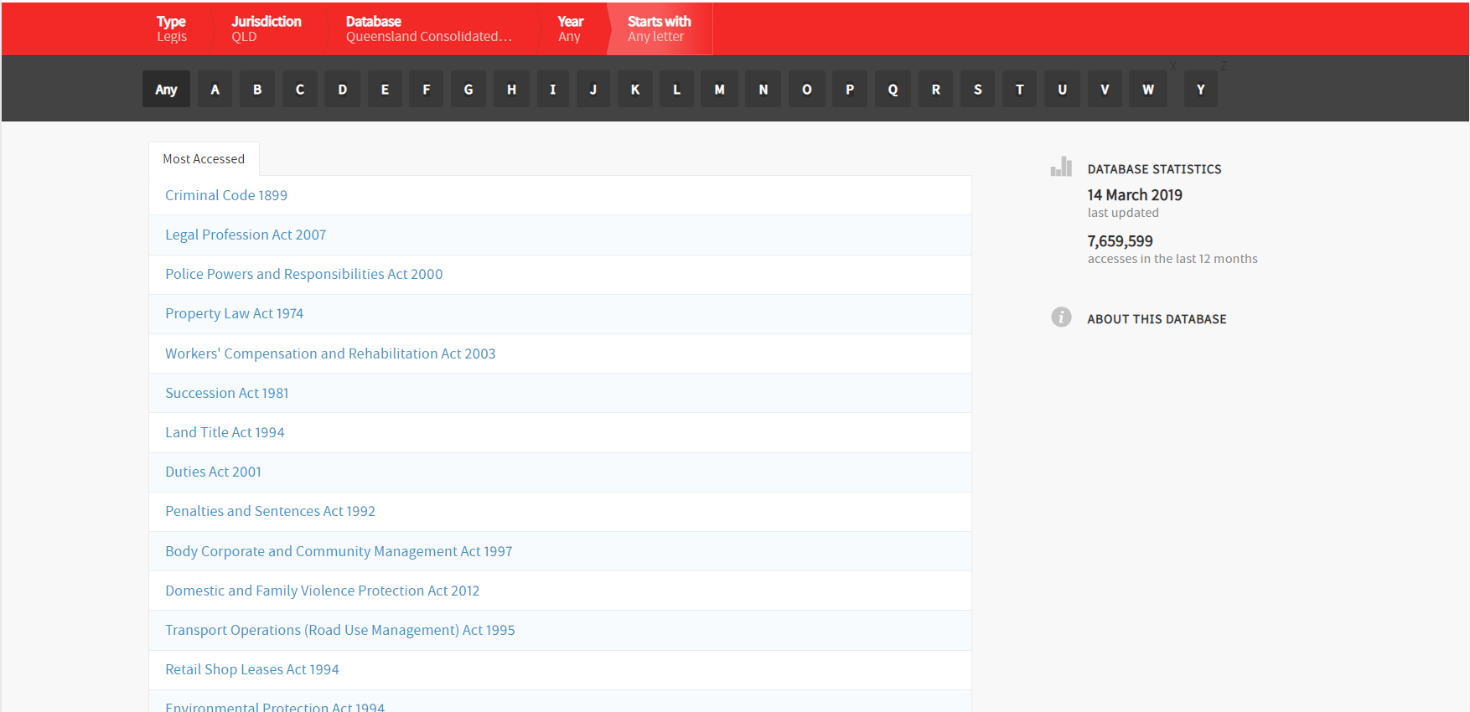
AustLii
Cases considering a section of legislation

Slide 57
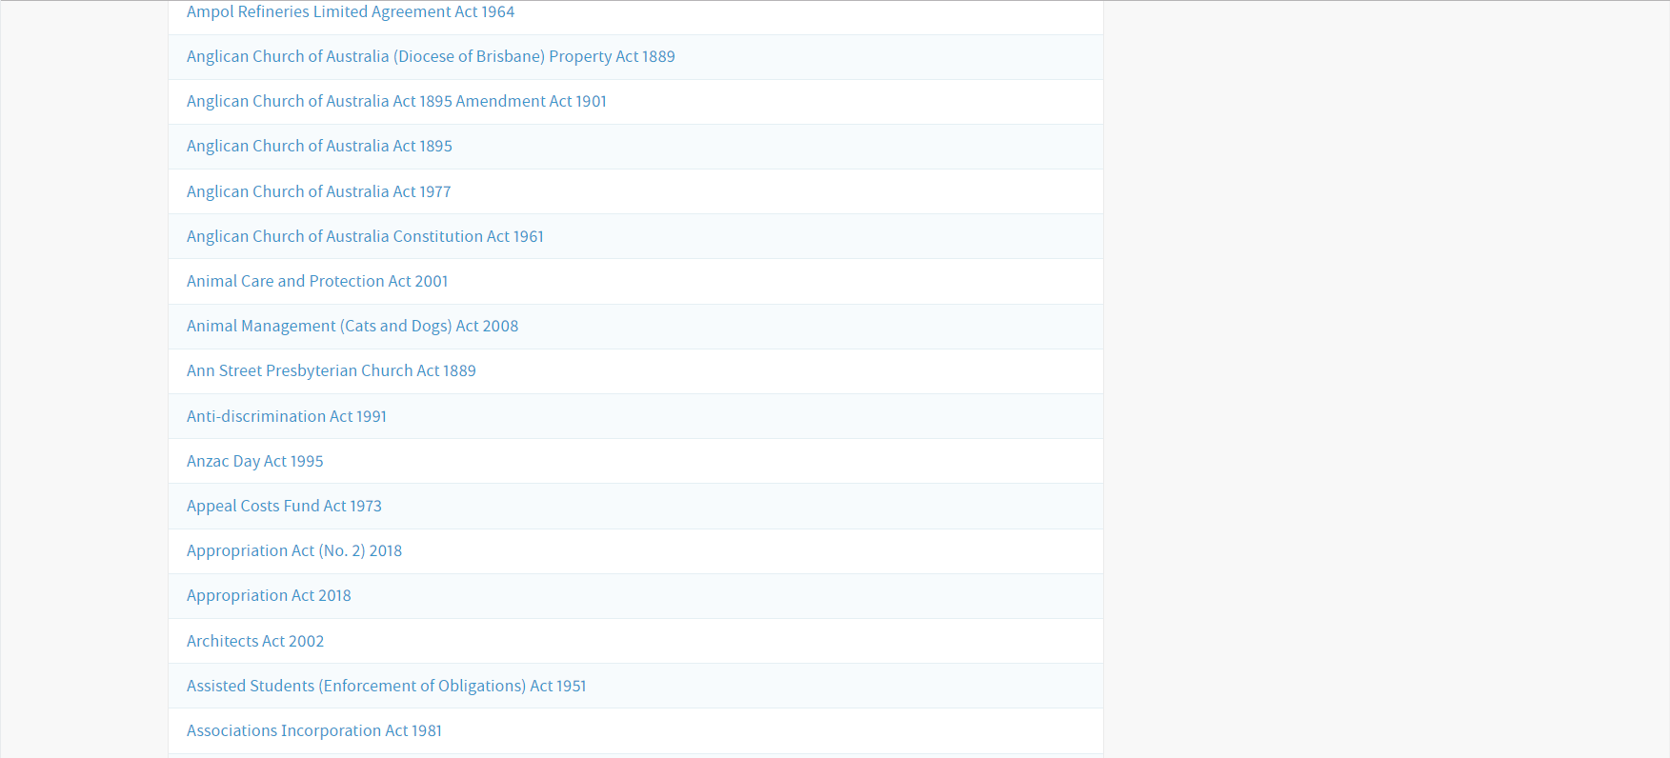
AustLii
Cases considering a section of legislation

Slide 58
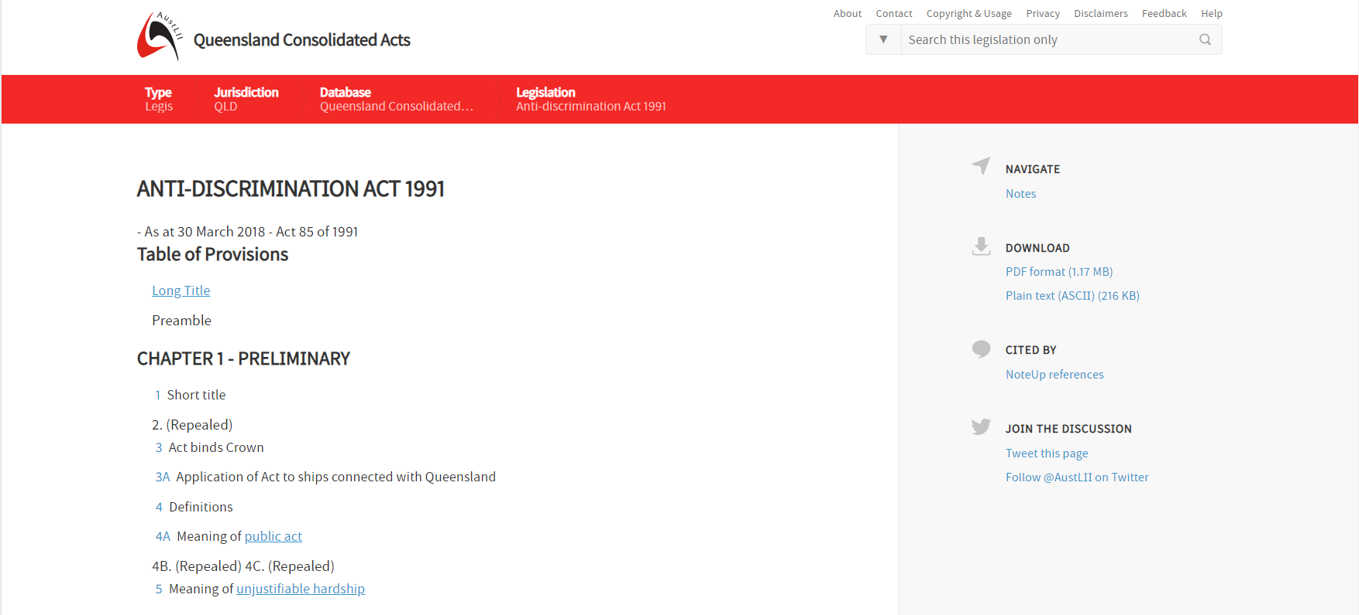
AustLii
Cases considering a section of legislation

Slide 59
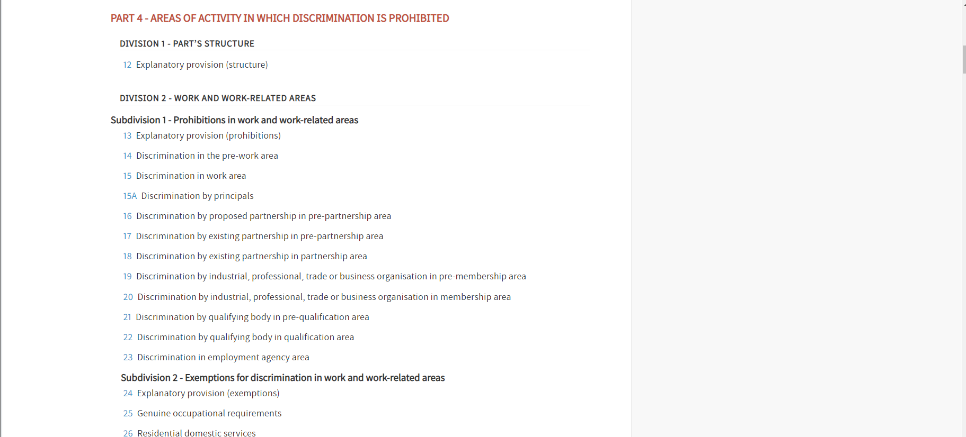
AustLii
Cases considering a section of legislation

Slide 60
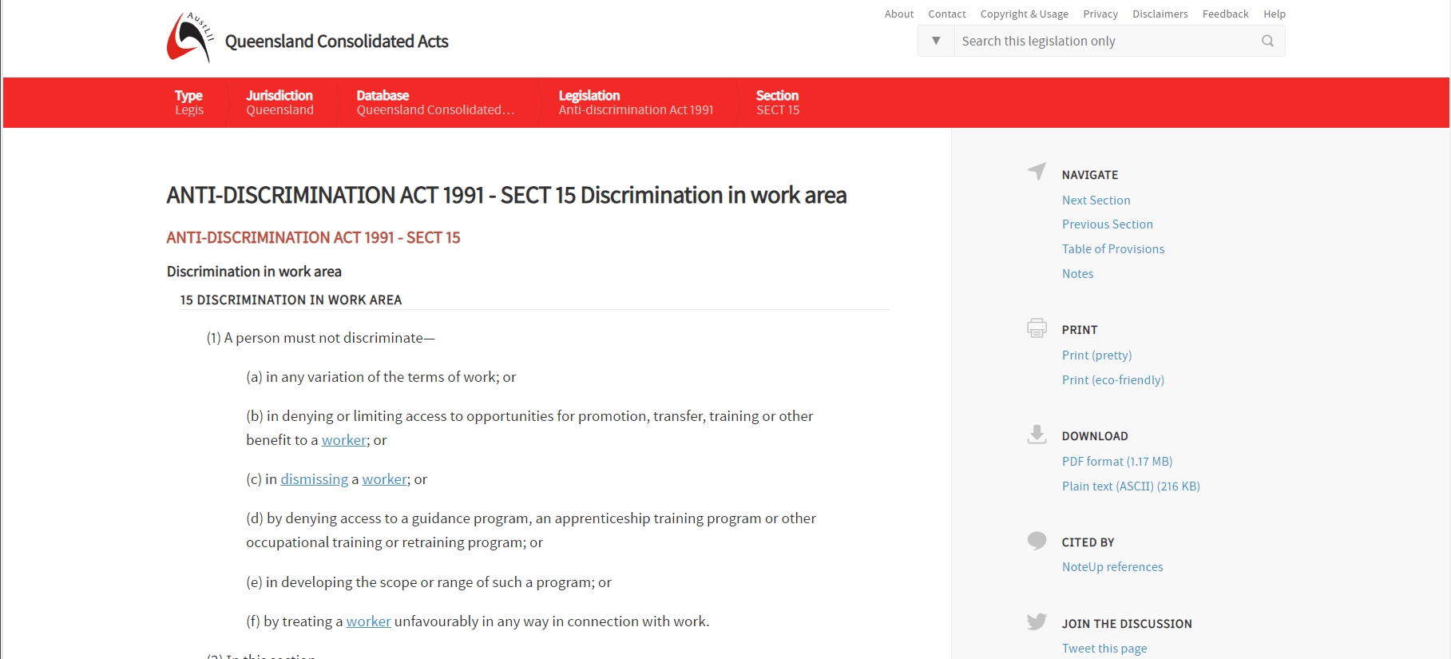
AustLii
Cases considering a section of legislation

Slide 61
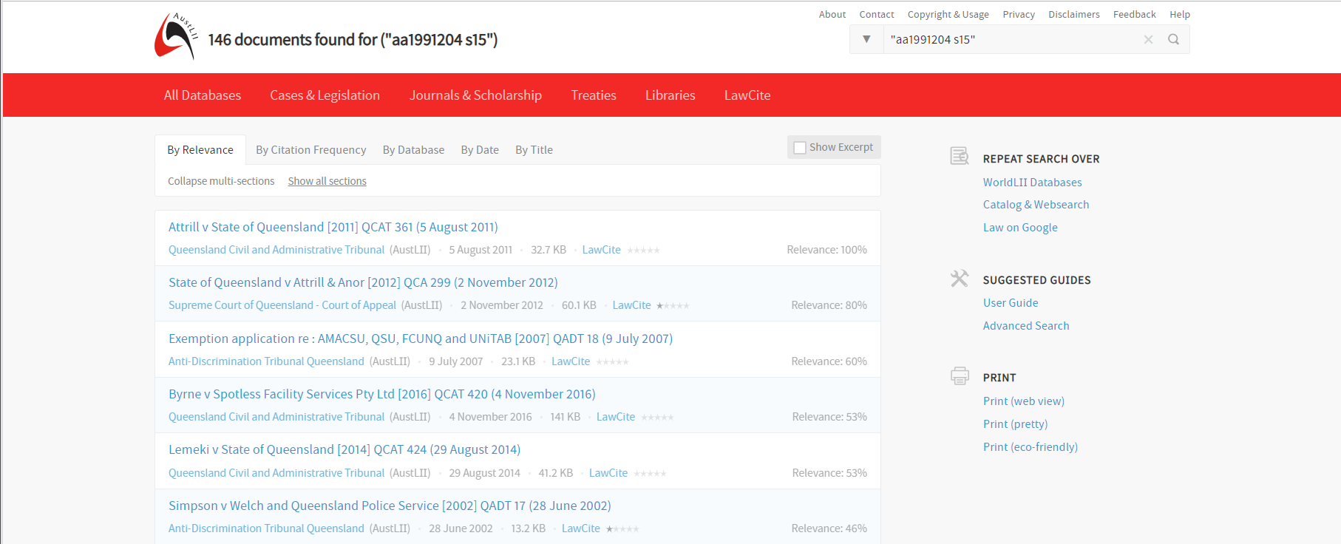
AustLii
Cases considering a section of legislation

Slide 62
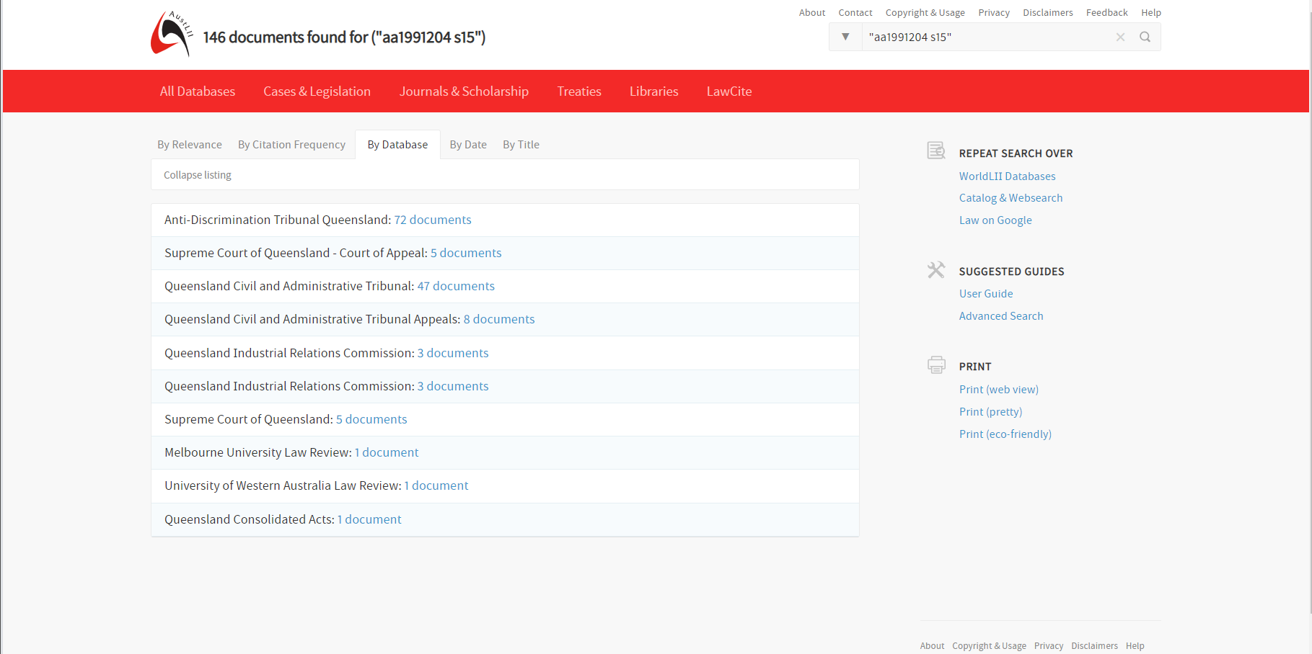
AustLii
Cases considering a section of legislation

Slide 63
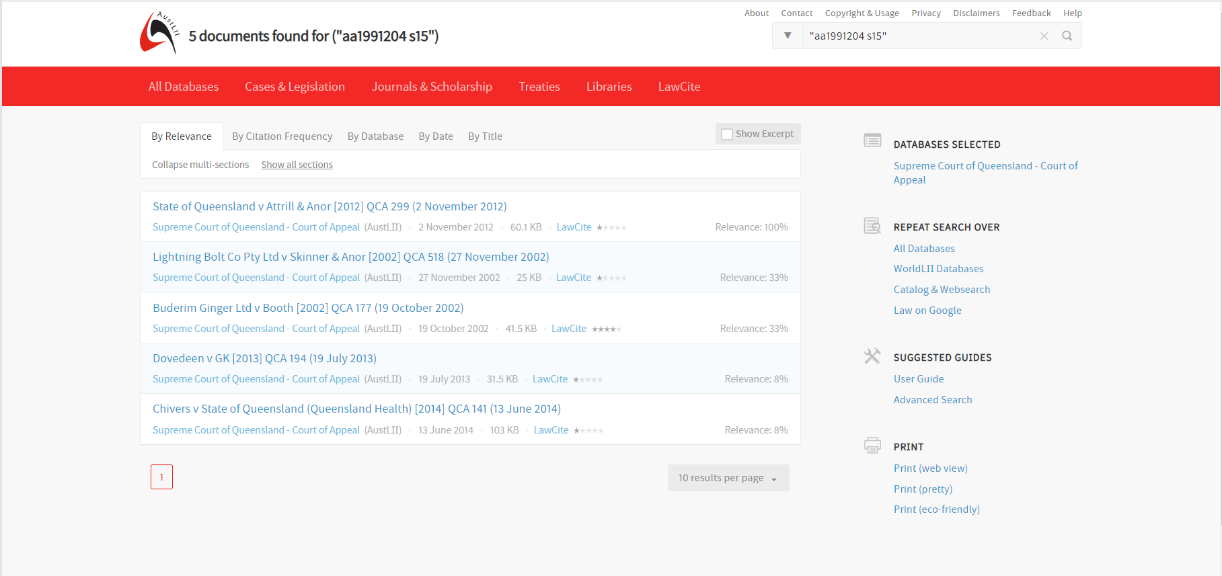
AustLii
Cases considering a section of legislation

Slide 64
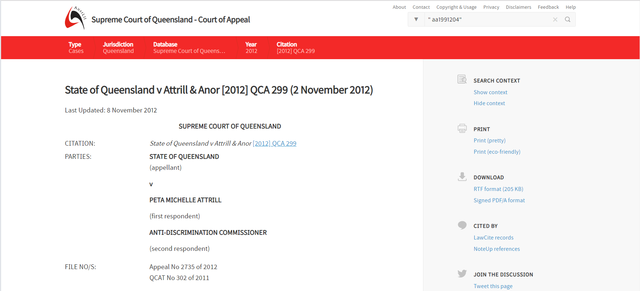
AustLii
Cases considering a section of legislation

Slide 65
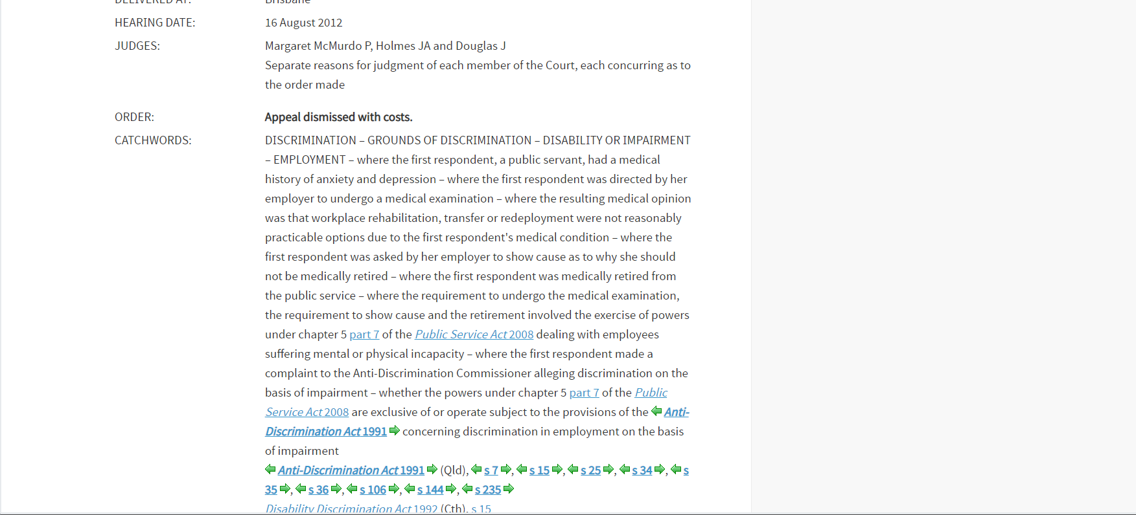
AustLii
Cases considering a section of legislation

Slide 66
Supreme Court Library Queensland
Cases considering a section of legislation

Slide 67
Supreme Court Library Queensland
Cases considering a section of legislation

Slide 68
Supreme Court Library Queensland
Cases considering a section of legislation

Slide 69
Supreme Court Library Queensland
Cases considering a section of legislation

Slide 70
Supreme Court Library Queensland
Cases considering a section of legislation

Slide 71
Supreme Court Library Queensland
Cases considering a section of legislation

Slide 72
Supreme Court Library Queensland
Cases considering a section of legislation

Slide 73
Queensland Judgments
Queensland reports

Slide 74
Queensland Judgments
Queensland reports

Slide 75
Queensland Judgments
Queensland reports

Slide 76
Queensland Judgments
Queensland reports

Slide 77
Case law
Sources to use
Unreported/ reported
Supreme Court Library Queensland
Queensland Judgments
Consideration of a section
Austlii
Supreme Court Library Queensland
Case law on a topic
Austlii
Supreme Court Library Queensland

Slide 78
AustLii
Cases on a topic

Slide 79
AustLii
Cases on a topic

Slide 80
AustLii
Cases on a topic

Slide 81
AustLii
Cases on a topic

Slide 82
Supreme Court Library Queensland
Cases on a topic

Slide 83
Supreme Court Library Queensland
Cases on a topic

Slide 84
What has been covered
A few takeaways from today's session
To compare versions of legislation:
Queensland Legislation
To find extrinsic material:
Queensland Legislation
Queensland Parliament
To find legislation on a topic:
Lawlex
To find case law considering a section / on a topic:
AustLII
Supreme Court Library of Queensland

