Slide 1

A Human Rights Act for Queensland: From supplicant to rights holder
‘Making Rights Real’
Queensland Community Legal Centres Conference
Edward Santow
Human Rights Commissioner
22 March 2019
Notes:
Acknowledgements
Traditional owners:
Proposals for an Australian bill of rights:
There have been proposals for an Australian bill of rights going back as far as the 1898 Constitutional Convention.
A US-style Bill of Rights was rejected for reasons including that it might protect “Chinamen, Japanese, Hindoos, and other barbarians” (Dr Quick).
More recent attempts, eg, under Hawke Govt.
State and Territory HRAs
In the last decade, attention has focussed on the states: NSW, ACT, Victoria, WA, Tasmania and – now – Queensland.

Slide 2
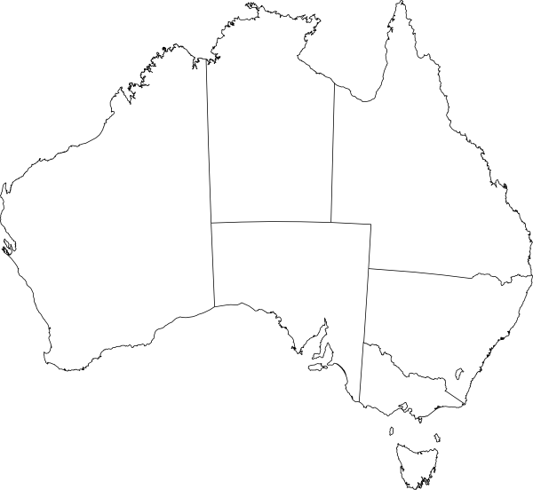
2002

Slide 3
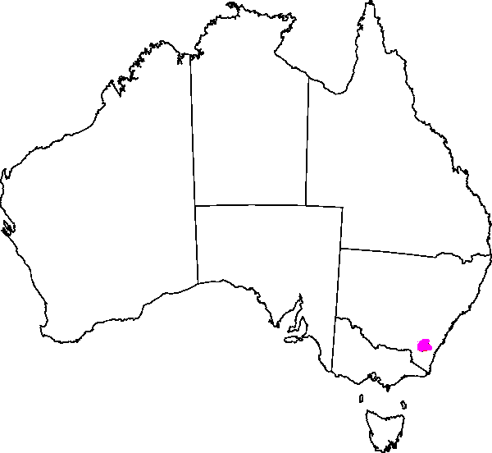
2003

Slide 4
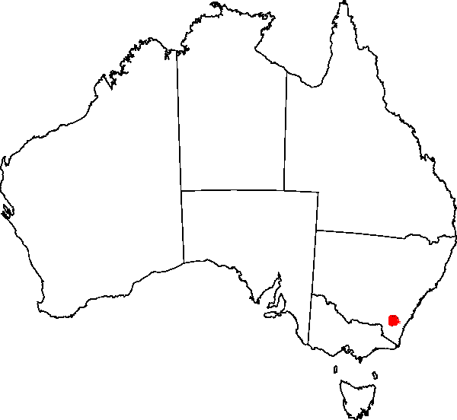
2004

Slide 5
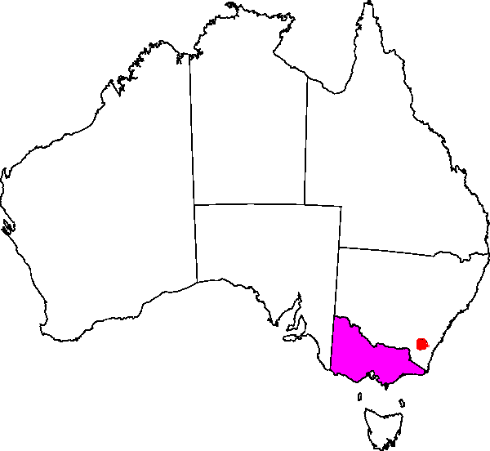
2005

Slide 6
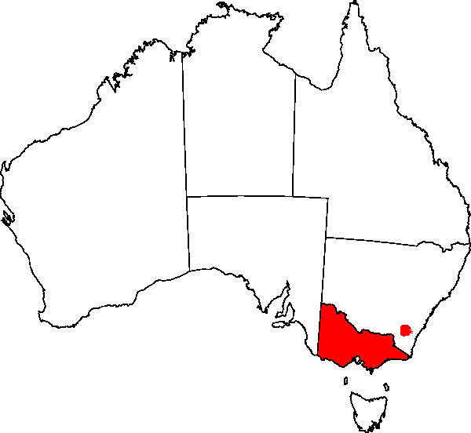
2006

Slide 7
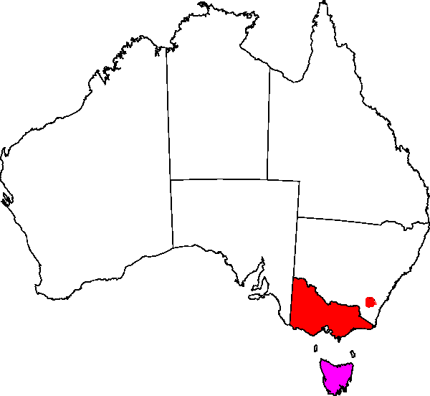
October 2007

Slide 8
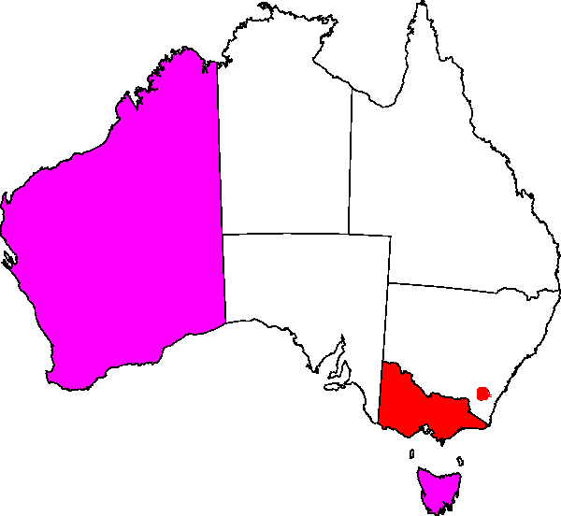
December 2007

Slide 9
2009
Notes:
Human Rights Bill 2018 (Qld) passed on 27 February 2019.

Slide 10
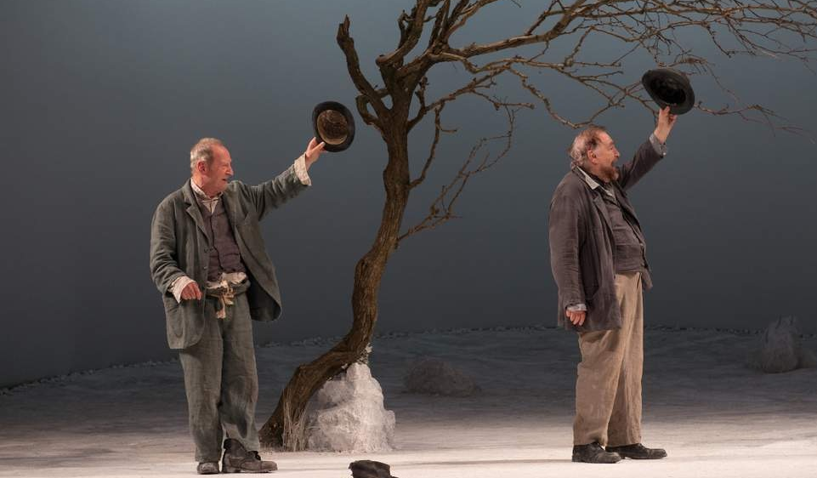
Notes:
(Waiting for Godot)

Slide 11
Support for a Human Rights Act?

Slide 12
Opinion polling on a HRA (2009)
Notes:
If you take out those who were neutral, then about 80% of ppl polled were in favour of a HRA, and only 20% opposed. Moreover, there is strong evidence suggesting that when people learn more about the likely impact of a HRA, they’re more likely to be positively disposed towards a HRA.

Slide 13
Support for HRA: submissions to 2009 NHRC
Notes:
If you take out those who did not express a view, 87% of submissions favoured a HRA.

Slide 14
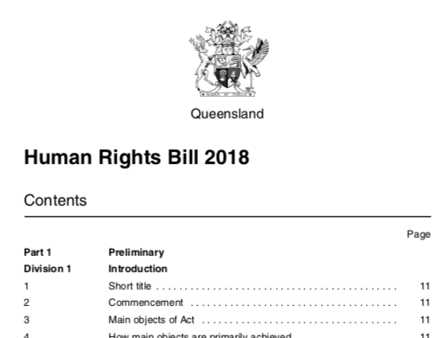


Slide 15
Qld Human Rights Act: key features
A ‘dialogue model’ HRA.
Focus on ICCPR rights (plus health & education)
Interpretation of laws
‘Public entities’ must comply with human rights
Full range of remedies (inc damages) for breach
Qld Human Rights Commission mediation function
Review in 2023
Notes:
Dialogue model:
Ordinary Act of Parl’t (not constitutionally entrenched)
Parliament is supreme
Limited role of the courts

Slide 16
Controversies and myths
This porridge is too hot
Lawyers and unelected judges…
This porridge is too cold
Exemptions for religious bodies
Need for standalone cause of action and broader remedies
Youth justice and corrections.
Myths
‘But Zimbabwe and the Soviet Union had bills of rights.’
‘Our system already protects human rights.’
Notes:
National Human Rights Consultation Report:
On the Zimbabwe/USSR myth, the report said that “the rule of law and existing democratic institutions” distinguish Australia from such countries, and these are of course necessary preconditions to the success of this or any other law (p296).
The report concluded that the argument that a HRA would involve an anti-democratic shift of power from Parl’t to the Judiciary was “particularly weak in the case of a legislative (as opposed to constitutional) charter of rights. In addition, the separation of powers under the Australian Constitution is designed specifically to allow the sharing of sovereignty, recognising the limits of majoritarian democracy and the benefits of an independent judiciary.” (p296)
On the “lawyers’ picnic” myth, the report accepted that the predicted “flood of litigation has not come” in the UK, and other jurisdictions that have introduced a dialogue-model HRA (pp251 and 297).

Slide 17
What’s the Practical IMpact?
Notes:
Institutional change
Link to civil society (eg, advent of HRLC linked to Vic Charter coming into force)

