Slide 1
Making LGBTI Rights Real

Slide 2
To begin with….
How many people here feel that you know a little bit about LGBTI people?
How many people here feel fairly confident in your understanding of LGBTI people?
And how many people feel completely lost once we get past the LGB…?
Notes:
Now, throughout this presentation and I want you to hold the following question in your mind.
How can we make our workplaces more safe for LGBTIQ+ people including staff, volunteers, visitors, and of course – clients?
Today I will give you a quick intro to the acronyms and some practical tips.
Then looking specifically at the T in the acronym I want to help you to understand the way that gender exists outside the binary of man/woman and talk about non-binary transgender identities.
Finally, Drew will….

Slide 3
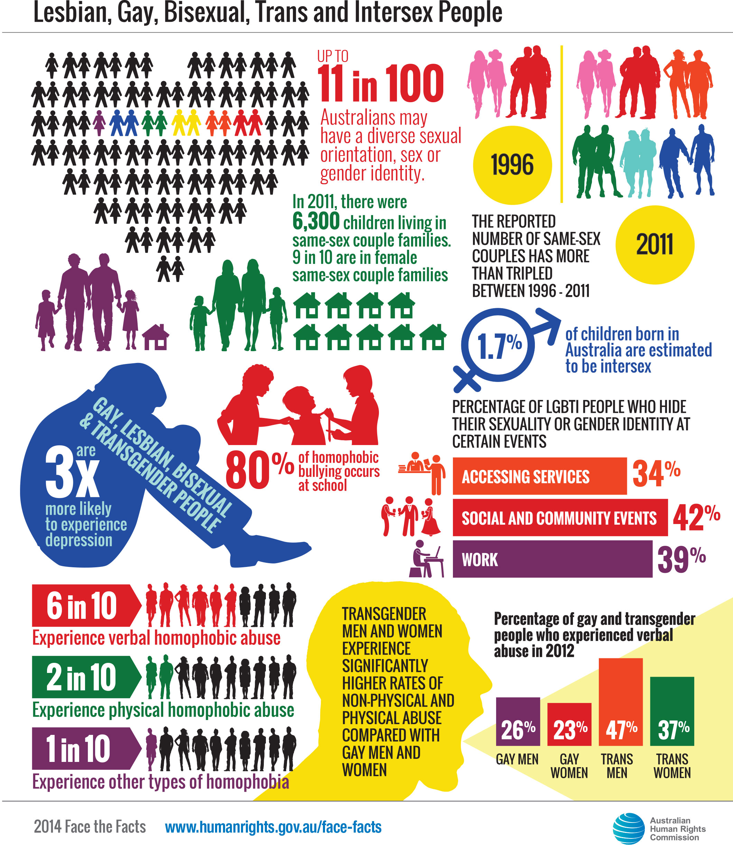

Slide 4
What role can CLCs play in achieving a just future for LGBTIQ+ clients?

Slide 5
Understanding the terminology
LGBTIQ+
Umbrella term that encompasses
Gender and sexually diverse people
Those who use other terms to describe their sexuality and/or gender identity
LGBTIAQQP2+

Slide 6
Source: https://transgenderally.files.wordpress.com/2013/07/1600-genderbread-person.jpg
Notes:
I’m sure some of you may have seen an infographic like this before.
These resources are really helpful to understand the way that sex, gender and sexuality are all distinct from one another but can be understood in relation to one another.
Biological sex or sex assigned at birth refers to the physical, hormonal, chromosomal and genital make up that corresponds to the box that doctors tick on our birth certificates.
The term ‘intersex’ refers to people who are born with genetic, hormonal or physical sex characteristics that are not typically ‘male’ or ‘female’. Intersex people have a diversity of bodies and identities.
Gender Identity refers to the inner sense of how someone feels about their own gender. It exists separately to Gender expression to demonstrate that someone’s gender identity and gender expression can be different. Being a feminine man or a masculine woman does not take away from that person’s identity with their gender.
This is just a very quick overview but the key point I would like to stress is that understanding the distinction between sex and gender is essential to accepting transgender people.

Slide 7
Understanding the terminology
Cisgender
Non-binary
Gender fluid
Gender dysphoria
Gender expression
Gender identity
Transgender
Gender diverse
Transitioning
Sister girl/brother boy
Please see:
ADCQ Trans*@Work
Notes:
So most people here would be familiar with, or have at least heard these terms before.

Slide 8
Group activity: Why is a trans inclusive service beneficial?
Client perspective
Service/staff perspective
Notes:
Ask audience to talk in small groups for 5 mins
Consider both the client perspective and the service/staff perspective
One person from each group to report back

Slide 9
Benefits of a trans inclusive service
For the client:
Access to services
Improved safety
For the service:
Improving staff retention through modern, employment practices
Complying with state and federal discrimination legislation

Slide 10
Discrimination laws, attributes, exemptions and case studies

Slide 11
What is prohibited?
Discrimination, direct and indirect
Sexual harassment
Vilification (Qld only)
Unlawful requests for information (Qld only)
Information and examples on the following pages include extracts from
http://www.adcq.qld.gov.au/resources/lgbti-people/Gender-identity-and-your-rights
Notes:
Vilification and Unlawful requests only protected in Qld

Slide 12
Discrimination examples
A transgender woman is refused entry to a women's only domestic violence shelter
A workplace where jokes about ‘hermaphradites’ are constantly made in front of an intersex staff member
A housing provider refuses to use the female name of a transgender woman until she shows evidence of gender reassignment surgery.

Slide 13
Cont.
A workplace refuses to use the preferred pronoun of a gender non-binary person, despite making it clear that they want to be referred to by they/them pronouns
An employer will not let you change your sex marker to X on their employee record

Slide 14
Vilification (hate speech)
Gender identity vilification: publicly inciting hatred towards, serious contempt for, or severe ridicule of someone because of their gender identity
Example
A neighbour of a transgender woman yelling out from a unit complex that they intend to bash the “shemale” living next door.
Notes:
Also includes sexuality, race, religion

Slide 15
Unlawful requests for information
Examples may include;
during a job interview an employer asks you about whether you are pre or post-operative;
you are asked if you have male or female genitalia by a security guard when trying to enter a nightclub

Slide 16
Case example
Client had taken leave and was transitioning
Requested her workplace to change her name and sent through documentation
Workplace requested medical information and continued to ask probative

Slide 17
Exceptions
Some exceptions allow sex discrimination in certain circumstances
No specific exceptions granted to organisations in Qld allowing gender identity discrimination
Some general exceptions allowing gender identity in sport and working with children

Slide 18
Sex Discrimination Act 1984 (Commonwealth)

Slide 19
Attributes
gender identity means the gender‑related identity, appearance or mannerisms or other gender‑related characteristics of a person (whether by way of medical intervention or not), with or without regard to the person’s designated sex at birth.
intersex status means the status of having physical, hormonal or genetic features that are:
(a) neither wholly female nor wholly male; or
(b) a combination of female and male; or
(c) neither female nor male.

Slide 20
Exemption
Section 30
It is lawful to discriminate against another person, on the ground of the other person’s sex, in connection with a position as an employee, commission agent or contract worker, being a position in relation to which it is a genuine occupational qualification to be a person of a different sex from the sex of the other person.

Slide 21
Gender identity discrimination and sex discrimination exceptions
An exception allowing sex discrimination does not allow gender identity discrimination
Danger in defining binary distinctions
Notes:
Trans women and non binary cant be discriminated against
Trans men

Slide 22
Privacy Act 1988 (Cth)
Information Privacy Act 1999 (Qld)

Slide 23
Privacy
Protects information that is:
Personal
Health related (may include hormone treatment and counselling)
Gender identity is personal information
Regulates collection and disclosure of this information
Is information necessary for service functions or activities?
Notes:
Gender identity is personal information. Can be collected
health related information. This may cover hormone treatment and counselling.
Consistent with Australian Privacy Principle 11, to protect the privacy of an individual who has changed their sex and/or gender on Australian Government records, departments and agencies should ensure an individual’s history of changes of sex/gender or name is protected from interference, subject to appropriate security controls and is recorded and accessed only when the person’s history is relevant to a decision being made. Information which is no longer needed or required must be de-identified or destroyed.

Slide 24
Legal needs and experiences of transgender people
Notes:
Trans have long history, dating back thousands of years

Slide 25
Law Council of Australia Justice Project LGBTI People
64.8% reported experiencing discrimination or harassment
2014 ‘First Australian National Trans Mental Health Study’
Up to 50% of transgender people have attempted suicide at least once in their lives
36.2%of transgender Australians met the criteria for experiencing a major depressive episode in 2005
Compared with 6.8% of the general population

Slide 26
Higher morbidities and lower life expectancy
55.9% of trans and gender diverse respondents earned under $40 000 per annum, excluding unemployed students
National Trans Study
Transgender and intersex people face discrimination in the realm of healthcare

Slide 27
Accessing services
33.6% of LGBTI people hide their gender identity and/or sexuality
Private Lives Survey 2012
Of existing DV service providers;
18% rated themselves as “fully competent” to work with gay or lesbian people
7.69% rated themselves as “fully competent” to work with transgender clients
5% rated themselves “fully competent” to work with intersex clients
2011 “Gap analysis of NSW domestic violence support services

Slide 28
DFV Benchbook
They may be less likely to report the behaviour or seek the help they need for fear of;
Ostracism and discrimination;
a negative response from the police and courts;
escalating the violence/issue;
being ‘outed’;
being disbelieved or blamed;
or due to personal feelings of shame or embarrassment or
a need to protect the perpetrator/relationship

Slide 29
Rainbow Tick
Organisational capability
Cultural safety
Professional development
Consumer consultation
Disclosure and documentation
Access and intake processes

Slide 30
Example intake form information
At (service name) we strive to ensure that we treat all service users, staff and volunteers with respect and provide a positive and safe space to access services and work in. We are aware that there may be additional barriers to accessing support on the basis of:
• Age
• Disability
• Religion and Belief
• Lesbian, Gay, Bisexual
• Transgender identity
• Variations in sex characteristics
• Race
Notes:
Transgender people are often wary about revealing that they are transgender and may feel
particularly uncomfortable about discussing their gender identity in person and may not
feel able to answer a question relating to their gender identity directly.

Slide 31
Dead names
Dead name: the name a person had prior to their transition
Deadnaming: calling a person by the name they no longer use

Slide 32
Pronouns and pronoun cuing
Misgendering: describing or addressing someone using language that does match a person’s gender identity
Pronoun cuing
She will be late today
This man makes the best coffee
Have you met Sam? They can answer your IT questions. Wouldn’t know what to do without them.
Notes:
If you make a mistake – apologise briefly and move on. Don’t make it a big deal.
If you realise afterwards that you’ve misgendered someone, find an appropriate way to have a private conversation and apologise.
Another great thing to do is include your pronouns in your email signature or ask what it is in your intake form.
This normalises a wider discussion and visibility of the issue.

Slide 33
Scenario
You have just started a new job
You have heard that one of your new colleagues is transitioning
You do not want to make assumptions and you do not know what pronouns they prefer to use

Slide 34
Scenario
Introducing yourself and ask what pronouns they prefer
Try using they/them pronouns in a conversation
New scenario: Pretend that you already work here. You notice that the new employee is unsure of how to refer to your transgender colleague. Practice pronoun cuing they/them

Slide 35
Transitioning in the workplace
Demonstrate organisational commitment
Revise Rules, Membership etc
Policy – clear but flexible
Inclusivity and sensitivity training
Plan for client or employee reluctance
Your practice (CLE, law reform, collaborations, client interview etc)
Notes:
Plan for client or employee reluctance

Slide 36
What can CLCs do?
A place that is safe to visit and work
To feel safe and supported in legal consultation
Ongoing development of knowledge and skills
Advocate for the rights and issues that affect people from the LGBTIQ+ community
Notes:
Achieving a just future for LGBTIQ+ people involves creating a safer and more inclusive world. CLCs are able to play a role in this by Firstly being a place that people feel safe to visit, secondly, for LGBTIQ+ people to feel safe and supported to talk about the problems they face, thirdly, for CLCs to have the ongoing knowledge and skills to support LGBTIQ+ clients and lastly, to advocate for the rights and issues that affect LGBTIQ+ people.

Slide 37
Group activity: 1. Does your centre have policy in place that is inclusive of LGBTI people? 2. What elements would be covered in such a policy? 3. What are your next steps now you have some more information?
Notes:
Show of hands Q1 – who has a policy in place currently?
Q2 & Q3
Ask audience to talk in small groups for 5-10 mins and go through the WIRE policy
Consider both the client perspective and the service/staff perspective
One person from each group to report back

Slide 38
Making LGBTI Rights Real

