Slide 1
Transurban Hardship Assistance
Reducing tolling debt and fines in vulnerable communities
Community Legal Conference QLD
March 2019

Slide 2
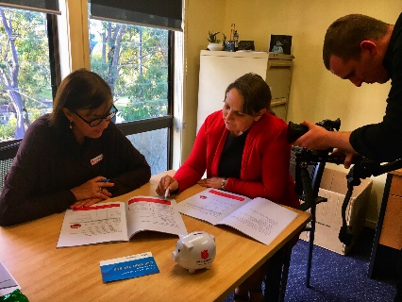
Hardship Pilot: Logan LGA
What we tested
With more than 50 community legal, welfare and financial counselling representatives:
Specialised staff training to enhance capabilities to detect and respond to hardship
A dedicated community practitioner support line
A streamlined eligibility process based on a trust model
Supporting information and materials

Slide 3
Linkt Assist is here
How to get in touch
Dedicated community sector line:
1300 110 129
Self-advocating clients:
1300 767 865
Email: linktassist@transurban.com
Web: www.linkt.com.au/assist
1300 767 865
Notes:
One team, Australian-based single point of contact – a ‘case-managed’ approach
Supported by appropriate training regime and culture
New hardship program: Linkt Assist
Customer-centred program with protocols, guidelines and processes in line with best practice
Streamlined access and eligibility
Dedicated ‘professional support’ phone line
Eligibility based on trust model
Improve clarity and accessibility of information
Consolidated online information hub / translated materials www.linkt/com.au/assist
Information on where and how to pay / how to avoid fees and fines / consequences
Education and early intervention
Work with state road authorities to better incorporate information about safe and legal travel on toll roads into driver education materials
Work with other stakeholders on joint education and early intervention strategies
Best practice leadership
Identify, join and contribute to appropriate platforms, partnerships and programs to strengthen the way we support vulnerable customers
Founding membership of Thriving Communities Partnership

Slide 4
Linkt Assist online information hub
www.linkt.com.au/assist

Slide 5
Education and early intervention
A range of tools for you and for your clients available to download

Slide 6
Hardship improvement initiatives
Other recommendations:
More flexible treatment of fines
Additional payment options and channels
Improve clarity and accessibility of information
Education and early intervention
Notes:
Further explore more supportive and flexible processes for the treatment of fines when evidence of financial hardship is identified.
Explore alternative enforcement options that don’t require infringement.
Explore options for tailored product for eligible Linkt Assist customers.
Explore Centrepay as an alternative payment channel for people on CentreLink benefits.

Slide 7
Linkt Assist
A reminder…How to get in touch
Dedicated community sector line:
1300 110 129
Self-advocating clients:
1300 767 865
Email: linktassist@transurban.com
Web: www.linkt.com.au/assist
Notes:
Further explore more supportive and flexible processes for the treatment of fines when evidence of financial hardship is identified.
Explore alternative enforcement options that don’t require infringement.
Explore options for tailored product for eligible Linkt Assist customers.
Explore Centrepay as an alternative payment channel for people on CentreLink benefits.

