Slide 1
Building Capacity: Domestic and Family Violence Best Practice Supporting clients with intellectual, or cognitive disabilities.
27th February 2019
Leona Berrie
Manager
WWILD SVP Association
WWILD is funded by state government to provide sexual assault services and victim of crime support services to people with intellectual, cognitive and learning disabilities in Brisbane, Logan and Caboolture.

Slide 2
Acknowledgement of country
WWILD acknowledges the traditional owners of the land on which we are holding this presentation, the Turrbul and Jaggara people.
We pay our respects to their elders, past, present and emerging, and acknowledge the important role Aboriginal and Torres Strait Islanders continue to play in our society.
We also acknowledge the disproportionately high rates of domestic violence experienced by Aboriginal and Torres Strait Islander peoples and the additional challenges this creates in responding to this issue.

Slide 3
Aim of this presentation.
This presentation will summarise
Intersections between disability and gendered violence/Domestic Violence
Identifying when disability may be an issue impacting on your work together
Common communication issues and some suggested strategies to minimise/mitigate these issues
Supported decision making
Considerations for improving accessibility for your organisation and your practice (hint: it’s not just about ramps and lifts!).

Slide 4
In a nut shell…
Depending on the research cited, it is estimated between 50% and 99% of women with intellectual disabilities will experience sexual assault in their lifetime (French, 2007).
Up to 90% of women with an intellectual disability experience some form of abuse within their lifetime (Hughes et al., 2011)
Women with intellectual disabilities are often subject to unique forms of violence and perpetrators that are specifically relevant to their disability. This can include destruction of assistive devices, deliberately incorrect administration of medication, theft, or neglect in performing personal care (Platt et al., 2017).
Vulnerability to abuse is likely to increase with the severity of a person’s disability (Plummer & Findley, 2012).
Women with physical and cognitive disabilities experience higher rates of intimate partner violence than those without disabilities, and those with cognitive disabilities are particularly vulnerable (Brownridge 2006; Cohen et al 2005).

Slide 5
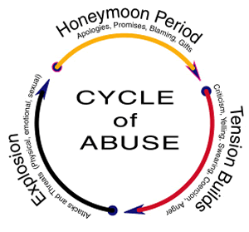
Intellectual Disability & Vulnerability to Violence
People with Intellectual Disability are:
Often reliant on care therefore more vulnerable to threats by abusers
Less likely to understand their rights in relation to violence
Less likely to seek help
Less likely to have received sex education and therefore remain ignorant of their rights in relation to sexual assault/sexual activity
More likely to be financially dependent on perpetrators of violence and social isolation may be intensified
Likely to have limited capacity to organise/access the supports in a crisis
Less likely to be believed
Notes:
Dependency- important element of exploitation/ violence of people who have an intellectual disability.
Legislation does not cover all fors of “domestic”- eg paid workers in the home, co residents .

Slide 6
Broadening Definitions of Domestic Violence
Sexual abuse – unwanted touching by caregivers, forced sterilisation, demands for sexual activity in return for assistance
Emotional/psychological abuse – forced social isolation, threats to withdraw services or support
Physical abuse - withholding disability related equipment, deprivation of food or water, heating a bath too hot
Financial abuse – using the person’s disability as an excuse to control their finances
Perpetrators may not be covered by the Act (e.g. a co tenant, paid carers)
Notes:
Pwda reference
Women with disability experience all of the same forms of domestic violence as nondisabled
women, including physical, sexual, emotional and financial violence.
However, women with disability are subjected to further forms of violence, which may
include but are not limited to:

Slide 7
What is intellectual disability?
AAIDD 2014 definition:
Intellectual disability characterized by significant limitations in:
Intellectual functioning - reasoning, learning, problem solving, memory, planning, comprehension, abstract thinking
Adaptive behaviour – conceptual, social and practical skills
Originates before the age of 18. (WHO 2014)

Slide 8
Conceptual
Language
Social
Empathy
Practical
Personal care
Reading social situations and cues
Interpersonal communication skills
Ability to make and retain friendships
Suggestibility
Compliance
Masking
Travel skills
Safety
Use of money
Schedules and routines
Use of phone
Occupational skills
Reading
Writing
Money
Sequencing
Time
Reasoning
Knowledge
Memory
Planning
Problem solving
Literal thinking
Humour and sarcasm
Abstract thinking
Generalising learning from one situation to another

Slide 9
Legal Definition
‘Person with an impairment of the mind’ (Evidence Act 1977).
A person is an ‘intellectually impaired person’ if the person has a disability – (a) that is attributable to an intellectual, psychiatric, cognitive or neurological impairment or a combination of these; and (b) that results in:
(i) a substantial reduction of the person’s capacity for communication, social interaction or learning; and (ii) the person needing support.
Notes:
Vic
I have heard concern in the past from officers that this seems a high bar – that the person must meet this criteria and this criteria and this criteria. But we are here to try to break that down to what it actually may practically look like when someone meets this definition.
A lot of people need support, but it is often not available, or piecemeal.
They don’t get the support that they need
A lot of people don’t have assessments done to show that they have a diagnosis
The 2nd part of difficult to ascertain in short conversation and people are really good at masking – don’t assume because they have good verbal skills it doesn’t mean they have good comprehension, memory, reasoning.
Kobi case study.

Slide 10
Talking about disability

Slide 11
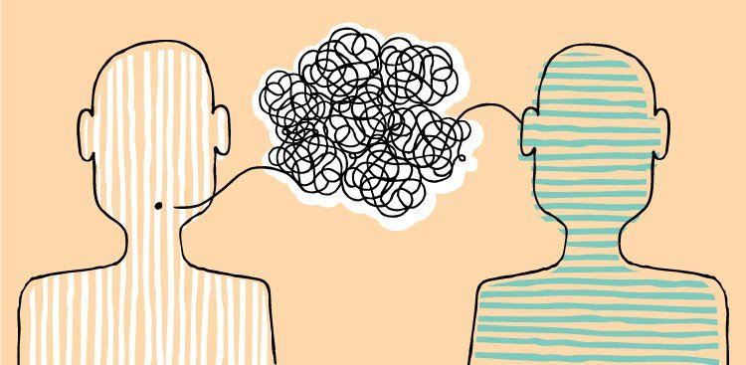
Communication
Clients might:
Have a short attention span and be easily distracted
Have trouble absorbing and recalling information
Responses may be delayed
Find problem solving difficult
Have trouble with sequencing
Have speech and verbal issues
Have trouble understanding questions
Be compliant
Be unable to generalise
Notes:
Gillian

Slide 12
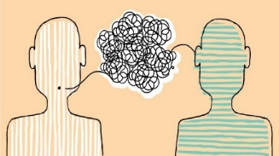
Have difficulty articulating feelings
Be vulnerable to suggestibility
They are likely to have trouble elaborating
Be concrete (literal) thinkers who have trouble with abstract thought
They may not identify as having a disability (masking)
Have difficulties with literacy and numeracy
Have trouble with complex tasks
Become frustrated easily

Slide 13
Communication Tips
Treat the person as a person – and as an adult
Be clear and concrete; Use easy words not complicated words
Conversations will take more time; pace your communication
Be prepared to discuss things more than one time and in different ways
Take responsibility for not understanding
Sign post a change of conversation topic
One question at a time & one choice/idea per question
Speak in clear, short sentences

Slide 14
Communication Tips
Give time for the person to process your words and give a reply
Use open ended questions, avoid yes and no questions
Use simple sentences not complex sentences full of lots of ideas
Let people tell their story in their own way (it is likely not to be sequential)
Take the time to listen and show you value what people say
Concentration may be a challenge. Having shorter, but more frequent conversations is more helpful.
Be concrete – ‘Does he call you names’? Rather than ‘Does he verbally abuse you’?

Slide 15
Tips - Check understanding through:
Clarification: “Could you tell me in your own words”
Breaking down complex ideas into parts: “what’s the first thing you need to do? What do you need to do after that?”
Naming and concretise alternatives: “We could do x. or we could do y, either is fine with me. What would you like to do?”
Naïve questioner: “I don’t know much about x. Could you tell me about it?”
Where possible you may be able to share information with support people or advocate to help give a consistent message and consistent information

Slide 16
Capacity and decision making
Not everyone who has a cognitive disability has a decision maker
Decision making capacity is presumed unless significant evidence to the contrary
Making “bad decisions” is not the same as lacking capacity to make decisions – can be particularly frought in the DFV space
To achieve the desired outcome if applying for someone to have an formal decision maker relies on having the supports to enact the decision.

Slide 17
Capacity and decision making cont…
Many people rely on more informal arrangements for supported decision making
Supported decision making principles
Information is presented to me in a format, environment and over a period of time that is most conducive to my understanding and learning needs
I am free from coercion in making my decision
I have been supported to understand the consequences of the options presented to me (which means also having the option of changing my mind)
Having people who support me to make decisions (where safe and appropriate) available to remind me of the information when I need it.

Slide 18
Maximising conditions for supported decision making
Taking time to build rapport with the person so they would feel as comfortable as possible to express themselves for example if they didn’t understand something.
Carefully and clearly explaining the form in understandable language, the contents of their statement, the consent form and the statutory declaration. – this takes time.
Explain the implications of what they are signing – what may or may not happen if they do sign or do not sign, what they are declaring by signing the forms. Eg. WWILD consent to use photos form.
Throughout the process, checking for understanding by asking questions such as ‘can you explain to me what this means?’, or ‘what do you think would happen if…?’
Where appropriate, we may engage other support people in the conversation to ensure understanding and accuracy, such as family members or other workers (in a DV context this requires careful consideration).
We also provide support letters with applications, and with the person’s written consent become a contact person in reference to their application, to assist with them understanding any further communication regarding the application.
Notes:
Taking time to build rapport with the person so they would feel as comfortable as possible to express themselves for example if they didn’t understand something. We do this in person so we can also observe body language and facial expression to pick up on anxiety or confusion. This is unlikely to be achieved in one meeting.
Carefully and clearly explaining the form in understandable language, the contents of their statement, the consent form and the statutory declaration. – this takes time.
Explain the implications of what they are signing – what may or may not happen if they do sign or do not sign, what they are declaring by signing the forms. Eg. WWILD consent to use photos form.
Throughout the process, checking for understanding by asking questions such as ‘can you explain to me what this means?’, or ‘what do you think would happen if…?’
Where appropriate, we may engage other support people in the conversation to ensure understanding and accuracy, such as family members or other workers (in a DV context this requires careful consideration).
We also provide support letters with applications, and with the person’s written consent become a contact person in reference to their application, to assist with them understanding any further communication regarding the application.

Slide 19
How you might check understanding / assess capacity to make a decision
Is there a decision to be made and when does it need to be made
Does the person have all the relevant information to make an informed decision
Has the information been presented in an accessible way
Is the person freely able to make the decision and how this relates to the level of risk involved.
Can they communicate back to you what the implications of their decision might be.
Notes:
Guardianship rant – guardianship will make decisions but wont necessarily put supports in because DVS supports don’t suit a lot of women with disabilities guardianship gets turned to to fill that gap
Where it can be useful is where someone is being financially abused

Slide 20
Accessibility - Barriers
Knowing you have a problem
Knowing there is help available
Knowing how to contact
Having the means to contact
Having the means to communicate
Having the means to transport
Physical access
Time management
Literacy and numeracy
Comprehending the information
Retaining the information
Applying the information
Discriminatory attitudes
The client not identifying as having a disability
The practitioner not identifying or adjusting their communication/practice

Slide 21
Why improve accessibility?
This will help everyone!
E.g. People who have a disability, people who are experiencing trauma, people form non English speaking backgrounds, people with poor literacy and numeracy, people experiencing other mental health issues

Slide 22
Accessibility in practice…
Flexible appointments and the likelihood of the need for multiple appointments (how do you handle cancellations?)
Allowing more time (good process takes longer)
Easy read material
How does your service make itself known to people who have a disability
Being mindful of your communication
Check your assumptions
Willingness to work with supporters where appropriate
How will this knowledge and practice be embedded and reviewed and reflected upon in the organisation
Consider conducting a disability audit and creating a disability action plan
Notes:
concentration, the person may not have all the information,
Good process takes longer and can make the difference between feeling heard or not.

Slide 23
Resources for organisational accessibility
Creating a disability action plan
Practical recommendations for Domestic and Family Violence services
These can both be found at :
https://pwd.org.au/our-work/campaigns/preventing-violence/building-access/

Slide 24
Rural, regional and remote clients
Obviously, the resources you have to draw on are further limited but some important things to consider
Advocacy services often fill the gap in a range of service gaps in supporting people with disabilities to advocate for the things they need.
Who is the service funded as the local area coordinator for the NDIS? If the person doesn’t currently have supports, they may play a role in getting the supports the person needs.
Having a disability does not mean you are not entitled to access the regionally funded DFV service. Some advocacy may be required.

Slide 25
Case study
Freya is 19. She has a cognitive disability that impacts her ability to control impulse, to plan ahead, or prioritise. She has difficulty with comprehension, but is very capable at verbally expressing what she is thinking at the time. She has a Public Guardian appointed for legal decisions.
Freya lives with her boyfriend Adrian. Adrian does not have a formal diagnosis and does not receive any support, but you suspect he has a cognitive disability.
Adrian and Freya live together and have a very physically violent relationship.
Police have been called a number of times to their home due to violence. This time Freya’s neighbours called the police because they heard screams and smashed glass.

Slide 26
Important points from this presentation.
Violence for people with a disability can take on a wider definition
People with disabilities experience violence at higher rates, are more likely to experience violence over longer periods of time and more likely to experience multiple instances of violence over their lifetime.
Myths and attitudes impact the kind of support we provide (e.g. hero carer narratives).
Capacity needs to be presumed and supported decision making approaches are going to be your most useful way of ensuring you are confident in the instructions you are receiving.
Accessibilty needs to be considered from an organisational perspective as well as from our individual practice

Slide 27
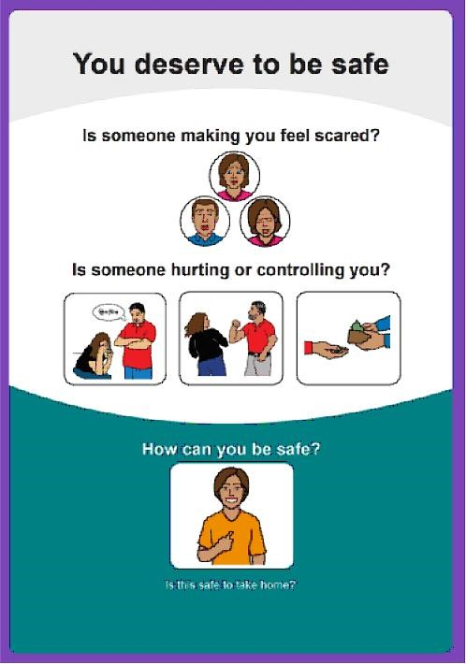
WWILD SVP Association
211 Hudson Road,
Wooloowin, Q, 4030
Ph: 07 32629877
E: info@wwild.org.au
W: www.wwild.org.au
You Deserve to Be Safe – Easy read book about DFV
https://wwild.org.au/wp/wp-content/uploads/2016/08/final_web_tagged-pdf-002.pdf

