Slide 1
Community Legal Centres Queensland State Conference 2019
Exploring Your CLC’s Appetite for Risk
21 March 2019

Slide 2
What we will cover …
Risks: the risk of not dealing with risk is of itself a risk
Language around ‘risks’
How to assess and record risks?
Types and categories of risks
Identify which categories of risks are likely to escalate faster (these should sit at top of the risk register)
Risk Appetite – what is it, do you need it?

Slide 3
Tricker Model of Governance
Compliance roles Performance roles
Provide accountability
Strategy formulation
External role
Approve and work with and through the CEO
Internal role
Monitoring and supervising
Policy making
Past and present
orientated
Future orientated
Source: Robert I. Tricker, International Corporate Governance: Text Readings and Cases, New York: Prentice Hall, 1994, p.149

Slide 4
CLC Board’s role in risk management
Board’s role is to make informed effective decisions and seek to ensure decisions lead to enhanced performance outcomes
Sets tone and direction for risk management
Must comply with Incorporated Associations Act, Corporations Act and and ACNC Act requirements
Directors individually accountable
Board must monitor performance against organisational objectives and provide performance information
Board manages strategy risk (ACNC Governance Standards)

Slide 5
CLC’s Executive role in risk management
Integrating risk management into all activities and ensuring a risk aware culture is promoted throughout CLC (achieved through implementation of Risk Management Policy)
Assists the Board in making decisions that lead to enhanced performance outcomes by:
identifying and managing risks as part of daily workloads
embedding culture to emphasis importance of ethical behaviour, quality control and risk management
sharing experiences / learnings so that this may be translated into the framework to manage organisational and strategic risks

Slide 6
Defining ‘risk’
‘effect of uncertainty on objectives” (AS/ISO31000:2009)
“The chance of something happening that will have an impact on objectives” (AS4360:2004)
COSO* Enterprise Risk Management – Integrating strategy with performance 2017 (clarifies importance of enterprise risk management in strategic planning and embedding within the organisation. Also provides guidance on Risk Appetite and Risk Tolerance.)
Risk is a measure of a possibility that the future may be different from what is expected
*Committee of Sponsoring Organisations of the Treadway Commission

Slide 7
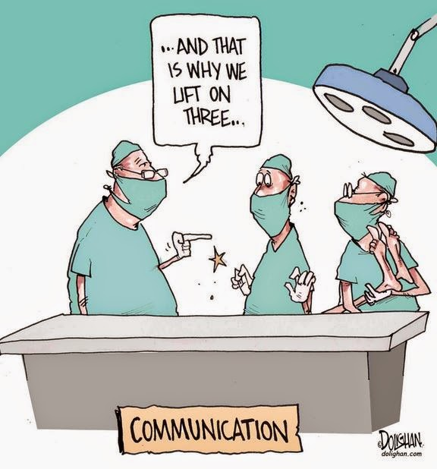
‘Risk’ v ‘Compliance’
Risk and compliance are NOT the same
Risk Management is set by own standards with a view to reducing or managing risks
Compliance is set by law and courts with the objective of eliminating or preventing

Slide 8
RISKS - CONTEXT IS EVERYTHING!

Slide 9
CLC Risk Governance Context
Identified by considering:
CLC’s legal framework
State and Federal Legislation
Policies
Organisation’s activities

Slide 10
Risk Governance Language …
Risk attitude
Relates to organisation’s culture
Enables effective decision making to moderate potential negative future impacts (risks) and to capitalise on opportunities to assist in achieving strategic and operational objectives
Risk Appetite
Designed to reflect organisation’s culture, objectives, values and context
Provides a scale that allows for numerical and/or qualitative measures
The appetite towards achieving objectives are tested through each category, offering an upper and lower limit
Measurable risk tolerances can then be determined within category’s appetite
Risk Categories
Used to categorise the various risks faced by an organisation to enable analysis
It offers a lens to look through to consider the organisation’s appetite for risk taking in the pursuit of its objectives

Slide 11
Risk Governance Language …
Risk tolerance
Provide a measurable indication that the organisation is operating within its comfort zone with regard to that specific appetite
Decisions must take into account cost benefit of treatment and whether risk has been reduced as low as reasonably possible
Inherent Risk Rating
Level of risk before manageable controls are introduced
Residual Risk Ratings
Level of risk remaining after mitigating risk controls are set into place
Provides an indication of the effectiveness and adequacy of controls
Target Risk Ratings
Level of risk that is desired based on appetite and cost/benefit of mitigation

Slide 12
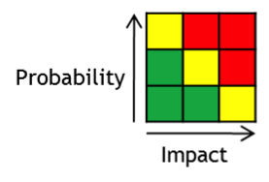
What is risk management?
Risk Management is defined as a logical and systematic method of identifying, analysing, assessing, treating and monitoring associated with an activity or process in a way that will enable an organisation to minimise losses and maximise opportunities

Slide 13
Risk Management
1. Identify Risks
2. Evaluate, analyse and prioritise Risks
Communicate and Consult
4. Monitor and review
3. Treat Risks
- Identify treatment options
- Evaluate and select treatment options
- Prepare treatment plans
- Implement plans
Myles McGregor-Lowndes – ‘What is Risk Management’ based on AS4360

Slide 14
What can you take away from today?
Objective
Already managing risks as part of daily workloads /decisions
Consider that information so this may be translated into a framework to understand whole of organisation risks
Key steps to achieving a robust risk management framework
Identify the risks
Evaluate the risks
Design the framework
Implement and continual review

Slide 15
Overarching Risk Appetite Statement
Interaction between Risk Categories, Risk Exposure and Risk Tolerance
Appetite Scale (example):
Avoid | Little to no appetite | Avoidance of risk and uncertainty as will impact achieving objectives
Averse | Small appetite | Prefer safe options with little risk of adverse exposure
Accept | Medium appetite | Consider all options and choose most likely for successful delivery with reasonable degree of protection
Receptive | Large appetite | Will engage with risks and opportunities when the potential benefit is great

Slide 16
Step 1: Understand Risk Appetite
Risk appetite is the amount of risk a Board is willing to carry to meet the organisation’s strategic objectives
When preparing the risk appetite statement, the Board should ensure the statement:
informs and shapes the risk culture
aligns with the organisation’s purpose, vision and values
takes into consideration the organisation’s operating environment
provides clearly defined, measurable tolerances to inform the whole risk cycle

Slide 17
Setting Appetite for Risk (Example)
Likelihood
MEASURE | DESCRIPTION
Almost Certain | High/frequent level of exposure – recurring recorded incidents – event expected to occur in most circumstances. Expected frequency range is greater than one per annum
Likely | Exposure is likely – recorded incidents – the event will probably occur in most circumstances. Expected frequency range is between 1 and 3 years and occurring once per annum in that period
Possible | Exposure could happen – infrequent recorded incidents – the event might occur at some time. Expected frequency range is between 1 and 3 years and occurring at least once in a 3 year period
Unlikely | Exposure could happen – very few recorded incidents – event could occur at some time. Expected frequency range is between 1 and 10 years and occurring once in a 5 year period
Rare | Exposure to hazard could happen – an incident might be possible – may occur only in exceptional circumstances. Expected frequency range is less than 1 and 10 years and occurring less than once during a 10 year period.

Slide 18
Setting Appetite for Risk (Example)
Consequence
MEASURE | DESCRIPTION
 | Damage | Financial Impact | Reputational Impact
Medium | Minor adverse effect in particular area of operation, but could escalate if completely disregarded | <$10,000 | Series of articles in press
Serious | Adverse effect which could have serious consequences for organisation if not addressed promptly | <$100,000 | Short term State wide or extensive local negative media coverage
Major | Major adverse effect which does or could hinder a substantial part of organisation operations | <$350,000 | Extensive State wide negative media coverage
Extreme | Intolerable adverse effect which substantially hinders continuation of organisation’s operations | <$500,000 | Extensive nationwide negative media coverage
Catastrophic | Intolerable adverse effect which means that the organisation is not sustainable in its current form after the event. | <$5,000,000 | Extensive nationwide negative media coverage

Slide 19
Step 2: Identify the Risks – Operational v Strategic
Operational risks - something internal or external that may impact on your ability to achieve organisation’s existing strategy. Examples include:
WH&S Hazard – most commonly understood risk and very operational in nature
Uncertainty – potential that actual results do not equal anticipated results
Strategic risks
something external that if it occurs will force a change in existing strategic direction

Slide 20
Examples of strategic risks …
Examples of strategic risks include:
Kodak – film vs digital
IBM – desktops v laptops
Sony – portable sound vs Ipod/Ipad
Video Stores – online streaming services
This Photo by Unknown Author is licensed under CC BY-SA
This Photo by Unknown Author is licensed under CC BY-SA

Slide 21
Step 3: Categorise the Risk
Categories of risks include:
People
Reputation
Financial
Information & Data
Advocacy
Property
Products
Notes:
Stop here and ask for suggested categories for PACT

Slide 22
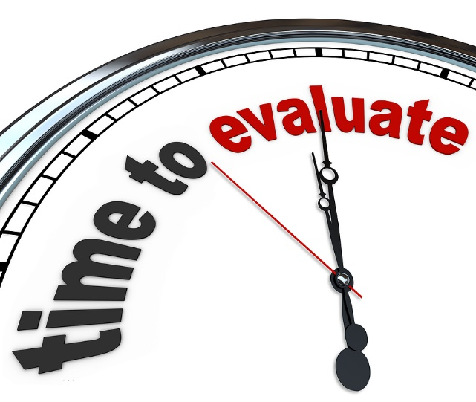
Step 4: Evaluate and Analyse the Risk
What is the probability of a loss and the severity of such a loss?
Consider risks that have a high probability but a low cost and risks that have a low probability but a high cost

Slide 23
Evaluating Risk (Example)
Risk Rating Matrix
LIKELIHOOD | CONSEQUENCES
 | Medium | Serious | Major | Extreme | Catastrophic
Almost Certain | L | VH | VH | VH | VH
Likely | L | H | VH | VH | VH
Possible | L | M | H | VH | VH
Unlikely | L | M | M | H | VH
Rare | L | L | M | H | H
Key to Risk Ratings used in the Risk Rating Matrix and corresponding Risk Priority
RISK RATING |  | RISK PRIORITY
VH | Very High | (1) | The activity that gives rise to the risk should be resolved. Immediate urgent Board meeting to be called. Regulators to be advised
H | High | (2) | The activity should be halted or resolved until the risk has been reduced or sufficient control measures in place. Policies and procedures to be reviewed. Approval required from CEO where appropriate. CEO to notify Finance, Risk and Audit Committee and Board who will decide how to proceed.
M | Moderate | (3) | Efforts must be made to reduce the risk, but the costs of doing so need to be carefully considered. Approval required from relevant Executive, with notification to CEO.
Low | Low | (4) | No further action is needed at present but monitoring will be necessary to ensure that controls are maintained. Manage by routine procedures

Slide 24
Step 5: Treat the Risks
Risk avoidance
stop the activity
Risk control
reduce its probability occurring or severity of possible loss
Risk financing
self insurance through reserves to cover the effect of unexpected losses
Risk transfer
transfer to an insurer, an independent contractor, etc

Slide 25
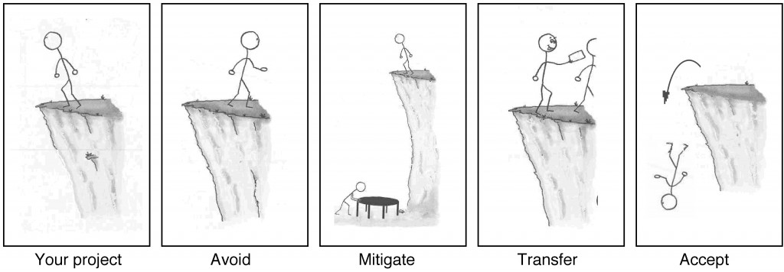
Step 5: Treating the Risks cont …

Slide 26
Step 6: Monitor and Review
Must be continuous review to take account of changes in activities and compliance/law
Culture of risk awareness starts with capturing the knowledge within your CLC
Then need to ensure staff:
understand the framework and share commitment to compliance
have adequate resources and support
understand link to the Board’s role (to exercise care and diligence by understanding and managing key risks)

Slide 27
In summary
Board’s role
Monitor inherent ‘red’ risks
Monitor and address strategic risks
Management’s role
Develop and maintain risk registers and review regularly
Monitor and manage risks for the organisation
Report to the Board/C’ee on risks as required

Slide 28
Group Work - Case studies 1 – 4
Small Community Legal Centre
Generalist centre providing advice only and no case mgt
One or two staff members with a number of volunteer solicitors
Medium Community Legal Centre
Generalist centre providing advice and limited case mgt
8 – 10 staff
Large Community Legal Centre
Generalist centre providing advice and case mgt
A large number of staff and volunteers
Specialist Community Legal Centre
Mid size centre working within an area of specialist expertise

Slide 29
Sonya Beyers
Director
PO Box 7077
East Brisbane Qld 4169
PH: 0412 806 876

