Slide 1
Today’s webinar: Social enterprise
14 May 2019

Slide 2
Acknowledgement of country
Community Legal Centres Queensland acknowledges the traditional owners of the land on which we are holding this presentation, the Turrbul and Jaggara people.
We pay our respects to their elders, past, present and emerging, and acknowledge the important role Aboriginal and Torres Strait Islanders continue to play in our society.
As this presentation is being viewed throughout Queensland, we also pay respect to the traditional owners of the land throughout the country and extend a warm welcome to any First Australians listening to this presentation.

Slide 3
GoToWebinar housekeeping
Facilitator:
  Amanda Wisenthal, Project Officer, Community Legal Centres Queensland
Recording:
  This webinar is being recorded and will be available on the Staff Training page of our website: https://communitylegalqld.org.au/clc-staff/staff-training-and-cle
PowerPoint / webinar materials:
  Emailed prior to today’s session
  Available to download from Handouts section of GTW control panel
Questions:
  Type your questions/comments into question box on GTW control panel OR
  Raise your hand and we will unmute your microphone
  Questions will be addressed at the end
Technical help:
  Email sdo@communitylegalqld.org.au or use question box in GTW
Notes:
Presenter will be introduced shortly

Slide 4
Legal disclaimer
This presentation is for professional development and education purposes only. The information provided in this presentation is not legal advice and is designed for lawyers and other staff working and volunteering in a community legal centre setting in Queensland.
This presentation and webinar is not to be published or reproduced for commercial purposes without the express permission of the author.
Information is current as at 14 May 2019. Community Legal Centres Queensland does not accept any liability for the accuracy of the information in the presentation.

Slide 5


Details of presenter
Belinda is an Associate Professor in the School of Accountancy at Queensland University of Technology
She has approximately 15 years’ experience in academia, teaching accounting and approximately 10 years working for a Big 4 accounting firm in Australia, Ukraine, Papua New Guinea, and China
Belinda’s research focuses on accountability and reporting in third sector organisations

Slide 6

Aim of this webinar
The objectives of this webinar are to:
  promote awareness and understanding of what social enterprise is
  highlight some of the challenges faced by social enterprise
  consider how some of these challenges might effectively be addressed

Slide 7



What this webinar covers
Background to social enterprise
What we know and what we don’t know
Why social enterprise?
Issues regarding social enterprise
- legal forms
- hybrid nature
- reporting
Future of social enterprise

Slide 8
Background to social enterprise
Social enterprise (SE) has emerged as an important part of the third sector
- organisations established for a social (or environmental) purpose, which
trade to support their mission
‘profit for purpose’
- balancing money and mission
- alternative to traditional not-for-profit model
Various organisations in Australia representing SE
Social Ventures Australia
works with partners to alleviate disadvantage
Social Traders
connecting social enterprises with social procurement opportunities and supporting social enterprise to successfully deliver on the contracts they win,
jointly funded by the Dara Foundation and the Victorian State Government

Slide 9



What’s the point of business?
Milton Friedman (1970s): maximising profit for shareholders
Peter Drucker (1980s): Creating a customer
Richard Branson (2000s): making a difference in the world

Slide 10
What’s the point of business?
The responsibility of business is to make profits ‘while conforming to the basic rules of society, both those embodied by law, and those embodied in ethical custom’ (Friedman, 1970: 123)
Howard Bowen (1953) business managers should follow lines of action which are desirable in terms of the objectives and values of society
Bowen (1948) social economy – broader concept of economy, whole economic system, comprehensive social fabric

Slide 11
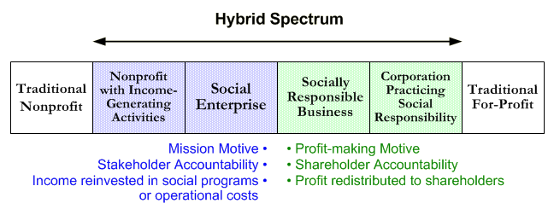
Social enterprises’ position in the business spectrum
Non-profit organisation
Non-profits with income generating activity
Social enterprise
Socially responsible business
Corporation practising social responsibility
For-profit organisation
(e.g. charity)
(cancer council)
(WISE)
(Body Shop)
(e.g. mining company)
Mission motive
Stakeholder accountability
Income reinvested in social programs
Profit making motive
Shareholder accountability
Profit distributed to shareholders
(Based on Alter, 2004)

Slide 12
Social enterprises & mission orientation
$
social programs
$
social programs
$
enterprise activities
Mission centric Mission related
Commercial operations unrelated to mission
$
enterprise activities
social programs
(Based on Alter, 2004, 2007)

Slide 13
Development of SE globally
Various countries have encouraged the development of social enterprises
L3C: low-profit limited liability company in the US
legal and tax flexibility
social benefits of a non-profit organisation
branding and market positioning advantage
CIC (Community interest company) in the UK
business with primarily social objectives
Community contribution company in British Columbia, Canada
hybrid organisation
Other business forms / certifications
Benefit corporations in the US
required to consider social, environmental, and financial implications
B corporation certification
companies assessed and required to score a certain amount for social and environmental performance

Slide 14
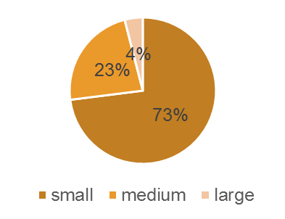
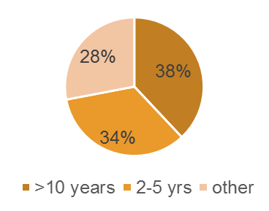
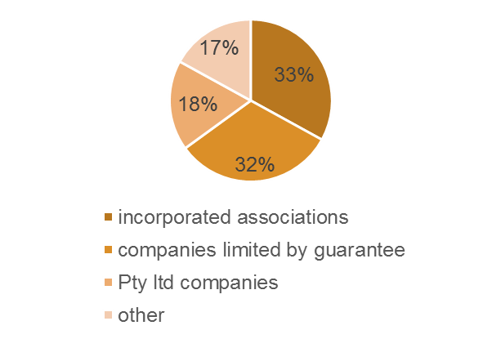
What we know – SE studies
Estimated 20,000* social enterprises in Australia
Mostly small organisations
Gradually maturing sector
Various industries and legal forms
(Finding Australia’s Social Enterprise Sector (FASES), Barraket et al., 2016)
Size
Years operating
Legal form

Slide 15
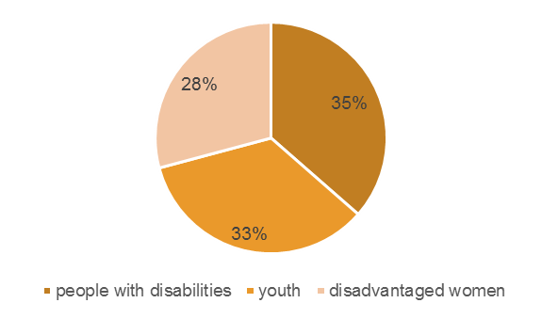
What we know – SE studies
Beneficiaries
Opportunities for social enterprise development:
social procurement
Needs of social enterprise sector:
support in the form of policy
finance
impact measurement
(Based on Barraket et al., 2016)

Slide 16

SE: what we don’t know
Number of social enterprises in Australia
Finding Australia’s Social Enterprise Sector
Barraket et al. (2016) estimated 20,000 social enterprises in Australia
No single accepted definition of SE
general acceptance of SE as hybrid organisations
questions regarding financial sustainability, funding uncertainty
financial independence v.
financial sustainability / financial security
short-term v long-term

Slide 17



SE challenges
Financial sustainability
Mission drift
Financing
Legal forms / recognition / identity / assistance
‘Measuring’ or communicating impact

Slide 18
Reporting
Reporting frameworks
GRI
SROI
OECD, 2015
Integrated Reporting
Statement of Recommended Practice (UK)
AASB Reporting service performance information ED 270
IPSASB: Recommended practice guideline 3 on reporting service performance information
NZASB Service performance reporting
Statement of Service Performance (NZ)
Productivity Commission Report, 2010
Narratives (e.g. case studies on impact)

Slide 19
Reporting in context
Reporting frameworks | Limitations
GRI | understandability; disclosure overload no reference to financial performance
SROI | approximations, proxy amounts, and estimates assumes reliable measurement
OECD, 2015 | understandability (i.e. lacks clear and concise detail)
Integrated Reporting | understandability and comparability lack of a succinct, clear reporting framework
Statement of Recommended Practice (UK) | no detail on social performance /achievements
AASB Reporting service performance information ED 270 | comparability (lack of a clear reporting framework)
IPSASB: Recommended practice guideline 3 on reporting service performance information | comparability (lack of a clear reporting framework)
NZASB Service performance reporting | comparability (lack of a clear reporting framework)
Statement of Service Performance (NZ) | outcomes without associated inputs and outputs
Productivity Commission Report, 2010 | comparability (lack of a clear reporting framework)
Narratives (e.g. case studies on impact) | incomplete account focus on impacts without inputs, outputs, and outcomes

Slide 20

Issues re current reporting approaches
X disclosure overload
X no clear structure
X understandability
‘We’ve actually worked with […an accredited assessor of a particular impact measurement method]. The way in which social impact is measured. I couldn’t explain it to you…’
‘The best way of actually explaining what a social enterprise can achieve is through story telling’ (FASES, Barraket et al. 2016)

Slide 21
Challenges re social reporting
uncertainty ‘how’
People are becoming more savvy about what they’re investing in, and they’re wanting to see that as making a difference as well, and how you actually do that (Manager, NFP, 2014).
It’s how you tell the story. I have no problem with the narrative…but that’s not how it’s displayed in the annual [financial] accounts.
I mean, how do you put a value on a social return.. What’s valuable to me and what’s valuable to you is very subjective. (Manager, SE, 2014).
Interviewer: They’re good numbers to advertise [referring to zero defaults on loans].
Manager: I agree, but it’s a bit like the Qantas safety record; you just don’t want to test fate (Manager, SE, 2014).
fear of exposure
What’s the value of our social contribution? It’s a good question. Can you put a hard number on it? Probably not. Do you really need to? Probably not (Manager, PS, 2014).
measurement challenges

Slide 22
Issues re current reporting approaches
Forms of legitimacy | Key features | Level of evaluation^
Moral
Pragmatic
Procedural*
Structural*
Cognitive
Output
Consequential

Slide 23
Considerations re current reporting approaches
Forms of legitimacy | Key features | Level of evaluation^
Moral | what an organisation represents the ‘right’ thing to do | organisational
Pragmatic | participation, responsiveness exchange and influence | operational
Procedural* | techniques and processes appropriate routines
Structural* | capacity to perform proper / adequate operations / actions
Cognitive | operating how cognitive justification, coherence | achievements
Output | production; what NGOs produce (Ossewaarde et al., 2008)
Consequential | accomplishments; achievements effectiveness and empowerment (Atack, 1999) making a difference (Lister, 2003)

Slide 24
Principles of financial reporting
Relevance | to understanding
Faithful representation | complete account of material aspects
Understandability | through clear and concise presentation
Comparability | via structured consistent presentation
Reliability | verifiable
Measurement | where reliable

Slide 25
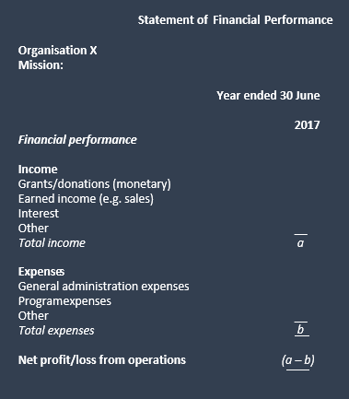
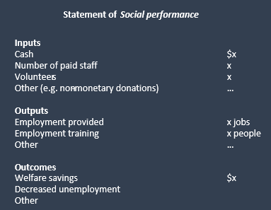
Suggested reporting approach

Slide 26

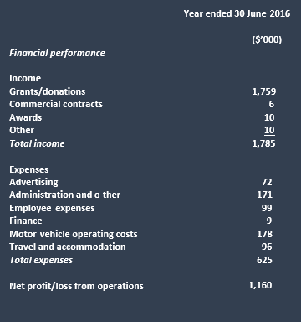
Suggested reporting approach
Statement of Social performance
Inputs
Number of paid staff 6
Number of volunteers 622
Mobile vans 9
Number of locations 66
Outputs
laundry washed per week 7.1 tonnes
conversation 65,000 hours
Outcomes
helping homeless people living with dignity
providing connections for those who feel isolated or excluded
providing referrals to other social services where relevant

Slide 27
Reflections
All businesses have social implications
Central position of social enterprise in the business spectrum
Need for increased awareness
One way of achieving this is (a systematic approach to) social reporting
What’s the value of social reporting?
(potential)

Slide 28









Thanks. Questions?

Slide 29
Useful contacts/additional resources
Alter, K. (2004, 2007) Social enterprise typology, https://www.globalcube.net/clients/philippson/content/medias/download/SE_typology.pdf
Barraket, J. et al (2016), FASES Report, https://www.csi.edu.au/media/uploads/FASES_2016_full_report_final.pdf
Centre for Social Impact, UNSW
QUT School of Accountancy & Australian Centre for Philanthropy and Nonprofit Studies
Social Ventures Australia, www.socialventures.com.au
Social Traders, www.socialtraders.com.au
Swinburne University of Technology

Slide 30


