Slide 1


APPLICATION WRITING for success
Legal Assistance Funding
Workshop
Notes:
Welcome to today’s workshop we are going to work through all aspects of Application Writing.
In this session we will refer to the up and coming Department of Justice Queensland and Commonwealth legal assistance service delivery funding round.
The task of writing a grant proposal can be an exciting process (cough cough), right!!!. Seriously though, You have the opportunity to turn your organisation’s ideas into something real and continue to deliver your mission- to deliver legal assistance to vulnerable Queenslanders.

Slide 2
Strategic Grants’ mission is to enable non-profit organisations to establish sustainable, cost-effective grant-seeking strategies to deliver projects that fulfil their organisational missions.
Our vision is to build the capacity of non-profit organisations to apply strategic thinking to their service delivery and fundraising programs.
Notes:
Just a quick intro on us… Strategic Grants is a mission-driven business and aims to work with organisations to ensure they are building their capacity to ensure long-term sustainability.
We aim to work with organisations to ensure they are achieving a good ROI for their grants program. This should be better than 25 cents in the dollar (which is a sector acceptable rate on average across different fundraising methods).
We provide holistic support around all the essential strategies and processes that organisations must have in place to be successful in their fundraising and specifically, their grant-seeking.

Slide 3
Agenda
Grant readiness
Key dates & What Funders Want
Where to start- Being Grant Ready
Telling the story - Project Plan
The Golden Rules
Application Questions - Evaluation Criteria
Backing up your Statement with Evidence
Budget
Questions
Notes:
We will be covering off ….
Key dates and the application,
What you need to be grant ready
The Golden Rules
Project plan- resources -messaging, telling the story
talking about multiple programs succinctly
Need and the proof – evidence to back up your ask
And budgeting

Slide 4
Queensland and Commonwealth Legal Assistance Service Delivery Funding 2020-2025
Key Dates
Prior to the application opening Register for Q Tenders
21 October 2019 Application process opens
6 November 2019 Community Legal Centres Queensland webinar
15 November 2019 Last date to submit questions through Q Tenders at 5pm
29 November 2019 Applications close at 2pm
31 March 2020 Deadline for announcement of procurement outcomes by the Queensland Attorney General
Notes:
Currently, these are the expected key dates for leading up to the final submission date for the grant
Register for Q Tender so that you can access the application documentation when tender is open
There is a 6 week window to put together your application- but of course you can start today- if you haven’t already.
Start your draft…asap- in the 6-week procurement window. Draft your response to the criteria in the Application Form. Your application will benefit from a number of drafts as you research, develop and refine your overall application. You should aim for a cohesive evidence-based approach to addressing all the quality evaluation criteria. (we will come back to this)
Ideally you want to ask any questions you have about the process or application in the first week. You will also receive updates when questions have been answered. Frequently Asked Questions and responses will be disseminated through QTenders by DJAG.
All applications and documents such as annual reports and financial reports must be submitted through QTenders.
Registration as a supplier with QTenders is an important preliminary step.

Slide 5
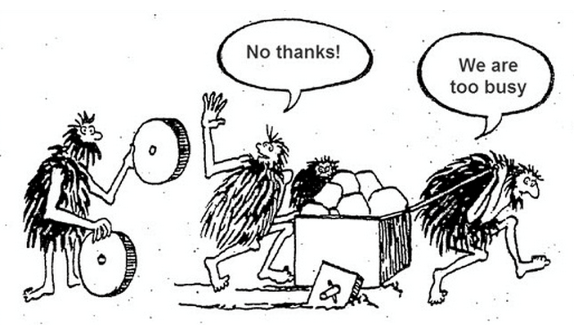
Why have a grants strategy and processes?
j
Notes:
Grant development is NOT an activity limited to proposal writing
The Biggest challenges we see NFPs facing and making in developing grant applications include: Not enough time to get strong applications in against ever-changing deadlines and not enough robust project information. Without clear strategic plans, operational budgets and annual budgets and clear internal communications about what the organisational priorities are, it is going to be extremely challenging to find the project information to submit against looming grant deadlines, let alone ensuring there is a project budget that makes sense.
So before we get into the application writing for the Queensland and Commonwealth legal assistance service delivery funding, let’s take a quick look at ALL the essentials that you should to have in place to build a successful grants proposal.

Slide 6

Being Grant Ready
Know funder deadlines?
Previous grants acquitted on time?
Clear current and consistent messaging across your website/social media
Organisation history and success
Evaluation/outcomes/performance measures?
Engagement and stewardship strategies in place?
A balanced budget
Project plan
Prioritised, approved wish list
Evidentiary Documentation
Sustainability plan
A good writer and/or reviewer
Evidence of the need
Key messages
Notes:
Grant seeking, implementation and management is a targeted process that involves planning, researching, cultivating relationships, fundraising principles and monitoring.
So lets have a look at the check list - which of these do you have in place to get to the finishing line successfully.
Successful proposals are the result of careful planning and design that will not only win the grant, but will also permit successful implementation of the project. A proposal assembled in a hurry or without proper planning at the front end can result in poor project management and inability to deliver Getting Your Organization Grant-Ready 11 Journal of the American Association of Grant Professionals Fall 2008 intended results in the implementation stage, hurting future funding opportunities (Brumbach and Villadsen, 2002).

Slide 7

Notes:
Key Messages Statement
Clear and current web-site
Prioritised wish list
Project plans including evaluation plan and budget
List of funder deadlines
Relationship management plans
Sustainability plan
A good writer and/or reviewer
These are all elements of a successful grant-seeking strategy. You need all these things in place FIRST!
You ALSO want to make sure you are not putting all your eggs in one basket. The hard truth is this funding opportunity is highly competitive- funding amount available has not increased- not all community legal centres will be funded to deliver all the services needed. So while you are putting in the work to develop your application for this funding round consider other opportunities are out their to help fund your services. So where do you go to find other opportunities???

Slide 8
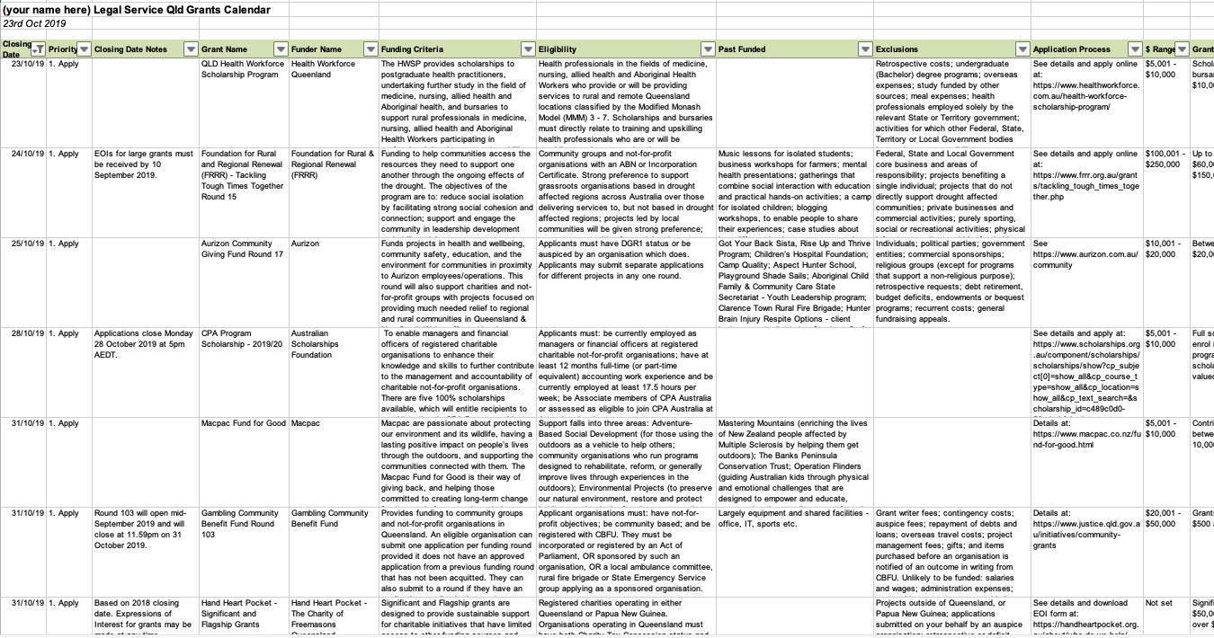
Search
Research
Project Match
Phone Them
Notes:
Best place to start of course is with a grants calendar that gives you a chronological list of all the funding opportunities. Ideally you want this for 12 months. So you can be planning ahead. For example. We know that the annual Perpetual deadline is late Nov / early Dec. so we should have started planning that application now! –

Slide 9
?
What does DJAG want?
Questions answered clearly and succinctly
Responses contain substantiated evidence of the claims being made
Clearly defined project need backed with data and references
No unanswered questions left
Confidence that the project has been well-thought and planned and that it will meet their objectives
The budget makes sense
Clearly defined outputs, outcomes and impact.
Evidence of learnings and success
Notes:
What does DJAG want? – Pretty much what all funders want
The procurement process is an opportunity for community legal centres in Queensland to articulate the legal needs of their community (be it a local or statewide community) and to ensure that resources are appropriately directed based on the best available evidence. In your application you will need to tell the story of your multiple programs succinctly. This will require some crafting.
For those already receiving funding- you will need demonstrate how, what, why & back it up with your data
If you are applying for a new service- demonstrate why, how it will work and the need- with evidence
You need to be already monitoring and capturing the data you need- more and more funders are expecting evaluation of the programs they ‘invest’ funds in. & so they should….

Slide 10
Most common weakness of grant applications
Questions are not answered clearly and succinctly
Responses contain interesting information, but no substantiated evidence of the claims being made
The project need is not evident. Lack of data and references.
It is clear that the project implementation plan has not been well thought out, from the lengthy unclear responses.
The budget does not make sense – according to the project implementation plan
Outputs and outcomes are confused.
Notes:
Not only do we review hundreds of applications but we also work with funders and meet with them regularly so this is combined feedback from what many funders report and what we see, daily…

Slide 11
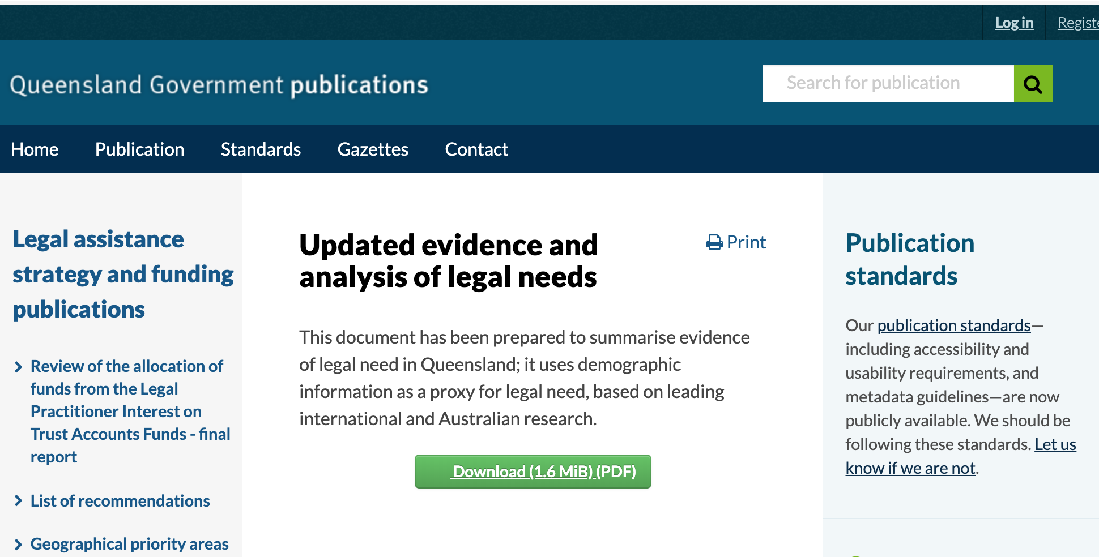

So where to start?
Robust Project Plans
Reading the guidelines
Know the criteria
Review strategic alignment
Notes:
Regularly draft applications we are asked to review, indicate that a project plan has clearly not been developed and that the project’s implementation is being made up on the spot, in response to the questions being asked by the funder.
https://www.qld.gov.au/law/legal-mediation-and-justice-of-the-peace/legal-advice-and-investment/legal-investment/legal-assistance-service-investment/legal-assistance-services
https://www.publications.qld.gov.au/dataset/legal-assistance-strategy-and-funding-publications/resource/5d69ce04-5600-45ec-80d1-aaccaf24bf63
Strategic alignment: 2014-17
The evaluation criteria for the application process are directly related to a set of 2017-20 funding strategies, which were developed in consultation with Queensland’s legal assistance sector. The 2017-20 funding strategies are largely adapted from the principles of the
Be familiar with the National Strategic Framework for Legal Assistance 2015-20. - do you projects/services align to these

Slide 12

THE GOLDEN RULES!
Read the guidelines AGAIN!
Highlight the key words of their funding objectives.
Check for extras e.g. letters of support, project plans, quote requirements
Presume the funder doesn’t know you or your project. NO acronyms or jargon!
Notes:
So getting down to practical step by step – where do we start once we have gathered all our organisations information identified our priority need areas and are ready to write…
Talk through each point…

Slide 13
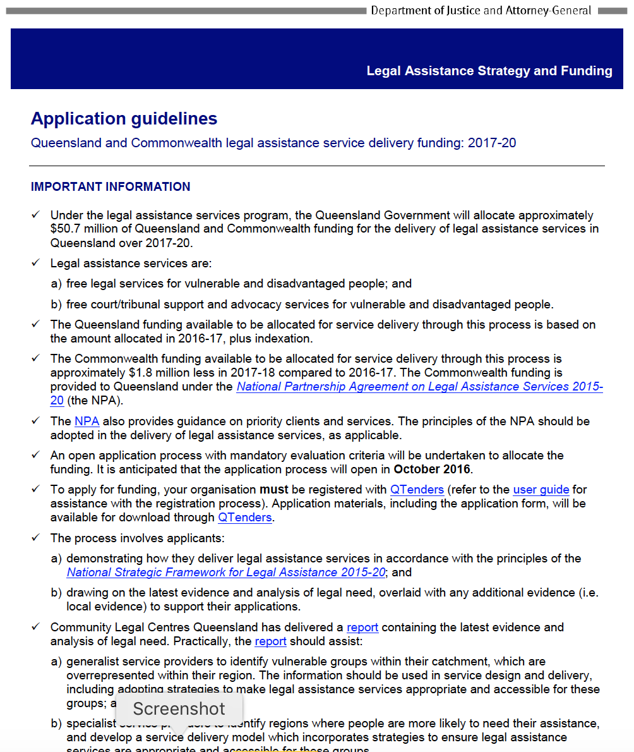
Notes:
Application guidelines are not available yet, but you can review the previous round guidelines and application- (a little birdie told me there are not many changes) so you can be prepared at least for the bulk of the questions.

Slide 14
Mandatory evaluation criteria
To meet the mandatory evaluation criteria, applicants must meet one of the ‘quality standards’, one of the ‘service requirements’ and both of the ‘other requirements’.
Quality criteria
The legal assistance services focus on, and are accessible to, people facing vulnerability and disadvantage.
The legal assistance services are appropriate, proportionate, client-focussed and tailored to people’s legal needs and capabilities.
The legal assistance services are collaborative with government services and other services to provide joined-up services to address people’s legal and other problems.
The legal assistance services identify and resolve legal problems in a timely manner before they escalate.
The legal assistance services empower people to understand and assert their legal rights and responsibilities and to address, or prevent, legal problems.
Value for money criterion
In the context of client needs and locality, the model for delivering the services provides value for money in terms of the services that can be delivered with the funding sought.
Notes:
You will need to meet Mandatory criteria, Quality criteria and value for money criterion- so lets take a look at what you need to do to address these
When reading the guidelines highlight the key words and other information about the funding round, This will help you to be sure that you are using these words to make it very easy for the reader to identify that you are ticking their boxes.

Slide 15
Project Plans
What is the aim of the project?
How do we know it is needed? (provide evidence)
Strategies / activities to achieve the aim?
Your organisation
Sector or government data (e.g. population statistics)
Global evidence: academic research; evaluations of similar programs run by other organisations or in other countries
Notes:
You will be asked
What Services are you proposing to deliver?
And
How are the Services appropriate for people impacted…?
How do the Services contribute to addressing the broad social problems – how do the services translate to the outcomes and impact?
Your project aims need to align with your organisation mission (org aims) e.g CLS mission is to provide legal services to non-unionised vulnerable workers with a particular focus on trainees and apprentices; migrant workers; and taxi drivers.
The project aim is to to develop a statewide telephone advice line for non-unionised vulnerable worker
Are your projects on-mission and in line with your strategic plan if you have one? Or are you putting together projects based on what funders are funding? It’s very obvious when projects don’t make sense, - there isn’t evidence of the need.
You don’t want your prospective funder to be asking: why would I fund this organisation whose mission doesn’t relate to the project or target beneficiaries, when I could fund this other one which does?
You also need evidence of the need the project’s approach to address the need. That can be evidence you’ve gathered in the course of your normal service delivery, or feedback from beneficiaries; it can be sector best practice examples; and it can be global evidence for example from research by other organisations or universities – for example an academic paper which backs up the outcomes achieved in XX community.

Slide 16

Key Messages
Organisation description: Short and long
Vision, mission and purpose
Organisation structure
Organisational history
Key achievements
Scope - size and nature of target group(s)
Geographical coverage
Number of staff and volunteers and profiles of key staff
Funding breakdown
Notes:
This list has all the important information you will need to weave into your application. This will help provide an overview of your organisation – the organisational context to the proposed services and indicate the stability and sustainability necessary for providing services based on previous performance.
Lets take 15 min to jot down some points related to each of these
Overview of your organisation

Slide 17
Key Messages
Partnerships
Examples of successful projects/case studies
Up-to-date research that supports your approach / clarifies the need your organisation addresses
Top strategic priorities for next 12 months and three years.
Organisational efficiency and effectiveness KPIs – how you measure your performance
How you measure project / program performance

Slide 18

Tell us about your organisation and what you do?
Urbane CLS is a Legal Service, which serves residents of Banana. We believe that legal services should be available to all people. We recognise that a number of factors impact on our clients' ability to obtain legal advice.
But what does the organisation actually do? What’s the mission of Urbane? What are the services Urbane provides?
The current legal services in the area of employment and industrial relations consists of Legal Aid Queensland, specialist community legal centres, Aboriginal and Torres Strait Islander Services, lawyers in private practice… etc. No other local CLS provides legal assistance for non-unionised employee workplace issues.
Who specifically are you helping and how does this align with their mission?
Notes:
Let’s take a look at how it’s done
Discuss…
How do the proposed Services fit within the current service system and why are they required?
We can’t ascertain ​the overall mission of the organisation and the fit of the mission with services
The answer didn’t clearly address the second part of the question.We don’t know how the focus of the organisation is meeting needs in the community;
Now let’s look at a different response to the same question by the same applicant….

Slide 19



Example
Engage
me…
Tell us about your organisation and what you do?
Community Legal Service (CLS) is the only service supporting vulnerable workers in the areas of unfair dismissal, unpaid wages, general protections under the Fair Work Act, and discrimination in Banana.
CLS started in 2009 as a volunteer only service, to meet a community need for individualised legal assistance services by vulnerable workers. Non-unionised workers experiencing legal problems in the area of employment and industrial relations are particularly vulnerable, for example last year 18120 non-union workers were unfairly dismissed (WORKPLACE RELATIONS FRAMEWORK, 2018). Our service focus particularly, on trainees and apprentices; migrant workers; and taxi drivers could not afford general legal services
In the last ten years CLS has grown to a service with 10 staff consisting of lawyers, industrial advocates, support staff and over 50 volunteers with specialist practice expertise. In that time we have provided legal assistance services including legal information, referral, advice, casework and representation services to XX non-unionised vulnerable workers.
In the last 5 years, we have increasing assisted female clients to access minimum entitlements set out in the National Employment Standards (NES) and awards . This work was recently consolidated when we assisted a number of our clients to address flexible working arrangements . We are seeking funds for a new statewide telephone service as we have identified significant gaps in legal assistance in this area.
This application will specifically identify the service gaps and how the advice line will cater to gender equity needs in the workplace.
Who what where…
Need…
Notes:
Read the response…
In this re-write you will note that we have:
- Engage the reader /intro statement – people see it as a problem but we see it as an opportunity
Outcomes (track record/ trust me)
- Specifics about target group
Specifics on what they deliver
Mission and how it aligns with funder’s
In this description we can see the key messages -that tell the story about who you are
Organisation description: Short and long
Vision, mission and purpose
Organisation structure
Organisational history
Key achievement

Slide 20
Overview of the nature and types of services and why these services are needed
What do you know the need for your service is?
  What is the demand?
  Usage rates?
  What do local council statistics say about the need you are addressing?
  Is there global needs data that endorses what you are doing?
How is what you are doing different to others?
  It might come down to geography?
  Demographics
  Socio-economics
  Literature reviews
  What will happen if you don’t exist?
Notes:
Overview of the nature and types of services and why these services are delivered to particular client groups and geographical areas
Responses to this question should:
• broadly describe the nature and types of services for which you are seeking funding; and
• establish the evidence of legal need and the resources required to the meet need.
The kinds of information that can be provided to describe the nature and types of services
include:
• Target clients;
• Areas of law;
• Location of services;
• Service delivery model e.g. mixed service delivery model where a wide range of services can
be used to assist a client or community;
• Types of services – information and referral, legal advice, legal tasks, representation,
ongoing assistance, court support, duty lawyer services, support services, community legal
education, law and legal reform; and
• Key relationships and partnerships.
For those already receiving funding- you will need demonstrate how, what, why & back it up with your data
If you are applying for a new service- demonstrate why, how it will work and the need- with evidence
You need to put best examples forward but briefly describe the multiple services talking about multiple programs succinctly

Slide 21
NEED - What you are looking for
Information that backs up your claims about the need for the project
Information to back up your claims about the target audience the project serves
Information that backs up your rationale for running this project type or program model (i.e. evidence to support your rationale for expected outcomes.)
Court and Tribunal data
Local government data
Your organisation’s data,
Queensland Government Statistician’s Office
Community Legal Centres Queensland Evidence and Analysis of Legal Need
https://communitylegalqld.org.au/evidencebase
Notes:
One of the greatest weaknesses we see in applications we are reviewing before submission, is a lack of demonstrable evidence to back up the claims being made in applications. And our funder friends tell us the same thing. That one of the main areas submissions fall down is that there is no data and evidence to back up claims plus no clarity on the information gaps being filled and most importantly the points of difference between the project that is being presented in the submission, and others that already exist or may be competing in the same funding round.
There are a range of data sources, both qualitative and quantitative, that can be used to
demonstrate legal need including:
It is important to reflect on your own understanding of your service and the region/priority
client area/s in which you provide support by using your own on-the-ground experience to tell
your own story in your procurement application.

Slide 22
1
Organisational Evidence
Your organisation is the expert. What kinds of evidence do you have to draw on?
Documented observations from your staff
Demand for your services (ie. waiting lists for services. Is demand outstripping your capacity to deliver?)
Service / activity use or attendance statistics
Evaluations of previous programs
Ask your beneficiaries!
Notes:
Funders expect you to have organisational evidence and performance data.
It’s really important to collate data from your previously run projects, along with statistics on service usage increases etc. You should have data capture tools in place that enable staff to document observations, including service demand and waiting lists, numbers of participants, and feedback from participants and referral agencies.
A lot of the time when we talk to applicants– especially when we’re helping with one of the big applications and tenders they don’t have data comparing how much service they’ve provided to how many people this year vs last year.
They don’t have feedback from beneficiaries on how the services have helped them.
You need to be tracking your own performance as a nonprofit using both qualitative and quantitative data, to be able to quickly and reliably be able to pull out organisational evidence of need.

Slide 23

2 +
3
Sector/Government + Global Evidence
Desktop research time!
National statistics sites (ABS in AU / Stats NZ )
Local Council / legal network statistics/demographics data
Other nonprofits in your sector (local and/or international)
Research bodies (institutes/ universities)
Save your references!
Notes:
It’s a really good idea to compile your research in one place so you have a go to document with referenced evidence. Always make sure you save the source of the information with the information, as you do need to reference your sources in your grant applications. If you can not fit in full reference links due to restrictions on word counts, simply use references in your statements such as “According to the most recent 2018 report “Report Title” and name of organisation….

Slide 24

2 +
3
Sector/Government + Global Evidence
Need to look deeper?
Boolean search strings:
"Western Australia" AND "rural" AND ("statistics" OR "percent" OR "rates") AND ("homelessness" OR "sleeping rough" OR "housing insecure" OR "poverty" OR "impoverished")
Notes:
Nerdy as it is, Boolean searches can really save you time when you’re looking for something quite specific.
Mainly you’ll be using operators like inverted commas for an exact term or phrase. If you’re looking for something with more than one word, its useful to use brackets and OR/AND.
So you can see in this example we are wanting to find out how many people in Rural Western Australia are sleeping rough.
Using inverted commas around a search phrase like "Western Australia" ensures that the exact term is found within the results, rather than each word separately which might take you to something about 'Western countries like Australia' for example. It's great for longer phrases too – like if you were searching for a particular quote. If you were specifically looking for statistics on homelessness and poverty rates in rural Western Australia, you would need to include our next two best Boolean friends: AND and OR
Obviously there is different terminology used around homelessness and poverty, so to ensure you're not missing any sites where you might find information pertinent to your research, you're going to need to include variations of these words, as well as the kind of information you're looking for (statistics) and the geographic location.
This is going to ensure that your results are the ones most relevant to statistical or numerical information on WA homelessness and poverty.
Most of the time you'll find relevant information long before you have to resort to long string searches like this, but they are useful when looking for things less common or known about and are fantastic time savers when you're looking for an exact statistic or something to back up a needs statement in a grant application!

Slide 25

Your grant-ready project: How do you know it is needed?
Scan the landscape
Far enough away that we don’t need to worry
Too close to home!
Notes:
So looking at your grant-ready project. Is it grant-ready? How do you know it is needed?
Before we even contemplate running a program, we need to Scan the landscape and check that we have looked at what other organisations are doing? Are their projects similar enough to yours that yours might be considered to be replication?
You don’t know if there’s a need for your project until you know what other service providers are offering. If there are others offering similar services but in different geographic regions, that’s okay, but it’s still good for you to know so you are able to point out your niche if asked by a funder.

Slide 26
Scan the landscape
Desktop research time!
Google search on terms like: Location/Program type/ Beneficiary group e.g Search: Banana legal services
Think like your beneficiary – what search terms would they type in to find your services/program?
Talk to your partner organisations /referring organisations.
Talk to any peak bodies/ sector organisations
Look at what other projects in your area your prospective funder has funded!
Notes:
Know who is doing what and why your service and approach is needed. If the CLS in the next town is also delivering similar services is there a way you can work together to deliver more value for money?

Slide 27
What makes good evidence?
Assess your sources for:
Recency – is the information the most up to date or are you able to find more recent sources?
Consensus – is the source an outlier in its findings, or are there other sources that say the same/similar things?
Is the institution/author reputable/ well-regarded?
Is the type of source reliable? (i.e. a blog post is less reliable/verifiable than a peer-reviewed journal article or a report by a research institution)
Notes:
These are things to think about as you’re looking at your evidence sources.

Slide 28
Using evidence in Applications
Organisational knowledge on solution in-situ
Project Need
In the last 12 months, CLS has collected data on the types of matters that we could not provide assistance due to limited capacity (turnaways). There were a total of 400 turnaways. 20% of turnaways were seeking assistance for tenancy; and 18% were seeking assistance in the area of social security. This is confirmed by our involvement in the Regional City network of community service providers that have been working together to address the increasing demand on community services for housing and addressing the risks of homelessness.
A Very Important Government Report (ref) indicated that Regional City is a hotspot for housing stress for people who are newly arrived in the community. This application for funding seeks additional and new funding to prioritise legal services in social security and tenancy law with a targeted focus on culturally and linguistically diverse
communities and people aged over 65 years.
Sector and Government evidence of need
Notes:
So now let’s put all that hard research work and collation, into practice into our application. Looking at typical funder application question, what is the need for the project. Here, we look at our fictional NFP, My Place, which provides psychotherapy art programs for newly arrived refugee children as one of its programs…

Slide 29

Project Plans
Outputs? The NUMBER of people you will reach, products or services you will purchase, deliver or distribute.
Outcomes? The changes that will occur as a result of the activities and outputs?
How will you measure your success?
Can you complete the project in the required timeframe and report according to the funder requirements?
Notes:
You will need to also evidence how you monitor the service to know you are meeting the aims.
Yes you need a number of beneficiaries. You’ll need to work this out based on previous similar programs you’ve run, or estimates based on population, or whatever metric is right for your program. Project plans need as many specifics as possible. It doesn’t need to be 100% accurate, but it does need to be your best guess, based on something. In some applications you need to show how you’ve worked it out.

Slide 30

VALUE
What will it cost:
your organisation
funders
community
other organisations
Government
If the project proceeds
If the project doesn’t proceed?
What will the benefits be?
Can you put $ value on these?
Notes:
And be sure that if your submission requires a cost benefit analysis – that you have both the time and expertise employed to help you prepare this. A CBA examines… Read Slide.
It is good to be able to demonstrate this in simple terms even if a sophisticated CBA is not requested.

Slide 31

Hook, line and sinker
Tell me the solution
What are you going to do ?
Objectives & strategies
Who will benefit
Timeframe/Budget
Engage me
Hook/Intro
Aim
Who you are & what you want
Explain the problem
Project need
(provide evidence to back it up!)
Show me the impact
Outputs
Expected outcomes
Evaluation Measures
Motivate me
Summary
Call to action
Prove I can trust you
Experience
Track record
Collaborations
Notes:
So once you have your heavy tackle ready and to overcome all of those common grant application weaknesses, we can apply our hook line and sinker strategy to ensure that all of these elements are covered off in responses, to ensure the assessors are hooked.
Engage me generally relates to what is usually one of the first project related questions on the majority of funding application forms – what is that you want to do. It is your short summary of who you are and what you want you want to do, which will also touch on they why. We will see an example of this later in the webinar. You also need to remember that humans are reading your applications. And that they generally have many to read! And that most of us are time poor. You know yourself when you are reading something that is not interesting or hard to understand – your may be inclined to put it to one side. You want to make sure that your funder is engaged early, and is not confused.
CLICK FOR CIRCLE: These are the elements of your business case: Engage me and motivate me are largely about pulling the funder in and involving them with your cause and your project outcomes. The circled section is all the info you need behind those emotive statements to make a strong argument for funding.

Slide 32

No Surprises -
Project Budget
If it is in your proposal it should be represented numerically within your budget
If it is in your budget you should understand why from the narrative within your proposal
make sure your words and numbers say the same thing
Notes:
You don’t want your funders to have any surprises- remember a well crafted budget will answer questions about your grant proposal – not raise questions
Now lets look at how to balance our expenditure and the income of our project- even if you are not charging people for services or selling them a product – there will still be income from the project. The income will be your successful grant or grants, any contributions from your organisation (inclusive of staff time, volunteer time, and inkind resources), contributions from other organisations ( e.g. venue hire free of charge)….

Slide 33


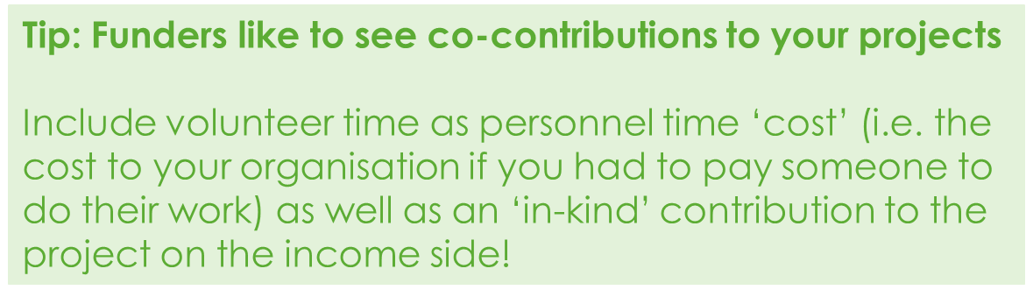
Project Budgets
Total cost to your organisation to implement?
Include all costs
Don’t make figures up. Get quotes!
Funding from other sources?
Notes:
So all that information forms a robust project plan! Once you have those in place for your projects, you have enough information to start looking for funding prospects that are well aligned to you needs.

Slide 34
Project Budget Preparation
They call it a balance sheet for a reason
Ensure that income and expense columns are equal!
What is the total cost to your organisation to implement this project?
  include all costs and expenses
  don’t make figures up. Get quotes!
  Include all funding from other sources? Provide details.
Notes:
As you calculate the expenditure and income tables make sure the Total Amounts from each are the same.
Remember that budget details usually reveal whether a proposed project has been carefully planned and may ultimately be feasible.

Slide 35
Mistakes in grant budgets & how to avoid them
What we know…
  Basic math errors
  Sloppy budget
  Asking for the wrong amount
  Your words and numbers don’t match
  Ignoring the budget as a stand alone document
  Matching your operational budget to your project budget
  Fictional figures
  Time-frame in your budget
  Rounding
  Format problems
Notes:
We have reviewed thousands of grant application – the number one mistake (which is really easy to avoid) is basic math errors. A mistake in your sums undermine your organisation's credibility. Do the numbers make sense? How can the budget explanation be improved? Double check the math.
Sloppy budgets. The assessor at the funder has seen hundreds, if not thousands, of budgets. They will immediately know if your budget is reasonable for your project. If you’ve left out a major item, she’ll know. If you’ve padded the salaries, she’ll know. The budget that accompanies a grant proposal should be prepared with the same care as the narrative description and match it point for point.
Asking for the wrong amount. This mistake is closely related to number 2. In your research, you should determine what size grants the funder has made to similar organizations. Asking for substantially less or more than their typical grant will end in failure
The numbers in your narrative and budget don’t agree. During one of your reviews, check and compare only the numbers.
Failing to recognise that some of your reviewers will only look at your budget. For many funders the budget is the proposal. They view the narrative as the details and not the other way around. Examine your project budget as a stand-alone document. Does it tell the story of what you will do?
The numbers in your annual operating budget bear no resemblance to the numbers in your project budget. For example, the project budget supply line item for five people cost three times your annual supply budget for your 50-person agency. If true, explain why in a footnote of the project budget. Also, adjust your annual budget accordingly.
Guessing the costs of things rather than getting a quote. You list a $500 printer. It’s the same or similar to the one a reviewer bought last week for her office for $250. Don’t ballpark prices, confirm them.
You fail to put a time frame on your budget.
You add cents on a $50,000 budget.
You forget to label the columns and other format challenges.

Slide 36

Grant-writing checklist
Strong project / funder match?
Relevant, up-to-date information?
Ensure the ask is at the top and focus on the need.
Clearly define the AIM of the project.
Demonstrate the need for the project, and qualify with data.
Define process you will undertake to deliver the project
Outcomes? What will success look like?
What information will you collect to evaluate success?
Budget: adhere to guidelines; factor in other income; include in-kind support.
Spelling & grammar check – make it look professional.
Ensure formatting adheres to any funder guideline specifications.
Proofread - get a third party to check the application with fresh eyes.
Check you have attached everything requested and followed the “how to submit” instructions.
Notes:
So this checklist should go to your proof reader as well as being your constant check list. If they can give each one of these points a clear tick – then you have a good application. If there are crosses, go back and edit. Then get it proofed again.

Slide 37

Where to from here?
Proactive, forward planning and organised
Reactive, scrambling for projects against deadlines?
Notes:
Success = Planning (GEMS) or your own schedule – and emphasize importance of avoiding last min scramble

Slide 38

Questions and Discussion
info@strategicgrants.com.au 07 3892 1150
Visit our website for free grant-seeking resources and other training opportunities, and subscribe to our newsletter!
www.strategicgrants.com.au

