Slide 1
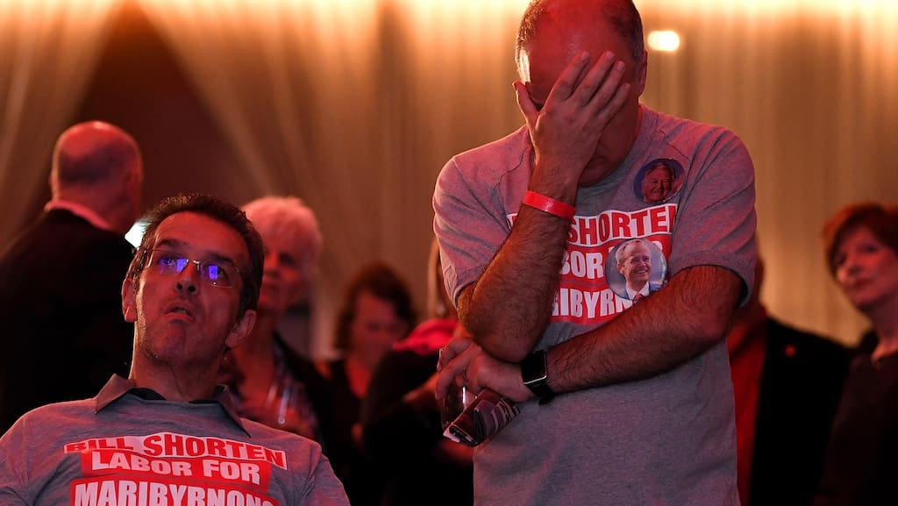
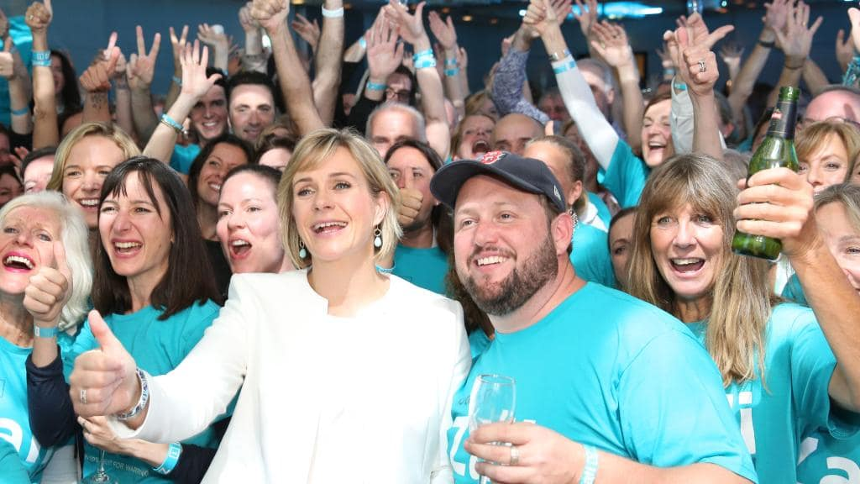
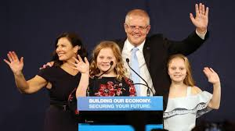
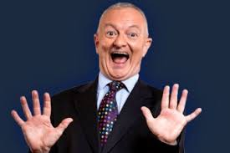
The 46th Parliament

Slide 2
Today’s fun…
How did we get here?
What does the 46th Parliament look like?
What sorts of decisions are the 46th Parliament making?
What now?

Slide 3
How did we get here?

Slide 4
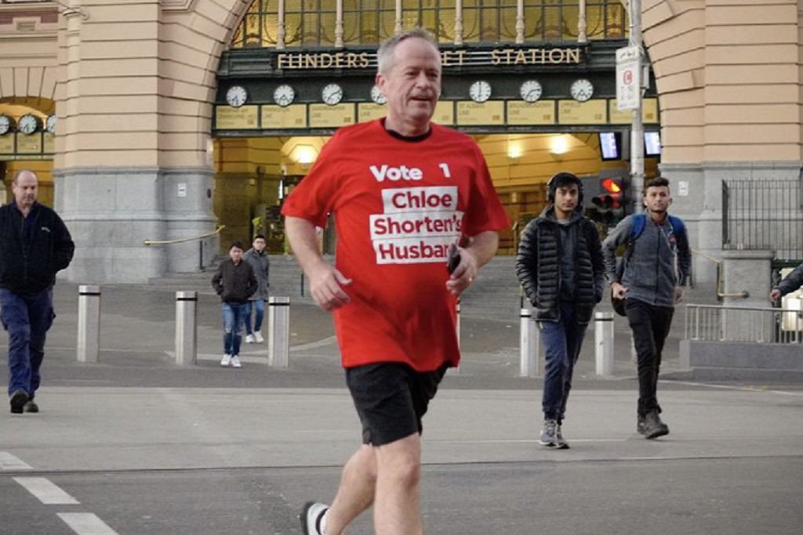
am

Slide 5
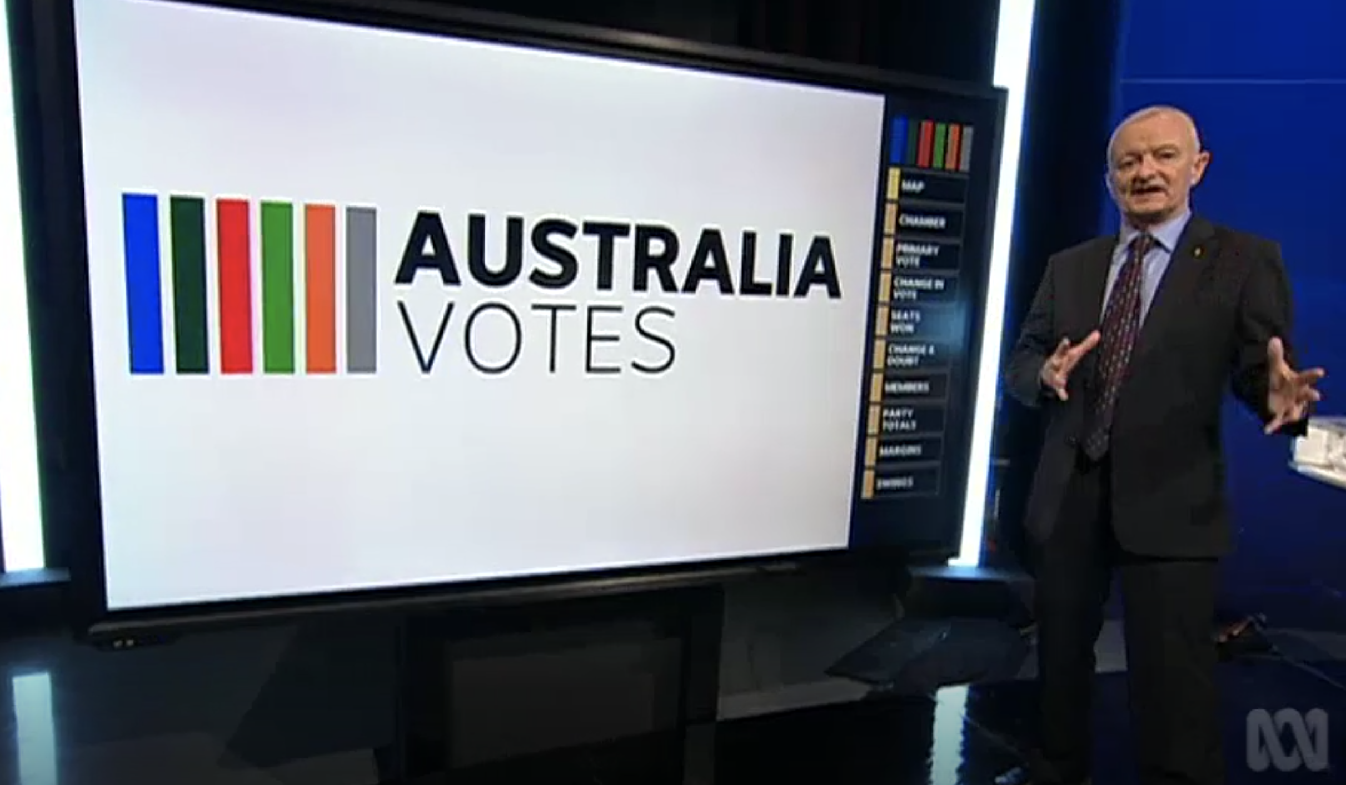
pm

Slide 6
pm

Slide 7
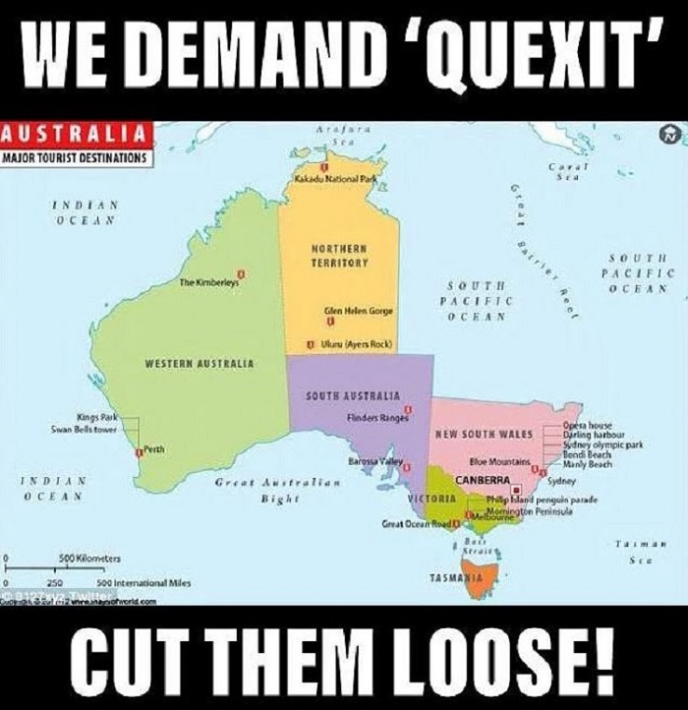
pm

Slide 8

pm

Slide 9
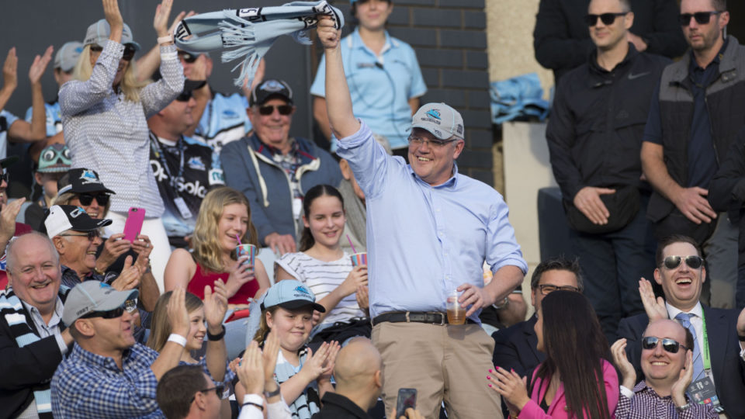
Sunday

Slide 10
What changed?
At the surface… not much…
Two party preferred
Party | Votes | % | Swing
Coalition | 7,167,745 | 51.30 | +0.94
ALP | 6,804,984 | 48.70 | -0.94

Slide 11
What changed?
And also…
National first preferences (swing towards)
Party | Votes | % | Swing (+)
United Australia Party | 488,814 | 3.43 | 3.43
Pauline Hanson’s One Nation | 438,591 | 3.08 | 1.79
Independent | 479,803 | 3.37 | 0.56
Fraser Anning’s Conservation National Party | 77,204 | 0.54 | 0.54
Sustainable Australia | 35, 617 | 0.25 | 0.25
Western Australia Party | 25,298 | 0.18 | 0.18
Shooters, Fishers and Farmers | 41,480 | 0.29 | 0.18
The Greens | 1,482,401 | 10.40 | 0.17
Liberal National Party | 1,236,401 | 8.67 | 0.15
Animal Justice Party | 116,674 | 0.82 | 0.12

Slide 12
What changed?
And also…
National first preferences (swing against)
Party | Votes | % | Swing (-)
Centre Alliance | 46,945 | 0.33 | 1.52
Australian Labor Party | 4,752,407 | 33.34 | 1.39
Liberal | 3,989,510 | 27.99 | 0.68
Christian Democratic Party | 97,517 | 0.68 | 0.63
Rise Up Australia | 14,033 | 0.10 | 0.41
Liberal Democrats | 34,665 | 0.24 | 0.25
Australian Christians | 23,802 | 0.17 | 0.15
The Nationals | 642,232 | 4.51 | 0.10
Katter’s Australian Party | 69,736 | 0.49 | 0.05
Science Party | 12,616 | 0.09 | 0.02

Slide 13
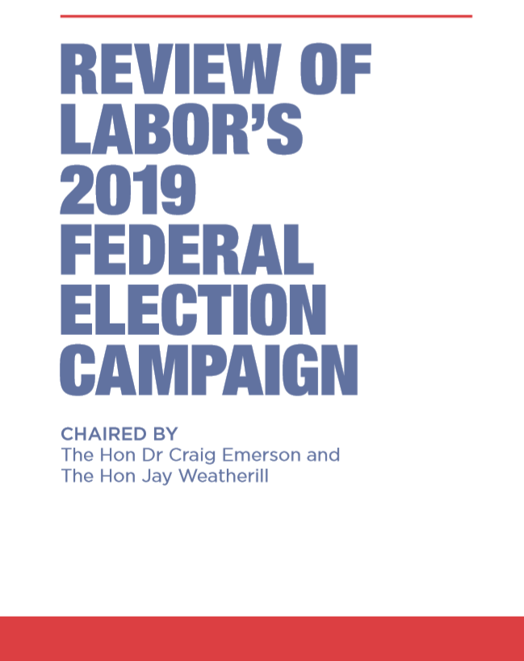
Labor Party Analysis
‘Labor has failed to win a majority in the House of Representatives in eight out of its last nine starts’
‘Labor should not be less ambitious about policy but its policy agenda should be less complex. Labor has won elections with bold policy platforms and lost elections where it has pursued a “small target” strategy. Labor should not abandon its progressive values and principles.’
‘announcing hundreds of policies in the lead-up to an election removes all flexibility to adjust to changing economic conditions and other circumstances following an election victory. The voting public does not expect, nor would it believe, a party could announce a full suite of policies for three years of government that would not vary come what may.’
‘A vast array of advocacy groups banked the Labor win before the election. They knew if they did not obtain a Labor commitment to adopt their favoured policy then in a crowded field they were unlikely to gain any such commitment after the election. Labor’s policy processes were too attentive to these efforts.’

Slide 14
What does the 46th Parliament look like?

Slide 15
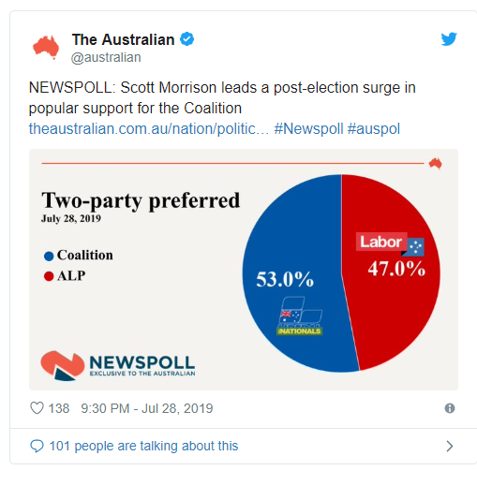
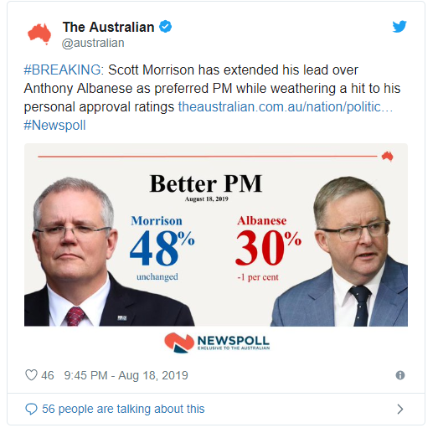
The first poll two months post election
28 July 2019
18 August 2019

Slide 16
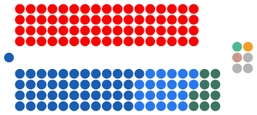
The numbers in the House of Representatives
77 Coalition
68 Labor
3 Independents
1 Centre Alliance
1 Katter Party
1 Australian Greens

Slide 17
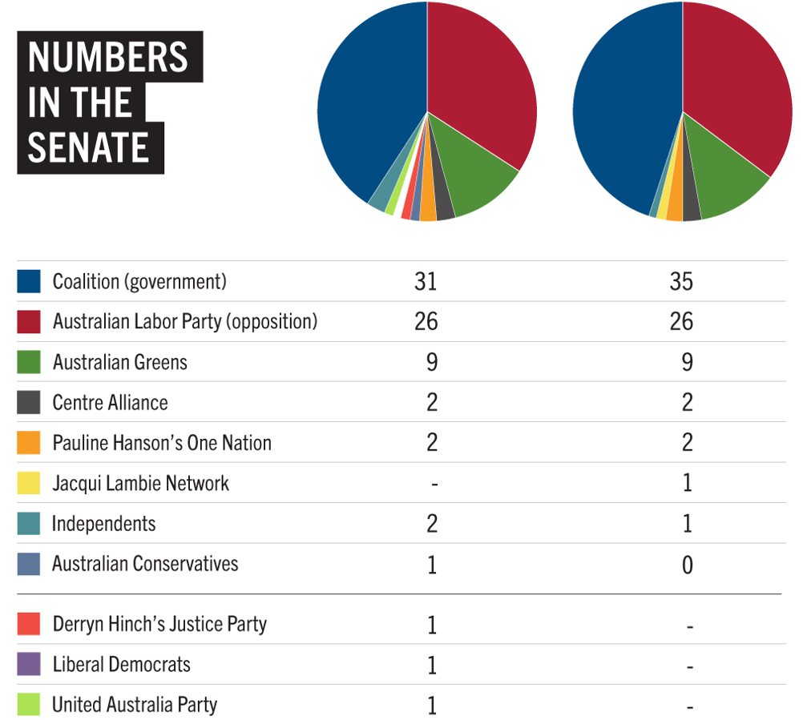
The numbers in the Senate

Slide 18
The cross benchers
Senator | Party | State/Territory
Stirling Griff | Centre Alliance | South Australia
Rex Patrick | Centre Alliance | South Australia
Pauline Hanson | Pauline Hanson’s One Nation | Queensland
Malcolm Roberts | Pauline Hanson’s One Nation | Queensland
Jacqui Lambie | Jacqui Lambie Network | Tasmania
Cory Bernardi | Independent | South Australia

Slide 19
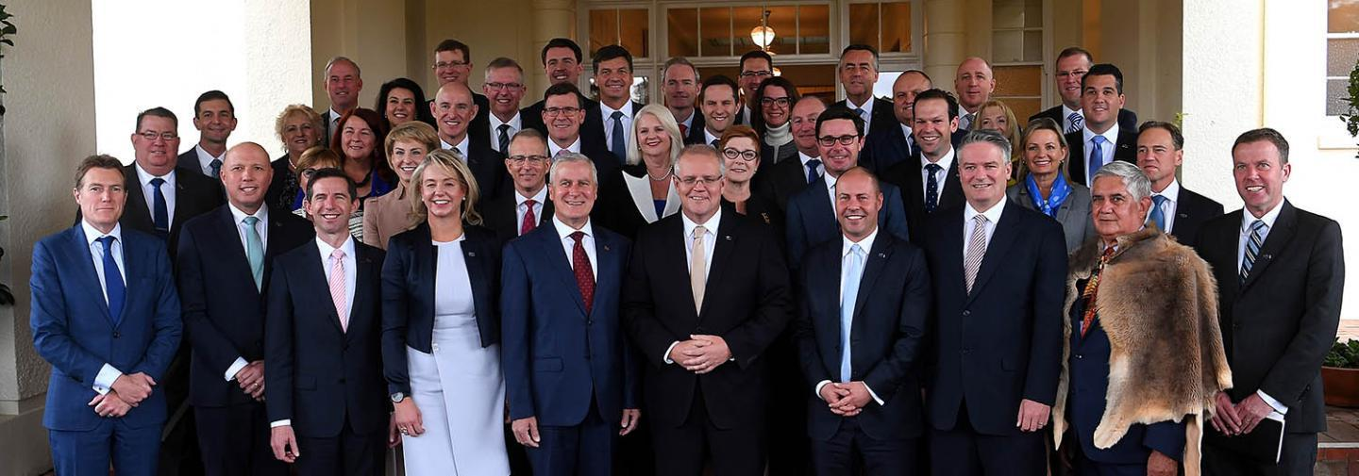
Important considerations…
Morrison is elected Prime Minister for first time

Slide 20
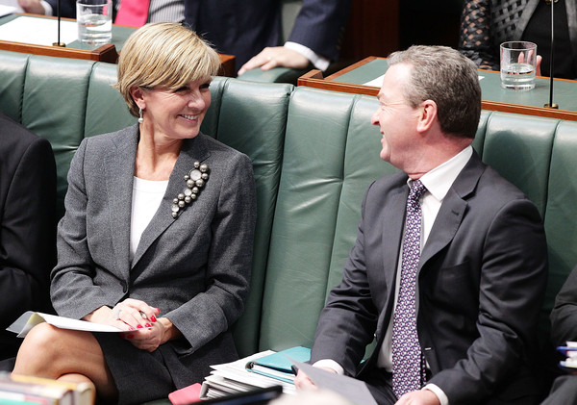
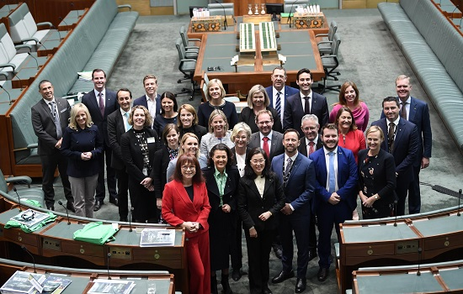
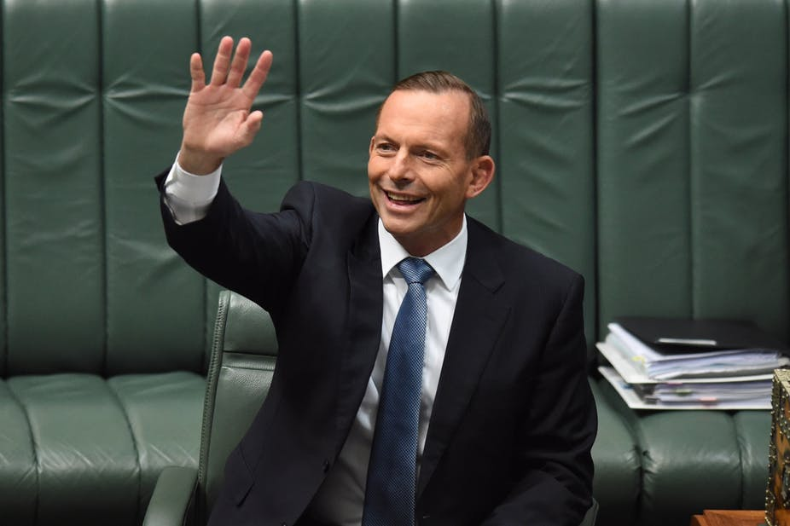
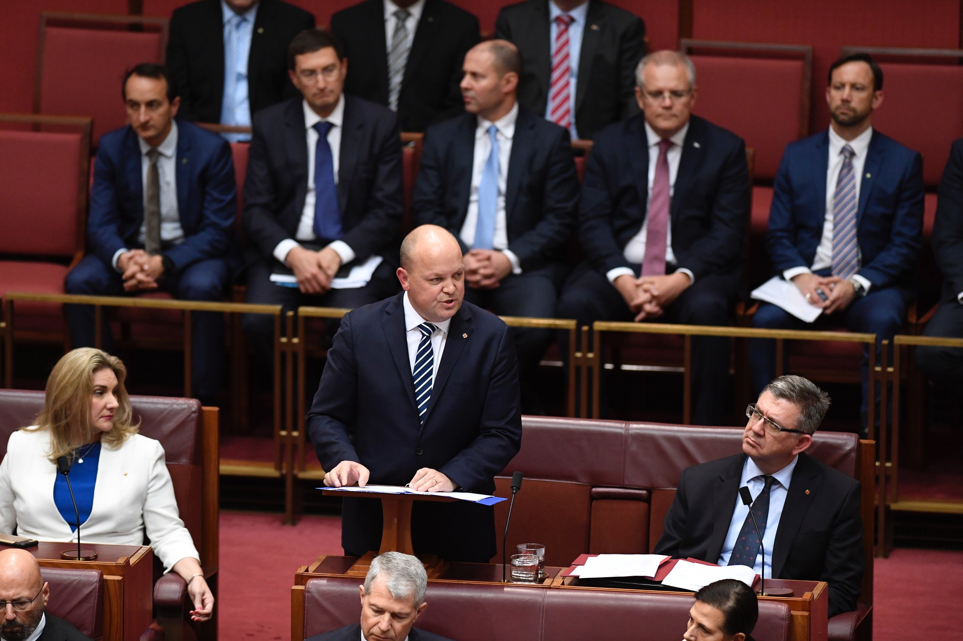
Important considerations…
Key players no longer there
45 new members of Parliament

Slide 21
What sorts of decisions are the 46th Parliament making?

Slide 22
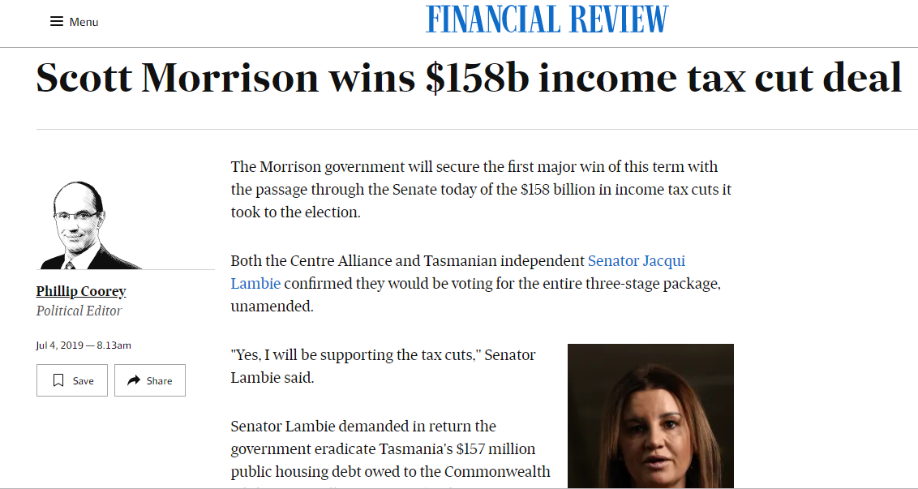
What we know so far..

Slide 23
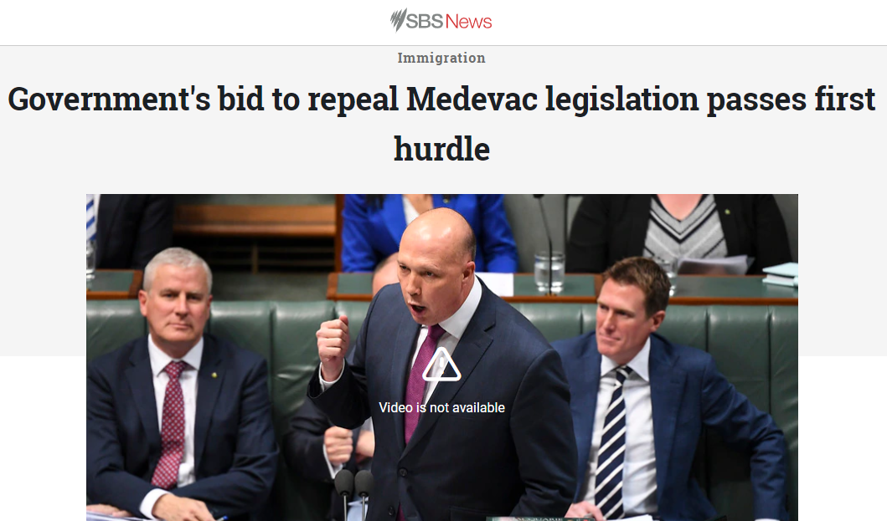
What we know so far…

Slide 24
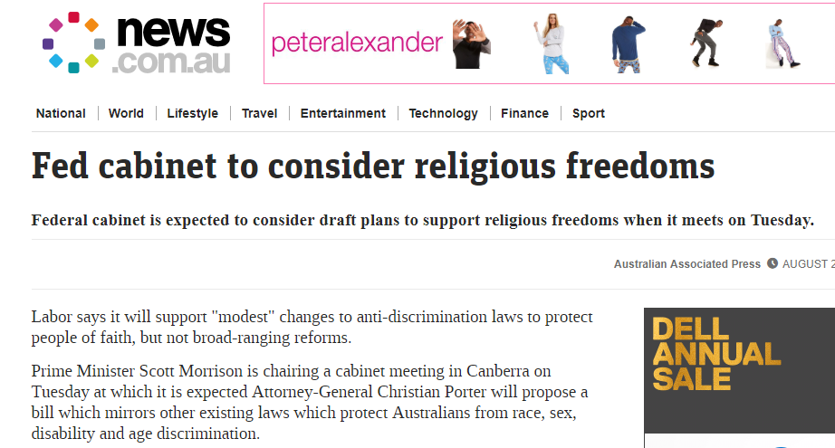
What we know so far…

Slide 25
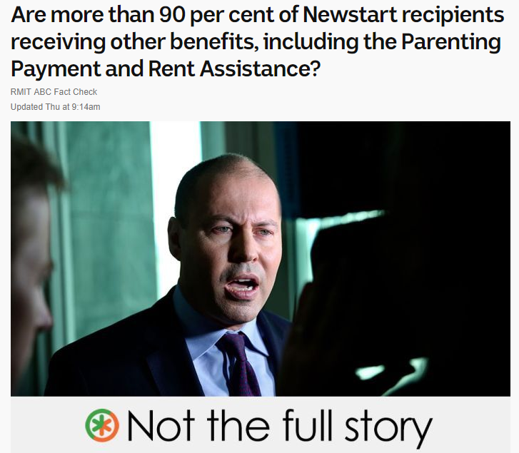
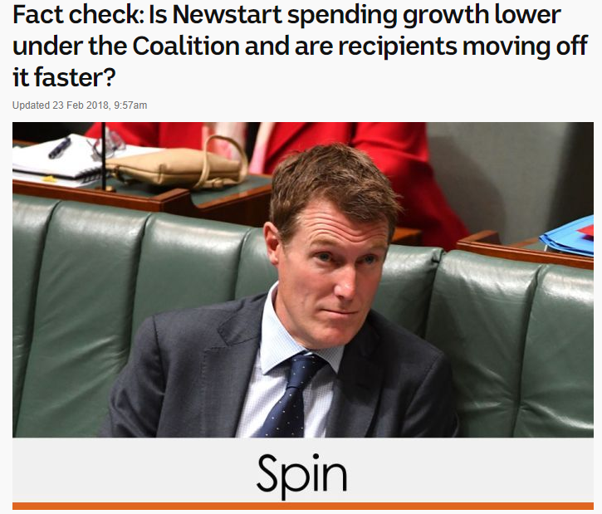

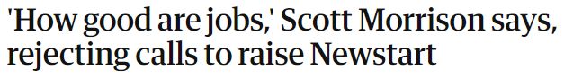
What we know so far…

Slide 26
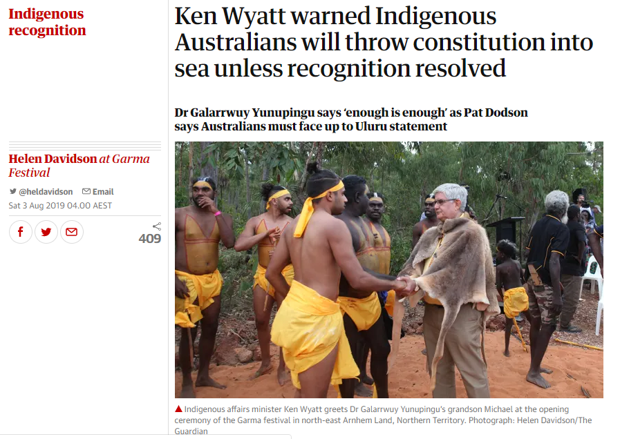
What we know so far…

Slide 27
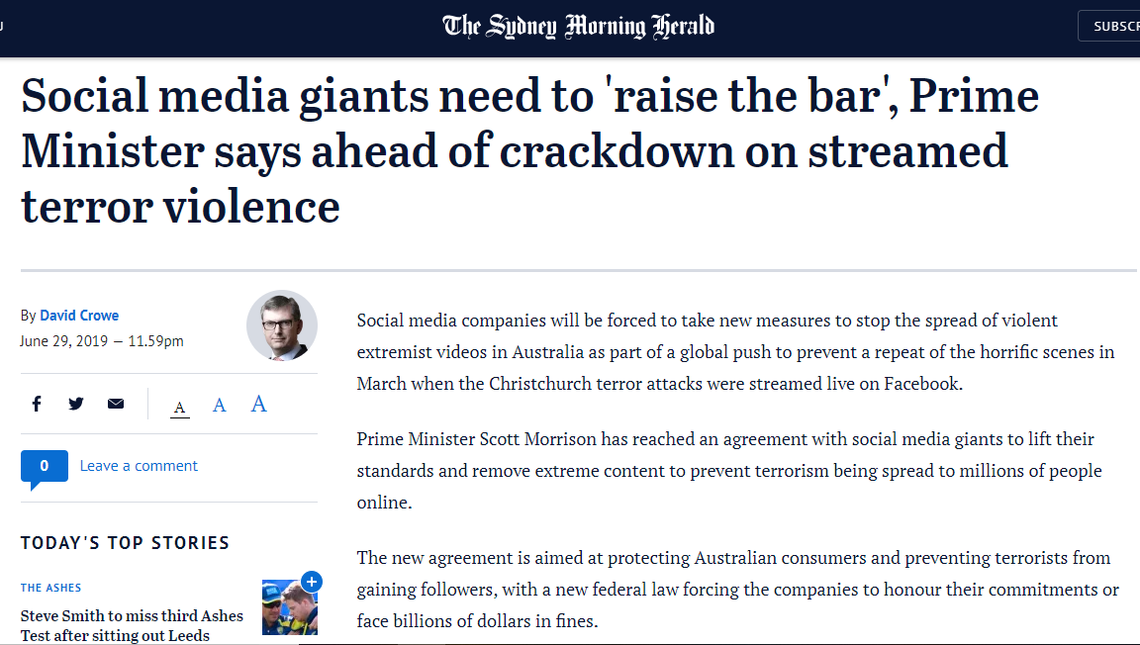
What we know so far…

Slide 28
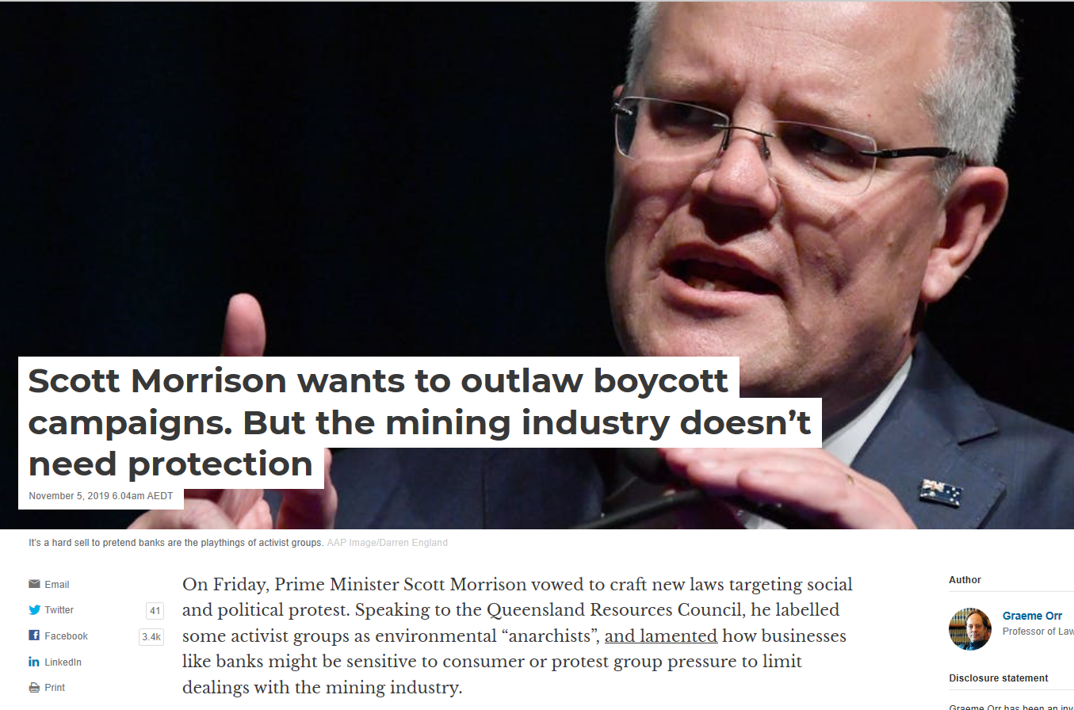
What we know so far…

Slide 29
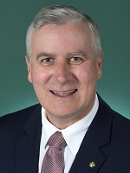
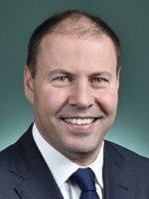
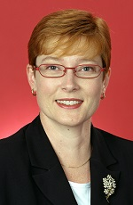
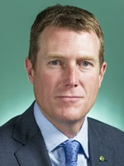
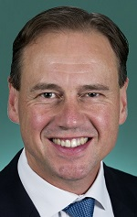
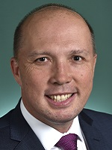
The familiar faces in Morrison’s cabinet
The Hon Michael McCormack MP
Deputy Prime Minister Minister for Infrastructure, Transport and Regional Development
The Hon Josh Frydenberg MP
Treasurer
Senator the Hon Marise Payne
Minister for Foreign Affairs
The Hon Christian Porter MP
Attorney-General
Minister for Industrial Relations
The Hon Greg Hunt MP
Minister for Health
Minister Assisting the Prime Minister for the Public Service and Cabinet
The Hon Peter Dutton MP
Minister for Home Affairs

Slide 30
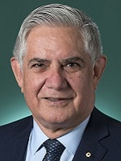
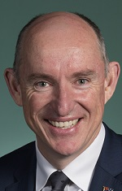
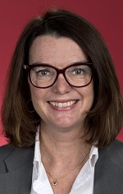
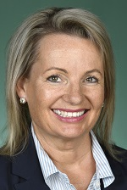
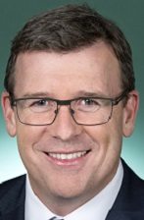
New members to Morrison’s cabinet
The Hon Ken Wyatt AM MP
Minister for Indigenous Australians
Senator the Hon Anne Ruston
Minister for Families and Social Services
The Hon Sussan Ley MP
Minister for the Environment
The Hon Alan Tudge MP
Minister for Population, Cities and Urban Infrastructure
The Hon Stuart Robert MP
Minister for the National Disability Insurance Scheme
Minister for Government Services

Slide 31
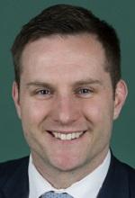
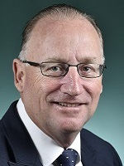
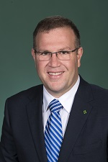
Morrison’s inner circle
Hon Stuart Robert MP
Minister for the National Disability Insurance Scheme Minister for Government Services
Hon Alex Hawke MP
Minister for International Development and the Pacific Assistant Defence Minister
Hon Steve Irons MP
Assistant Minister for Vocational Education, Training and Apprenticeships
Hon Ben Morton MP
Assistant Minister to the Prime Minister and Cabinet

Slide 32
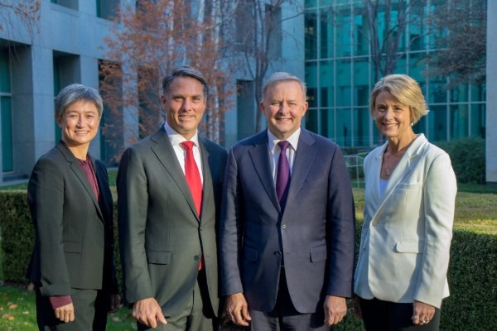
New Opposition leadership team

Slide 33
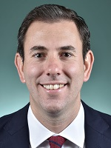
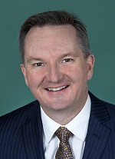
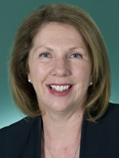
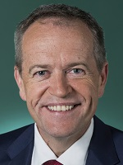
Changes to the Shadow Cabinet
Dr Jim Chalmers MP
Shadow Treasurer
Hon Chris Bowen MP
Shadow Minister for Health
Hon Catherine King MP
Shadow Minister for Infrastructure, Transport and Regional Development
Hon Bill Shorten MP
Shadow Minister for the National Disability Insurance Scheme
Shadow Minister for Government Services

Slide 34
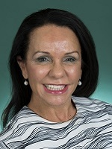
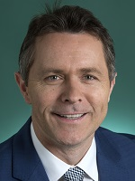
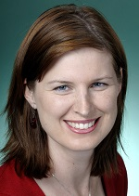
Changes to the Shadow Cabinet cont.
Hon Linda Burney MP
Shadow Minister for Families and Social Services
Shadow Minister for Indigenous Australians
Hon Jason Clare MP
Shadow Minister for Regional Services, Territories and Local Government
Shadow Minister for Housing and Homelessness
Hon Julie Collins MP
Shadow Minister for Ageing and Seniors
Shadow Minister for Women

Slide 35
What now?

Slide 36
..
Parties are very risk averse and look for announce-ables to appeal to their natural constituency.
Other factors that present opportunities
Threat to leadership
Change in leader
Change in Ministers
Repeated high profile crisis
Election
Year 1
Year 2
Year 3
Year 4
Opportunity
Present a range of asks, including legislative change, policy development and costed programs.
Parties are looking to demonstrate that they follow through on promises.
Parties start to become more risk averse as they position themselves for election.
Opportunity
Support the implementation of election promises.
Work with the opposition to develop policy positions.
Repurpose promises and funds.
Opportunity
Start the election conversation. Work collaboratively to develop policies.
Parties look for new ideas, including policies and programs that keep people in their camp happy.
Opportunity
Work with all sides of politics to develop policies, including bold new policy ideas.
.

Slide 37
Next election
The earliest possible date for a simultaneous House/half-Senate election is Saturday, 7 August 2021 and the latest possible date for a half-Senate election is 1 July 2022.

Slide 38



Focus on the fundamentals
Step 1: What is your ask?
Step 2: Who is your target?
Step 3: What is your strategy?

Slide 39
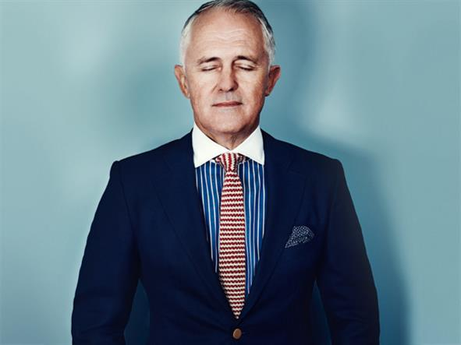



TARGETS
POLITICIANS
PUBLIC SERVANTS
POLITICAL PARTIES
CORPORATES
INFLUENCERS INFLUENCERS INFLUENCERS INFLUENCERS

Slide 40



TARGETS: THREE IMPORTANT QUESTIONS
WHO HAS THE AUTHORITY TO MAKE THE DECISION?
WHAT DO THEY NEED TO HEAR?
WHO DO THEY NEED TO HEAR IT FROM?
(INFLUENCERS)

Slide 41

RESEARCHING POLITICIANS
First speech in parliament
Other speeches in parliament
Committee involvement
Involvement in media – opinion pieces, comments
Diaries (if Ministers in NSW and Queensland)
Roles before entering parliament
Your previous engagement with them
Your friends/colleagues previous engagement with them

Slide 42
Thanks!
amy@forpurpose.com.au
0405 330 357
@purposeaus @amypferg
www.forpurpose.com.au

