Slide 1
The Right to Education in the Human Rights Act 2019 (Qld)
7 February 2020

Slide 2
Acknowledgement of country
Community Legal Centres Queensland acknowledges the traditional owners of the land on which we are holding this presentation, the Turrbul and Jaggara people.
We pay our respects to their elders, past, present and emerging, and acknowledge the important role Aboriginal and Torres Strait Islanders continue to play in our society.
As this presentation is being viewed throughout Queensland, we also pay respect to the traditional owners of the land throughout the country and extend a warm welcome to any First Australians listening to this presentation.

Slide 3
GoToWebinar housekeeping
Facilitator:
Carly Hanson, Sector Sustainability Coordinator, Community Legal Centres Queensland
Recording:
This webinar is being recorded and will be available on the Staff Training page of our website: https://communitylegalqld.org.au/clc-staff/staff-training-and-cle
PowerPoint / webinar materials:
Emailed prior to today’s session
Available to download from Handouts section of GTW control panel
Questions:
Type your questions/comments into question box on GTW control panel OR
Raise your hand and we will unmute your microphone
Questions will be addressed at the end
Technical help:
Email carly@communitylegalqld.org.au or use question box in GTW
Notes:
Presenter will be introduced shortly

Slide 4
Legal disclaimer
This presentation is for professional development and education purposes only. The information provided in this presentation is not legal advice and is designed for lawyers and other staff working and volunteering in a community legal centre setting in Queensland.
This presentation and webinar is not to be published or reproduced for commercial purposes without the express permission of the author.
Information is current as at 7 January 2020. Community Legal Centres Queensland does not accept any liability for the accuracy of the information in the presentation.

Slide 5
Keep safe – content note
Community Legal Centres Queensland wants to ensure that community legal centre workers and others accessing these training materials feel safe, and are able to access appropriate and timely help and support.
Some content in these training materials may be disturbing, upsetting or trigger strong/negative emotions for victims and survivors of violence and trauma, and others.
Community Legal Centres Queensland respects your autonomy. If you feel triggered or upset by any of the content or materials provided here, we encourage you to use your discretion as to whether you should continue reading, watching or listening to the material.
You may also wish to access more information and resources, as well as professional support or advice from one of the free and confidential organisations listed on our Keep Safe website page: http://communitylegalqld.org.au/keepsafe.

Slide 6
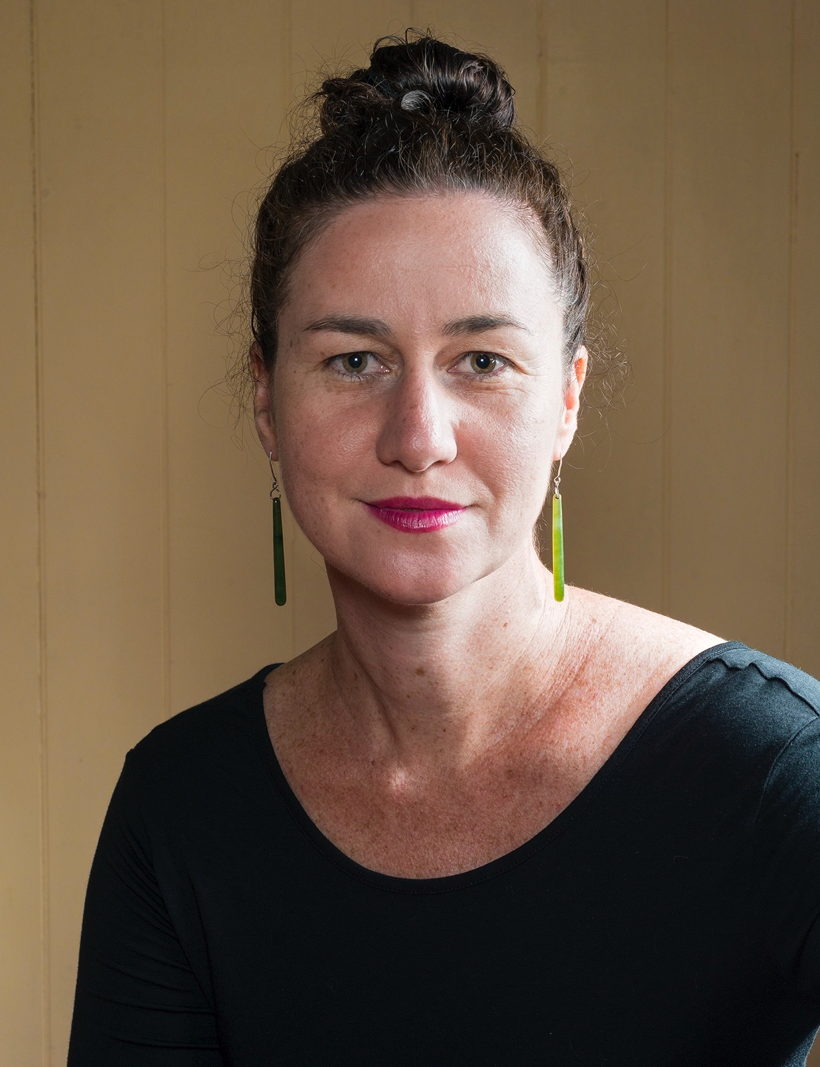
Bridget Burton, Caxton Legal Centre
Bridget Burton is Director of the Human Rights and Civil Law Practice at Caxton Legal Centre. She has been a lawyer since 2005 and practices mainly human rights, anti-discrimination and sexual harassment law.
Caxton Legal Centre represents the interests of people who are disadvantaged or on a low income when they come into contact with the law by strategically advocating to government, providing legal and social work services, publishing legal information and building community awareness about the issues faced by the people we help.
Photo of presenter to be included if possible please

Slide 7
Aim of this webinar
The Human Rights Act 2019 (Qld) includes a Right to Education. This webinar will look at how to use this right in practice.
This webinar is for lawyers, advocates and social workers in community legal practice. We will talk about how to engage with the Human Rights Act in a practical everyday way.
By the end of this webinar you should feel more confident talking to your clients about human rights, helping them prepare for negotiation and making complaints.

Slide 8
What this webinar covers
A (very) brief recap of the how the Human Rights Act 2019 operates
The meaning and scope of the Right to Education in the Human Rights Act 2019 and how it interacts with other rights and laws
Supporting your client to use the Right to Education in their direct conversations with a school
Making an internal complaint about a breach of the Human Rights Act
If the internal complaint does not resolve the matter – going to the Queensland Human Rights Commission and other options

Slide 9
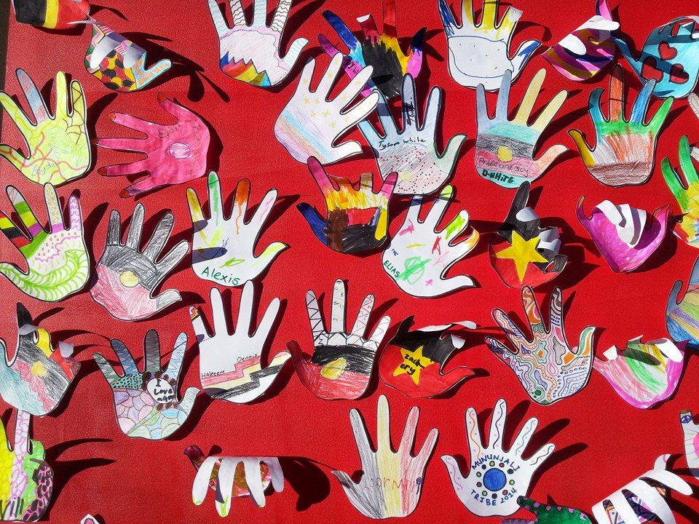
The Human Rights Act 2019:
Requires the Qld Parliament to consider human rights when making law
Instructs Courts to interpret law in line with human rights principles
Allows the Supreme Court to make declarations when a law cannot be interpreted in line with human rights
Requires public entities to consider human rights, and act and make decisions compatibly with human rights
Provides for complaint and enforcement options
It only protects individuals. It does not limit human rights protected by other laws. It does not create absolute rights and allows for limitations ‘consistent with a free and democratic society based on human dignity, equality and freedom’.
The Right to Education in the HRA 2019 (Qld) | 9

Slide 10
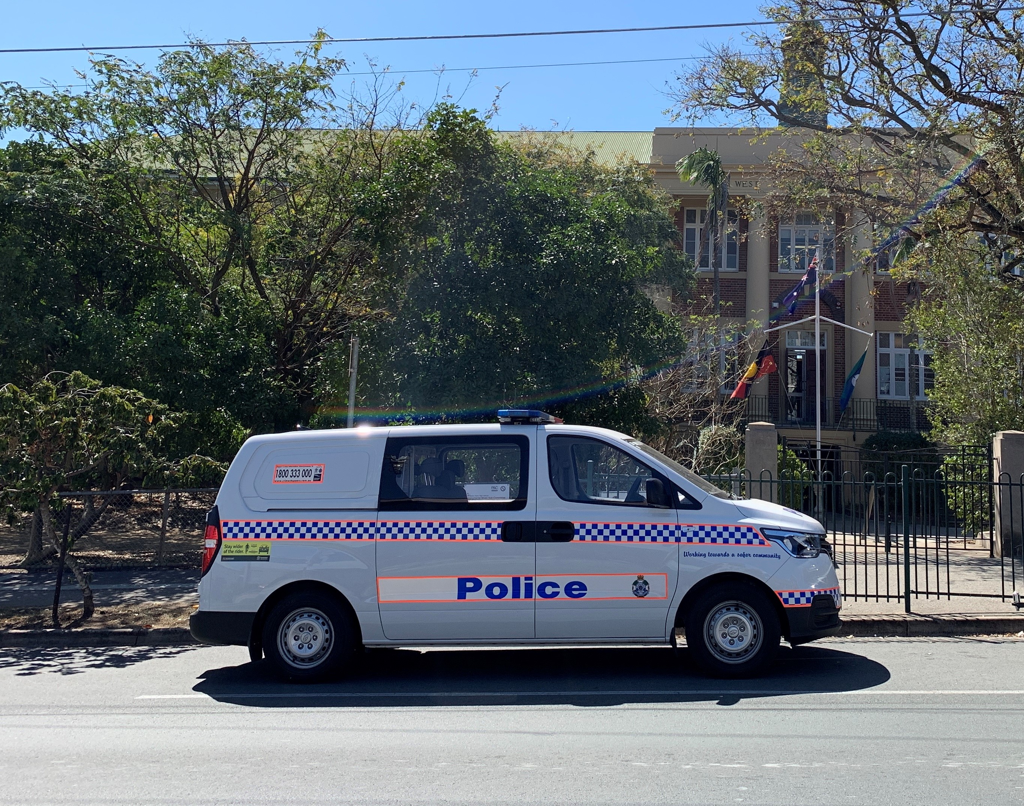
Conduct of Public Entities
58 Conduct of Public Entities
(1) It is unlawful for a public entity -
(a) to act or make a decision in a way that is not compatible with human rights; or
(b) in making a decision, to fail to give proper consideration to a human right relevant to the decision
The Right to Education in the HRA 2019 (Qld) | 10

Slide 11
Human rights compatible acts and decisions
Identify the human rights engaged
Will they will be limited by the act or decision proposed?
If yes, is the limit required by another law?
Or if not required – is the limitation permitted, proportionate and justified, considering the factors listed in section 13?
The Right to Education in the HRA 2019 (Qld) | 11

Slide 12
Limitations on human rights
Required by another law
Proportionate limitation justified in a free and democratic society based on human dignity, equality and freedom
The proportionality test (section 13)
What is the nature of the human right being protected?
What is the purpose of the limitation being proposed (including the extent to which the purpose is consistent with a free and democratic society based on human dignity, equality and freedom)?
What is the relationship between the limitation itself – and its purpose?
Are there less restrictive and reasonably available options to achieve that purpose?
How important is the purpose of the limitation balanced against the importance of safeguarding the human right?
The Right to Education in the HRA 2019 (Qld) | 12

Slide 13
Existing law and policy in Queensland
Education Queensland’s current Inclusive Education Policy
http://ppr.det.qld.gov.au/pif/policies/Documents/Inclusive-education-policy.pdf
Anti-Discrimination Act 1991 (Qld)
Disability Discrimination Act 1991 (Cth)
Disability Standards for Education 2005
Education (General Provisions) Act 2006 (Qld)

Slide 14
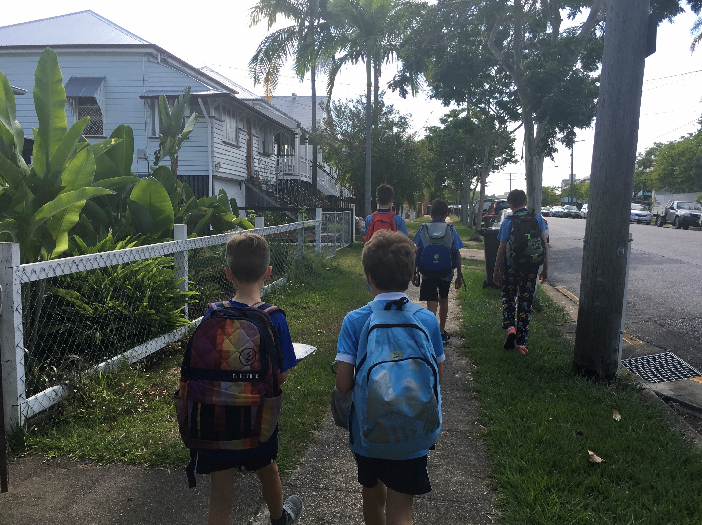
The Right to Education
36 Right to education
(1) Every child has the right to have access to primary and secondary education appropriate to the child’s needs.
(2) Every person has the right to have access, based on the person’s abilities, to further vocational education and training that is equally accessible to all.

Slide 15
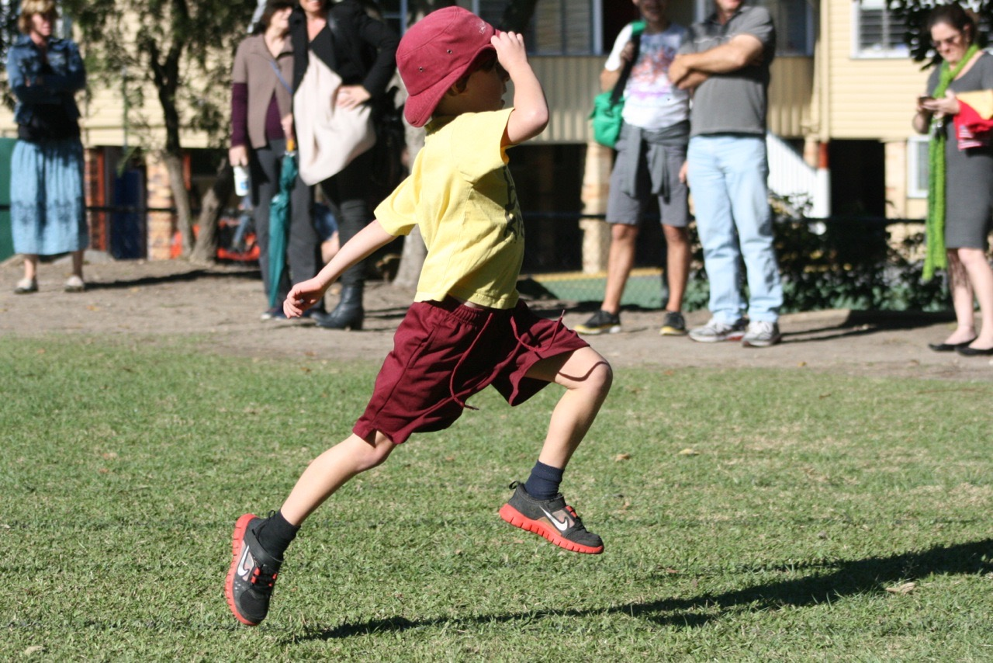
International law can help
‘The full development of the human personality and the sense of its dignity’ (ICESCR Art 13)
‘[e]ffective individualized
support ... in environments
that maximize academic
and social development,
consistent with the goal of
full inclusion’
(CRPD Art 24 (2))

Slide 16
Recognition and equality before the law (15) . protects against discrimination before the law, in relation to accessing human rights and generally | Right to life (16) . The right to live, and not be arbitrarily deprived of life and to protection of life | Protection from torture and cruel, inhuman and degrading treatment (17) | Freedom from forced work (18) . Other than by court order (such as community service) or similar (WDOs)
Freedom of movement (19) . Move freely within Queensland, enter and leave, and to choose where to live | Freedom of thought, conscience, religion and belief (20) | Freedom of expression (21) . To have an opinion and share it | Peaceful assembly and freedom of association (22) . Including joining a trade union
Taking part in public life (23) . Directly and through voting | Property rights (24) . To own property and not have it arbitrarily taken away | Privacy and reputation (25) . Includes the right not to have home, family and correspondence free from arbitrary interference | Protection of families and children (26)
Cultural rights – generally (27) . Protects various expressions of cultural, religious, racial and linguistic identity and heritage | Cultural rights – Aboriginal peoples and Torres Strait Islander peoples (28) . Protects practice, culture, kinship; and relationships to land and waters. Protects against assimilation/destruction of culture | Right to liberty and security of the person (29) . Liberty can only be taken away by law . Also protects certain rights in the arrest process and to obtain bail (subject to law) | Humane treatment when deprived of liberty (30) . Respects the inherent dignity of the human person . Looks after people held in custody before trial
Fair hearing (31) . Both criminal and civil proceedings must be fair, impartial, public and conducted competently | Rights in criminal proceedings (32) . Additional procedural rights in criminal proceedings including to representation and to have interpreters and communication adjustment if necessary | Children in the criminal process (33) . Separates children from adults, and provides for their proper treatment | Right not to be tried or punished more than once (34)
Retrospective criminal laws (35) . A person is protected from being found guilty of an offence if the conduct was not a criminal offence when it happened | Right to education (36) . Gives children a right to schooling according to their needs . Provides for access to vocational education | Right to health services (37) . Protects against discrimination in healthcare . Everyone has access to life saving and emergency care
The Right to Education in the HRA 2019 (Qld) | 16

Slide 17
Direct negotiation - the most important step
By far the step most likely to lead to a positive outcome.
Your client will need to be superhumanly calm; plan with them around this and refer for support if necessary
Consider who to speak with at the school and pay attention to their interests
Be as specific as possible about what is needed. Be prepared to respond to any dismissal of your request based on cost alone
Schools are deeply embedded in culture. Change involving structural adjustment can be hardest, even when it’s free and straightforward
If you get an agreement confirm by (friendly) email

Slide 18
Internal complaint – 45 business days to respond
6 February 2020 Dear Principal James My child Joe Burton – Grade 3H Thank you for meeting with my sister and I on 30 January 2020. As we discussed my son Joe is anxious and sometimes feels overwhelmed by classroom noise. Last year Joe missed 26 days of school as a result. His psychologist has recommended he use headphones to listen to a guided meditation and to block excessive noise when he is feeling overwhelmed. I attach again the psychologist’s letter confirming her recommendation. As you know, we spoke with Joe’s classroom teacher Mr Honey on the first day of this year and he told us that there is a school rule against using headphones in class. When we met with you, we had hoped that you would see Joe needed an exemption from this rule and were disappointed that rather than allowing him to use these strategies the school intends to move to shorter days for Joe. The Education Queensland inclusive education policy gives Joe the right to “achieve academically and socially with reasonable adjustments and supports tailored to meet [his] learning needs”. Additionally, as a child with an impairment Joe’s request for changes to school policy should be treated a request for adjustments under anti-discrimination law. Joe also has a right to an education appropriate to his needs under s36 of the Human Rights Act 2019 (Qld) and protection against discrimination under s15 of that Act. We believe you have not taken these rights into account in your decisions to refuse him access to his headphones and to reduce his learning time. Consequently we believe you have made decisions that are not compatible with Joe's human rights. Please review your decisions and allow Joe access to his headphones as requested and continued full-day attendance on an equal footing with his peers. Please treat this as a complaint under s65(1) of the Human Rights Act 2019. If complaints under that section must be brought to the attention of a different or additional person or unit within the Department of Education, please let me know immediately. Thank you again, Jamie Burton (Joe’s parent)

Slide 19
The Queensland Human Rights Commission – within 12 months
Facilitated dialogue
Investigation power
Conciliation conference
Settlement agreements
Reporting to the parties and publicly
‘Piggybacking’ complaints
https://www.qhrc.qld.gov.au/complaints

Slide 20
Responding to/appealing suspension and exclusion decisions
You can use the right to education in any administrative appeal against an exclusion or long suspension under the Education (General Provisions) Act 2006
You can complain to the QHRC about a suspension breaching the Human Rights Act 2019, even if the child is back to school or the suspension was too short to appeal
Breaches of the Human Rights Act 2019 can be 'piggybacked' to a Judicial Review application
For more about suspension and exclusion:
https://yla.org.au/qld/topics/school/expulsion/
https://queenslandlawhandbook.org.au/the-queensland-law-handbook/family-law/children-and-education/refusal-of-enrolment-exclusion-expulsion-or-suspension-from-school/

Slide 21
Useful resources
Tamara Walsh’s talk ‘What is the Right to Education’ for the Queensland Human Rights Commission, 2019 https://www.qhrc.qld.gov.au/resources/videos
UQ Pro Bono Centre student publication ‘The Right to Education Under the Human Rights Act’, 2019
https://law.uq.edu.au/files/45472/UQ_PBC_publication_right_to_education_under_the_human_rights_act_2019_24_may_2019.pdf
Walsh and Burton Queensland’s new Right to Education; what does it mean for children with disabilities, Alternative Law Journal https://journals.sagepub.com/doi/full/10.1177/1037969X19883967 (there is a cost for this one)
The Queensland Human Rights Commission
https://www.qhrc.qld.gov.au/
The Victorian Charter of Rights Benchbook
http://www.judicialcollege.vic.edu.au/eManuals/CHRBB/index.htm#57496.htm
DJAG's Human Rights Unit (materials designed for public entities) https://www.forgov.qld.gov.au/human-rights-resources
- 'Nature and scope of rights'
- 'When human rights may be limited'
- 'Act and make decisions compatible with human rights’

