Slide 1
Run-away Robodebt Train Derailed
Em. Prof Terry Carney AO
Sydney Law School

Slide 2
Outline
I. INTRODUCTION
II. WHY WAS ROBO-DEBT ILLEGAL?
III. THE NOVEMBER 2019 CAPITULATION
IV. ‘MORE’ OR ‘COMPLETE’ PROOF OF DEBTS?
V. WILL ‘METHODICAL’ REVIEWS CORRECT/REFUND ALL PAST DEBTS?
VI. WHAT OF THE ‘ONE-TOUCH’ FUTURE?
VII. LESSONS FOR PUBLIC LAW & WELFARE RIGHTS
VIII. CONCLUSION
Further: Carney, T., ‘Run-away Robo-debt Train Derailed: Pity about inadequate damage clean-up? (2020) 6, i, Social Security Rights Review

Slide 3
I. INTRODUCTION
On 19 November 2019, the morning after conceding its inability to defend the Federal Court test case challenge to robo-debt in Amato, radical changes were announced by internal Centrelink email.
Deanna Amato v The Commonwealth of Australia VID/2019/611-0
A revenue-raising measure to balance the Budget, robo-debt generated around 900,000 debts over its life
Laura Tingle, 'The robodebt scheme was a political disaster — but that's not necessarily why the Government is ditching it', ABC News Saturday 23 November 2019 <https://www.abc.net.au/news/2019-11-23/robodebt-scheme-political-disaster-why-government-is-ditching-it/11730090>.
Robodebt unlawfully and unethically sought to place an onus on supposed debtors to ‘disprove’ a data-match debt or face the prospects of the amount being placed in the hands of debt collectors
Unlawful because Centrelink, not the supposed debtor, bears the legal onus of ‘proving’ the existence and size of any debt not accepted by the supposed debtor, and cannot be extrapolated from ATO ‘average’.
Unethical because most alleged debts are either non-existent or greatly inflated, and because the might of government is used to frighten people into paying up – a practice rightly characterised as a form of extortion

Slide 4
Scale of robodebt issue
Rushed budget savings measure est. $3.7 billion to be recovered
July 2016-March 2019 500,281 robo-debts, valued at $1.25 billion
57,386 were reduced, 24,788 waived in part, and 31,160 fully waived
Average debt $2,184 but not uncommonly $10,000 or more
Sources: Carney 2018, 2019 etc and Luke Henriques-Gomes ‘Centrelink cancels 40,000 robodebts, new figures reveal’ Guardian Australia Wednesday 6 February 2019 https://www.theguardian.com/australia-news/2019/feb/06/robodebt-faces-landmark-legal-challenge-over-crude-income-calculations; (Luke Henriques-Gomes, ‘Centrelink still issuing incorrect robodebts to meet targets, staff claim’, The Guardian 29 May 2019; <https://www.theguardian.com/australia-news/2019/may/29/centrelink-still-issuing-incorrect-robodebts-to-meet-targets-staff-claim
BUT LARGE NUMBER OF MOST VULNERABLE WERE FRIGHTENED INTO PAYING UP NON EXISTENT OR LARGELY NON-EXISTENT DEBTS
Peter Martin ‘Extortion No Way to Fix the Budget’ SMH Thursday, 12 April 2018, p 20

Slide 5
II. WHY WAS IT UNLAWFUL?
Because Centrelink is always responsible for ‘establishing’ the existence and size of any supposed social security debt. A debt arises only if another section creates a debt (s 1222A(a)), eg s 1223 difference between entitled and paid
For working age payments, entitlement rate is fortnightly: eg Benefit Rate Calculator B (NSA)
McDonald [1984] FCA 59; 1 FCR 354 ‘practical onus’ is borne by Centrelink
Briginshaw principle (Briginshaw v Briginshaw [1938] HCA 34; (1938) 60 CLR 336) heightens this onus
ANALYSIS VINDICATED BY AMATO

Slide 6
Dixon in Briginshaw on required proofs
“Reasonable satisfaction is not a state of mind that is attained or established independently of the nature and consequence of the fact or facts to be proved. The seriousness of an allegation made, the inherent unlikelihood of an occurrence of the given description, or the gravity of the consequences flowing from a particular finding are considerations which must affect the answer to the question whether the issue has been proved to the reasonable satisfaction of the tribunal. In such matters ‘reasonable satisfaction’ should not be produced in inexact proofs, indefinite testimony, or indirect inferences.”
Further Carney, T., ‘The New Digital Future for Welfare: Debts without legal proofs or moral authority? [2018] (March) University of New South Wales Law Journal Forum 1-16 http://www.unswlawjournal.unsw.edu.au/the-forum/
Carney, T., ‘Bringing Robo-debts Before the Law: Why it’s time to right a legal wrong’ (2019) 58 Law Society Journal of NSW, 71-73. https://lsj.com.au/articles/why-robo-debt-bringing-robo-debts-before-the-law-why-its-time-to-right-a-legal-wrong/
Carney, T., 2018. 'Robo-Debt Illegality: A failure of rule of law protections', (Sydney: Gilbert + Tobin Centre of Public Law, UNSW Faculty of Law 2018) https://auspublaw.org/2018/04/robo-debt-illegality/

Slide 7
III NOVEMBER CAPITULATION
Debts would no longer be raised solely on the basis of an ATO average but would require additional proof;
Previous OCI identified debts will be ‘methodically’ reviewed, with a focus on debts where the person did not reply to the original OCI correspondence;
These will be reviewed to assess whether ‘further information is available to clarify the amount of any debt owed’; and
‘Affected’ persons will have recovery ‘frozen’ but otherwise there is no change to collection arrangements.
End February 2020 before all these reviews are completed

Slide 8
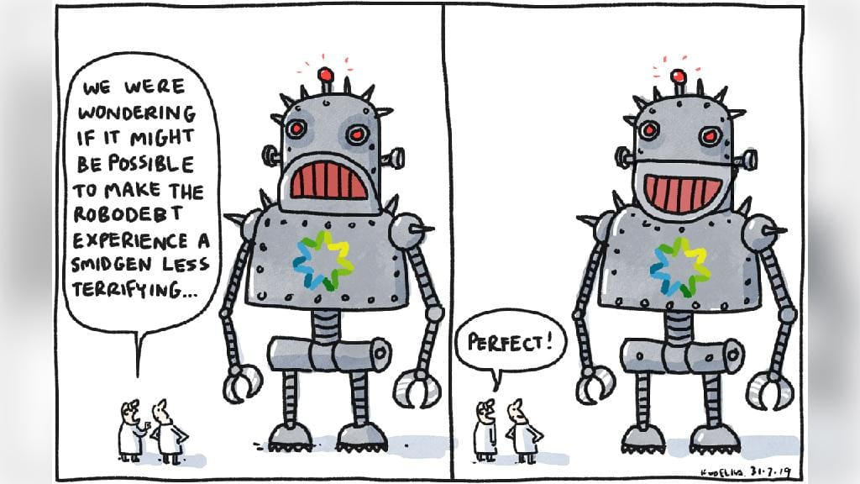
Australian: 31 July 2019
HOPEFULLY IS THIS IS NOT HOW REVIEW OF PAST DEBTS IS OPERATING?

Slide 9
IV. NOW JUST ‘MORE’ OR ‘COMPLETE’ PROOFS OF DEBTS?
Just more ‘proof points’ fails Amato.
The law requires Centrelink to provide adequate proof of debt for each and every fortnight of the debt period
If payslip etc documents are readily to hand, is it OK for Centrelink to ask for them?
Of course
If these documents are not provided on request, or there is no reply to the request, can Centrelink raise a lawful debt?
No it cannot
So what are Centrelink’s options under Amato?
It must abandon the debt or those parts of the debt amount, or
Use its statutory powers to obtain payslips or bank records from employers and financial institutions. Ie revert to pre-robo debt practice

Slide 10
V. WILL PAST ‘DEBTS’ BE REPAID?
Certainly all relevant debts are being reviewed, half of staff complement allocated to the work…(December Senate Community Affairs hearings)
But uncertainties remain/doubts are fuelled:
Is the approach still de facto reverse onus (Ie asking/expecting ‘debtors’ to locate paperwork or else)?
Probably, but cannot be
Will debts be wiped or powers to garner information be used if there is no reply to contact?
Must be, but will it?
Will all garnisheed or ‘repaid’ debts (partly or fully) be refunded if proof of all fortnights of the ‘debt’ is not established?
Must be, but will they?
Will interest be added to the refunds (as required in Amato)?
Ditto
Will any compensation be considered for psychological trauma (false accusation of debt) or other harms?
Class action to impose?: Katherine Prygodicz & Ors v Commonwealth of Australia VID1252/2019 at https://gordonlegal.com.au/media/1136/191119-prygodicz-ors-v-commonwealth-of-australia-statement-of-claim.pdf

Slide 11
VI. A ONE-TOUCH FUTURE?
Social Services and Other Legislation Amendment (Simplifying Income Reporting and Other Measures) Bill 2020
Almost contemporaneous matching of like with like: ATO one-touch (employer ‘pays’) with Centrelink reported income (now ‘actual receipt’)
Required employment income ‘carve-out’ from traditional ‘earned/derived/received’ definition of all income; now just receipt
Applies not only to working age payments but also pensions, so Bill tries to avoid causing too many conniptions for pensioners topping up with part time work ‘stability’ measure
But this is probably not going to avoid creation of overpayments for those with ‘fluctuating’ or casual employment income (thus reprising this aspect of robodebt)?

Slide 12
VII. LESSONS: Why So Long to Fix?
Lack of standards to prevent rushed government design and introduction of machine learning (‘smart’) systems of decision-making;
Lack of diligence by accountability agencies such as the Ombudsman or Audit Office;
Lack of ethical standards of administration or compliance by Centrelink with model litigant protocols;
Lack of transparency of first tier AAT review, resulting in a lack of protections against gaming of review by way of agency non-acquiescence or strategic non-contestation;
Lack of guarantees of independence and funding security to enable first line Legal Aid or NSSRN bodies to test or call out illegality;
Lack of pro-bono professional or civil society capacity to mount ‘second line’ test case litigation or other systemic advocacy; and
Tolerance of a ‘culture’ of political and public opinion devaluing the significance of breaches of the rule of law and rights of vulnerable welfare clients.
Lack of independence in AAT appointments
James Morgan, 'Securing the Administrative Appeals Tribunal's Independence: Tenure and mechanisms of appointment' (2018) 43(4) Alternative Law Journal 302-308
Further: Carney, T., ‘Robo-debt illegality: The seven veils of failed guarantees of the rule of law?’ (2019) 44(1) Alternative Law Journal 4-10 DOI https://doi.org/10.1177/1037969X18815913

Slide 13
VIII. CONCLUSION
Machine learning is part of the future furniture
Robo-debt tarnished the brand due to poor design and implementation
But the real issue is not the dangers of machine learning, but the failure of rule of law protections
This is an old story of excess of administrative/executive power and the serious flaws in the ‘new administrative law’ reforms to check such excesses
So reforms needed to rebalance the respective strength of the other two domains of the separation of powers
Esp strengthening AAT1 against being ‘gamed’ (non-acquiesence)
Use properly — Carney, T., ‘Robo-debt: Challenges and Opportunities for Administration and Accountability’ (2019) 5, i, Social Security Rights Review

Slide 14
Selected references
Terry Carney, 'The New Digital Future for Welfare: Debts without legal proofs or moral authority?' (2018) (March) UNSW Law Journal Forum 1 http://www.unswlawjournal.unsw.edu.au/the-forum/
Terry Carney, ‘Robo-debt illegality: The seven veils of failed guarantees of the rule of law?’ (2019) 47(1) Alternative Law Journal pre-print DOI https://doi.org/10.1177/1037969X18815913
Carney, T., ‘Bringing Robo-debts Before the Law: Why it’s time to right a legal wrong’ (2019) 58 Law Society Journal of NSW, 71-73. https://lsj.com.au/articles/why-robo-debt-bringing-robo-debts-before-the-law-why-its-time-to-right-a-legal-wrong/
Terry Carney, 'Robo-Debt Illegality: A failure of rule of law protections' on AUSPUBLAW (30 April)<https://auspublaw.org/2018/04/robo-debt-illegality/>.
Terry Carney, ‘Robo-debt: Challenges and Opportunities for Administration and Accountability’ (2019) 5(1) Social Security Rights Review http://www.nssrn.org.au/social-security-rights-review/robo-debt-challenges-and-opportunities-for-administration-and-accountability
Terry Carney, ‘Danger! Election 2016 delivered us Robodebt. Promises can have consequences’, The Conversation, 16 May 2019; https://theconversation.com/danger-election-2016-delivered-us-robodebt-promises-can-have-consequences-117191
Peter Hanks, 'Administrative Law and Welfare Rights: The 40-year story from Green v Daniels to “robot debt recovery”' (2017) 89 AIAL Forum 1.
Rick Morton, ‘Coalition’s $3.7bn robo-debt system ‘should be terminated’ The Australian, Tuesday, 5 February 2019 https://www.theaustralian.com.au/national-affairs/coalitions-37bn-robodebt-system-should-be-terminated/news-story/7d8a0d7a323f011c96ab86d23042d2dd

