Slide 1
Enabling a Thriving Community Legal Sector
July 28th, 2020

Slide 2
Introducing the Speakers
Disha Moses
Actionstep Sales Team
Greg Sando
Working with Actionstep for 6 years and implemented over 300 firms globally onto Actionstep including 10 CLC in Australia.
Working with CLC Australia on Class Integration on behalf of Actionstep

Slide 3
Actionstep

Slide 4
Understanding your World
Comprised of “Generalists” and “Specialists” i.e Family Violence, Social Security etc,

Slide 5
ALL IN ONE SYSTEM
One place for all your Centre Data and your team to collaborate
Intake Webform +
Document Portals
Document Automation & Storage
Task and Deadline Management
CLASS, DEX and AG Data Integration
Case Management
+
“Workflow”
Email & Calendar Management
Workload
+
Process Management

Slide 6
Community Legal Centre Needs
1) All in one and effective 'Case Management System’ for legal and non-legal matters.
2) Client Relationship Management (CRM)
3) Consistent and Accurate Data Collection for Evaluation and Reporting
4) Client Intake and Appointment Scheduling
5) Deadline and Task Management
6) In-built Reporting and integration with CLASS

Slide 7
Our Integrations
Take Actionstep’s features to the next level
Case Management
Reporting
Document Automation & Storage
Email & Calendar Management

Slide 8
Our Commitment
NO CONTRACTS
DATA SOVEREGNTY
We have both monthly and annual payment options but don’t tie you down to a long-term contract
We host your data via the Amazon Web Services in Australia
GET YOUR DATA BACK ANYTIME
FULLY ENCRYPTED DATA TRANSFER
Your data belongs to you and you can request a free data back up anytime
Your data is encrypted and secure while in Transit and when stored within Actionstep
DEDICATED SUPPORT & HEALTH CHECKS
SET YOUR PASSWORD POLICIES
Our Support Desk Service is included in your subscription via phone, email, chat or ticket
Set your own password policies, location & time of day restrictions and add 2 Factor Authentication
USER COMMUNITY
PERMISSION-BASED USER ACCESS
Gain access to our user training materials, user group forums, Customer Success team, webinars and publications
Control your staff’s access to different areas of the system based on their role within your firm

Slide 9
Our Stats
Don’t take our word for it…
10,000+
98.1%
4.5/5
Global Users
Average User Retention Rate
Review on Capterra
OUR COMMUNITY
A SYSTEM FOR LIFE
QUALITY & VALUE
We have a global community of over 10,000 legal professionals and growing every day.
Those who chose to partner with us, tend to stay with Actionstep for the long term
Actionstep’s platform quality and value for money is reflected by our user reviews

Slide 10
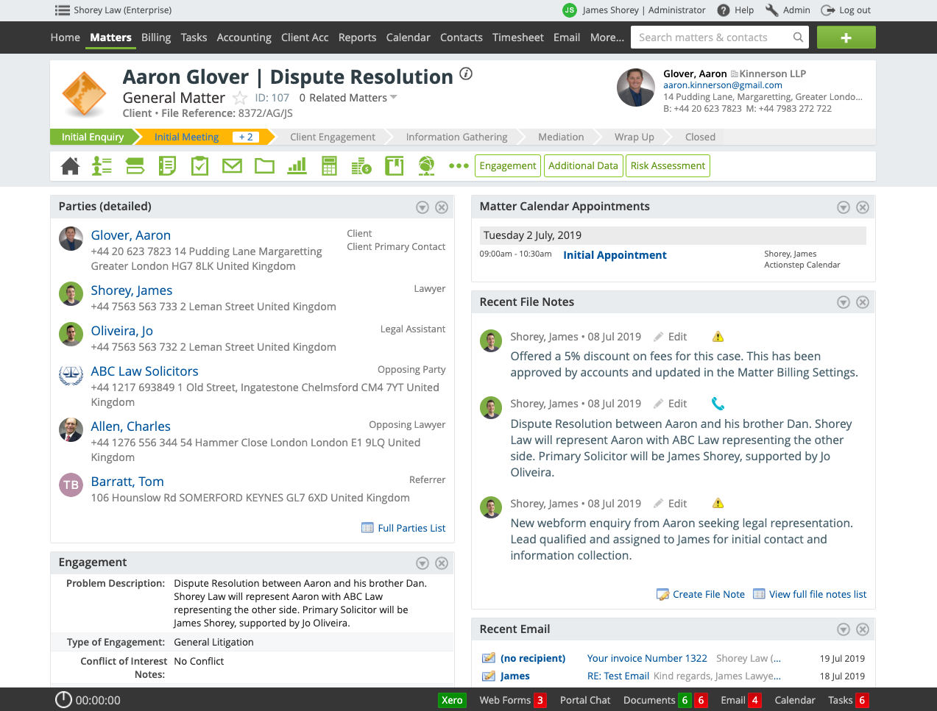
‘Work on the go’ from any device,anytime’ anytime...
Notes:
One of the biggest benefits of being cloud based is that you can login from anywhere, using PCs, laptops, mobile phones or tablets, and it’s just like Internet banking, and it is just as secure [NEXT SLIDE]

Slide 11
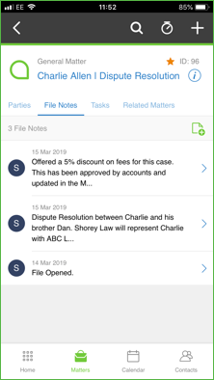
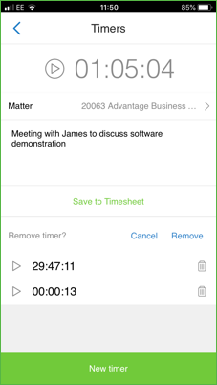
Use our Mobile App
When best to use:
Use on your mobile phone or tablet
Compatible with both Apple & Android
What is possible:
•Access all Case & Contact information
•Check your Actionstep calendar
•Time Record
•Enter in case notes
Notes:
Our mobile app is designed to give you basic access of the system to keep track of your day with features such as time recording, taking notes, accessing matters and contact information etc.
Do you or your team work away from your desk much at all?

Slide 12
Community Legal Centres on Actionstep

Slide 13
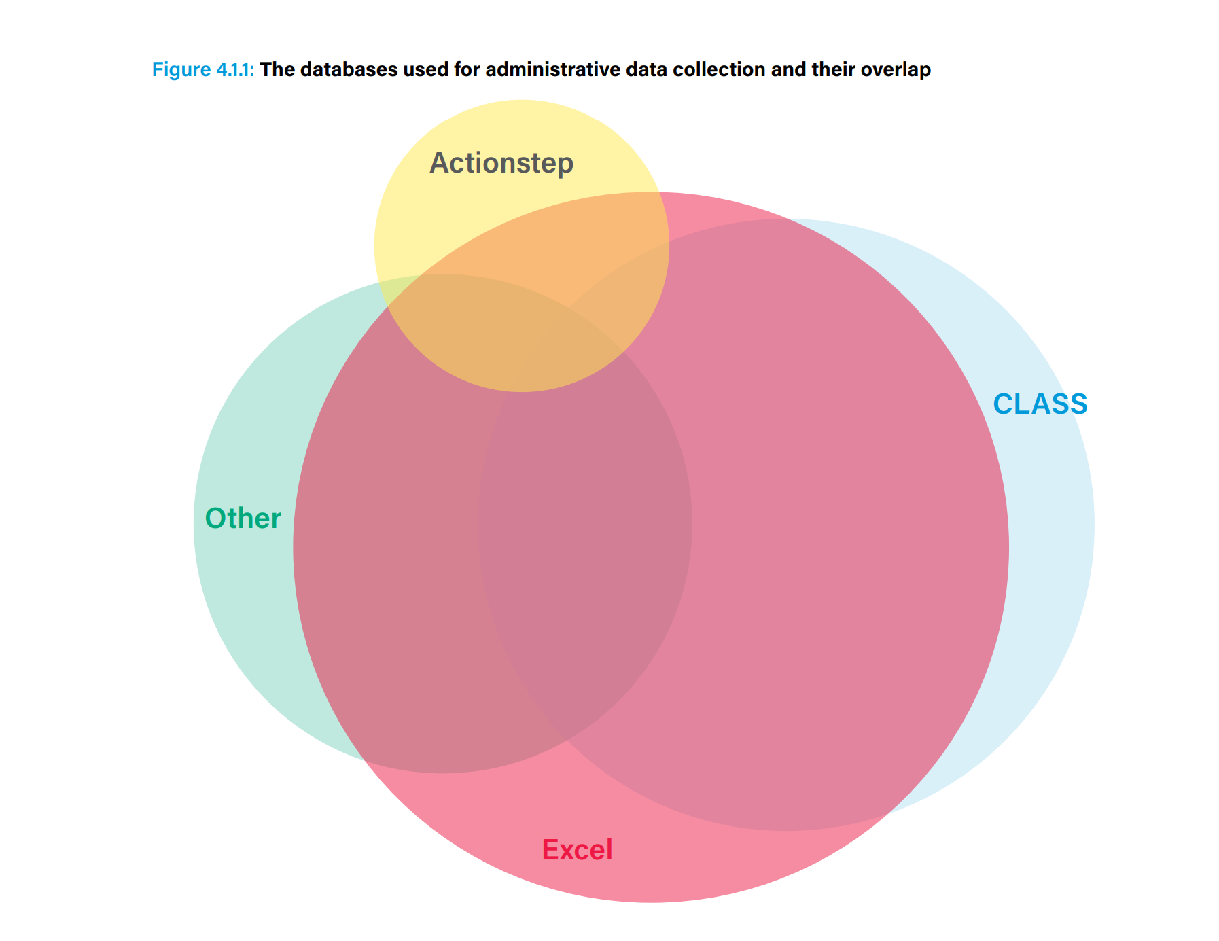
Current Systems used

Slide 15
Showing You Actionstep

Slide 16
The Case Management Journey in Actionstep
Client Intake Webform / Manual Entry
Intake Process including Conflict Check
Legal Case Management Process
Class Data
File Notes
Calendering
Tasks
Parties
Documents & Email Management
Document Portal
Matter lists
Office Integration

Slide 17
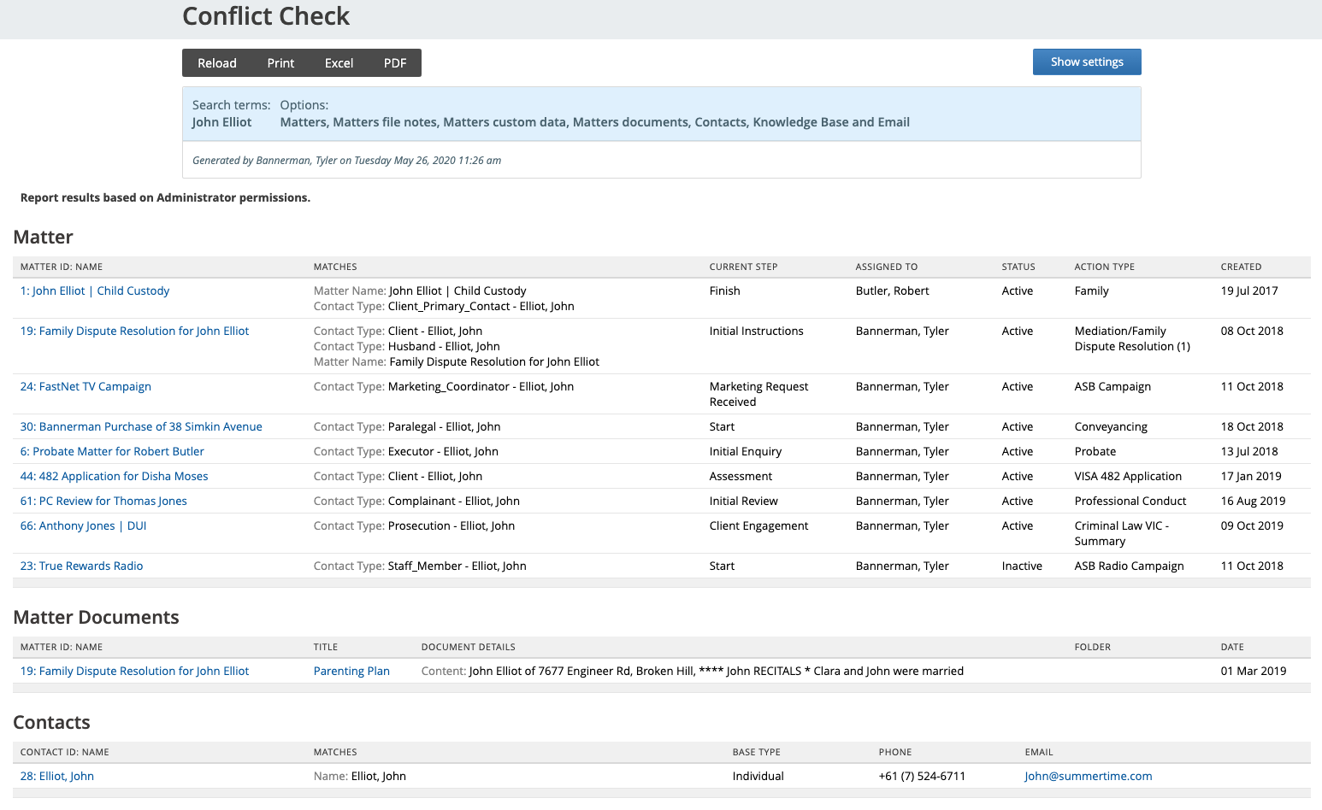
Conflict Check Report
Notes:
Document templates
Conveyancing specific reports – for clients
Conveyancing specific reports – for case management

Slide 18
Integration With Class

Slide 19
INTEGRATION WITH CLASS
CLASS compliant Data template – installed with Actionstep for CLC’s
All Service level data fields required for CLASS Reporting included
All Client level data fields required for CLASS Reporting included
Data Extraction from Actionstep to CLASS
Transformation into CLASS Import Format
Data sent to CLASS automatically

Slide 20
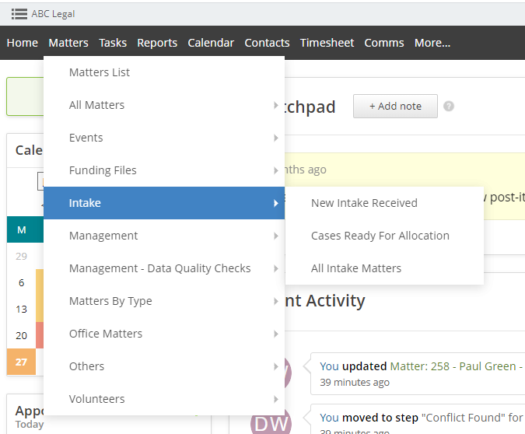
Custom Lists used by CLCs
Create your own lists in minutes
List can be used for browsing and filtering for files.
Lists can be used for business processes ie show a list of all files awaiting allocation, show all Volunteers that their police certificate will expire in 30 days etc
Lists can be downloaded to excel or emailed to you on a schedule
List views can be used for custom reporting
Notes:
Custom list views mean that you can set up a number of list views with everything that you would want to see at any given time. As an example, you can set up list views to see all your matters that are currently at client engagement stage. Or you may want to see all conveyancing matters at the settlement step that have overdue tasks on them. You can also use the heads up rule to have these emailed to you on any frequency that you choose. [NEXT SLIDE]

Slide 21
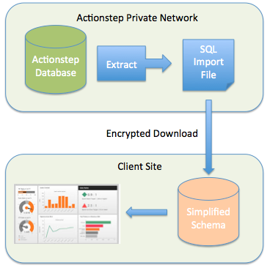
Direct Database Access
Download to your local database server
Create your own 100% custom reports and dashboards
Notes:
If the reports that you want are not in the system, that is no problem. We have a data exporter tool that enables you to retrieve your information out of Actionstep and use a tool like Microsoft Power B.I. or another dashboarding tool you can create your own custom reports. [NEXT SLIDE]

Slide 22
Next Step - Getting Started

Slide 23
Implementing Your Vision
Take advantage of pre-built CLC system accounts to get started now!
SYSTEM BUILD
Our Consultants will discuss your requirements and gather all your templates and firm information before building your tailor-made system on top of the CLASS base configuration.
DATA MIGRATION
Data and document import from your legacy systems into Actionstep based on agreed scope
TRAINING
Online training for managers, staff and volunteers to suit your needs
ONGOING SUPPORT & DEVELOPMENT
Continue to develop your system and workflow processes as you grow

Slide 24
Your Customer Journey
How we get you from here to… Success
Certified Partner Quote
START SEEING THE RESULTS
We'll get you in touch with the experts so you know exact costs and timelines
Hit the ground running from your first day on Actionstep
Project Scoping
Implementation
Go Live
Evolve
LET US DO ALL THE WORK
CONSTANTLY IMPROVE YOUR PROCESS
Our consultants will remove all the stress of system migration
Regular system Health Checks and learn from our User Groups

Slide 25
Next Steps
There are a few options of where to go from here
Quote
Plan
GET A FULL COST & TIMELINE ESTIMATE
START PROCESS MAPPING
Speak to the consultants and support specialists who will be taking you through your journey
Get your plan in place.
We can’t create innovation, only enable yours.

Slide 26
Special Pricing Offer for CLCs
AUD $50* PER USER / Month (FULL USERS), NORMALLY $149*
AUD $15* PER USER / Month (VOLUNTEERS)
Workcloud has discounted the implementation of Actionstep for CLC's. Implemnetation costs start from $490* per month over 6 or 12 months! Representing a 35% discount
*GST Applies

Slide 27
Contact Details : sales@actionstep.com – Disha Moses sales@workcloud.com.au – Greg Sando

Slide 28
Landing Page for CLC inquiries https://try.actionstep.com/overview-clc/

Slide 29
THANK YOU
EVOLVE & GROW WITH ACTIONSTEP

