Slide 1
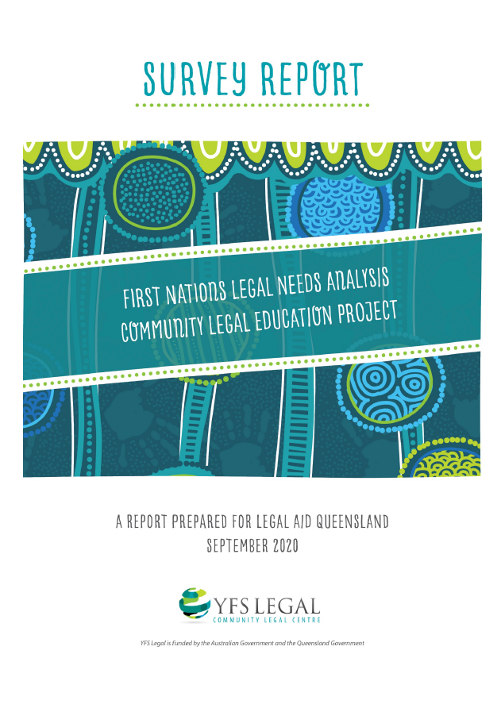
First Nations Legal Needs Analysis
Candice Hughes and Wyatt Cook-Revell

Slide 2
Overview
The First Nations Legal Needs Analysis Project represents the first analysis of the legal needs of the First Nations peoples of Logan.
The project aimed to identify legal needs and gaps in service delivery for the First Nations peoples of Logan.
The research project was undertaken by YFS Legal, a community legal centre in the Logan community. YFS Legal specialises in providing information, advice, and representation for clients 10-24 years of age who find themselves needing help with criminal law, as well as providing advice to the broader community on family and civil matters.
Legal Aid Queensland funded the project through the Community Legal Education Collaboration Fund 2019-2020.

Slide 3
Context
31% of First Nations people are estimated to require legal services nationally
9,817 people in Logan identified as Aboriginal or Torres Strait Islander in the 2016 Census (3.2% of the population)
6.5% of YFS Legal clients identify as Aboriginal and/or Torres Strait Islander
Disadvantage and legal problems go together. The more disadvantaged a person is, the more likely they are to have legal issues and need assistance to deal with these.
Logan is the home to many people experiencing significant disadvantage, which is compounded for First Nations people.
First Nations people are overrepresented in the criminal justice system. They are 13 times more likely to be imprisoned than non-Indigenous people. For this reason, legal support has tended to focus primarily on criminal matters.

Slide 4
Research
The project was implemented by a team of First Nations peoples.
The research involved a survey, stakeholder consultations and site visits.
84 respondents across the Logan region completed the survey.
From left: Nerida Brazier, Wyatt Cook-Revell and Candice Hughes

Slide 5
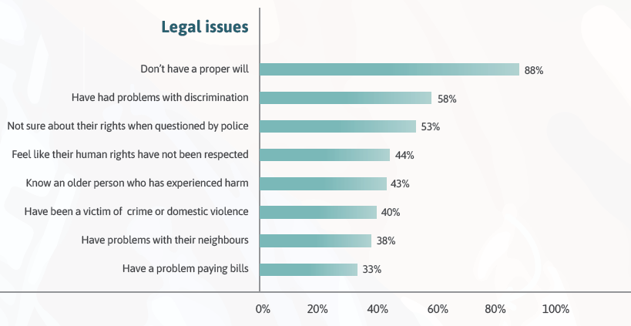
Results
The survey found that respondents experienced multiple legal issues across criminal and civil law.

Slide 6
Key principles for community legal education
The study found that community legal education for First Nations people should:
take a more holistic or client-focused approach;
aim to empower clients and increase legal capability;
address both criminal and civil law needs comprehensively;
engage in culturally competent law practice;
consider the unique legal needs of different First Nations people, including youth and older people; and
address the barriers that Aboriginal and Torres Strait Islander people face in accessing legal services: socio-economic disadvantage, cross-cultural issues, and language issues.

Slide 7
Next steps
YFS Legal will use the findings of the study to develop and trial a toolkit for First Nations legal community education.
An additional action research project supported by the Queensland Department of Justice and Attorney-General will enable a larger-scale trial, to ensure that resources and approaches are relevant, useful, inclusive, safe and able to be replicated in other settings.

