Slide 1
The Human Rights Act
Community Legal Education Showcase
Community Legal Centres Queensland State Conference
11 November 2020, 3-4pm

Slide 2

QAI Human Rights CLE
Emma Phillips, Principal Solicitor/Deputy Director, QAI
Development of CLE
  Planned
  Responsive
Audience
  People with intellectual/cognitive disability and/or mental illness & families
  Advocates, lawyers, social workers
Modes
  Conference presentations
  Resource development
Partners
  Universities, law associations, health services

Slide 3

Integrating a human rights lens into CLE
Top tips:
Acknowledge origins and significance of human rights
Know your audience and target accordingly
Focus on outcomes – addressing power imbalance, changing behaviour, creating a human rights culture in Qld
Relevance of HRA in different environments and situations
Provide practical examples

Slide 4
Examples of QAI's HRA CLE
Activities:
Human Rights Plenary CLCA National Conference: "Why Human Rights Matter: The Possibility and Role of Human Rights Frameworks in Australia"
CLCQld webinar: "Using the HRA to advocate for clients with a disability"
ALA Conference presentation: "Using the HRA as an Advocacy Tool for Clients with Disability"
Presentation to disability advocates: "Education, Health and Employment: How Qld's HRA will impact people with disability"
Guest lectures to university students on the HRA (UQ, Bond University)
Presentation to social workers on the HRA and its implications for their practice
Resources:
Know Your Human Rights: A Guide to the Human Rights Act 2019 (Qld)
Fact sheets on the HRA
"The Queensland Human Rights Act for children with disabilities in schools" (with UQ Pro Bono Centre)
Flow chart: "How will a legal problem be impacted by the HRA?"
ALA article: "How the new Queensland Human Rights Act can assist clients with disability"
"The Grassroots Campaign for a Human Rights Act in Queensland: A case study for modern Australian law reform", Alternative Law Journal

Slide 5
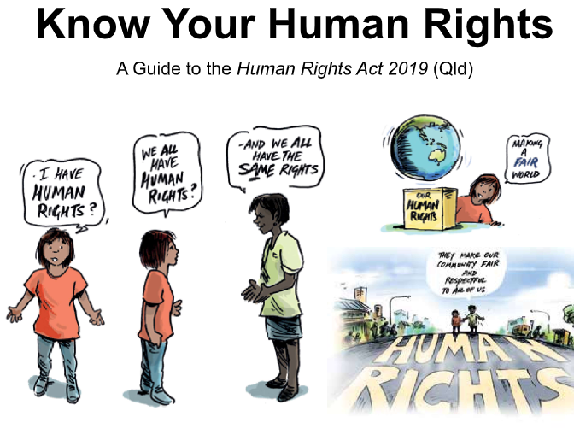
Know Your Human Rights: A Guide to the Human Rights Act 2019 (Qld)
Aim: to develop an Easy English booklet on the new Human Rights Act to assist people with intellectual/cognitive disability to understand the new Act.
Fact sheets

Slide 6







