Slide 1
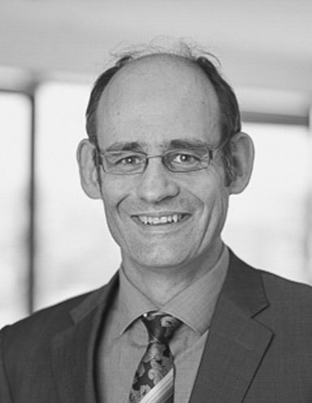
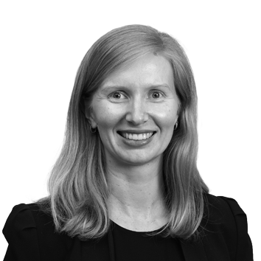
Queensland Pro Bono Lawyers Network
Pro bono refers to the provision of legal services either free or at substantially reduced cost to those who would otherwise be unable to protect their lawful rights and interests.
TYPES OF ASSISTANCE
Firms can provide pro bono legal assistance by:
Taking referrals, including for representation
Taking on strategic litigation – on the record, as co-counsel or behind the scenes, including preparatory work
Assisting with law reform and advocacy, including background research and preparing submissions
Providing organisational legal advice, including in corporate structure, governance, employment, tax, IP, data, privacy, leasing and property
Preparing community legal education tools
Providing continuing professional education
Staffing advice clinics and referral services
‘Phone a friend’ style on the spot advice
Queensland Pro Bono Lawyers Network
The Queensland Pro Bono Lawyers Network was launched in 2013 and aims to share opportunities in, ideas for, and experiences of pro bono work among a network of pro bono practitioners in Queensland.
Robert Reed MinterEllison T +61 7 3119 6155 | M + 61 422 000 161 robert.reed@minterellison.com
Corin Morcom Allens T +61 7 3334 3347 | M +61 451 233 014 Corin.Morcom@allens.com.au
If you require assistance in other areas, just ask.

Slide 2
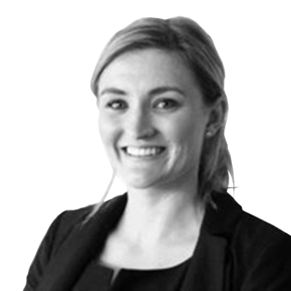
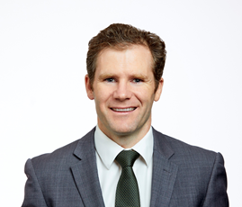
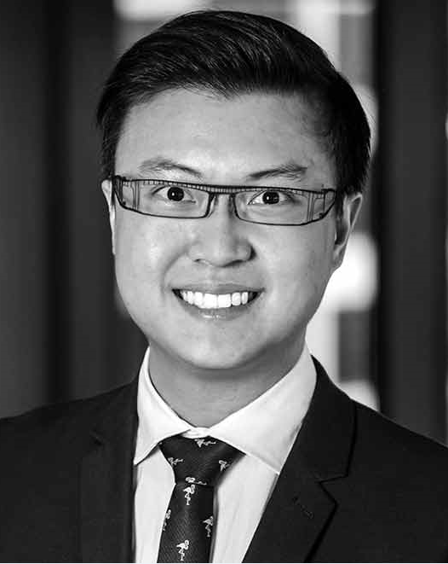
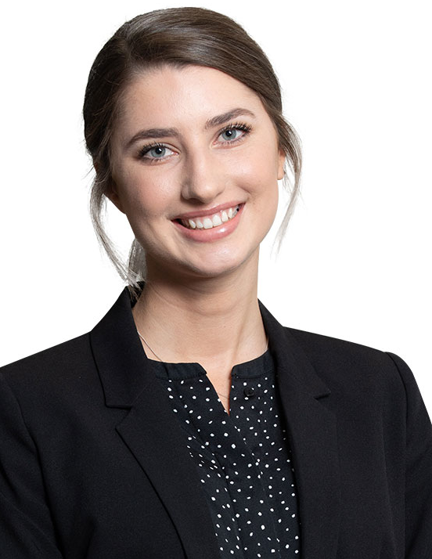
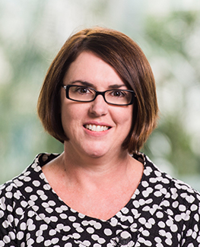
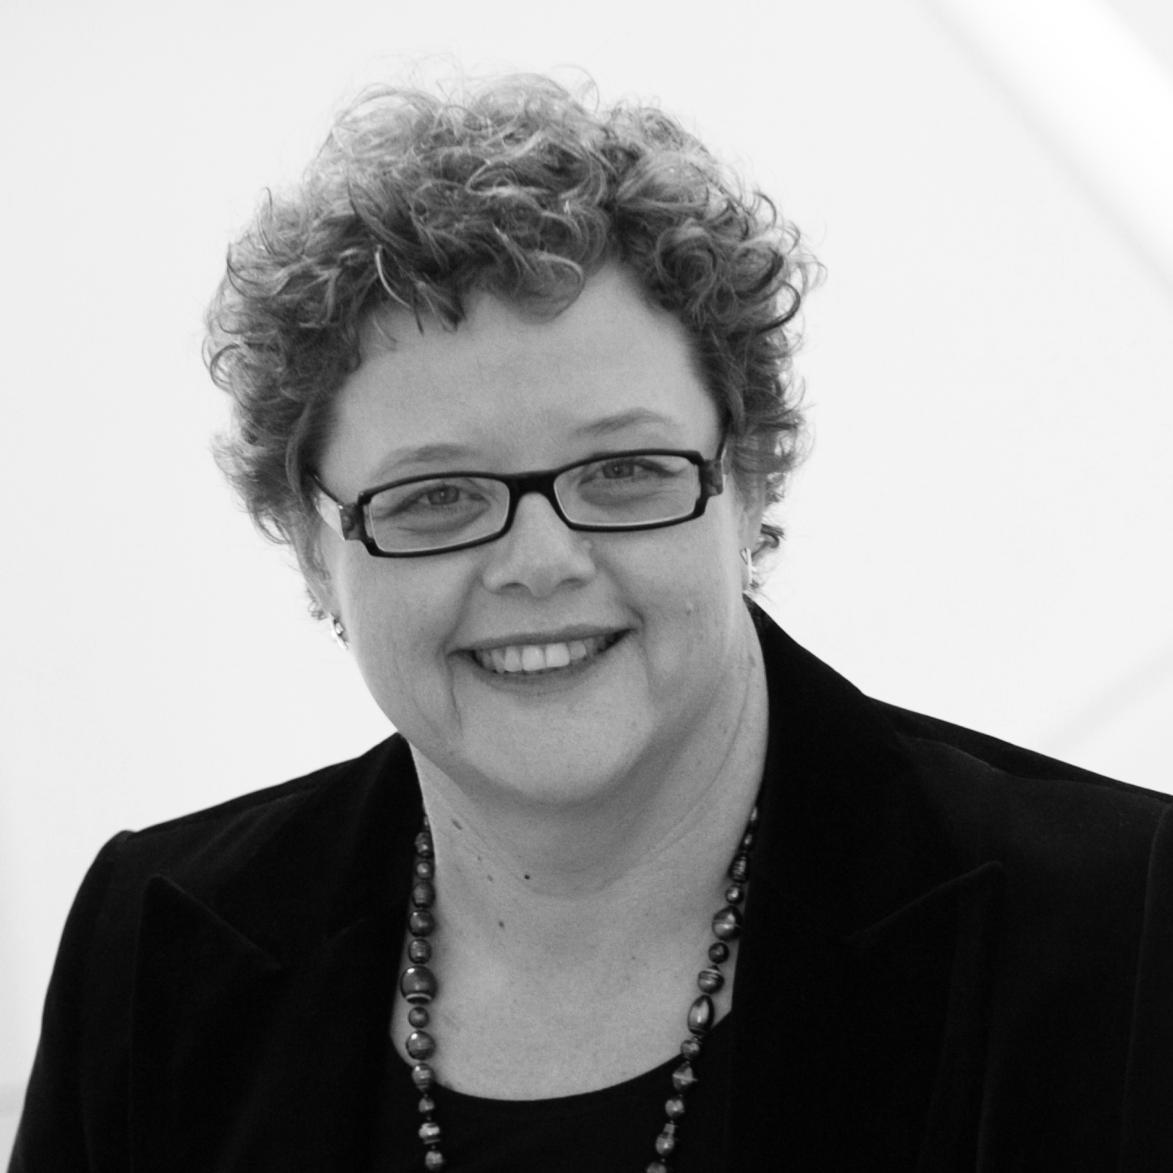
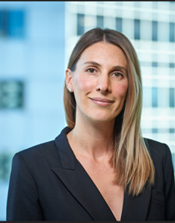
Pro bono contacts
We focus on human rights (incl. refugee rights), mental health, Indigenous rights, homelessness and the natural environment
Breaking cycles of disadvantage: incl homelessness, DFV, poverty, youth, diversity/inclusion, First Nations empowerment.
We focus on:
1. Indigenous rights
2. Financial Abuse
3. Human Rights
4. Climate & Disaster response
5. Mental Health & wellbeing
Refugees, First Nations peoples, the arts, women and youth at risk, seniors law and elder abuse
Meg Hogan Allens T +61 7 3334 3020 Meg.Hogan@allens.com.au
Robert Reed MinterEllison T +61 7 3119 6155 Robert.reed@minterellison.com
Leanne Collingburn Norton Rose Fulbright T +61 7 3414 2807 leanne.collingburn@nortonrosefulbright.com
Guy Donovan Holding Redlich T +61 3 9321 9867 guy.donovan@holdingredlich.com
Focus on groups with disadvantage i.e. elder abuse, homelessness, domestic violence, employee rights, LGBTI rights, NFPs etc.
All areas other than family & crime. Focuses incl. access to justice, RRR communities, indigenous capacity building & diversity
We offer assistance with nearly every type of civil matter. Our current focus is developing our legal clinics to reach as many people as possible
DFV, indigenous matters, discrimination, child protection and support generally for organisations working in the public interest
Shaun Chng Clayton Utz T +61 7 3292 7683 dhillard@claytonutz.com
Emile McPhee McCullough Robertson T +61 7 3233 8761 emcphee@mccullough.com.au
Verity Smith McInnes Wilson Lawyers T +61 7 3231 0632 vsmith@mcw.com.au
Nicole Radice Hopgood Ganim T +61 7 3024 0327 n.radice@hopgoodganim.com.au
Human rights and homelessness issues; abuse, domestic violence and victims of crime; accidents, insurance and superannuation.
KWM works to reduce inequality & poverty among young people, especially First Nations young people.
'We have strong input from our staff about the office's pro bono offering. We engage with lawright and we encourage our staff to offer legal support to the community organisation they are involved in
We advocate for refugees & asylum seekers, champion mental health initiatives, focus on human rights law & seniors rights, & assist in policy reform & laws relevant to not-for-profits
Joanne Rennick Muphy Schmidt T +61 7 3303 9800 jrennick@murphyschmidt.com.au
Dusan Stevic King Wood Mallesons T +61 431 302 318 Dusan.Stevic@au.kwm.com
Kate Boomer Clyde and Co T +61 7 3234 3053 | M + 61 421 901 932 Kate.boomer@clydeco.com
Emma Bray Wotton + Kearney T +61 7 3236 8704 emma.bray@wottonkearney.com.au

