Slide 1
The future of collaborative service planning
Legal Assistance Strategy and Funding
Department of Justice and Attorney-General

Slide 2
Acknowledgement of Country
We acknowledge the Traditional Custodians of the various lands on which we work today and the Aboriginal and Torres Strait Islander people participating in this conference.
We pay our respects to Elders past, present and emerging, and recognise and celebrate the diversity of Aboriginal peoples and their ongoing cultures and connections to the lands and waters of Queensland.

Slide 3
Legal Assistance Strategy and Funding
Amanda Shipway
Sarah Chase
Megan Topping
Director
Principal Project Officer
Senior Project Officer

Slide 4
1
Our achievements to date
Collaborative service planning under the National Legal Assistance Partnership 2020-25
2
Today's
Agenda
Aboriginal and Torres Strait Islander Legal Services (ATSILS)
3
Queensland Legal Assistance Forum (QLAF)
4
Regional Legal Assistance Forums (RLAFs) and the transition
5

Slide 5
Our achievements to date
CLCQ was funded by DJAG to facilitate regional service planning in 5 regions of Queensland during 2018-2019. The planning process involved three stages:
Data collection
Analysis of the data to understand services currently provided and where more or different services are required now and in the future
Developing recommendations for future service delivery in a workshop of regional legal assistance services.
CLCQ also developed a Resource and Facilitation Guide to help the process.
DJAG also funded CLCQ to develop and update the Evidence and Analysis of Legal Need Guide (2016 and 2019).
In 2017, DJAG funded CLCQ to develop the self-evaluation toolkit (measuring the impacts of CLCs).

Slide 6
NATIONAL LEGAL ASSISTANCE PARTNERSHIP (NLAP)
Objective:
To contribute to integrated, efficient, effective and appropriate legal assistance services which are focused on improving outcomes and keeping the justice system within reach for vulnerable people facing disadvantage, within available resources.
It outlines a framework to guide the legal assistance sector, including providers which may not be funded under the NLAP.
The NLAP consists of the Multilateral agreement and Bilateral Schedules between the Commonwealth and each state.
Within this structure there are arrangements for:
(a) mainstream and specialist legal assistance; and
(b) Aboriginal and Torres Strait Islander specific legal assistance

Slide 7
Collaborative service planning under the NLAP
Schedule B
of the NLAP
Tier 1
National
Tier 2
Jurisdictional
(QLAF)
Tier 3
Local
(RLAFs)

Slide 8
Any questions?

Slide 9
Aboriginal and Torres Strait Islander Legal Services
Operating in Queensland since 1972.
Formally administered by the Commonwealth under the Indigenous Legal Assistance Program (ILAP).
Now included in the NLAP.
Commitment to QLAF, RLAF and working groups.
Government to support ATSILS (e.g. Bamaga, ID project, Yellow Cards).
Presents an excellent opportunity (e.g. LawRight in Cairns).

Slide 10
QLAF
QLAF was established and held its first meeting in Brisbane on 7 February 2006.
Membership is comprised of the following organisations/bodies:
Aboriginal and Torres Strait Islander Legal Service
Bar Association of Queensland
Community Legal Centres Queensland
Department of Justice and Attorney-General
LawRight
Legal Aid Queensland
Queensland Council of Social Services
Queensland Indigenous Family Violence Legal Service
Queensland Law Society
The Commonwealth Attorney-General’s Department attends the QLAF as an observer.

Slide 11
QLAF
Purpose
To coordinate and maximise the reach of legal assistance services and provide feedback to the Queensland and Commonwealth governments and other relevant bodies on legal assistance strategies.
Implement and oversee collaborative service planning.
Endorse Queensland’s evidence base.
Facilitate best practice and continuous improvement in service design and delivery by coordinating working groups, forums and other legal and non-legal services including oversight of the RLAFs.

Slide 12
QLAF
In 2018, the QLAF developed a strategic plan which set out the following priorities for 2019-21.
Become better engaged, informed and connected with the RLAFs and working groups by seeking feedback on the best way to communicate with the members.
Actively review regional plans and support RLAFs without a plan to develop a plan.
Facilitate opportunities for information sharing between the legal services and social services sectors by leveraging the QCOSS/legal connection through CLE and by fostering formal referral pathways.
Understand, influence and contribute to the practical implementation and application of the Human Rights Act (and Declaration on the rights of Indigenous Peoples).
Seek funding to map the legal needs of, and legal assistance services for, marginalised and vulnerable people across Queensland.

Slide 13
Any questions?

Slide 14
Regional Legal Assistance Forums (RLAFs)

Slide 15
Background
In 2008, LAQ undertook a strategic planning process
Demand for more collaborative and cooperative working relationships with other legal service providers in rural and regional Queensland.

Slide 16
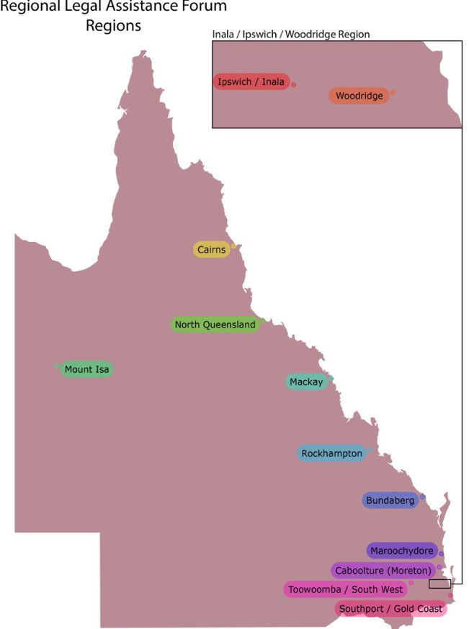
MEET THE RLAFs
Bundaberg
Caboolture
Cairns
Gold Coast
Ipswich/Inala
Mackay
Maroochydore
Mount Isa
North Queensland
Rockhampton
South West Queensland
Woodridge

Slide 17
Purpose of the RLAFs
To assist in reducing service duplication
Engender partnering relationships between services
Provide feedback to the QLAF on a range of issues
Moving forward…
Be the primary vehicle for the collaborative service planning in each region
undertake sector and regional building activities
development/follow up of regional collaborative service plans

Slide 18
Achievements of the RLAFs
5
Rockhampton RLAF was successful in its application for $7,500 from the LAQ CLE Collaboration Fund .
First Nations Community Art Project (the Project).
19 Indigenous young people who currently have community service hours to complete, the Project will create an Indigenous design suitable to utilise in a number of applications.
An avenue to complete community service obligations by participating in a number of art workshops directed by an Indigenous artist and attended by local Elders and appropriate support services.
REGIONAL COLLABORATIVE SERVICE PLANS COMPLETED

Slide 19
Transition of secretariat
With the additional funding provided by the Commonwealth Government for administration of the NLAP, this function will transition to DJAG from 1 December 2020.
DJAG will manage the secretariat functions of the following LAFs:
Aboriginal and Torres Strait Islander service planning working group;
Best Practice and Evidence Base working group;
Community Legal Education Assistance Forum;
Mental health service planning working group;
QLAF; and
RLAFs (at 12 regional locations).

Slide 20
How to reach us
AMANDA SHIPWAY
Ph: 07 3738 9422
amanda.shipway@justice.qld.gov.au
SARAH CHASE
Ph: 07 3738 9426
sarah.chase@justice.qld.gov.au
MEGAN TOPPING
Ph: 07 3738 9425
megan.topping@justice.qld.gov.au

