Slide 1
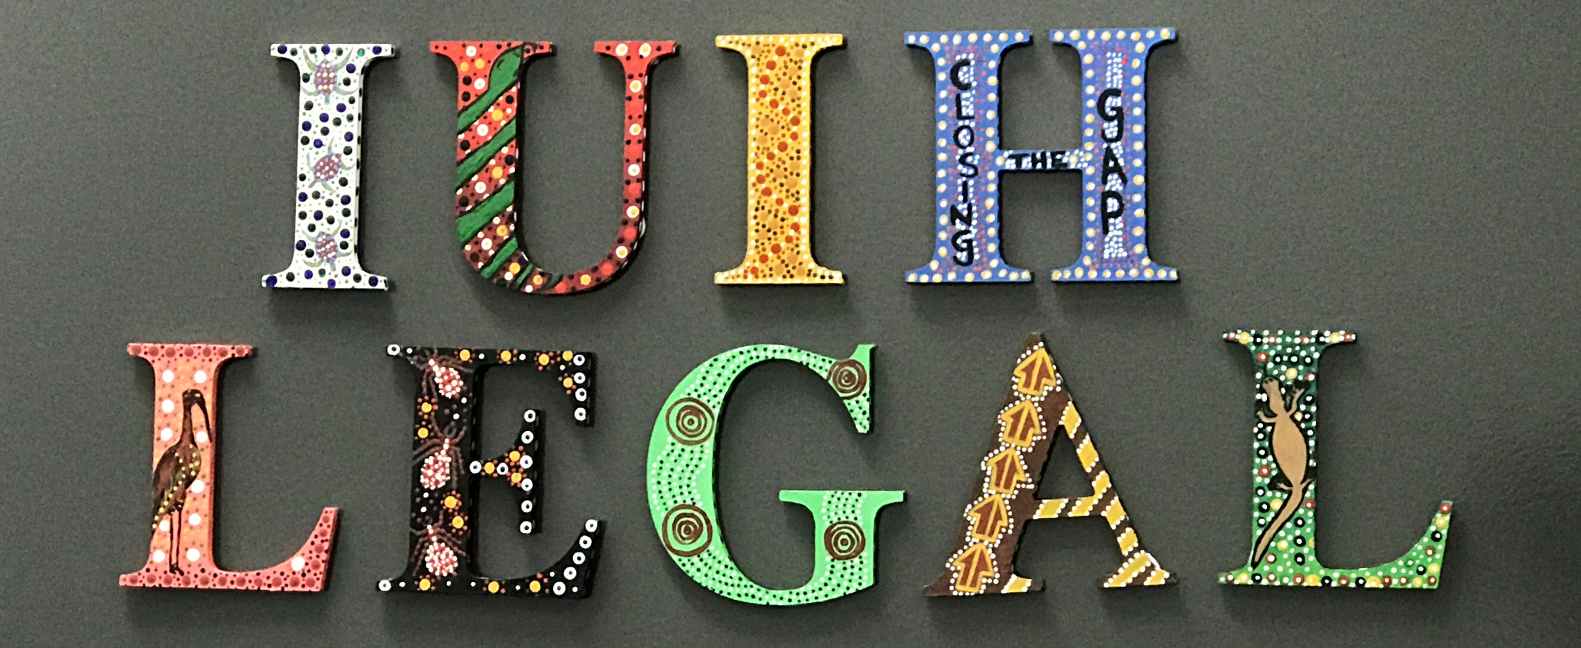

Slide 2
IUIH LEGAL SERVICE “Elder Abuse”
CLCQ Conference
12th November 2020

Slide 3
Acknowledgment: We honour the many Goori Tribal Nations whose territories we work across within South-East Queensland, and the Jagera and Turrbal people upon the land in which I present today. We honour the legacy and the vision of those who paved the way and those who continue to guide us. We honour our future generations by maintaining the vision with focused determination.

Slide 4
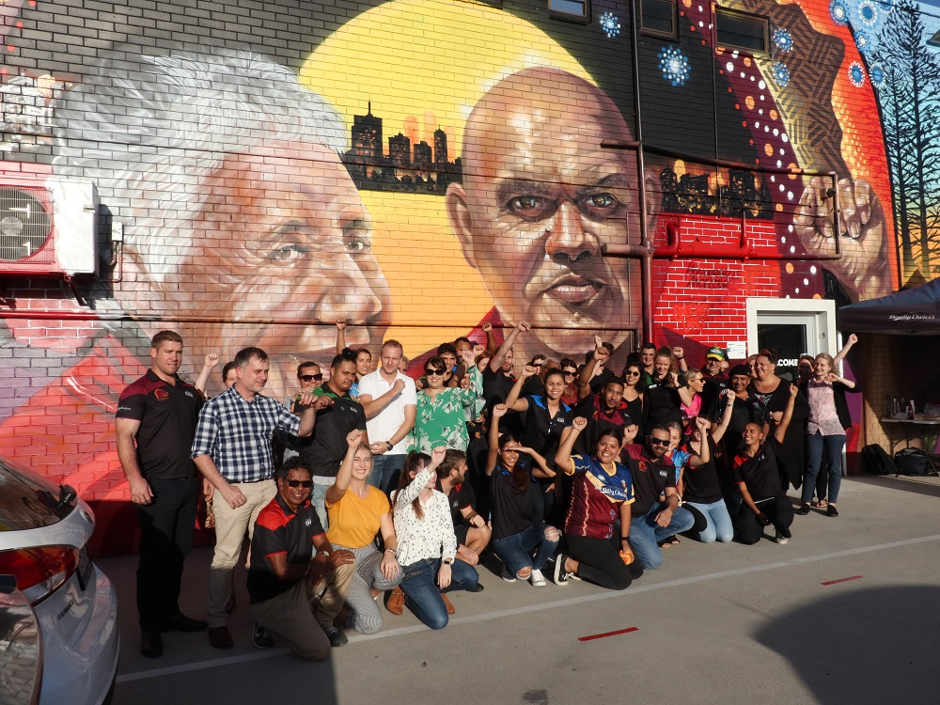
IUIH VISION
s
Healthy, strong and vibrant Aboriginal and Torres Strait Islander children, families and communities

Slide 5
Service Overview
IUIH Legal Service was established in June 2017 as a health-justice partnership, which is an initiative of the Institute for Urban Indigenous Health (IUIH).
IUIH is a not-for-profit that delivers community- controlled health services in South East Queensland and health promotion programs nationally through Deadly Choices.
IUIH Legal Service is embedded within IUIH’s “System of Care”.

Slide 6
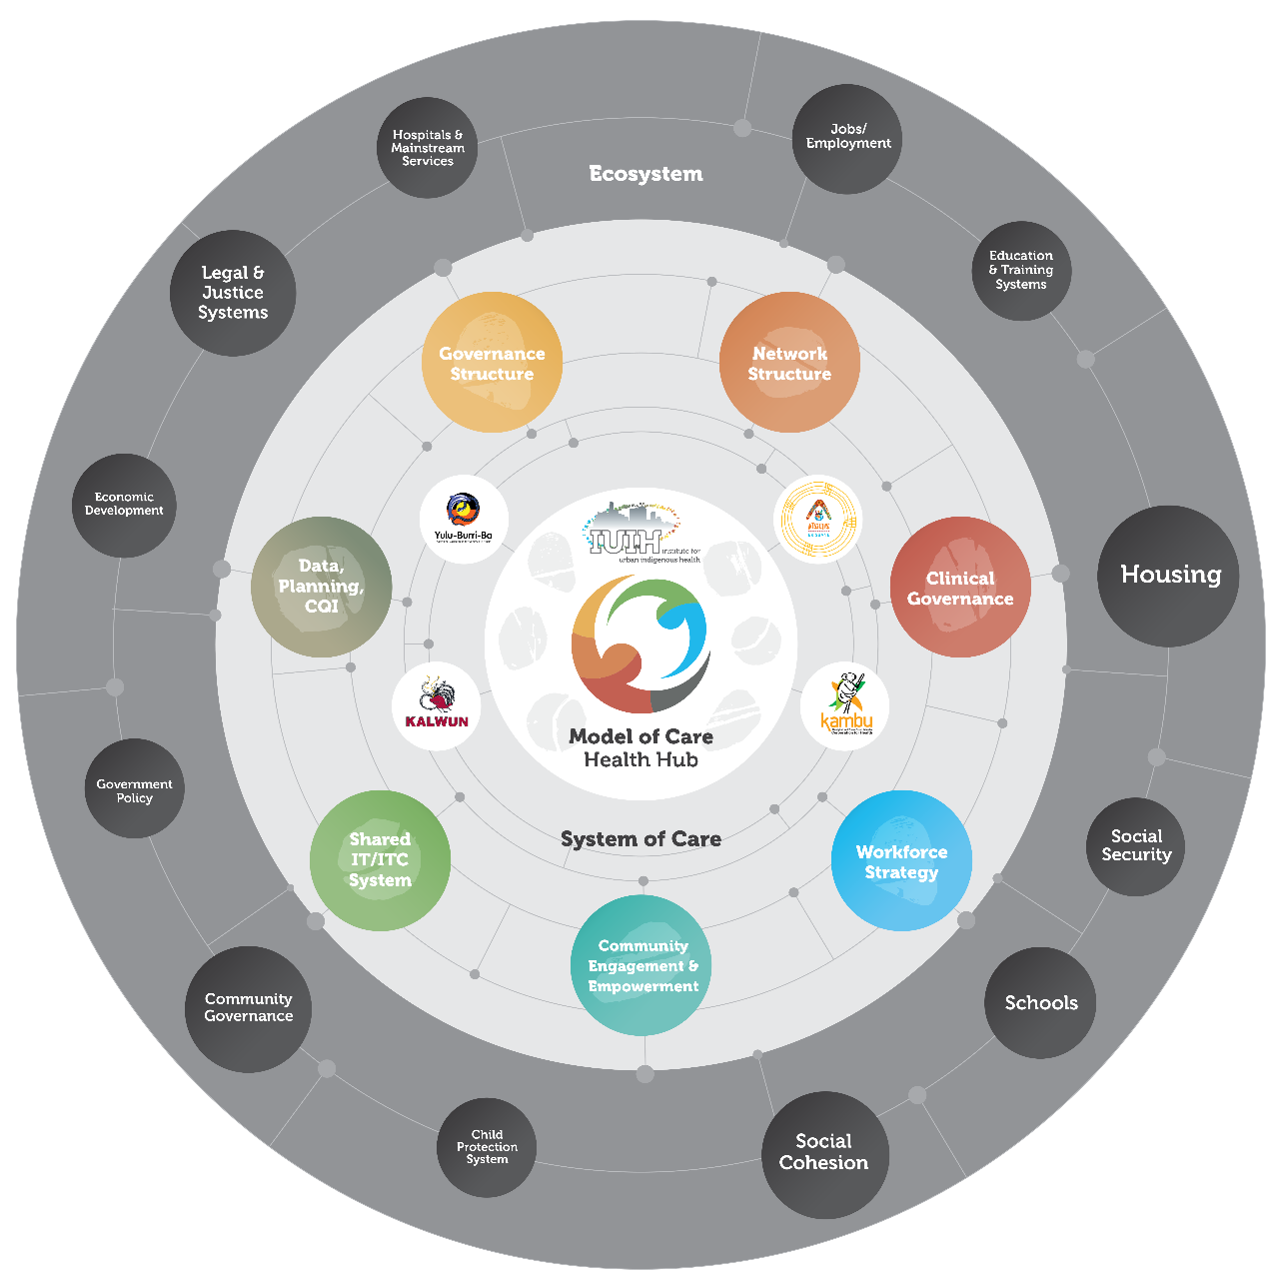

Slide 7
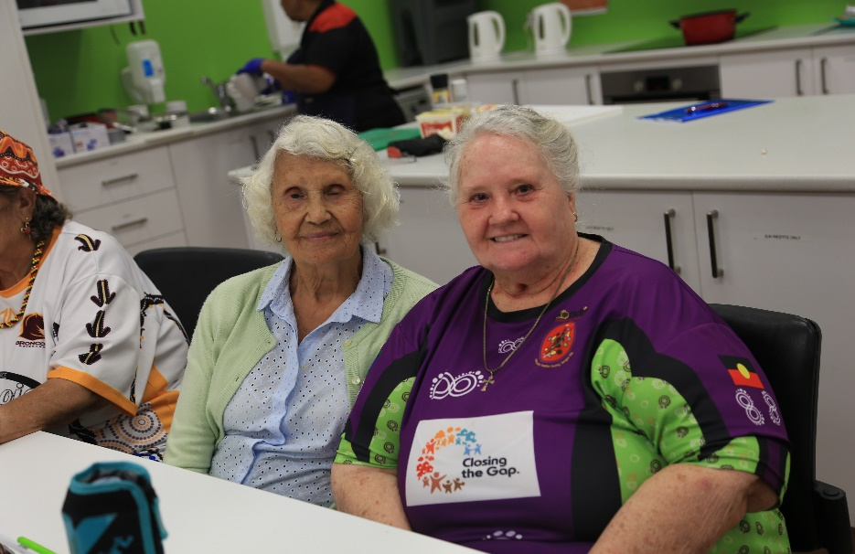
How we identify Elder Abuse
IUIH’s broader “system of care” enables Aged Care workers, GPs and other allied health workers to refer vulnerable patients/clients for a legal “yarn” (talk).
Legal education to empower Aboriginal and Torres Strait Islanders with knowledge of their legal rights and responsibilities.
Ongoing presence of the legal team within the IUIH respite services and aged care teams (e.g., we deliver training to aged care workers).

Slide 8
How our service approaches Elder Abuse.
1. Autonomy of client
2. Safety
3.Interconnectedness

Slide 9
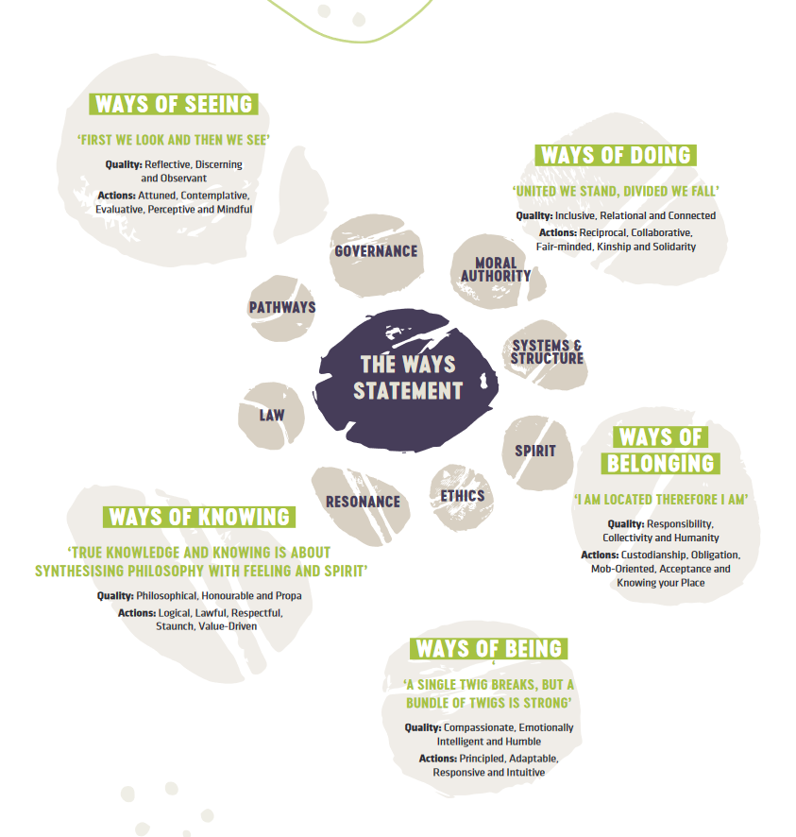

Slide 10
Cultural Considerations.
Respect of cultures- understanding that “shame” and “honour” is an important aspect of cultures which outweigh the presumption and notion of “guilt” and “innocence”

Slide 11
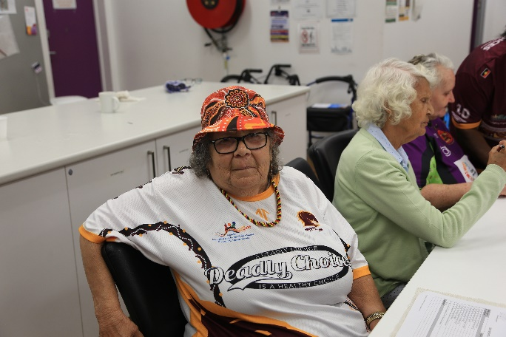
Insights from our learnings
An Elder/older person’s AUTONOMY is paramount.
Hint: Elders have encountered circumstances in their lifetime where institutions and other people have been telling them what to do and how to live. Reminding an Elder of their autonomy is not only a good legal reminder, but also honours and respects that Elder’s right to make decisions for themselves. An older person will most likely feel safer when they know a practitioner respects and honours their autonomy.
Legal avenues must be balanced with the safety/wellbeing of the client.
Hint: While applying for a protection order may be available to an older person, the timing in which this is done, if it is needed, must be balanced with the practical implications in terms of their safety, particularly if they live with the perpetrator.

Slide 12
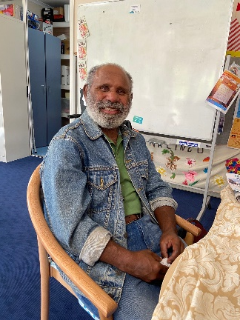
Insights from our learnings
Be culturally aware and sensitive to family and community dynamics within Aboriginal and Torres Strait Islander communities.
Hint: Aboriginal and Torres Strait Islander communities place high regard to shame/honour, therefore, some subjects may be difficult to discuss or even taboo for an older person to talk about particularly where there is shame involved. Pause, reflect and don’t make assumptions.
Be aware of language disparity so there is clarity for the older person to make decisions.
Hint: On occasions, we respectfully ask a client to tell us in their own words what they think they need to do next after we have given them the advice. This helps identify if there has been any gaps in understanding of legal rights and responsibilities. It also gives the practitioner a chance to provide positive feedback to the Elder/older person to empower them to make their own decisions as to what they choose to do next.

