Slide 1
Transurban: Family Violence Guidelines (Customers)
Improving the way we protect and support customers impacted by family violence
CLCQ2020

Slide 2
About Transurban: operator of Linkt
Our purpose: ‘To strengthen communities through transport’
We’re an Australian-owned, ASX-listed company which builds and operates toll roads.
We operate under the Linkt retail brand in Australia
Our toll roads are in Melbourne, Sydney, and Brisbane, as well as in Greater Washington, United States and Montreal, Canada.
QLD: All toll roads.
Not the case in NSW and VIC.
We operate 18 roads with 4 major projects underway.
Approx 5 million customers nationally
8.6 million customers globally

Slide 3
Linkt Queensland
Brisbane toll road network

Slide 4
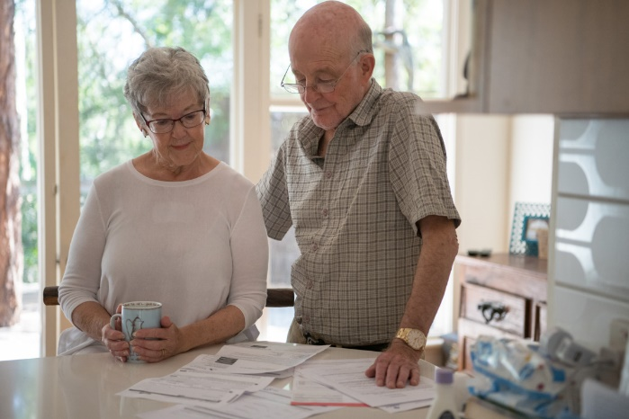
Linkt Assist
Launched February 2019
Dedicated community sector line:
1300 110 129
Customers:
1300 767 865
Email:
linktassist@transurban.com
Web:
www.linkt.com.au/assist
Notes:
BY now, you are hopefully aware Transurban’s inaugural team for supporting customers experiencing financial hardship - Linkt Assist - was launched on 12th of February 2019 with two dedicated phone lines, customers (1300 767 865) and the community sector (1300 110 129).
Can also get in touch with us via email or web – although we do advise that a phone call is usually the quickest and most effective way

Slide 5
Family Violence Guidelines:
What and Why?
To co-design leading practice family violence
guidelines for customers which ensure:
We are applying leading practice in the way we support, respond and protect customers impacted by family violence
We will move to prevent the weaponizing* of products and services, with a number of potential risks identified
*weaponising’ products or services means that a person using violence uses the product/service to facilitate their abuse, eg to access private information or incur debt in the victim survivor’s name.
Notes:
Why co-design? For enhanced…
Legitimacy and buy-in
Integrated solutions
Long term Sustainability
Appropriateness
Likelihood of implementation
Increased social capital…

Slide 6
The process
What we did
Internal Alignment
What does leading practice look like?
Understanding front-line & lived-experience
Co-design guidelines
Establish governance & measurement
Notes:
1. Transurban: (Internal Alignment) (Jane to take)
Customer & Communities Advocate
Linkt Assist
Customer Care
Customer Resolutions
Revenue Services
P&C
2. External organisations (Understanding leading practice) (Jane to take)
Commonwealth Bank
NAB*
Yarra Valley Water
Essential Services Commission
TCP
3. Lived experience & advocates (Understanding reality) Kate to take
Two victim survivors
QLD Legal Aid
WEstjustice (Victoria)
Moneycare, The Salvation Army (NSW)
4. Co-design Process (Cass to take)
*Economic Abuse Reference Group (EARG) provided final input for consideration. Members include:
VICTORIAN ORGANISATIONS
Consumer Action Law Centre
Domestic Violence Victoria
Financial and Consumer Rights Council
Good Shepherd Youth and Family Services Australia & New Zealand
Justice Connect
Uniting Kildonan
WestJustice
Womens Information & Referral Exchange (WIRE)
Womens Legal Service Victoria
NATIONAL AND NON-VICTORIAN ORGANISATIONS
Care Financial Counselling Service & Consumer Law Centre (ACT)
Financial Counselling Australia
Financial Rights Legal Centre (NSW)
Jane’s notes:
CBA - don’t try and get it perfect before you implement your approach, understand that something is a start that you can build off’
Journy began in 2015 with a commitment to a holistic strategic approach perspective – CBA wanted to be part of a movement and ‘play it’s part’, while also encouraging other partners and businesses to do better
5 pillars to strategy:
1. Providing a safe place to work – strengthened all internal policies. important to get it right for employees – 45k employees.
Talked to HR who helped to develop a range of training programs.
2. Supporting customers in crisis – strengthening policies and procedures to ensure we supported - across our 5 million customers – we had 40 disclosures, but in first week of opening up a hotline 6000 calls
3. Championing gender equality
4. Financial independence – back to our roots – long term approach to school banking. Education, school banking, smart start.
Financial literacy.
5. Advocating for change – talking to MP’s, decision makers etc
ESC - Key Message: Even if a response is great – it needs to be easy to find in order to reach people – don’t hide it on your website.
YVW _ it’s a journey and never time to stop - ever evolving, keep up to date with what the trends are and update accordingly

Slide 7
The outcome
Six principles and corresponding action statements
We will:
Design the experience around what works for the victim survivor
Prioritise safety, privacy and protection of victim survivors
Design simple, respectful communications
Not be bystanders
Develop purposeful partnerships to share, learn, improve and grow
Commit to continually building and improving our guidelines
Notes:
Cass to take first two principles.
Kate to take 3 & 4
Jane to take final two:
Develop purposeful partnerships to share, learn, improve and grow
Continuing to be active participants in a broad range of cross sector and cross industry communities of practice
Explore ongoing and effective partnership opportunities with national and local domestic and family violence support agencies
Working with people impacted by domestic and family violence and their advocates to build ongoing awareness, understanding and a continuous improvement environment within Transurban
Offering pathways to those using family violence to seek help and support to stop their use of violence and change their behaviour
Commit to continually building and improving our guidelines
Committing to ongoing training throughout the organisation
Completing regular reviews of the Guidelines, reflecting on outcomes and identifying opportunities for improvement or amendments
Producing an action and change management plan that will enable Transurban to implement ongoing improvements
Regularly engaging with customers and other stakeholders to share learnings, and get feedback on their experience and the effectiveness of the guidelines
Staying across emerging themes and leading practice to ensure the Guideline remains relevant and effective

Slide 8
Linkt Assist
Launched February 2019
Dedicated community sector line:
1300 110 129
Customers:
1300 767 865
Email:
linktassist@transurban.com
Web:
www.linkt.com.au/assist
Notes:
BY now, you are hopefully aware Transurban’s inaugural team for supporting customers experiencing financial hardship - Linkt Assist - was launched on 12th of February 2019 with two dedicated phone lines, customers (1300 767 865) and the community sector (1300 110 129).
Can also get in touch with us via email or web – although we do advise that a phone call is usually the quickest and most effective way

