Slide 1
Child Protection: Learnings from working with First Nations families
IUIH Legal Service

Slide 2
Acknowledgment: We honour the many Goori Tribal Nations whose territories we work across within South-East Queensland, and the Jagera and Turrbal people upon the land in which we present today. We honour the legacy and the vision of those who paved the way and those who continue to guide us. We honour our future generations by maintaining the vision with focused determination.

Slide 3
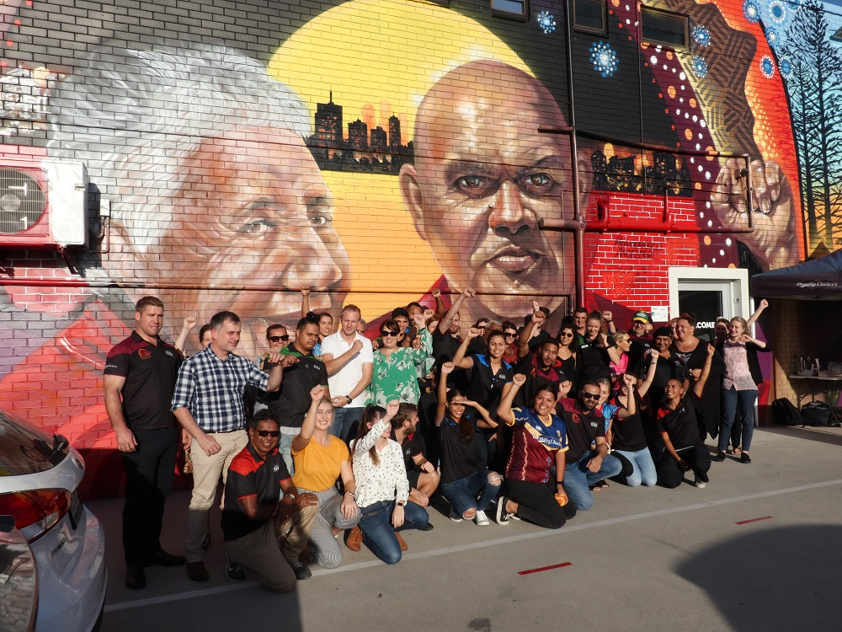
IUIH VISION
s
Healthy, strong and vibrant Aboriginal and Torres Strait Islander children, families and communities

Slide 4
Services offered
Accredited pro bono legal service within IUIH’s system of care.
Assist clients with legal education, advice, advocacy in a variety of matters that include Family Law, DV, minor civil matters, education, tenancy, Child Safety, and Elder Abuse.
Access to service is via referral from our doctors, allied health workers and social/support workers (e.g., Family Wellbeing Service).
Client consults offered within our culturally-safe spaces.
We have adapted to changing needs as a result of COVID-19 restrictions and have provided telephone consults, particularly during lock downs or if a client has specific health concerns e.g., terminal clients

Slide 5
Statistics from our practice

Slide 6
Client demographics
552 clients referred
49.8% of clients referred live in the Moreton Region (others were from Brisbane City Council, Ipswich City Council regions and occasionally from other regions)
80.6% are female (of those who identified a gender)

Slide 7
Client demographic

Slide 8
Learnings from our practice
Systemic issues
Risk factors that can trigger interventions
Approaches to legal practice

Slide 9
Questions?

Slide 10
Our contact info
1300 017 172
legal@iuih.org.au

