Slide 1


‘The Value of Trust’
Advocacy implications from the report into the Public Trustee’s fees, charges and practices
6 May 2021

Slide 2
Acknowledgement of country
Community Legal Centres Queensland acknowledges the traditional owners of the land on which we are holding this presentation, the Turrbul and Jaggara people.
We pay our respects to their elders, past, present and emerging, and acknowledge the important role Aboriginal and Torres Strait Islanders continue to play in our society.
As this presentation is being viewed throughout Queensland, we also pay respect to the traditional owners of the land throughout the country and extend a warm welcome to any First Australians listening to this presentation.

Slide 3
GoToWebinar housekeeping
Facilitator:
  Sam Cooper, Sector Sustainability Coordinator, Community Legal Centres Queensland
Recording:
  This webinar is being recorded and will be available on the Staff Training page of our website: https://communitylegalqld.org.au/clc-staff/staff-training-and-cle
PowerPoint / webinar materials:
  Emailed prior to today’s session
  Available to download from Handouts section of GTW control panel
Questions:
  Type your questions/comments into question box on GTW control panel OR
  Raise your hand and we will unmute your microphone
  Questions will be addressed at the end
Technical help:
  Email sam@communitylegalqld.org.au or use question box in GTW
Notes:
Presenter will be introduced shortly

Slide 4
Legal disclaimer
This presentation is for professional development and education purposes only. The information provided in this presentation is not legal advice and is designed for lawyers and other staff working and volunteering in a community legal centre setting in Queensland.
This presentation and webinar is not to be published or reproduced for commercial purposes without the express permission of the authors.
Information is current as at 6 May 2021. Neither the presenters nor Community Legal Centres Queensland accept any liability for the accuracy of the information in the presentation.

Slide 5
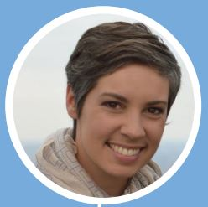
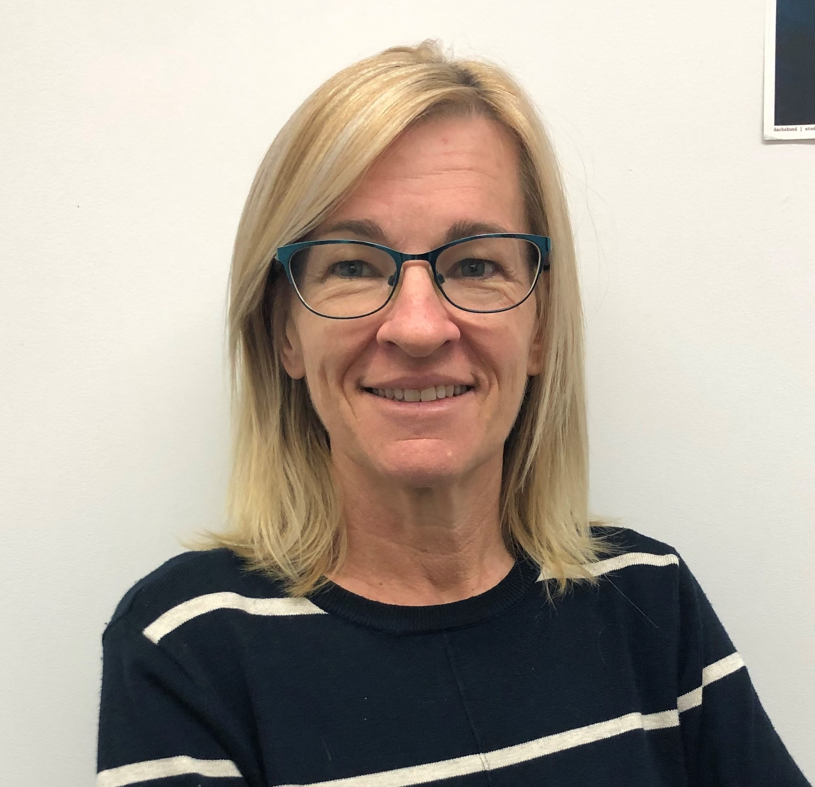
Who we are
Jo
Current: Senior Lawyer, LawRight-Mater Health Justice Partnership
Previous: Senior Lawyer and Research Officer @ Public Advocate
Interests: mental health law, forensic disability, health justice partnerships
Bec
Current: Solicitor, ADA Law
Previous: Human Rights Advocate, ADA Australia
Interests: guardianship & administration, elder and health law, impaired capacity

Slide 6
Aim of this webinar
We will aim to
help CLC and community workers to identify issues that clients under the Public Trustee’s financial administration may present with in order to better triage, respond and refer
We will not focus on
systemic issues
policies and procedures
political and cultural drivers
that have contributed to the problems identified in OPA’s report
or
the Public Trustee’s response or reform agenda – Appendix 1 of Final Report (from page 229)

Slide 7
What this webinar covers
Part 1:
About the Public Advocate’s report
About the PT and administration appointments
Cohort of clients vulnerable to fees
Other concerning practices
Part 2:
How to review the appointment of the PT
How to negotiate a better outcome from PT
What further changes would we like to see?

Slide 8

Public Advocate’s Report
Review: mid-2018 – January 2021
“The review revealed a range of Public Trustee fees, policies and practices that suggest that the Public Trustee is breaching some of its legal and fiduciary duties and may fall short of community expectations of a public trustee agency.”
Tabled in Parliament 10 March 2021
Majority of 32 recommendations accepted in principle
Full Report
Executive Summary
Video

Slide 9
How the Public Trustee can be appointed
Under EPOA or decision of QCAT
QCAT’s guardianship & administration jurisdiction
Finding that an adult lacks capacity to make decisions for financial matters
Need for an administrator
Broad powers
Term of order – generally unlimited
Review hearing

Slide 10

About the Public Trustee
Established in 1916 as the Public Curator
Service statistics - in 2019-20, the PT
  Provided administration services to 10,000 clients
  Made 24,500 wills
  Managed 2,000 new deceased estates
  Managed 4,400 trusts
The vast majority of PT clients pay low or no fees for the services that the PT provides, and appear to receive a reasonable level of service.
PT is - and will remain - an important service for clients whose capacity to manage their financial affairs is limited, and who do not have appropriate family/supports who are in a position to assume the responsibilities of an administrator for their loved ones.
www.pt.qld.gov.au

Slide 11
PT’s fees and practices: key concerns
Cohort of clients with modest assets disproportionately affected by system of fees and charges
  Cash assets may be eroded within 7 years
Broader range of clients may be affected by problematic practices:
  Failure to consult and involve adult in decision-making
  Failure to give consideration to adult’s individual circumstances
  Failure to apply rebates
  Lack of automation of simple administrative processes
  Transferring clients to PT-preferred superannuation providers and investment products
  PT retaining interest earned on investments
  Obtaining unnecessary financial advice services
  Legal services provided by Official Solicitor

Slide 12
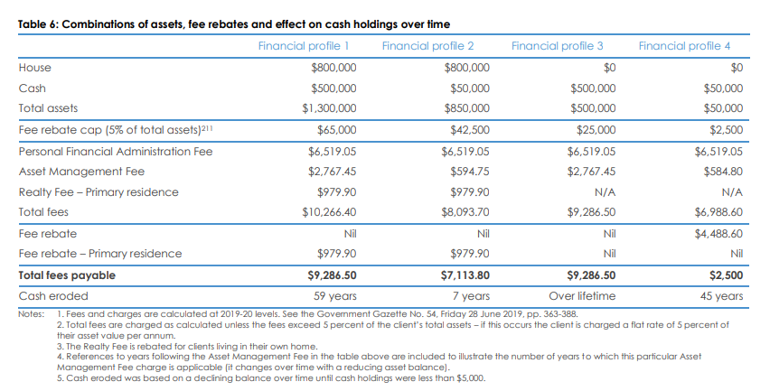
Disproportionate impact of fees

Slide 13
Standard fees and charges
Personal Financial Administration Fee
Asset Management Fee
Realty Fee

Slide 14
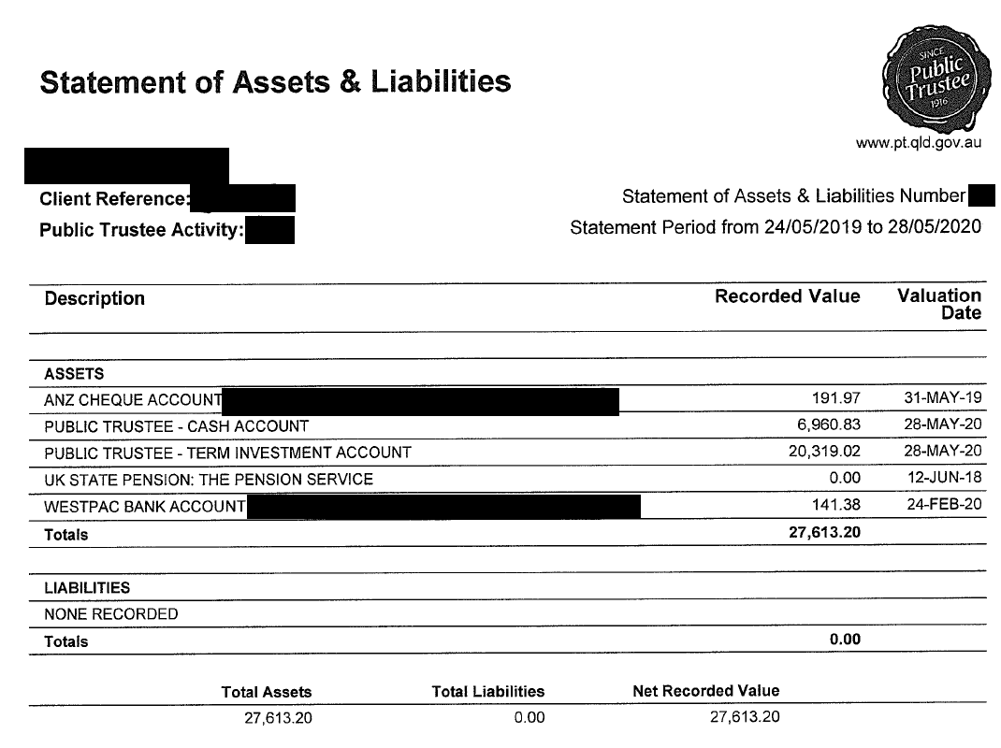
Example Documents

Slide 15
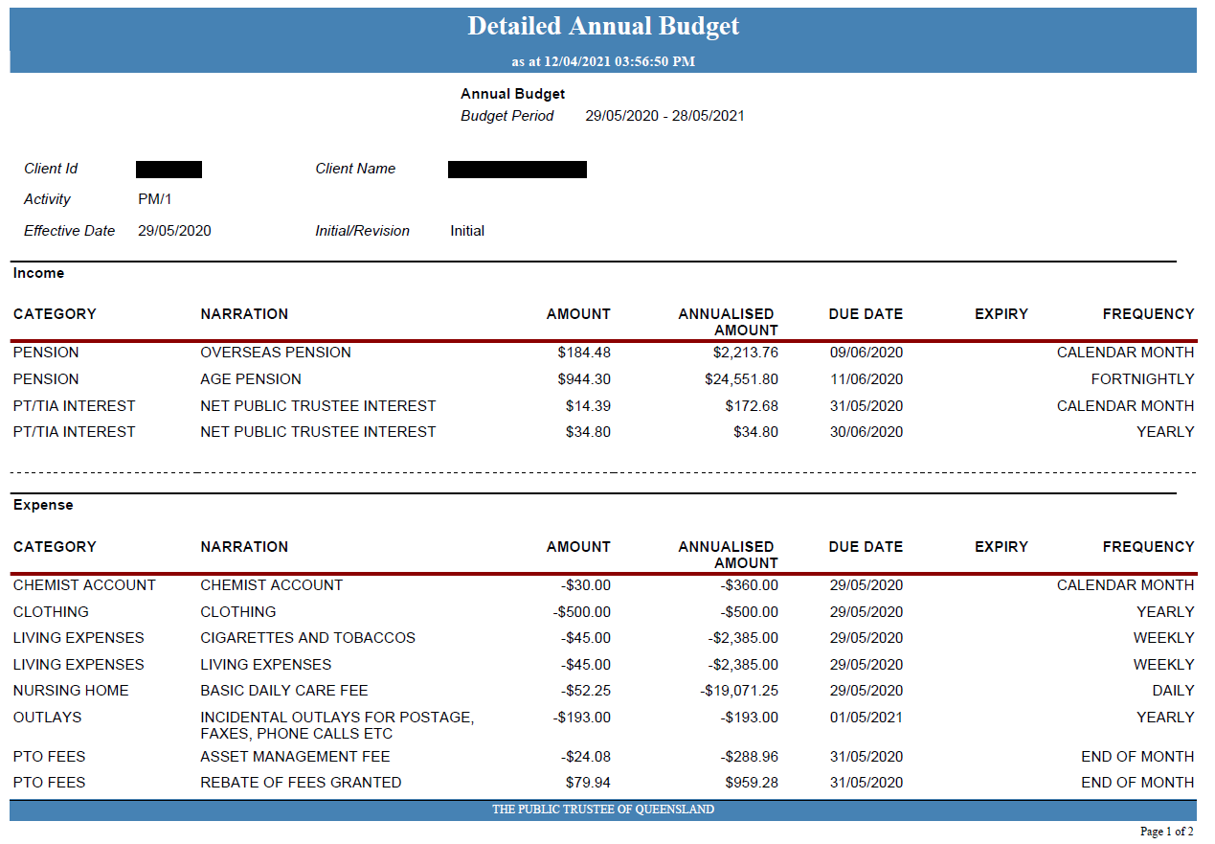
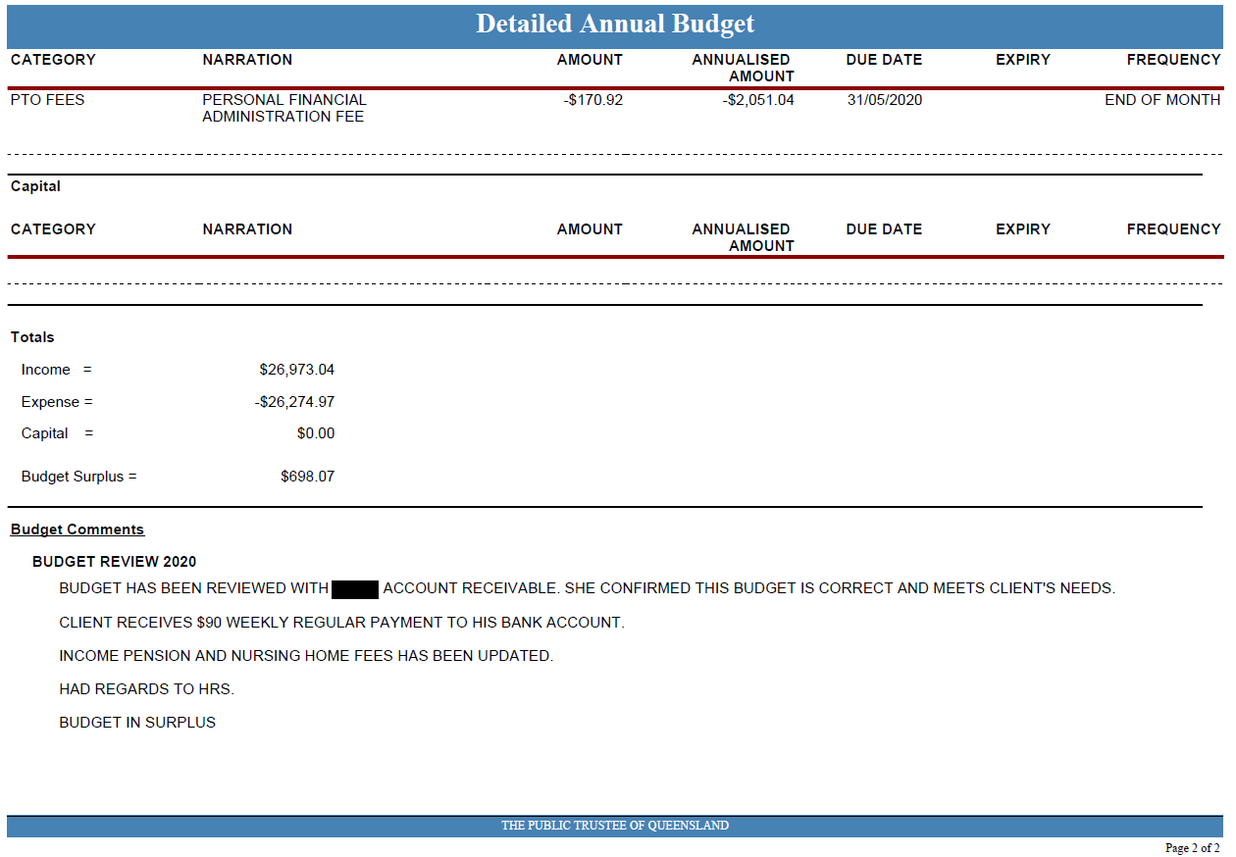

Slide 16
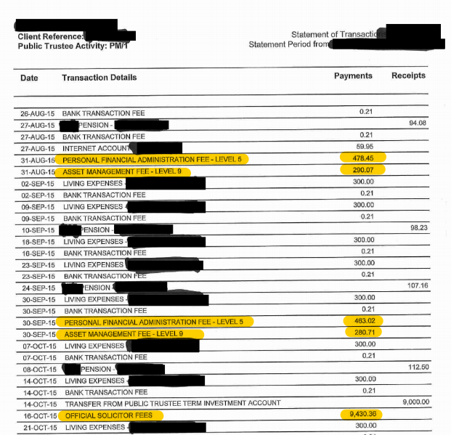

Slide 17
Additional fees, outlays & withheld income
Additional services fees
Fees on investment funds
Interest differential
No GST exemption
Outlays
Financial advice
Official Solicitor fees

Slide 18
Fee rebates
Also known as ‘Community Service Obligations’
Value of person’s home (PPR) is included when calculating eligibility to receive rebates (cf Centrelink)
Level of assets that triggers eligibility set very low ($5,000 cash)
Dipping into superannuation to pay PT fees
Not automatic – PT office must apply for hardship rebate for client

Slide 19
Other concerning practices
Failure to consult and involve adult in decision-making
Failure to give consideration to adult’s individual circumstances
Failure to apply rebates
Lack of automation of simple administration processes
Transferring clients to PT-preferred superannuation providers and investment products
PT retaining interest earned on investments
Obtaining unnecessary financial advice services
Legal services provided by Official Solicitor

Slide 20

Case Study: Bryan
Discharged home following period of hospitalization
Disability service provider applied to QCAT
Bryan became aware of the hearing < 1 week prior
Requested adjournment of hearing – refused
QCAT made interim order appointing PT and OPG
Bryan applied for re-opening of hearing to obtain and submit medical evidence about his capacity
PT provided written submissions raising technical points against Bryan’s application
QCAT made decision on the papers rejecting application
At 6 month review, Bryan obtained a declaration of capacity and the appointments were revoked
During the 6 month appointment, PT had charged $8,648 in fees, including $2,500 in Official Solicitor fees.
Following revocation Bryan discovered several bills were unpaid.
Bryan queried and requested review of fees – PT refused

Slide 21
Suggested service responses
Information access
File inspection
Authority to act
Complaints avenues
PT Internal complaints
Escalate to PT Customer Advocate
Queensland Ombudsman
Attorney-General
Legal Services Commission
Compensation avenues
Advice re: breaches of duties and entitlement to compensation
Applying for compensation - to PT directly or application to QCAT for compensation order (s 59 G&A Act)

Slide 22
How to review the appointment of PTQ: QCAT Process
Complete and submit:
    Form 10 Application for Review Link
    Health Professional Report (minimum 1) Link
        Consider relevant health professional, eg Neuropsychologist; Geriatrician; GP; Psychiatrist
    Form 11 Application for Declaration of Capacity (optional) Link
      Use if seeking return of decision-making recognition
After lodgement, QCAT hearing approx. 12-16 weeks later (up to 3 weeks notice usually given)
Always recommend the adult attends the hearing, ideally in person, with advocate / lawyer
        Referrals can be made to ADA Law / QAI / some CLCs for assistance with preparation of application, evidence gathering and attendance
Be mindful of potential additional PT fees and consider seeking disclosure from PT and/or directions from QCAT – see Chapter 7 OPA report

Slide 23
How to seek a better outcome from PTQ
New systemic responses:
  Customer First Agenda
  Introduction of PTQ Consumer Advocate role
    Developing and improving protocols for customer complaints
  In house training for staff - eg Supported Decision Making strategies
  Establishing Government and Customer reference groups to inform practice
  Budget Review meetings
  Preferred provider client preference:
    Eg Insurances, Financial Advisors, Superannuation

Slide 24
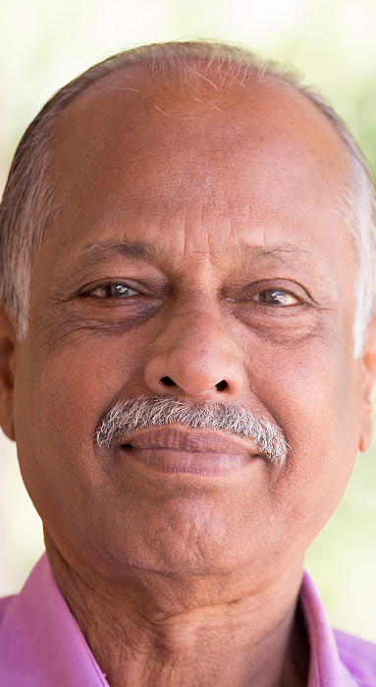
Case example:
Josef
  Older man, moved into aged care from his own home.

Slide 25
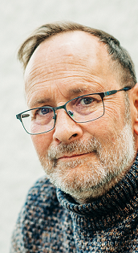
Case example: William
A middle aged man with a long mental health history.

Slide 26
Case example:
Aunty Doris
  Older woman, children fighting, resulted in QCAT application and appointments

Slide 27
What further changes would we like to see?
Increased use of supported decision making
Flexible ways to engage with the client
Ensure the client is directly engaged in budget setting
Automating bill paying processes
Reviews of fees and charges – fairer outcomes
Implementation of modern technologies

Slide 28
Key takeaways
  Public Advocate report makes 32 recommendations for change
  PTQ is seeking to implement a client focussed practice and culture with their new Customers First Agenda
  Adults (even with impaired decision making capacity) retain their human rights, which includes the right to be involved in decisions
  Clients can be assisted and encouraged to negotiate with the PTQ for more financial independence / engagement
  Clients can seek a review of the PTQ appointment but be mindful of additional fees
  Redress for potential breaches of fiduciary duties and past fees not yet tested but worthy of consideration for your clients

Slide 29
Public Trustee Contacts
General Enquiries
  1300 360 044
  clientenq@pt.qld.gov.au
Complaints
  1800 014 536
  complaints@pt.qld.gov.au
Customer Advocate
  Customer.advocate@pt.qld.gov.au

Slide 30
CLC contacts – advice and referrals
ADA Law
Individual advocacy for clients who have (or will potentially have) the PTQ/OPG or other decision makers appointed
Ph 1800 232 529
E intake@adalaw.com.au
www.adalaw.com.au
For further information visit:
www.mhlawqld.com.au
Queensland Advocacy Inc (QAI)
Human Rights Law Practice – incl guardianship & administration
Open to referrals for clients seeking advice or secondary consultations for CLC and community workers
Ph 3844 4200
E qai@qai.org.au
Lawright
Advice & casework for clients also accessing one of our community and health justice partnerships
QCAT Self-Representation Service
Pro Bono Connect program for complex/public interest matters
Service-specific contacts here:
www.lawright.org.au/about/contact-us/
E admin@lawright.org.au
Jo and Bec are happy to be contacted by CLC workers for secondary consultations or discuss practice experience – contact details next page

Slide 31

Contact Us:
Jo: 07 3518 8121 | Jo.Sampford@lawright.org.au
Bec: 1800 232 529 | Rebecca.Anderson@adalaw.com.au

