Slide 1
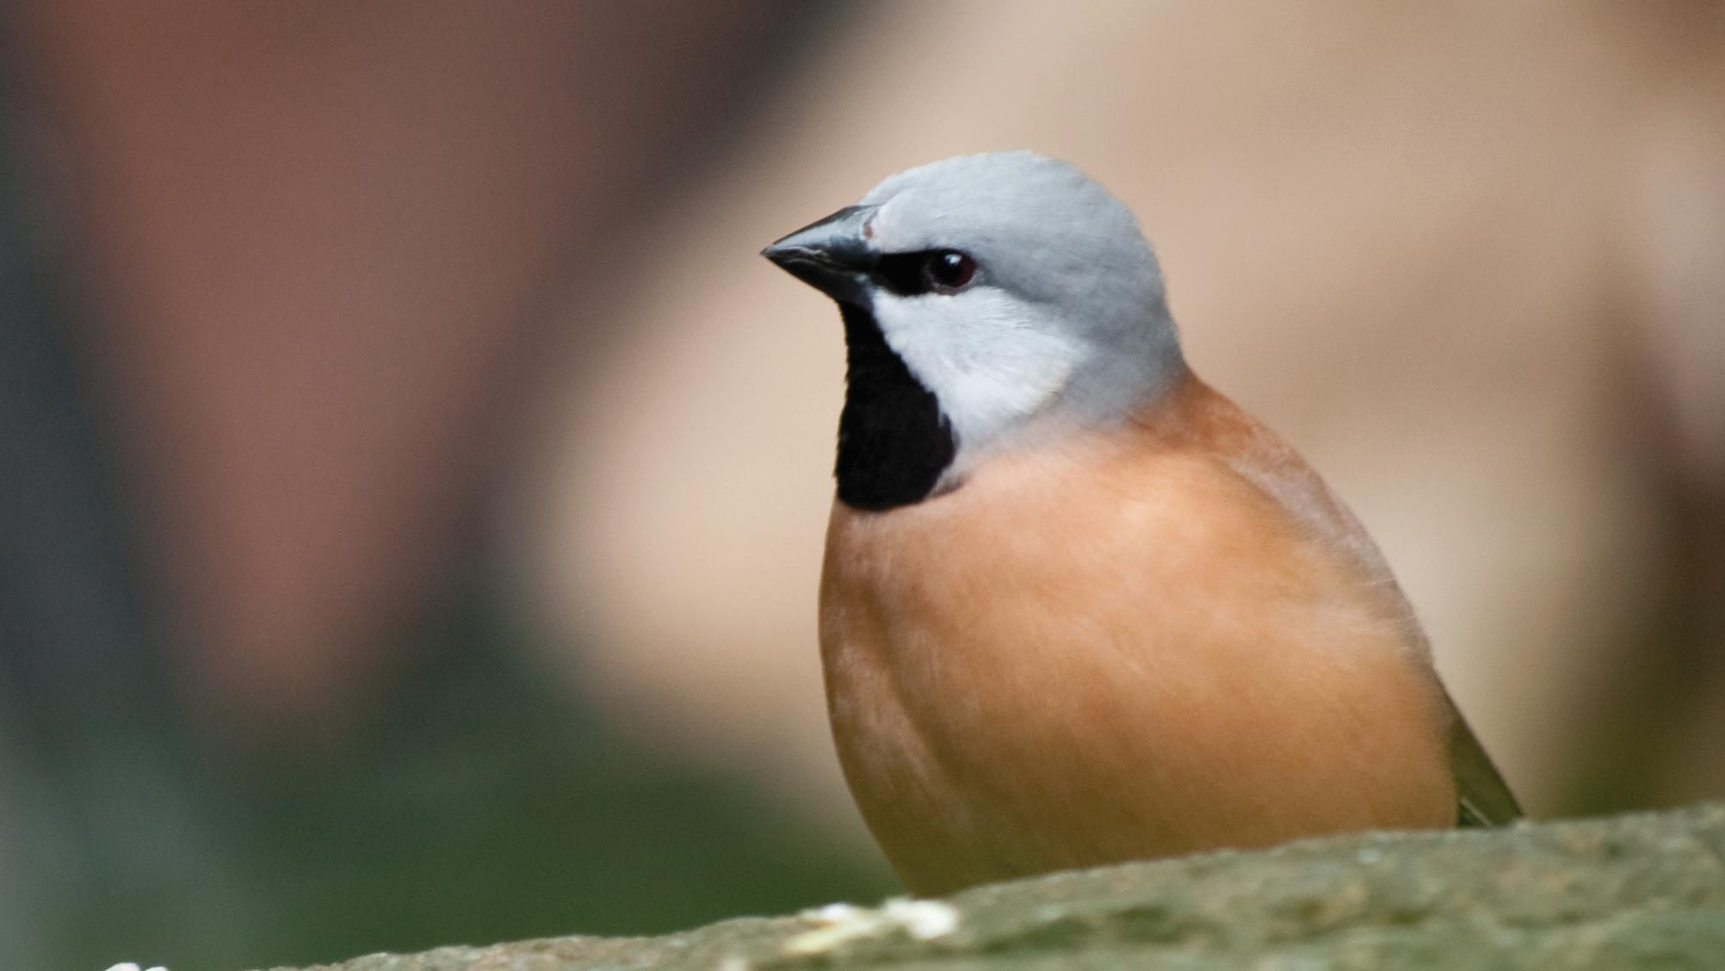
Advocacy at the EDO
Revel Pointon
Managing Lawyer – Southern and Central Qld

Slide 2
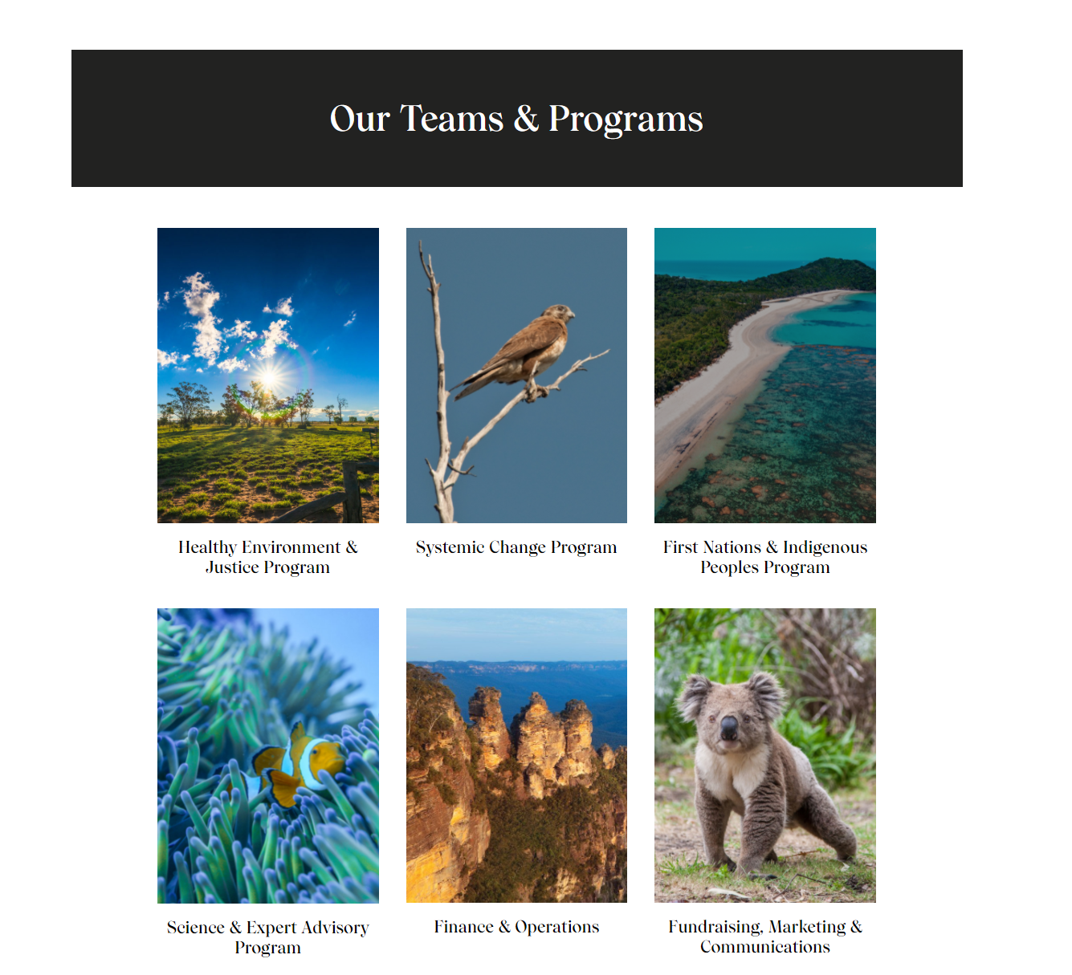
Who is the EDO?
Now a national community legal centre
Providing legal representation, litigation, advice, education and law reform services
New structure:

Slide 3
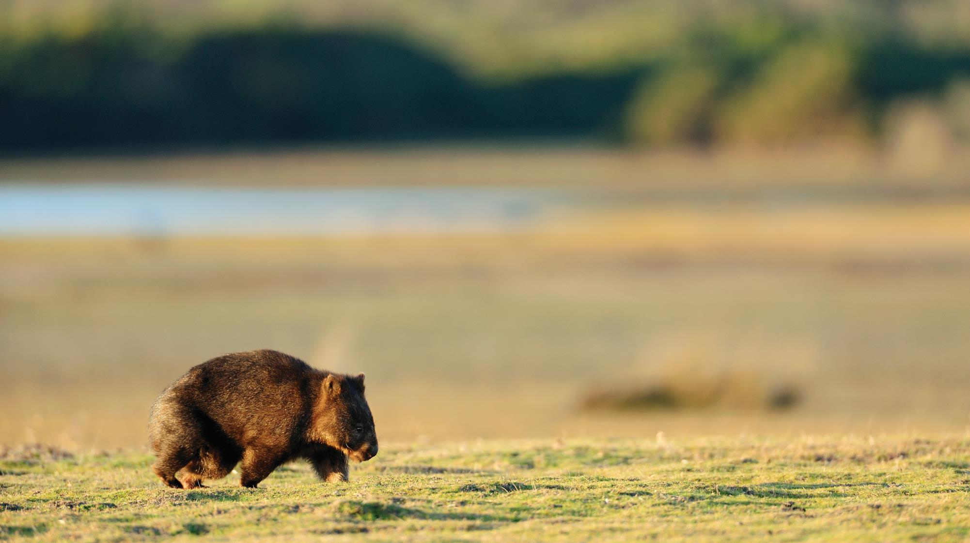
Who am I?
Managing lawyer – Southern and Central Qld HEJ team
Previously Law Reform solicitor
Prior to that:
Climate change litigation
Private practice
Sustainability education

Slide 4
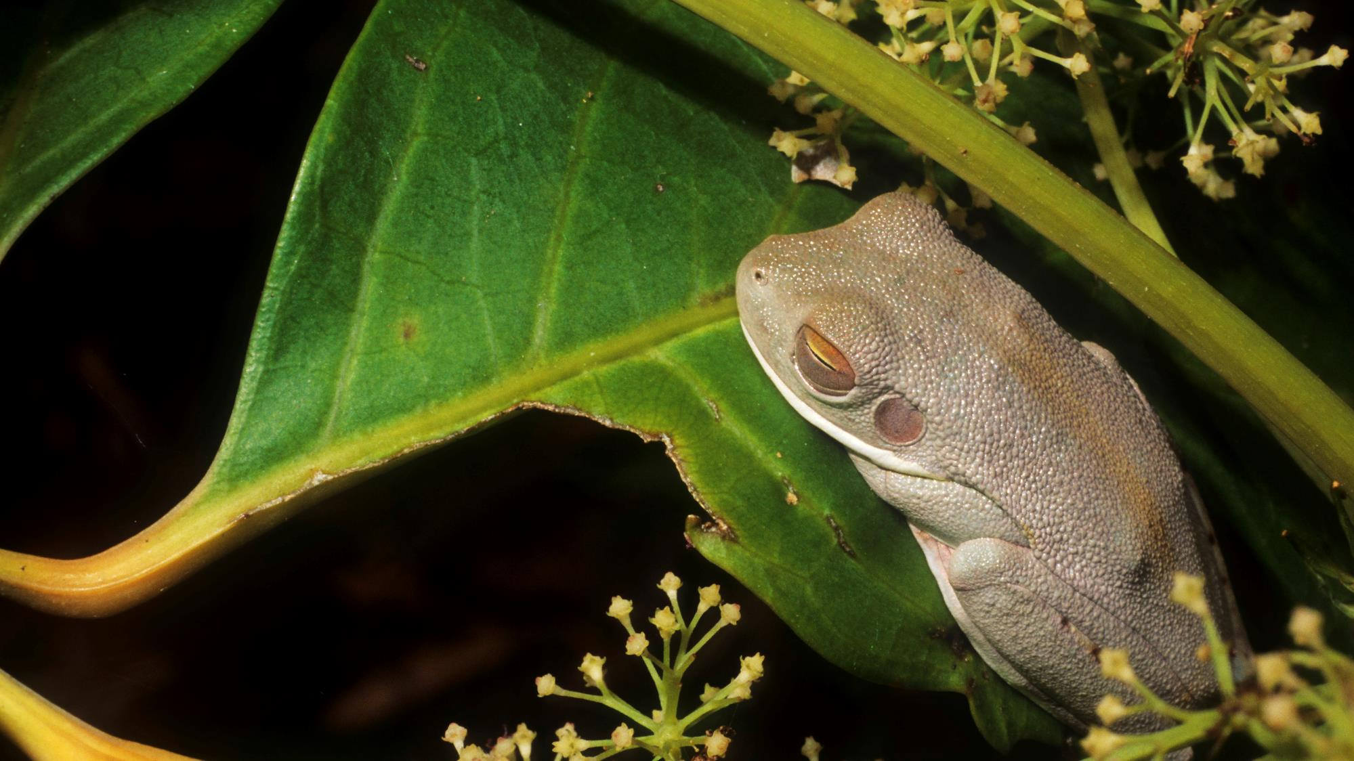

Advocacy at the EDO

Slide 5
How do we do advocacy at the EDO
Focus on ensuring our laws and policies provide for:
  Environmental protection/ sustainable development in the public interest; and
  Accountability in decision making.
Through:
  Legislative analysis
  Advocacy to government departments and Ministers
  Relationship building with other stakeholders, scientists and similar organisations – to build knowledge, power and mutual understanding of our positions

Slide 6
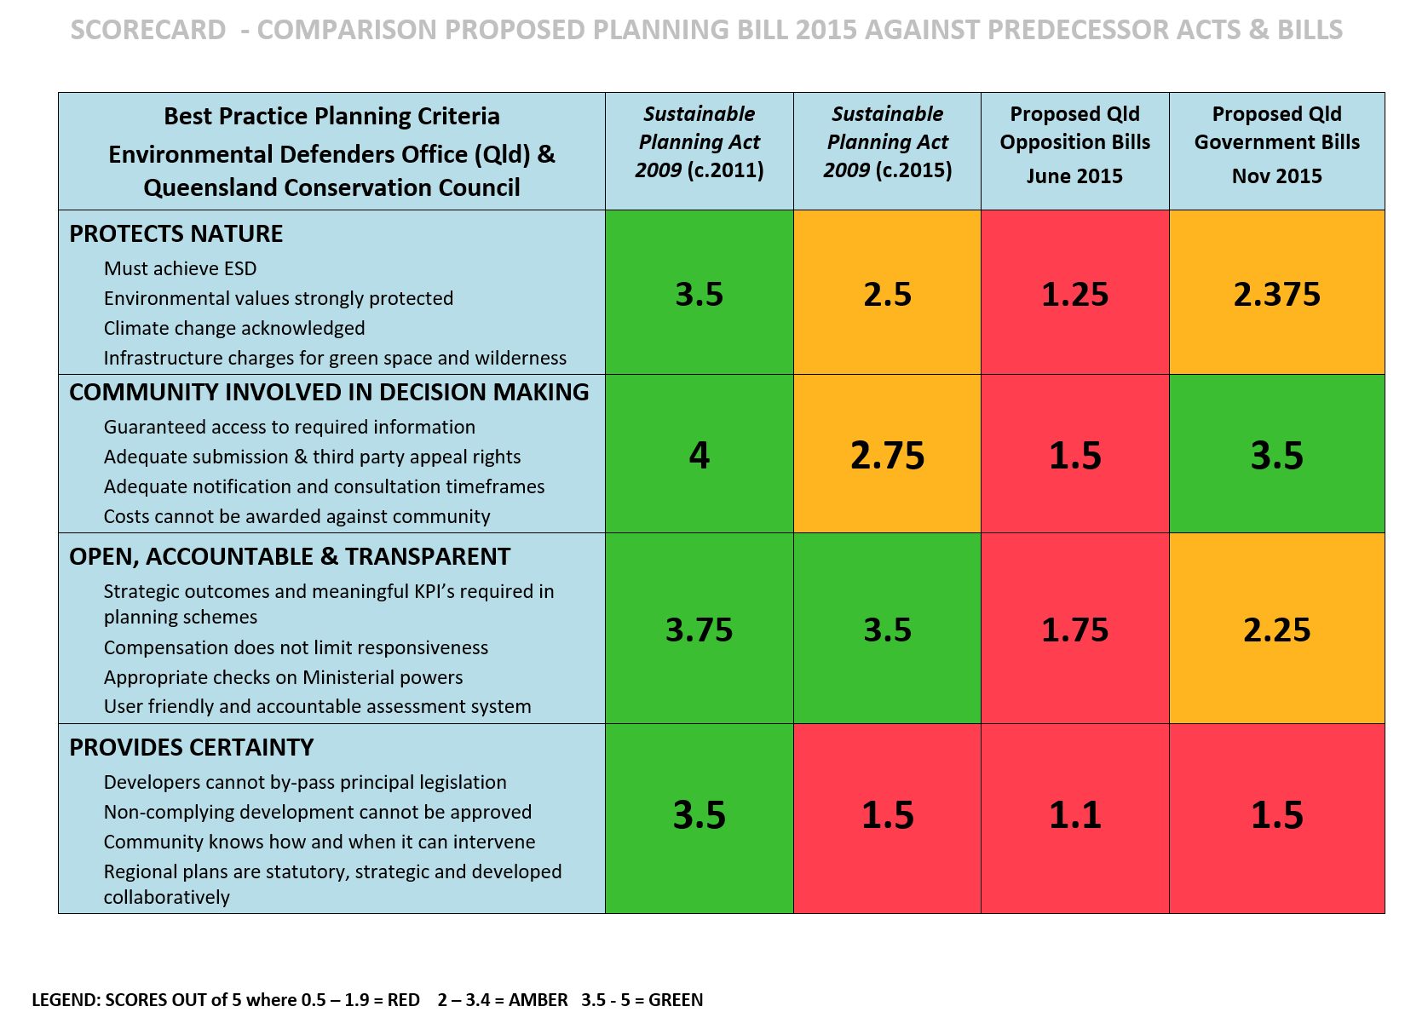
Planning law reform
2015
EDO and QCC

Slide 7
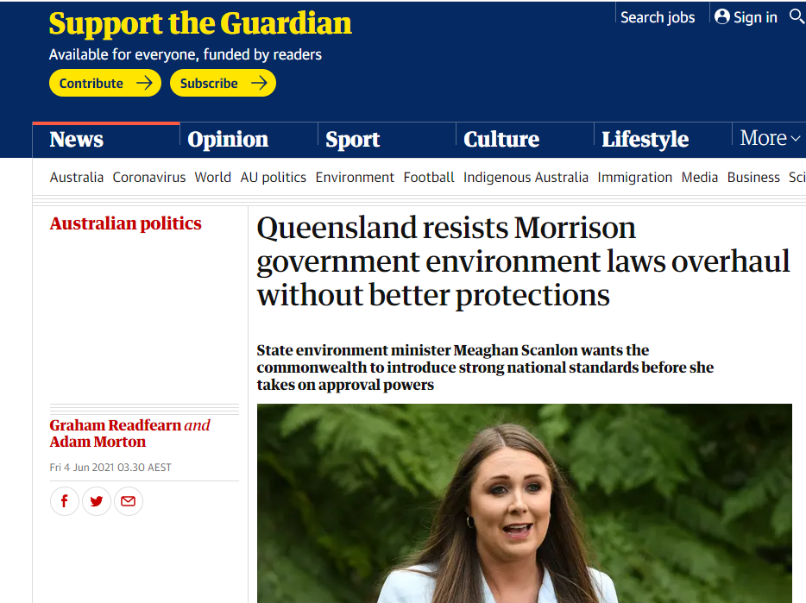
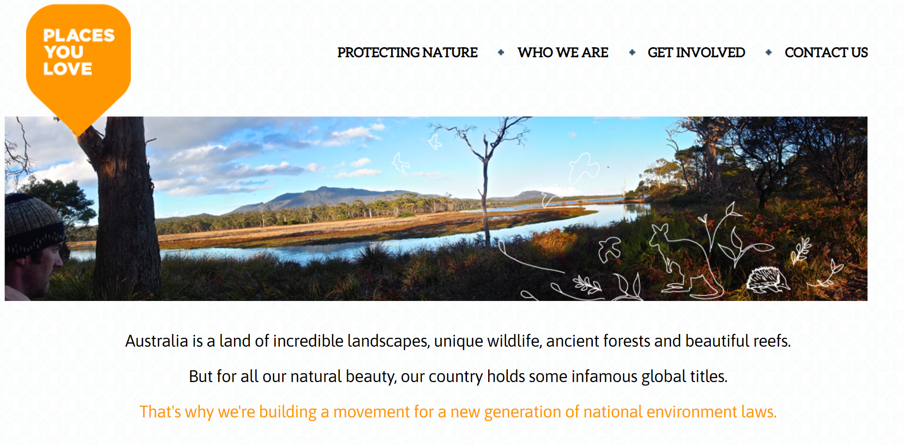
Devolution of EPBC Act approval powers to states and territories
Working with Places You Love, alliance of conservation groups at Federal level – key EDO solicitor Rachel Walmsley
Working with Business Council of Australia and other stakeholders to find areas of alignment
State EDO offices building relationships with and advocating to their governments on this issue, working with key likeminded groups in their areas, looking for interests of government that align with our interests

Slide 8

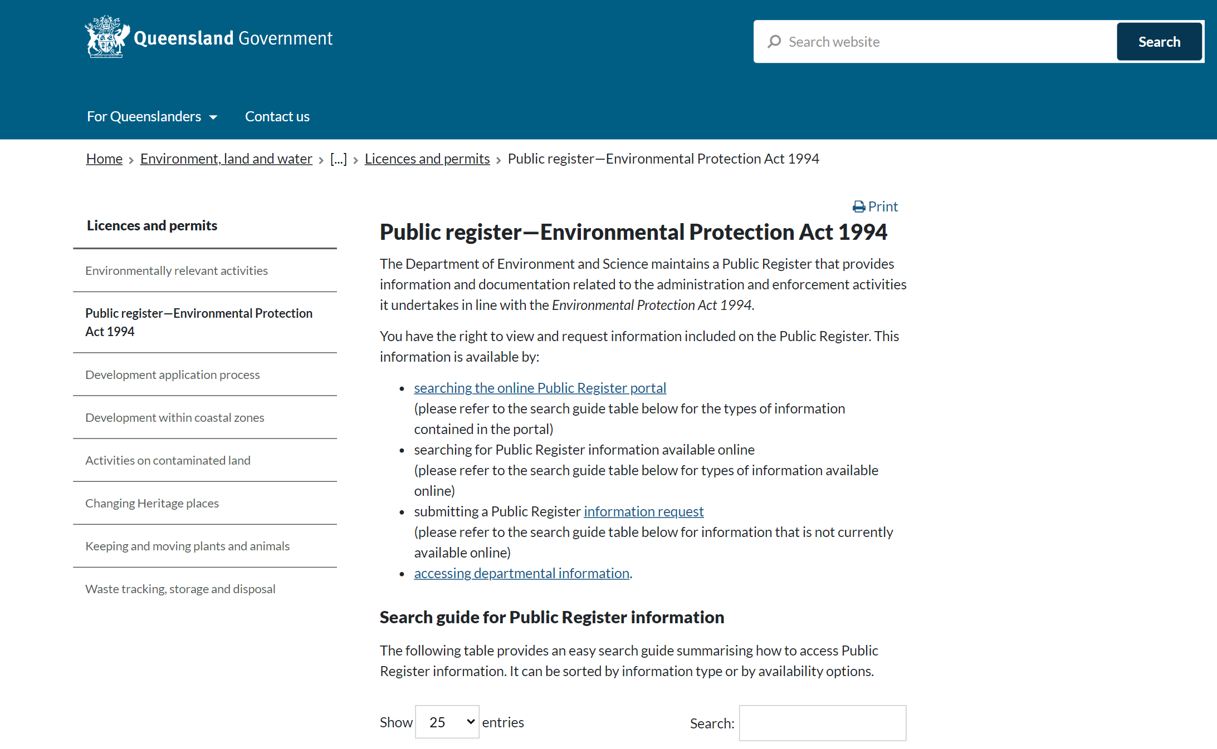
Public register – access to information

Slide 9
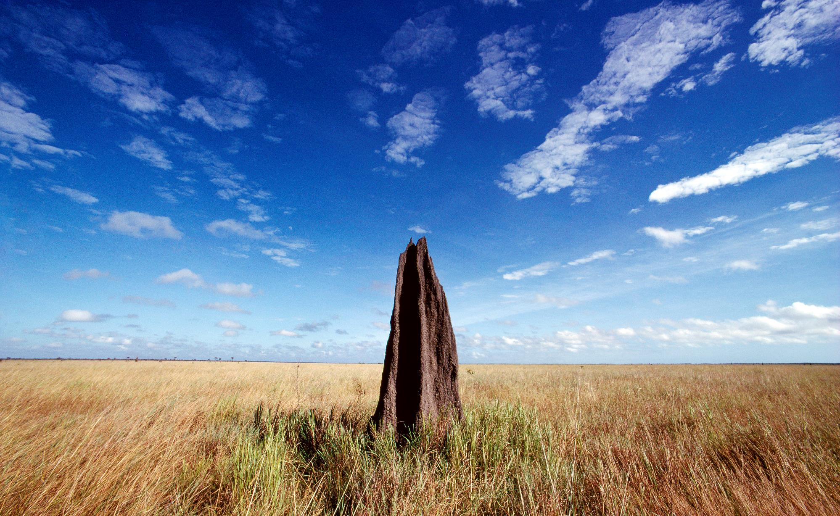
Key lessons:
Working with others is always more effective
Be open to working with unlikely allies where interests align
Simplify the message, and make it politically relevant
Never give up, dedication pays off

Slide 10

Thank you.

