Slide 1
Breaking Barriers to Videoconferencing by assessing client digital inclusion
Central Queensland Community Legal Centre
CQUniversity College of Law, Criminology and Justice
Central Queensland Indigenous Development

Slide 2
The problem
Users of Community Legal Services didn’t use videoconferencing services in 2012
Users of Community Legal Services don’t use videoconferencing services in 2021
Access to technology has transformed in that time, so why hasn’t take-up improved?

Slide 3
The process
Identify the possible reasons, other than access, for low take-up of videoconferencing in the legal assistance context
Improve client intake processes with a toolkit that supports videoconferencing

Slide 4
Project team
Judy Wright CQCLC Community legal services
Jason Field CQID Indigenous perspectives
Dr Luke Price CQUniversity Law and technology
Dr Jacob Deem CQUniversity Quantitative analysis

Slide 5
Rationale
For many RRR clients, in-person legal assistance is not an option
Legal assistance is available via telephone or videoconference
Videoconferencing offers key benefits over telephone meetings:
Better communication through body language
Trust building
Document sharing

Slide 6
Digital inclusion
Technology use is not just a matter of access
Being digitally included has three elements:
Access (Internet Access, Internet Technology, and Internet Data Allowance)
Affordability (Relative Expenditure and Value of Expenditure)
Digital Ability (Attitudes, Basic Skills and Activities)
(Australian Digital Inclusion Index, 2020)

Slide 7
Methodology
Australian Digital Inclusion Index (ADII) scores all 8 metrics of inclusion according to demographic profiles
CLASS data records clients’ demographic profiles
Overlaying ADII scores onto client demographic data produces digital inclusion scores for CLC users, tracking changes over time

Slide 8
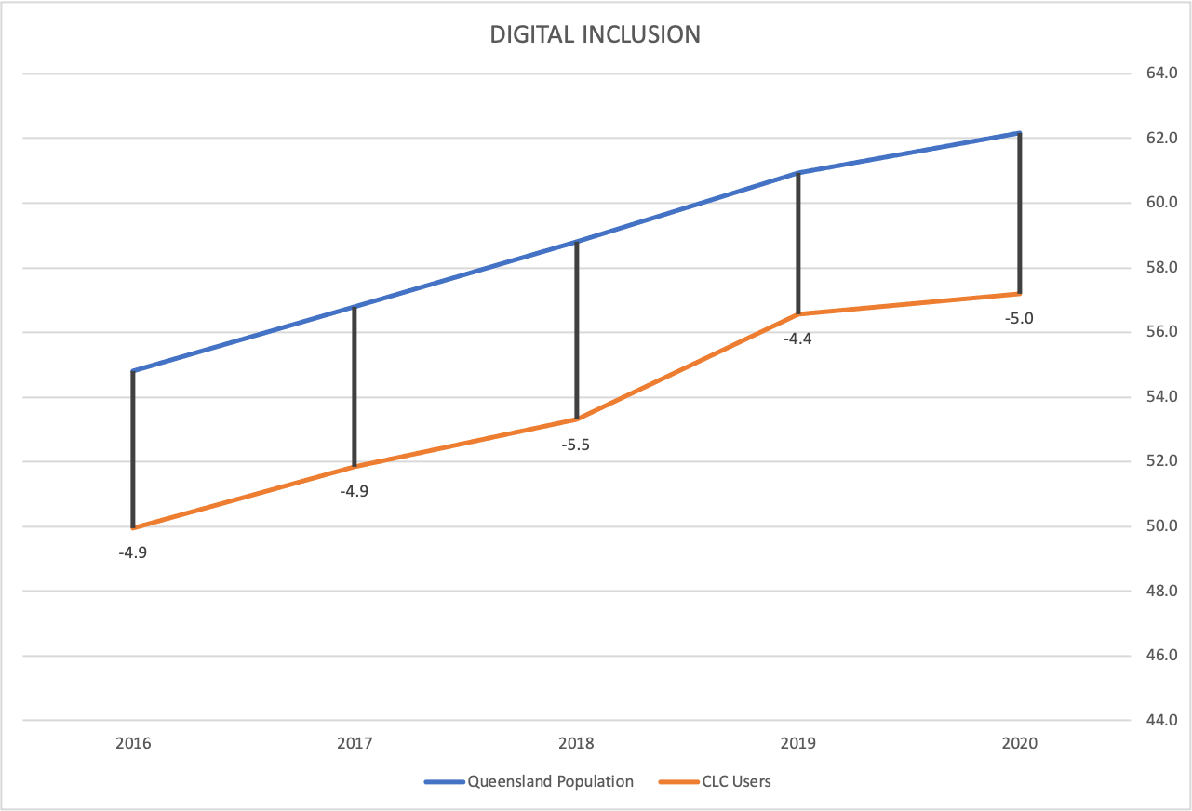
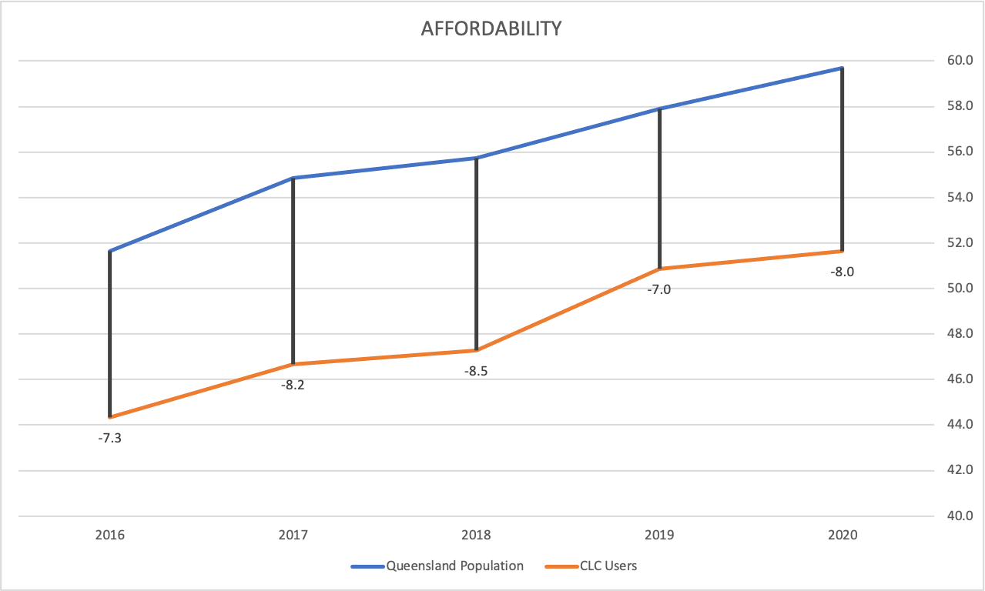
Findings
CLC users are significantly less included than the broader Queensland population, particularly in relation to affordability

Slide 9
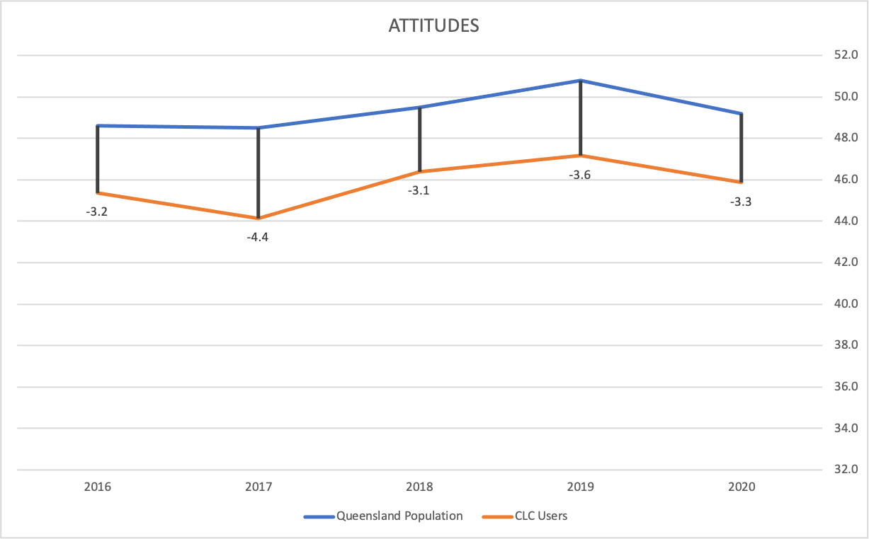
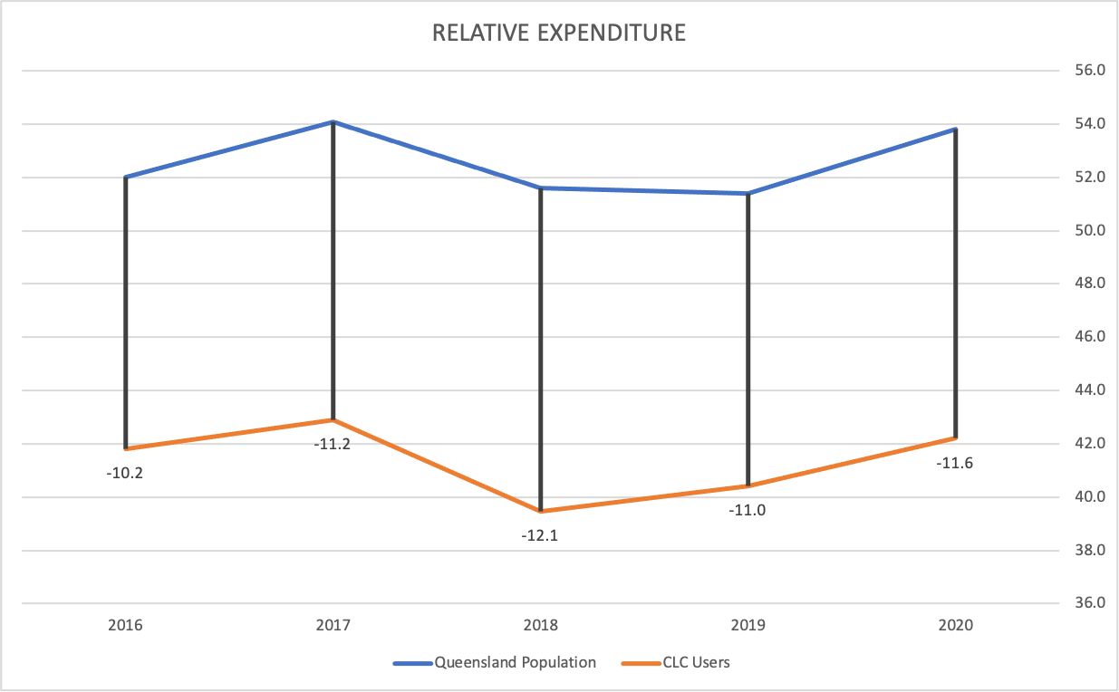
Findings
CLC users’ access to technology has transformed, but attitudes and affordability metrics have stagnated

Slide 10
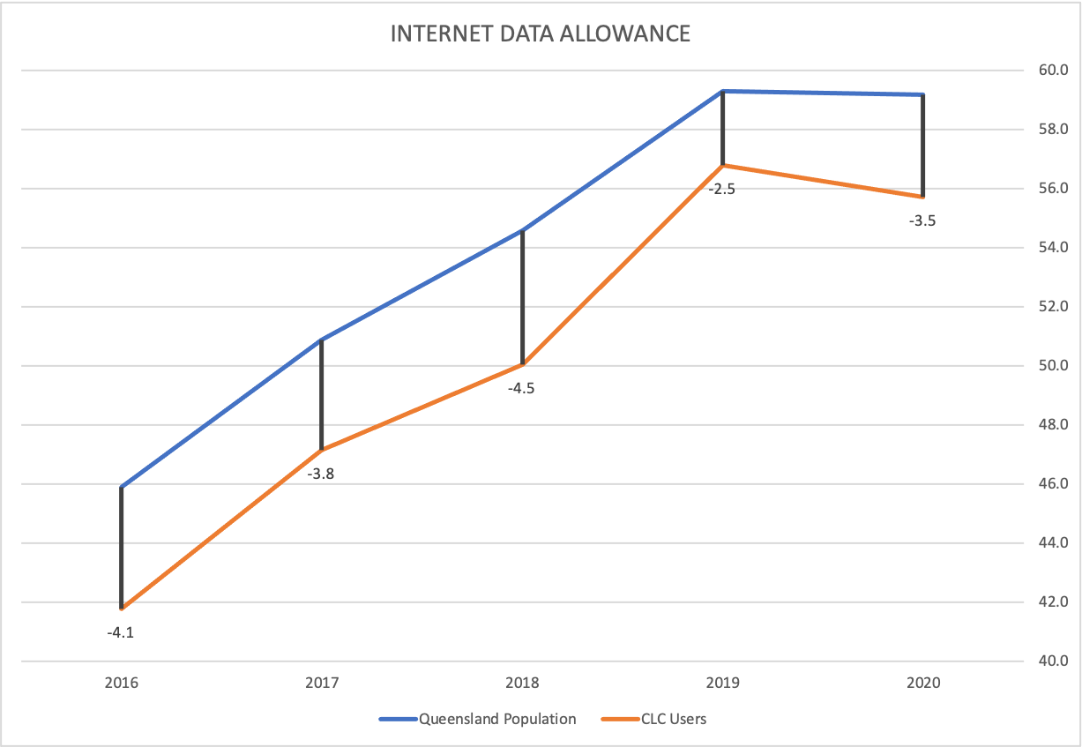
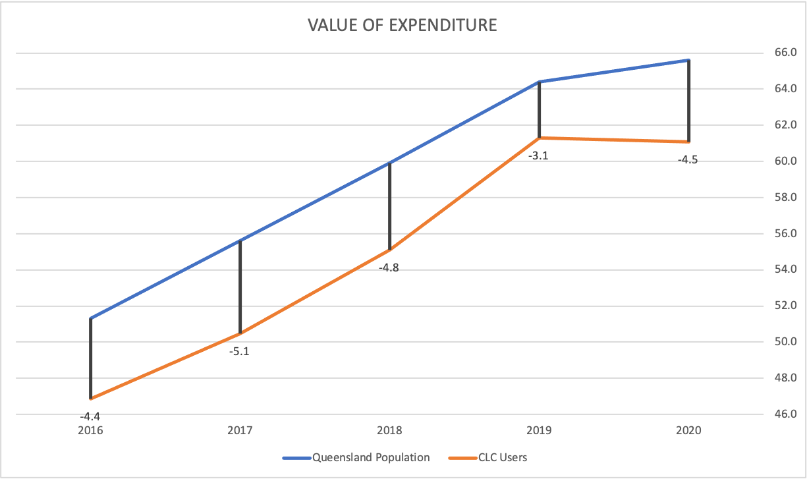
Findings
The digital inclusion deficit of CLC users has worsened during COVID-19

Slide 11
Impacts
Digital inclusion deficits can explain low videoconferencing take-up
Affordability and attitudes are the key barriers to videoconferencing with CLC users
Improving client digital inclusion is an essential response to COVID-19

Slide 12
Toolkit
Client digital inclusion assessment tool
Access and attitudes questionnaire
Videoconferencing training manual
CLC staff self-assessment

Slide 13
Next steps
Focus group testing the toolkit
Listening to your comments

