Slide 1
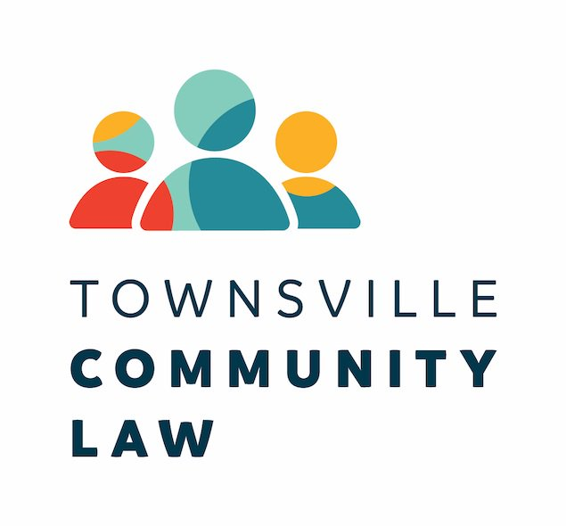
CLCQ Conference 2021
17 June 2021
DISASTER LEGAL ASSISTANCE

Slide 2
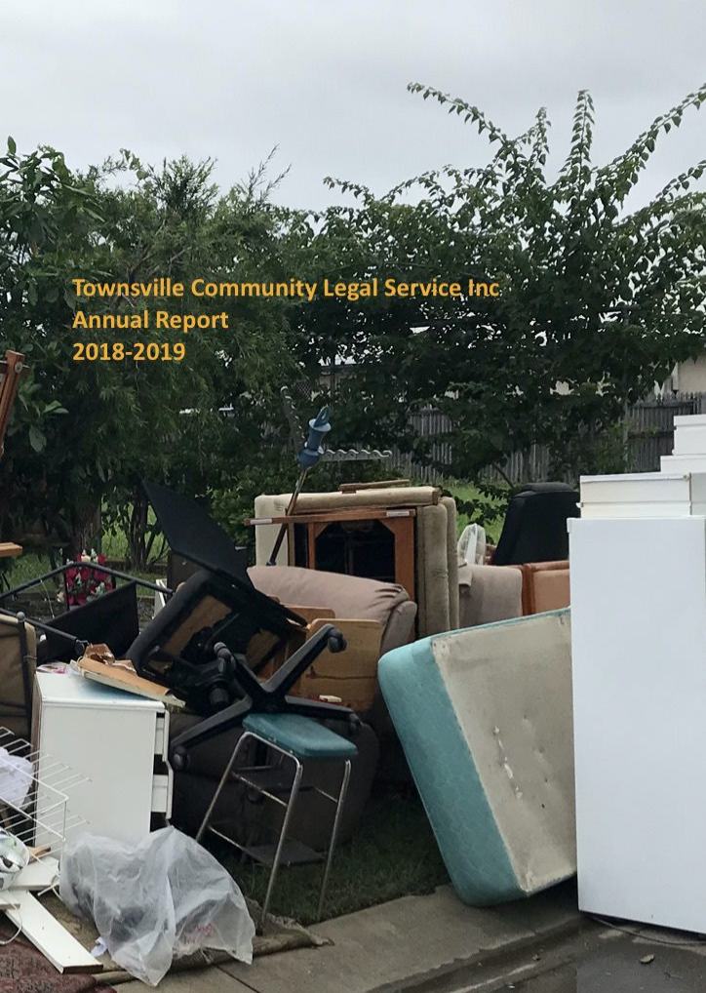
Townsville Community Law
& Disasters
Our history of disaster legal assistance:
  Floods (1998, 2010 - 2011, 2012, 2019)
  Severe Tropical Cyclone Justin (1997)
  Tropical Cyclone Tessi (2000)
  Severe Tropical Cyclone Larry (2006)
  Tropical Cyclone Anthony (2011),
  Severe Tropical Cyclone Yasi (2011)
Townsville experiences a major disaster every 2.5 years

Slide 3
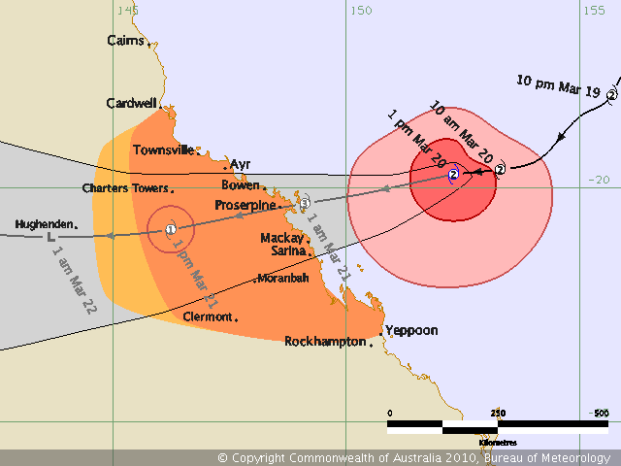
Recurring Déjà vu
“There will be a report on the Bushfire Legal Help in the next few months I think, and this may well assist others to put plans in place. Looking down the barrel of TC Ului this weekend, we are again hopelessly prepared to respond collectively to these sorts of matters.”
> Email to LAQ colleague (13 July 2010)

Slide 4
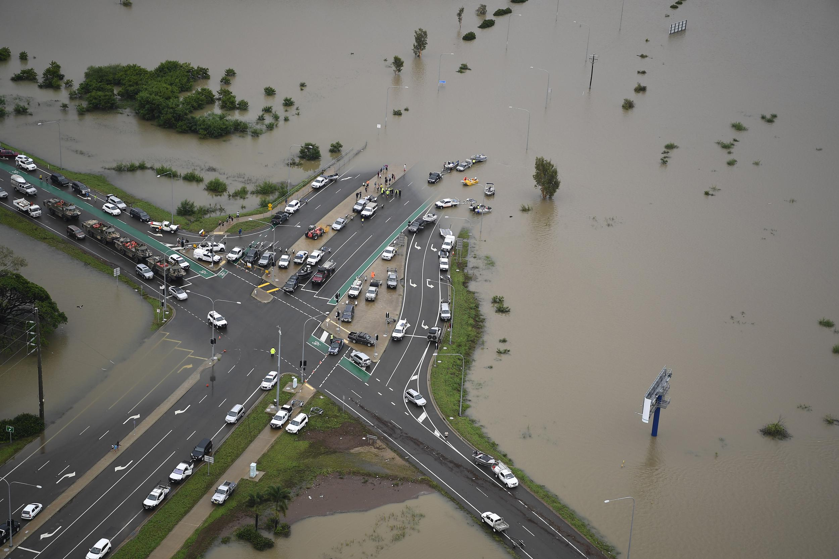
Where to from here?

Slide 5
The Model: Disaster Legal Assistance
Report & Proposal January 2021
Contents:
  Context of the proposal
  The Proposal
  Operational Details
  Disaster Legal Assistance Models
  New Lexicon

Slide 6
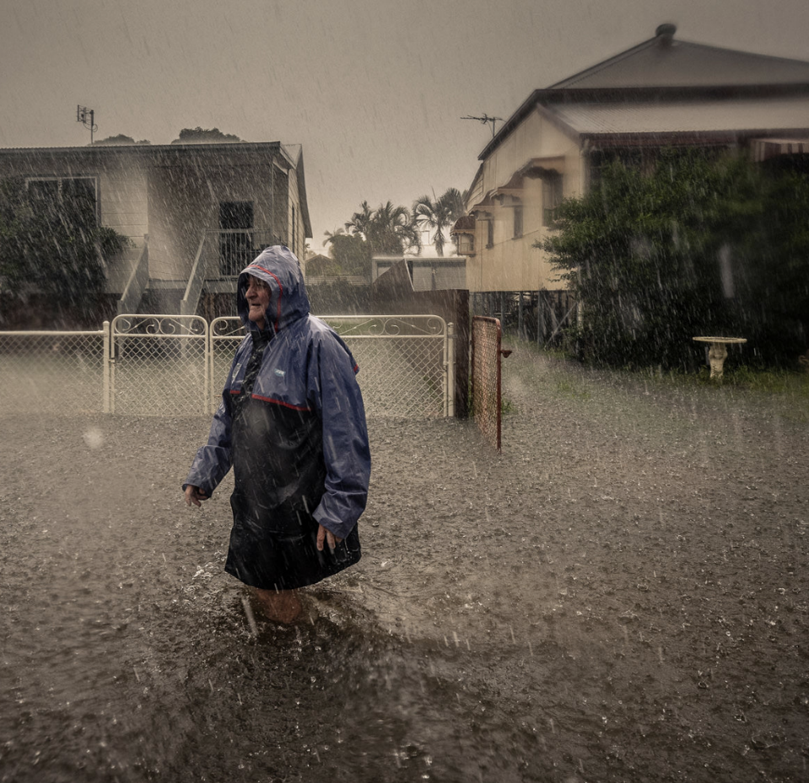
The Components
Disaster Legal Assistance has 6 components:
  Disaster Legal Needs
  Disaster Legal Assistance Planning
  Disaster Legal Assistance Plans
  Disaster Legal Assistance
  Disaster Legal Assistance Forum
  Disaster Legal Assistance Best Practices

Slide 7
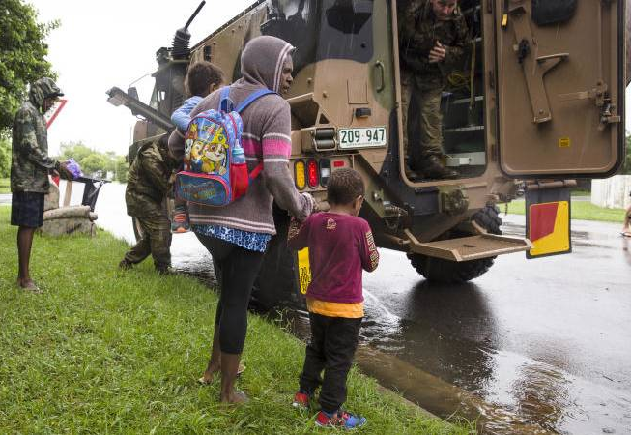
The Tiers
Disaster Legal Assistance operates over 3 tiers:
State (Jurisdictional)
  Queensland Legal Assistance Forum
District (Regional LAFS)
  Regional Legal Assistance Forums
Local (if needed)
  Local Services
The Legal Assistance Sector will collaborate with the Disaster Management Sector at each tier in planning processes

Slide 8
Collaboration
Disaster Legal Assistance operates over 3 tiers:
At each tier legal assistance and disaster management will engage in collaborative processes including Disaster Legal Assistance Planning (State-wide plan)
State (Jurisdictional) and District (Regional) tiers processes will lead to Disaster Legal Assistance Plans (sub-plans)
Planning at Local level can occur where District (Regional) frameworks (e.g RLAFS) don’t exist

Slide 9
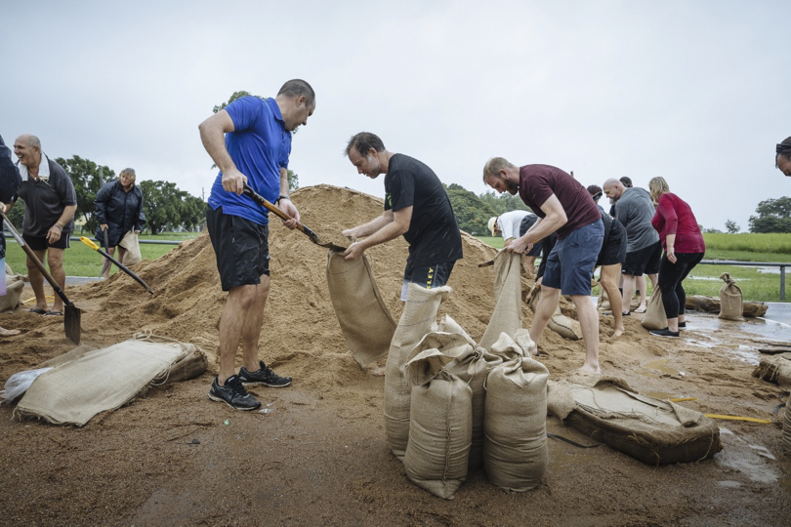
Model Outcomes
Disaster Legal Assistance will drive:
New processes: disaster legal needs assessment and disaster legal assistance planning.
New collaborations and outputs of those processes: disaster legal assistance plans.
New outcomes of those processes: disaster readiness.
Evidence-based processes: disaster legal needs.
Opportunity to build capacity and create better community outcomes

Slide 10
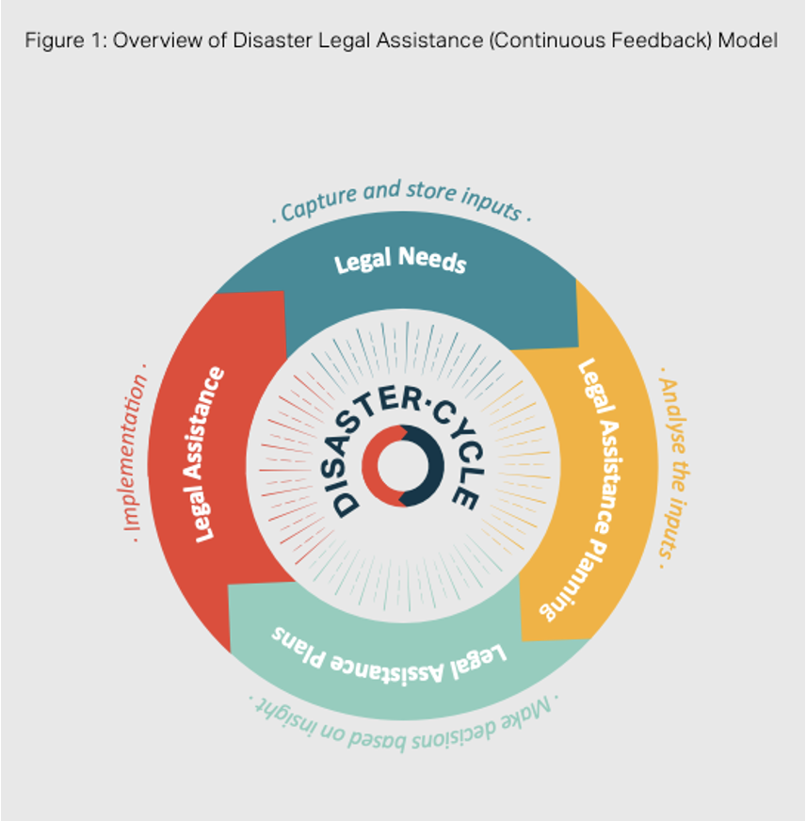
Continuous Feedback
The overall model uses a process (continuous feedback loop) that sits alongside the disaster cycle and mirrors the comprehensive approach. Each process contributes continuous feedback.
The assessment of disaster legal needs is both the starting point of planning for disaster legal assistance and an outcome of what is learned from the experience of disasters and providing disaster legal assistance.
Just as the disaster cycle is continuous, so too has disaster legal assistance been conceived.

