Slide 1
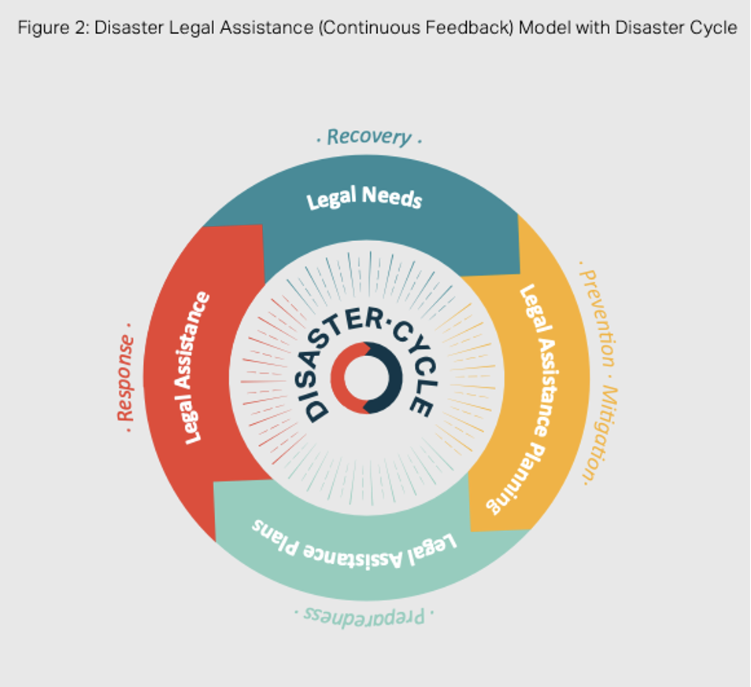
Complements Disaster Cycle
Each stage of Disaster Legal Assistance complements the Disaster cycle:
  Prevention
  Preparedness
  Response and
  Recovery
The model has a natural starting point at Assessment of Disaster Legal Needs which aligns with the Recovery phase

Slide 2
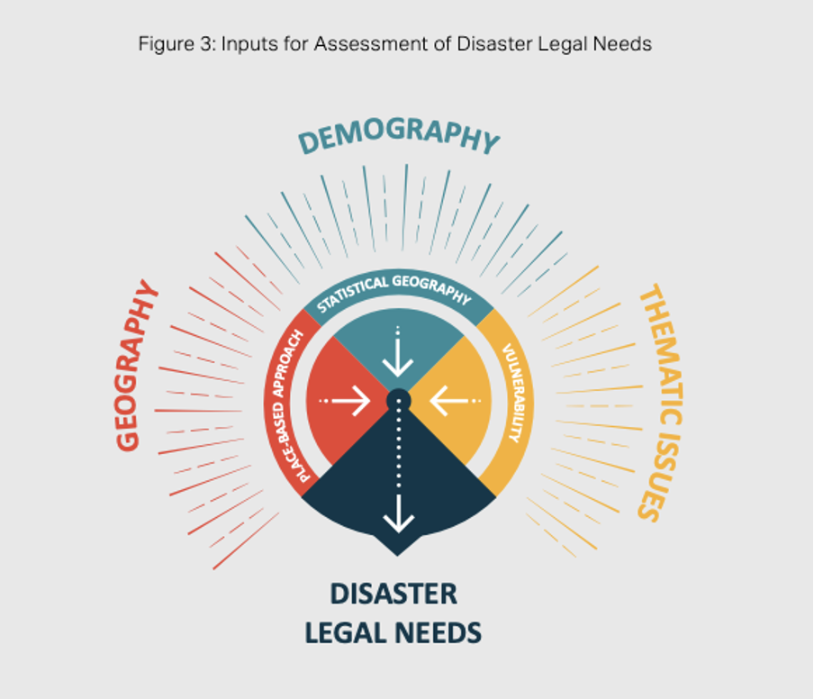
Disaster Legal Needs
"What then is legal need? Legal problems can be defined as disputes for which there is potentially a legal resolution . They can range from the relatively minor to those that can have a considerable impact, such as eviction from housing or unfair dismissal from a job." (Mirlees, 2020).
An assessment of Disaster Legal Needs will be undertaken within each tier
Each assessment will consider disaster legal needs against 3 areas

Slide 3
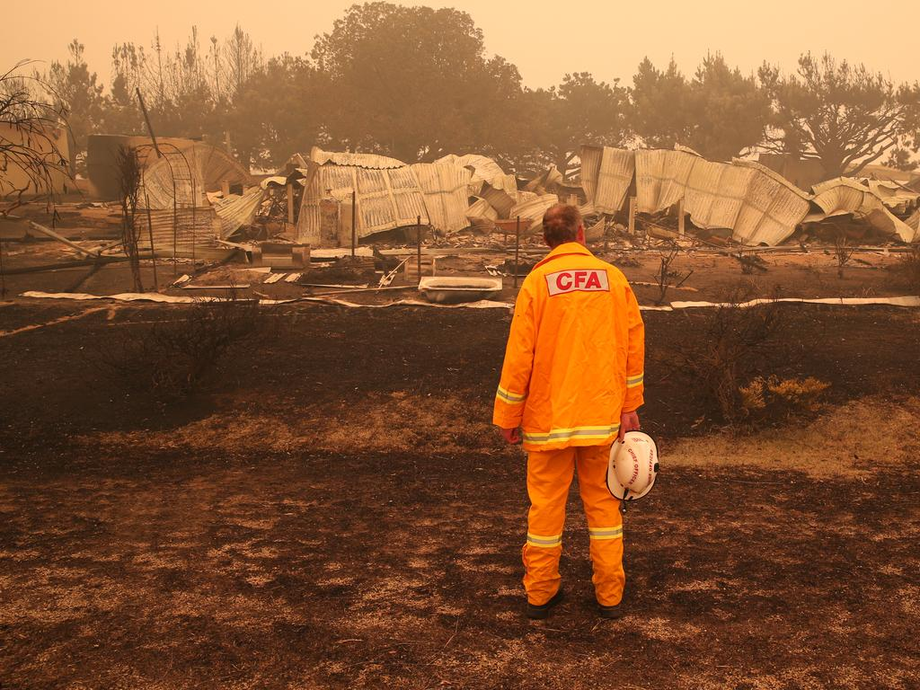
Human Rights
“A community prepared to effectively respond to a natural disaster will have a disaster response plan in place. A successful disaster response is one that places the rights of humans at the center.” Rice (2017)
Rights-based approach:
  Capacity development
  Participation
  Transparency
  Accountability
  Non-discrimination

Slide 4
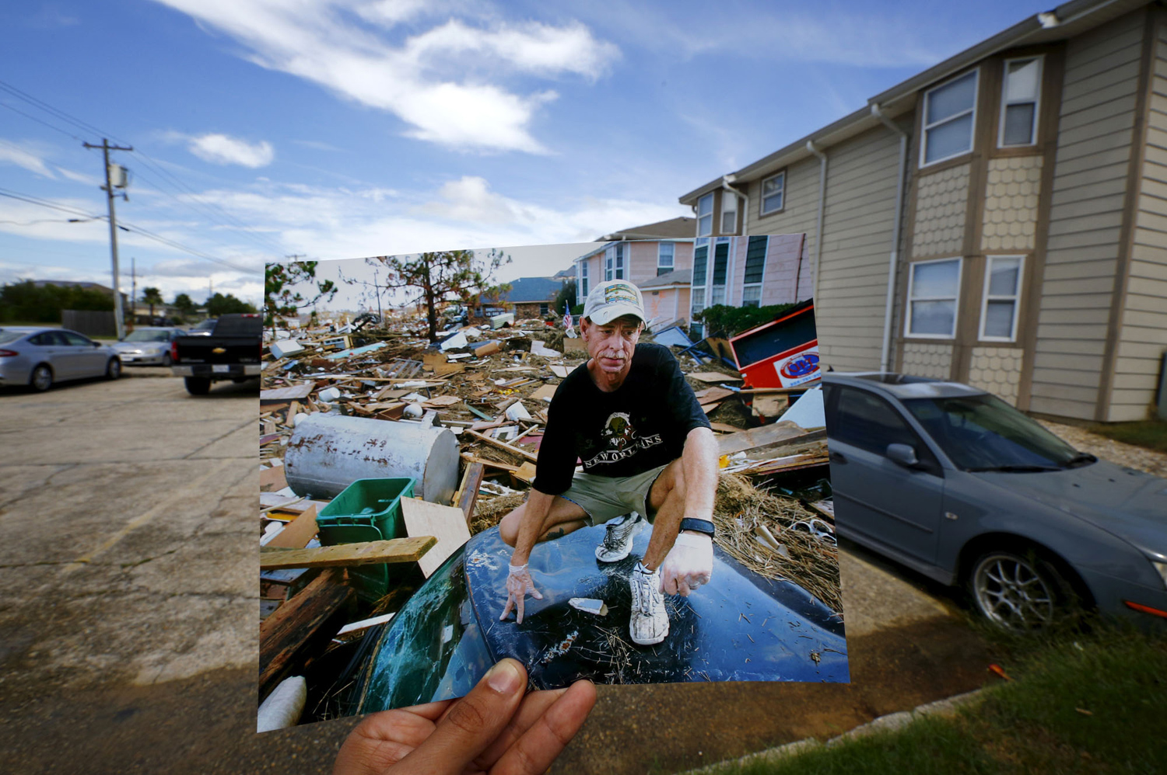
"For 10 years, Southeast Louisiana Legal Services has been on the frontlines helping people recover from the storm."
Laura Tuggle, Southeast Louisiana Legal Services

Slide 5

Notes:
Rationale
The Bushfire Royal Commission noted that during the 2019-2020 bushfires, the legal assistance sector mobilised a response to support affected individuals but there were a number of issues that arose due to the absence of pre-planning or strategic framework.
They noted that in NSW, there was no pre- agreed framework to activate regarding the legal sector’s response to disasters, which led to a longer period of confusion around roles and responsibilities in the response, and less clarity in public-facing communication in the initial periods of disaster response

Slide 6
Notes:
Rationale
The Bushfire Royal Commission noted that during the 2019-2020 bushfires, the legal assistance sector mobilised a response to support affected individuals but there were a number of issues that arose due to the absence of pre-planning or strategic framework.
They noted that in NSW, there was no pre- agreed framework to activate regarding the legal sector’s response to disasters, which led to a longer period of confusion around roles and responsibilities in the response, and less clarity in public-facing communication in the initial periods of disaster response

Slide 8
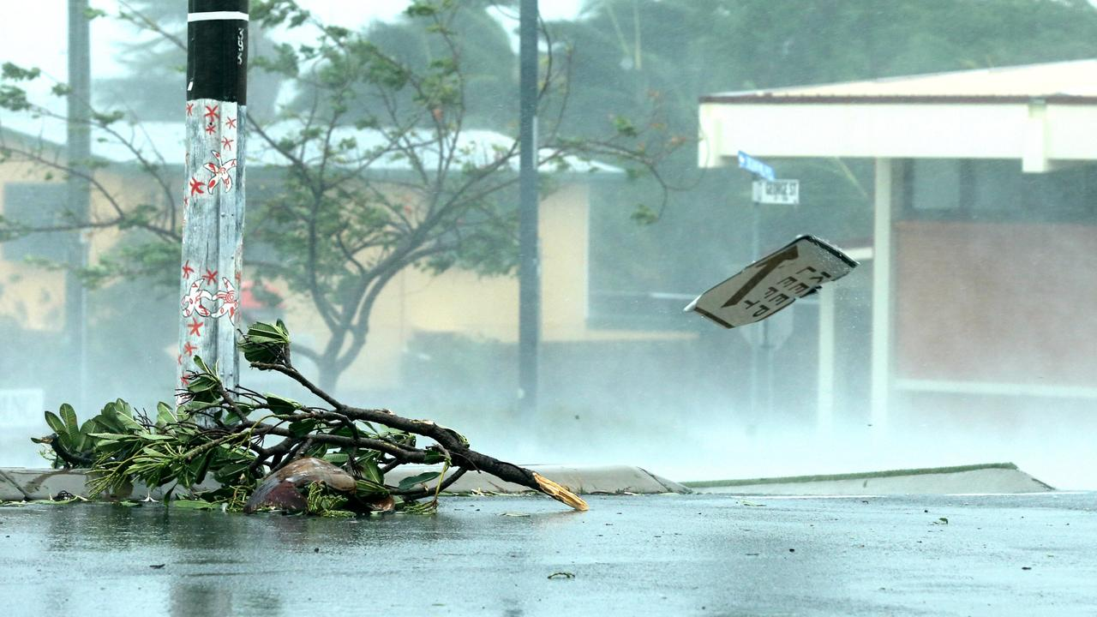

Slide 9
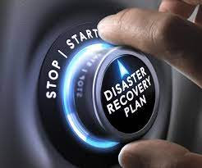
Future of the Project
QLAF supports progressive implementation across Queensland
Implementation to be trialled over 2020-2021 and 2021-2022
Trials will be at Jurisdictional (state) and District (regional) level
District trials will include three clustered districts (with lead agency):
  Townsville Burdekin, Charters Towers, Flinders, Hinchinbrook, Palm island, Richmond, Townsville
  Mackay Isaac, Mackay, Whitsunday
  South West Queensland District cluster: Charleville, Dalby, Roma, Toowoomba, Warwick
District trials will engage each component of the Disaster Legal Assistance model

Slide 10
Opportunity Knocks ...

