Slide 1
Dissociative States can happen at any time
A dissociate state often starts in childhood.
Children will detach or disconnect from their bodies while being subjected to abuse. This is protection of self.
Women will also dissociate to manage the terror of the abuse.
As a result of this disconnection significant safety problems will arise and may include suicidality, self-harm, impulsivity, aggression, reckless behaviour, self-medication, and re-victimisation.
(Courtois & Ford, 2014).

Slide 2
Missing resources plus non-discharged survival energy creates symptoms from trauma.
S
Y
M
P
T
O
M
S
THREAT
R
D
R
D
X
X
Compensatory Management of Survival Energy
R
D
R
D
Increase inThreat
THREAT
Heightened Arousal
☺
R
D
THREAT
Personal functioning baseline
Pre-event  Activation  Discharge 
R = Resource D = Discharge
X = Not available
Notes:
Learn this…
Explain Survival Energy
Discharge of the Survival
The human organism will be traumatized when the CNS is over-activated without adequate resources to meet the demands of the threat.

Slide 3
When we ignore generational trauma 5 generations – South America
1st generation: colonised – males killed – enslaved - imprisoned – females sexually misused
2nd generation: Men turn to alcohol and other drugs as their cultural and spiritual identity is damaged – self worth eroded
3rd generation: Spousal Assault – Societal Trauma
4th generation: Abuse moves from spousal assault to child neglect / harm, or both
5th generation. Cycle repeats as trauma begats violence begats trauma
6th generation. (where are we now! The kids on the streets at night. The children of the conquered terrorise their parents – grandparents – communities).
7th The grown children of the conquerors begin to live in fear of the grown children of the conquered. (Merida Blanco cited in Levine, 1997).

Slide 4
Brad … Our services are failing us!
Diagnosis:
Emerging psychosis with mood depressive content – some paranoia (he thinks the world is unsafe)
Suicidal ideation
Chronic compound grief
Chronic Complex Post Traumatic Stress
Trauma … seeing his mother killed at three, and his Aunty at 11. His world is unsafe.
Records show that in the two suicide attempts, they said he was just “attention seeking”.
Prescribed Ritilan.
(obviously not his real name)

Slide 5
Who teaches us? When racism defines us ... And love calls us home.
A racist phone call - an assumption, an arrest, and …
then they find they were wrong,
BUT the damage is done.
He feels labeled, leaves town, chooses drugs for a while …
BUT returns. And seeks out those who stood by him, believed (in) him.
This year he is back at school but this weekend the drugs hit town
And his short time in JJ has changed him. He is now a bad ass.

Slide 6
Who teaches us? When we fail in our care! And what is success?
A young women, raped with injuries enough to be hospitalised for corrective surgery.
Asks ... “Can you fix me?” I freeze. How can I ‘fix’ such pain?
And how do we fix the community that allows such pain?
But she is fixing herself.
She wants to join the police force to prevent, and help improve services for other young Aboriginal people subjected to - going through what she went through.
Our Youth – Our Future!!

Slide 7
Memories: “She loved me”. What are they teaching us! What are we learning?
Sitting in the Culture Room, in front of a photo on the wall, one among 40 of female Elders, now passed on.
I ask: “tell me about her”. His Gran. Died when he was 4. The last time he can ever remember feeling loved.
He is troubled … has anger outbursts … yet one day he finds a small plastic bag near where he lives and brings it – hands it in to the school … Meth ... ICE.
He goes on an excursion, and hears I am returning home that day. So he insists on coming in to say goodbye, …. And asks permission to hug me.
We all need to feel and know we are loved. Our Youth - our Future

Slide 8
Timor Leste - the Prun – being asked two questions. What is the difference between political, social or cultural trauma? What is the difference between loss, grief, victimization, traumatization?

Slide 9
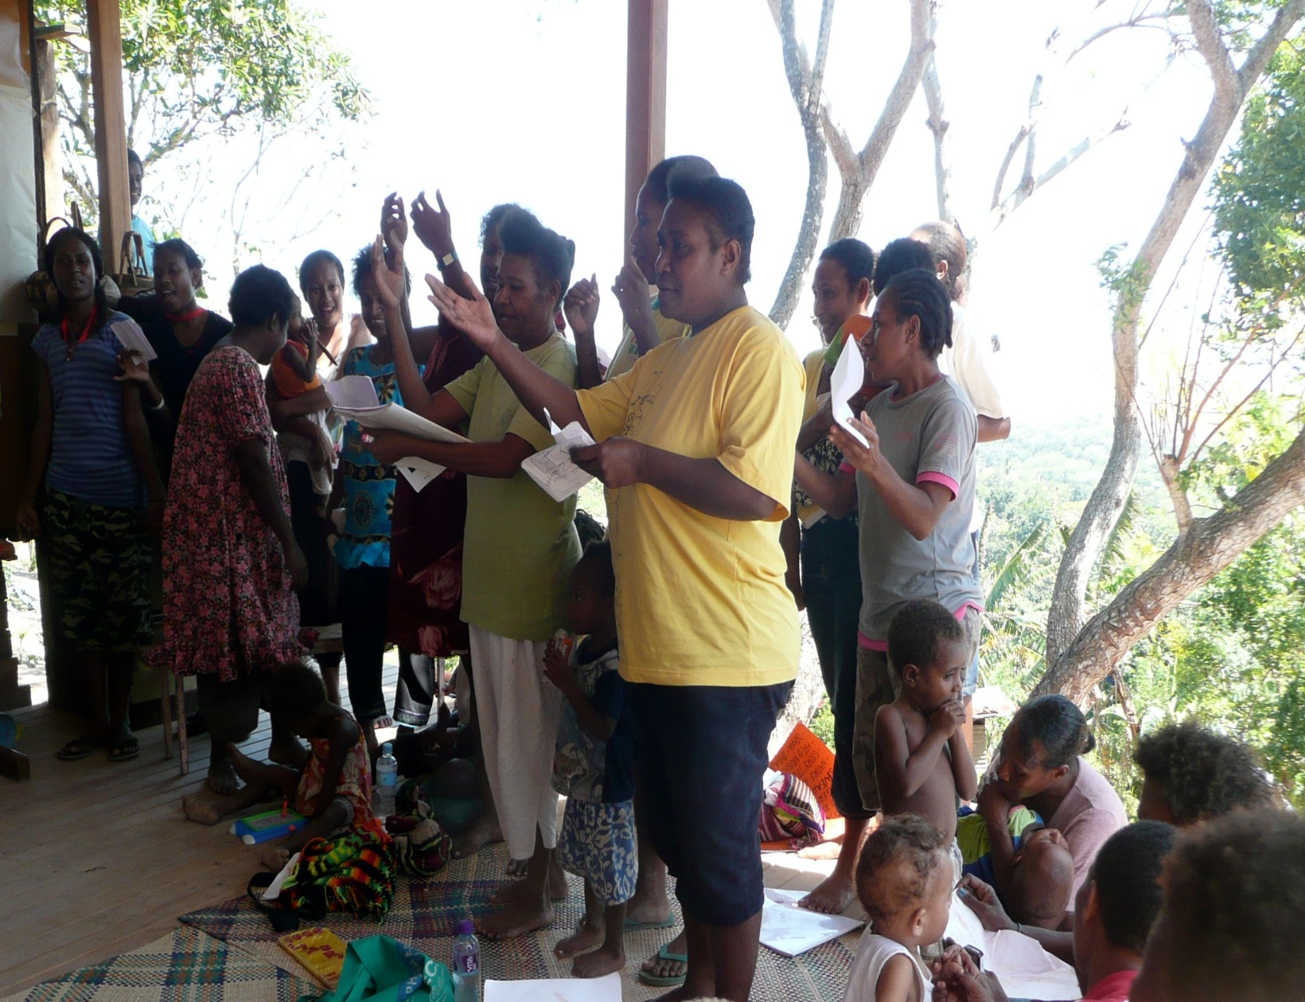
Papua New Guinea – Asking Permission “Youth for Change” “How does sexual violence effect a nation’s economy?”
I am Gold,
strong and shiny
like stars in the cold of winter. I am a river that gives life to the land,
and the rose that blooms in
the soft black night.
I am as brave as a lion. I am friends with the ants,
and I am like the Bird of Paradise,
beautiful but strong like the father
of loving care and compassion.
I have a fire in me that burns
bright for the world to see
that there is hope in me,
for we can make a change
for you and for me,
that you will see!
Doyle Kailap

Slide 10
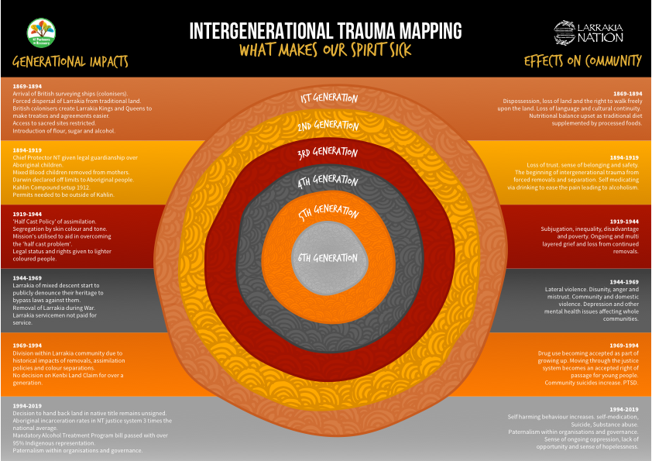

Slide 12
Trauma Stories can be Healing Stories if we work with focused intent
Mental Health cannot be separated from Social Emotional Spiritual Physical Cultural Health and Safety.
History - Racism - Lateral Violence – Kids in the Middle
Families > Community > You and Me … Are the Answer
Schools > Every child under law, has to attend school. If schools are racist, abusive, they fail. We need EDUCARING
WE are all accountable. Choosing to Walk the Circle of Wellbeing

Slide 13
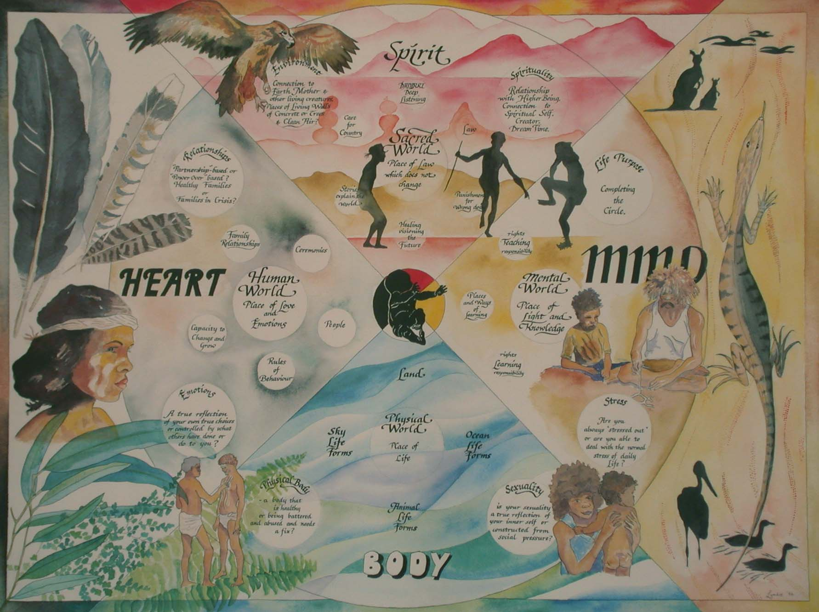
Healthy Country Healthy People body mind heart spirit
Artwork Lyndie Malan 1997

Slide 14
Whole of community – Multiple Event Crisis intervention (Silove 2007, Hobfall 2007, Atkinson 2007, Brooks/Atkinson 2011)
ADAPT (Silove) | Five Essential (Hobfoll | Atkinson / Brooks
Security / Safety | Sense of Safety | Safety / Security
Attachment | Calming | Calming, re bonding from crisis – Hope and Courage
Justice | Self and collective efficacy | Attachment and Belonging
Role/Identity | Connectedness | Justice, Fairness and Dignity
Existential Meaning | Hope | Valuing Self – Valuing others
 |  | Meaning and Coherence

Slide 15
Self Care: the Coolaman holds the stories. You hold the Truth within the Story Space

Slide 16
The future belongs to those who know the smallest seed will grow towards the light. Our Youth Our Future

